Slide 1
Bizarre blazar
Brittany Vamvakias

Slide 2
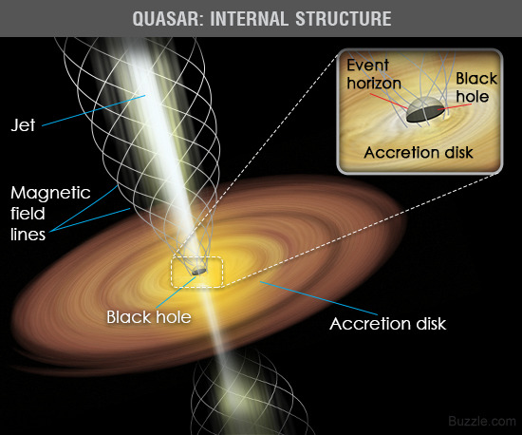
Quasars and blazars
A quasar is an active galactic nucleus with a supermassive black hole as the center.
It is thought to be formed by the collision of two galaxies.
A blazar is a more compact and energetic quasar, with the jet pointing towards the Earth.
https://empoweryourknowledgeandhappytrivia.files.wordpress.com/2015/05/quasar-structure.jpg

Slide 3
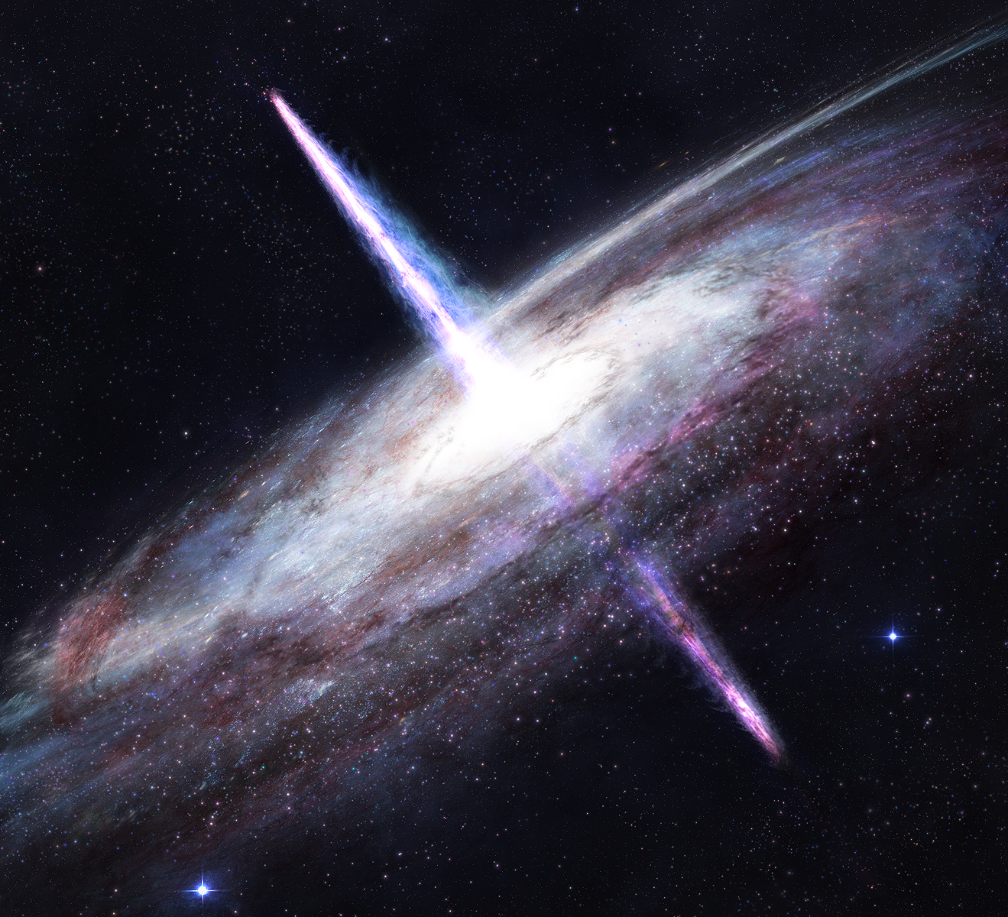
Why this project?
My object, BL Lac, is one of the brightest blazars that we can see around this time of year.
BL Lac is the prototype for a classification of highly variable AGNs.
Extreme space things are awesome.
http://orig05.deviantart.net/75f9/f/2011/156/f/c/quasar_by_tadp0l3-d3i5axl.jpg

Slide 4
Expectations
Magnitude values close to NOMAD-1 Catalogue values
Brighter magnitude in the V filter
Secluded from 3 reference stars in a color-color diagram

Slide 5
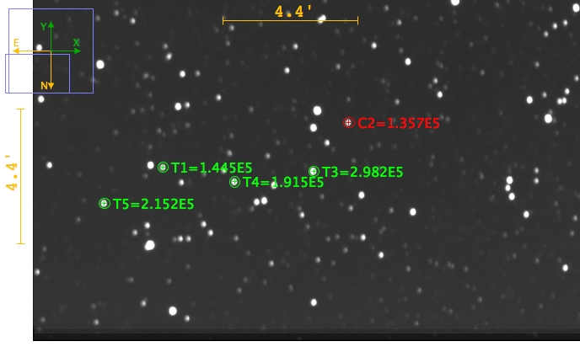
Goal of the project
To compare the magnitudes in the B, V, and R filter of BL Lac with 4 other reference stars to see if there’s a notable difference.
B Filter

Slide 6
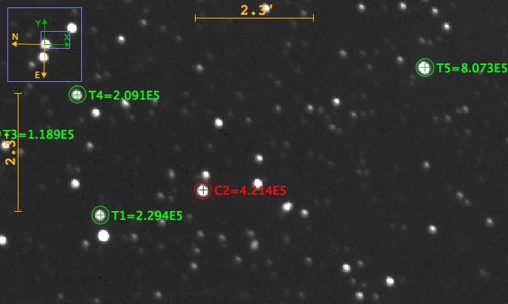
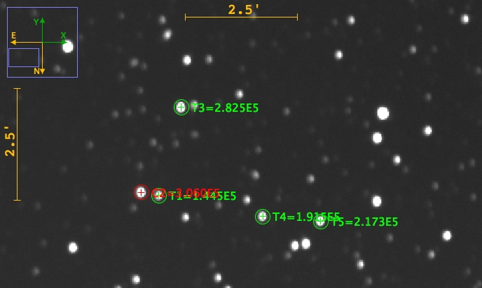
V Filter
R Filter

Slide 7
Method
20” Cassegrain with filters B, V, and R.
Darks and Flats
Reduction with CCDSoft
Coordinate System with astrometry.net
Multi-Aperture photometry with AstroImageJ

Slide 8
Data gathered
Filter | Flux of T1 | Flux of T2 | Flux of T3 | Flux of T4
B | 1.064928 | 2.196641 | 1.411162 | 1.585408
R | 0.544396 | 0.28215 | 0.496234 | 1.915935
V | 0.472375 | 0.923101 | 0.625956 | 0.709995
NOMAD-1 Catalogue Values
$f_{rel}$ Values
Filter | Magnitude of T1 | Magnitude of C2 | Magnitude of T2 | Magnitude of T3 | Magnitude of T4
B | 14.35 | 13.55 | 13.32 | 13.67 | 12.96
R | 13.71 | 12.43 | 13.92 | 12.91 | 11.66
V | 12.53 | 13.15 | 13.14 | 13.35 | 13.32

Slide 9
$$M_{obj}=\left(−2.5\right)\log{f_{rel}}+M_{ref}$$

Slide 10
Results
Filter | Calculated | Catalogue
B | 14.28 | 14.35
R | 14.37 | 13.71
V | 13.34 | 12.53
Target | B-V | V-R
T1 | 0.94 | -1.03
T2 | 0.18 | -0.78
T3 | 0.32 | 0.44
T4 | -0.36 | 1.66

Slide 11
errors
Autoguider is the best invention known to mankind
Weird ghost-like image in some darks

Slide 12
Conclusion
Calculated and catalogue values matched up well
V filter showed a lower/brighter magnitude
Bigger difference between filter’s magnitudes than reference stars
BL Lacertae is secluded in the color-color diagram
Filter | Magnitude of T1 | Magnitude of C2 | Magnitude of T2 | Magnitude of T3 | Magnitude of T4
B | 14.28 | 13.55 | 13.32 | 13.67 | 12.96
R | 14.37 | 12.43 | 13.92 | 12.91 | 11.66
V | 13.34 | 13.15 | 13.14 | 13.35 | 13.32
Filter | Calculated | Catalogue
B | 14.28 | 14.35
R | 14.37 | 13.71
V | 13.34 | 12.53

