Slide 1
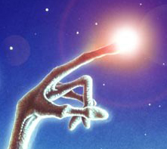
ET does science
Montana Williams

Slide 2
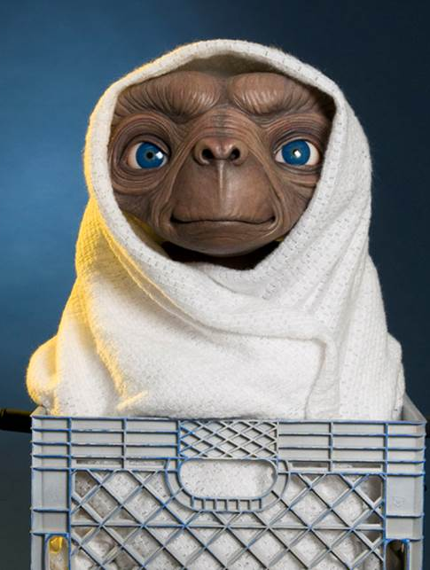
Background
I chose this project because it seemed like an interesting idea.
This cluster was easily visible, and well documented.
A color magnitude diagram is a plot of temperature vs brightness.

Slide 3
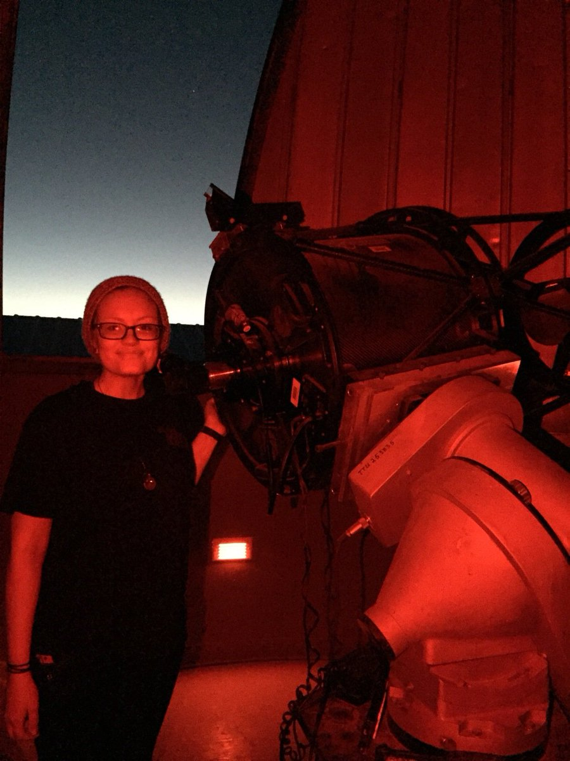
Spending all night at the observatory
Collecting two hours worth of data, an hour in each wavelength.
Exposure for the Blue filter was 20 seconds, and for the Visible it was 10 seconds.

Slide 4
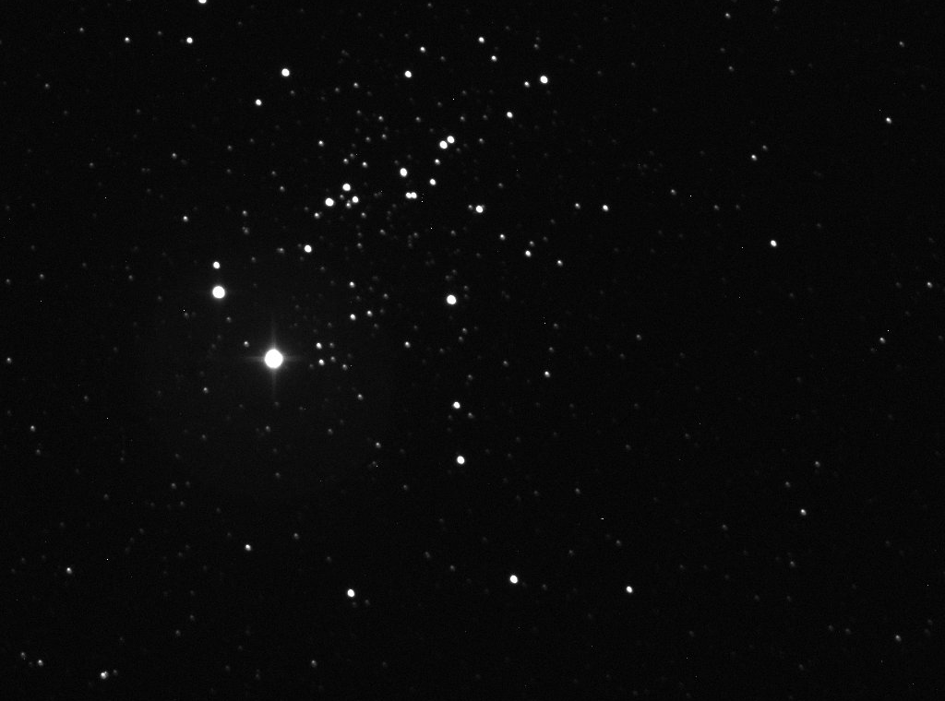
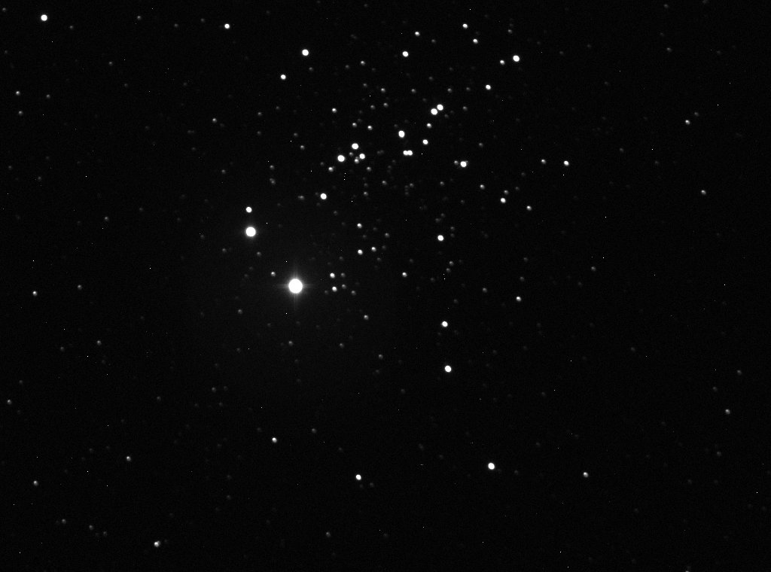
Reducing Data in AstroimageJ

Slide 5
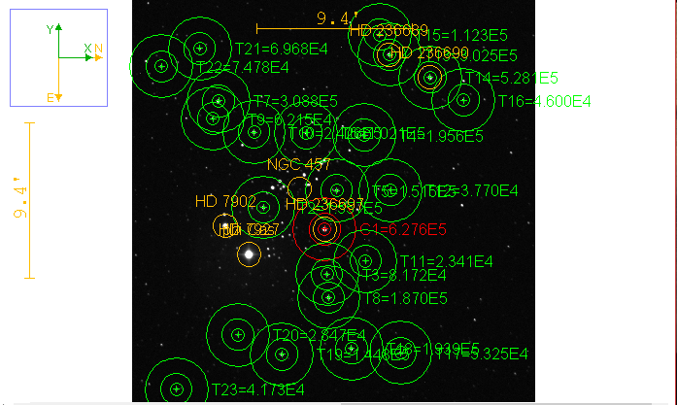
Photometry in AstroimageJ
Set the reference star to a “comparison star” and all other stars I deemed in the cluster to “target stars,” to get the correct flux ratio.
I had to leave out ET’s eyes, because they were too bright, and were over saturated.

Slide 6
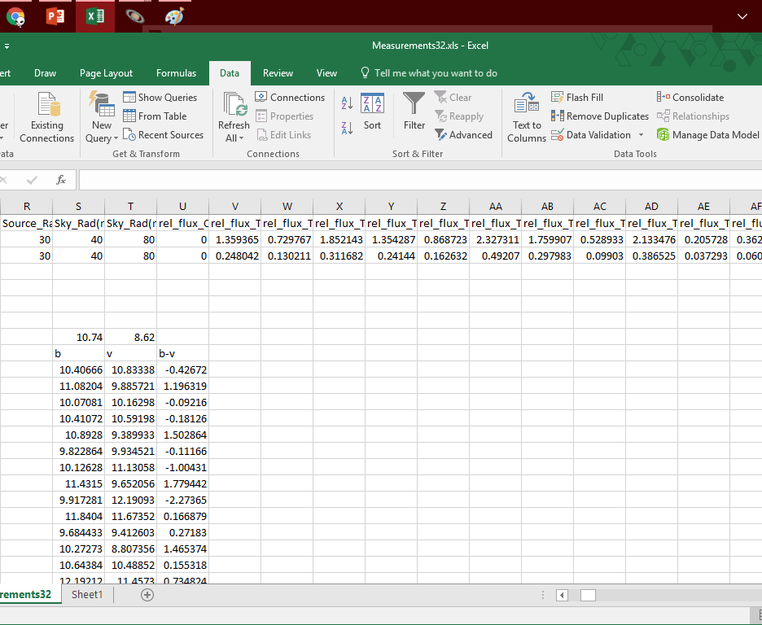
Using Excel to create a Color magnitude Diagram.
$M=−2.5\log_{10}\left(f\right)+M_{ref}$

Slide 7
Getting a weird Color Magnitude Diagram

Slide 8
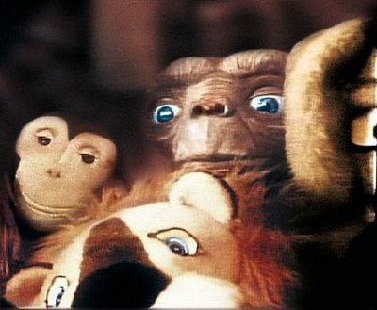
Failed Diagrams

Slide 9
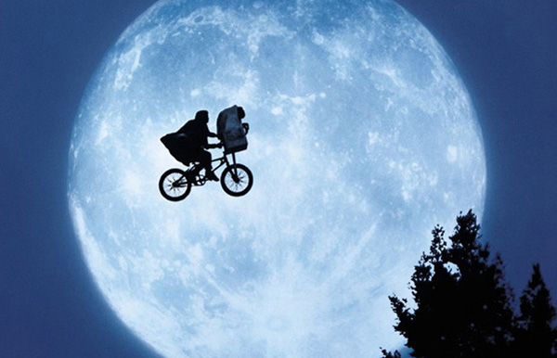
Notes:
In conclusion I ended up with a CMD, however it was a little hard to read due to the few data points, but overall was a mostly successful project.

