Slide 1
Taking a “Pretty” Picture
Abell 2666

Slide 2
A2666
Abell Catalogue
RA(J2000): 23h 50m 56.2s
Dec(J2000): +27d 08m 41s

Slide 3
Filters
Clear, Red, Green, Blue
10x10
~5.5 hours

Slide 4
Filters
Clear, Red, Green, Blue
6x7

Slide 5
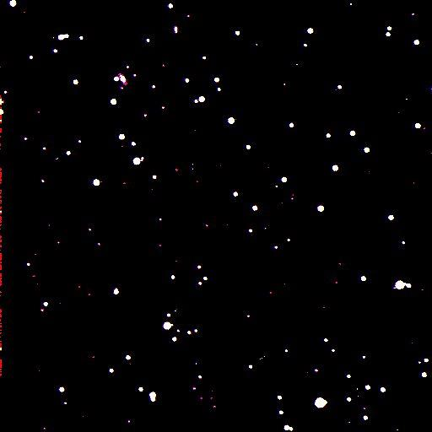

Slide 6
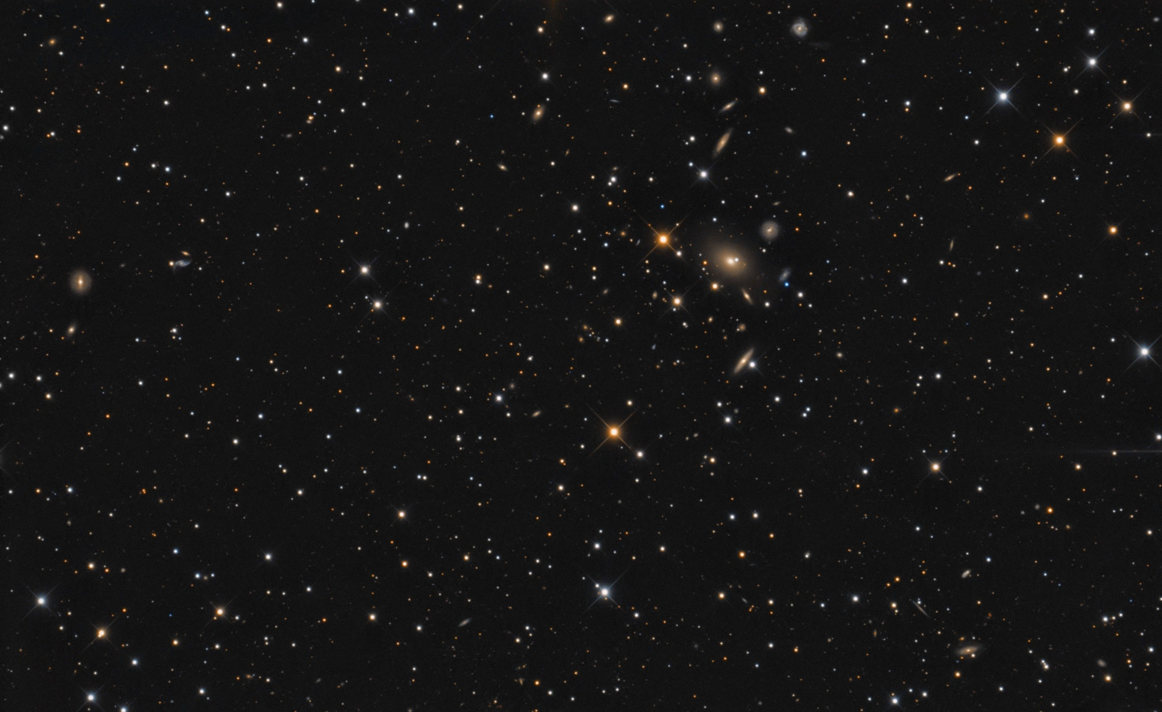
Bob Frank (http://bf-astro.com)

Slide 7
Errors
Exposure
Autoguiding
Super Moon

