Slide 1
How do we really look for gravitational waves?
A tour of some applied mathematical tools used within the LIGO and Virgo collaborations
Ra Inta (Texas Tech University)
for the LIGO Scientific Collaboration and the Virgo Collaboration
LIGO Document G1700692-v3

Slide 2
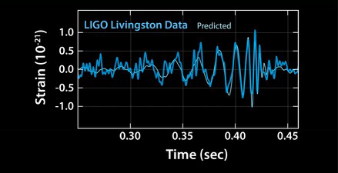
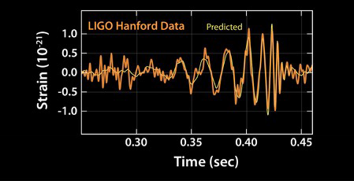
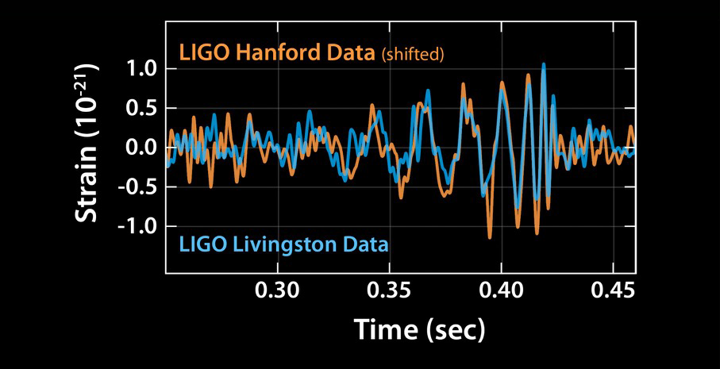
Gravitational waves
Caltech/MIT/LIGO Lab
Abbott, B.P. et al., PRL 116:061102 (2016)

Slide 3
Image: LIGO
LVC: “The basic physics of the binary black hole merger GW150914,”
Annalen der Physik 529(1) (2017)

Slide 4
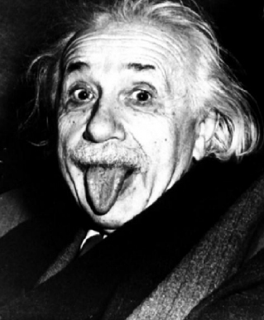
History of Gravitational Waves (GWs)
Einstein, A.: Sitzungsberichte der Königlich Preußischen Akademie der Wissenschaften (Berlin) 1, 688 (1916)
Notes:
Imgae: http://www.ocpp.org/2005/

Slide 5
History of Gravitational Waves (GWs)
Einstein, A. and Rosen, N.:“On Gravitational Waves,” J. Franklin Institute 223, pp.43-54 (1937)
search for: “who’s afraid of the referee?”
Notes:
Imgae: http://www.ocpp.org/2005/

Slide 6
Linearized general relativity
Take small perturbations, h, of the space-time metric, g:
Put into the Einstein Field Equations:
Get a wave-equation (in transverse-traceless gauge):

Slide 7
Linearized general relativity
Vacuum solution
Admits plane waves:
So:
(i.e. k is null)
Harmonic gauge:
(Transverse polarization)

Slide 8
Linearized general relativity
Two polarization states:
Mass quadrupole:

Slide 9
Linearized general relativity
Two polarization states:
Mass quadrupole:

Slide 10
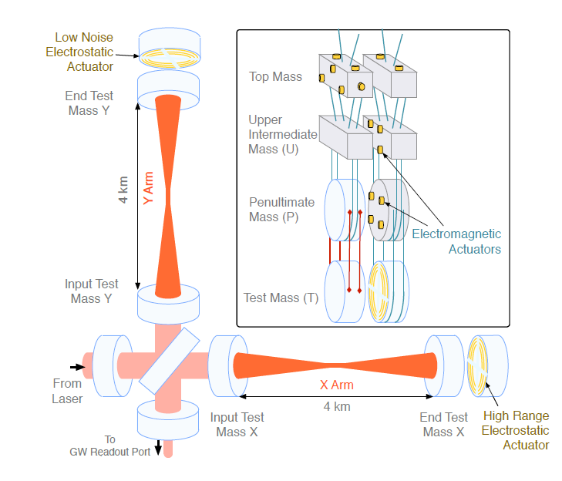
LASER interferometers
http://arxiv.org/abs/1602.03845

Slide 11
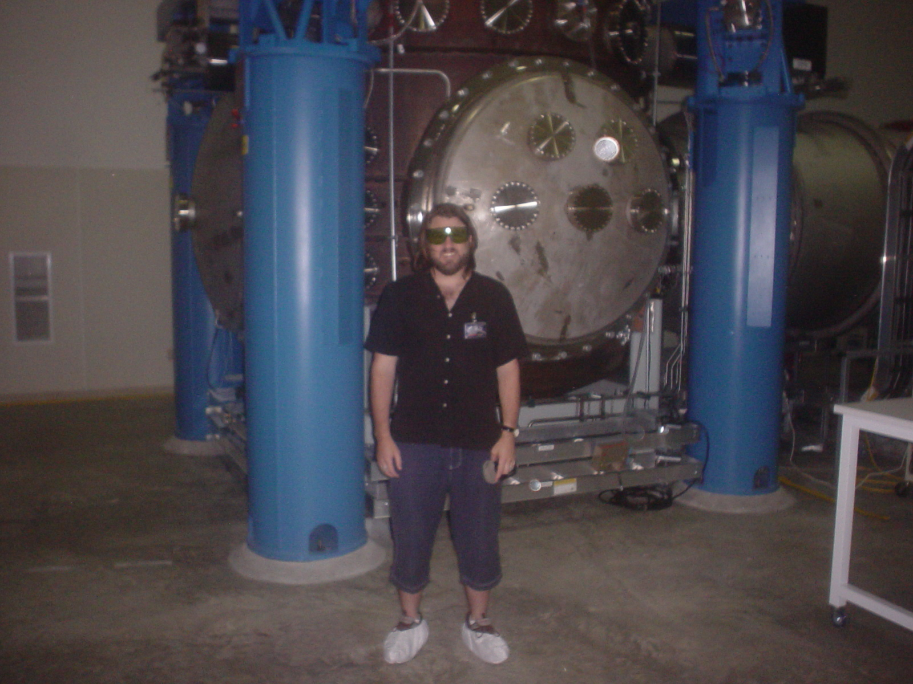

Slide 12
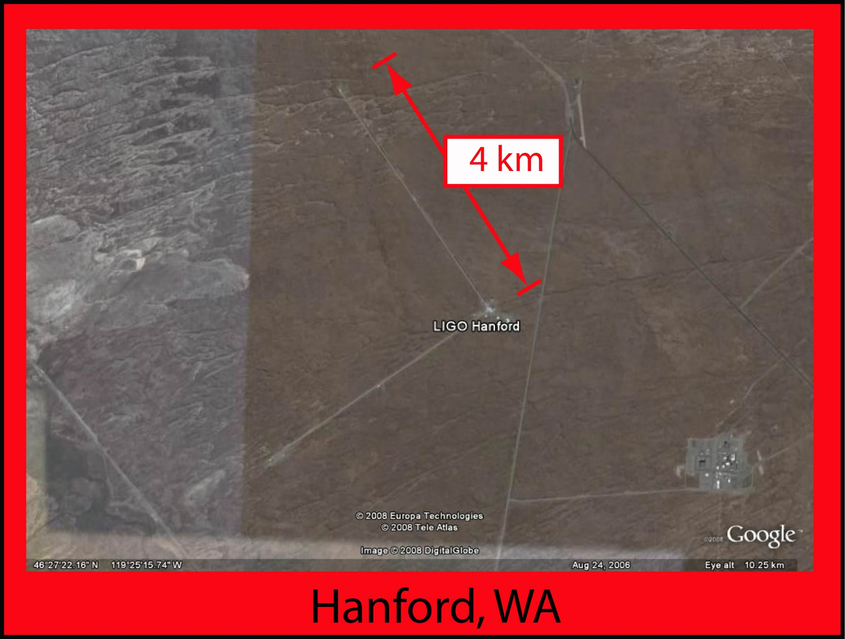
The LIGO Network
4 km baseline, seismic isolation
Notes:
Images: Google Earth

Slide 13
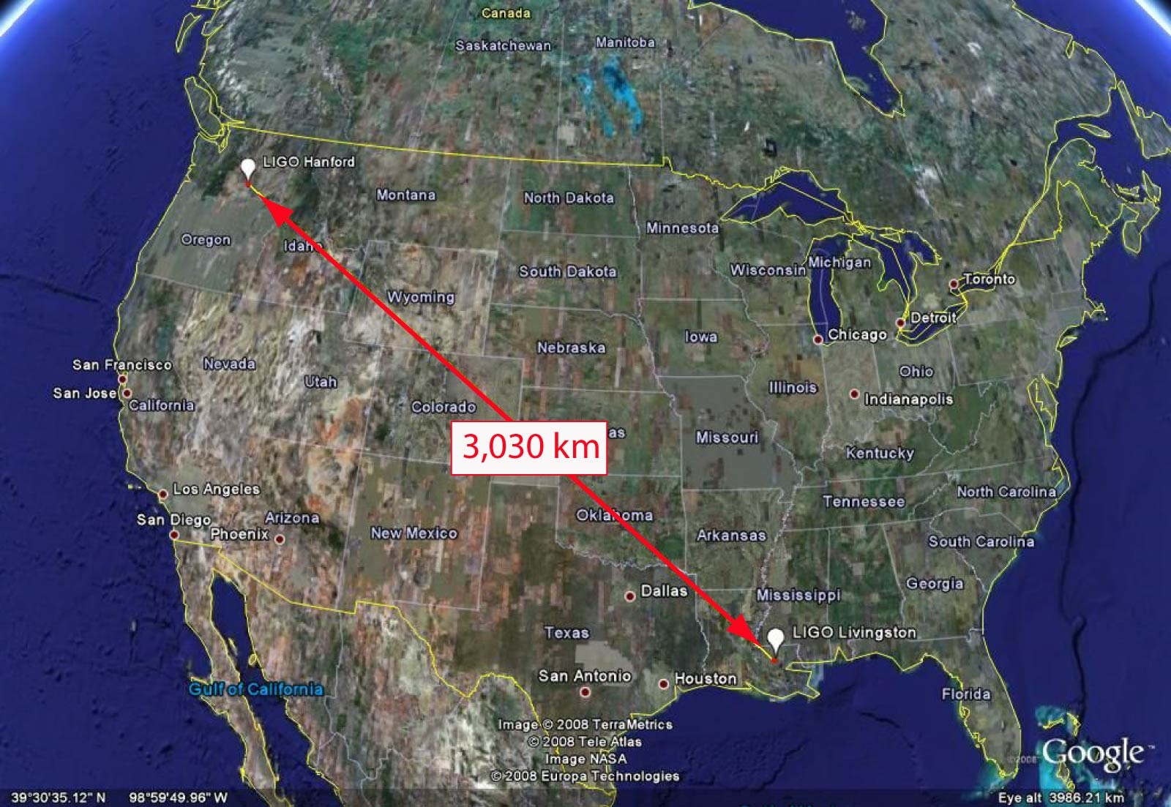
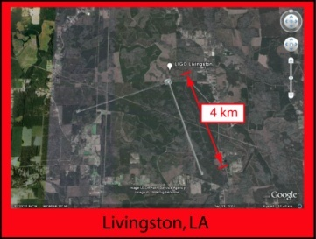
Notes:
Images: Google Earth

Slide 14
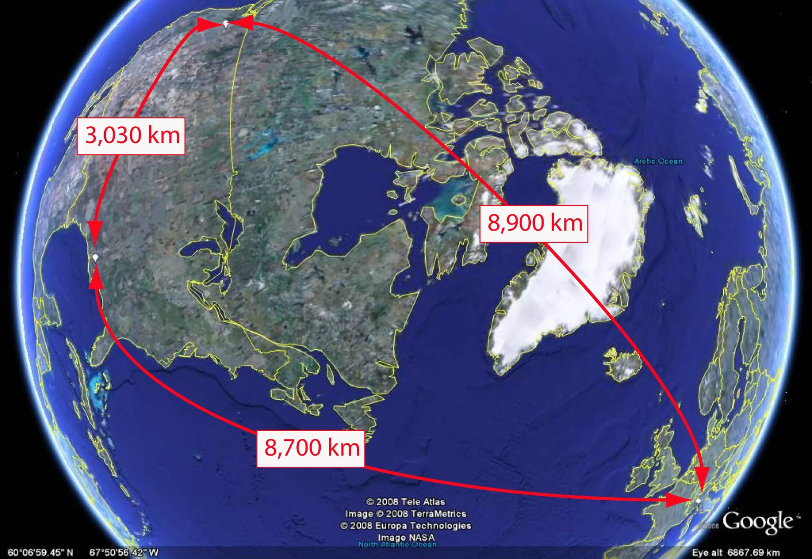
The LIGO-Virgo Network
Notes:
Image: Google Earth

Slide 15
LIGO/Virgo facts
Largest ultra-high vacuum system
LIGO/Virgo band: O(10) Hz – O(1) kHz (audio frequencies)
Dominant noise source at high frequency: quantum vacuum fluctuations (‘shot noise’)!

Slide 16
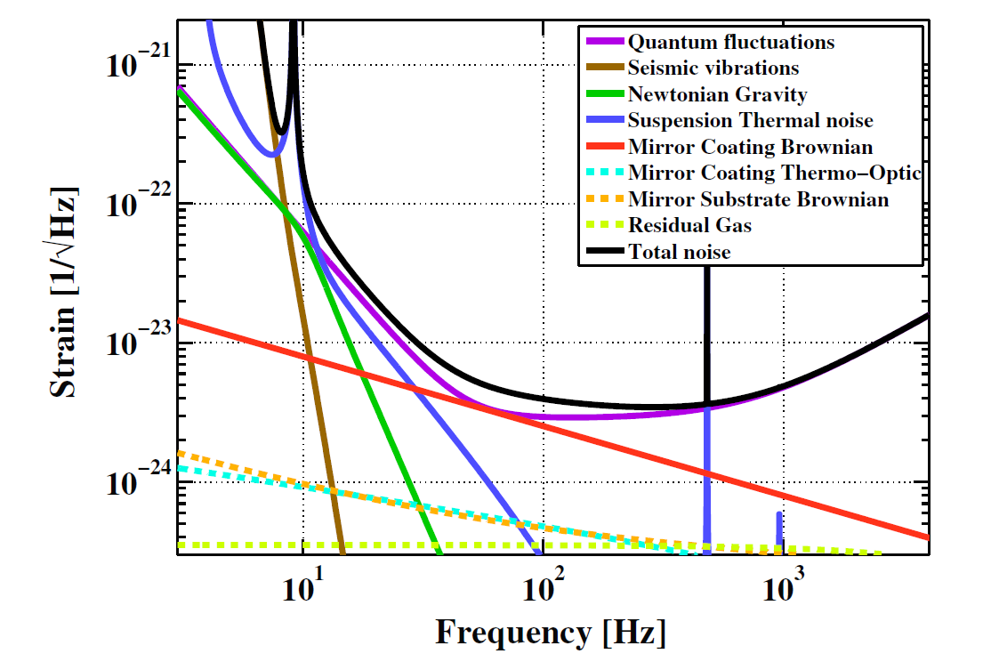
aLIGO noise budget
Adhikari, R.X.: “Gravitational radiation detection with laser interferometry,” Rev. Mod. Phys. 86 (2014)

Slide 17
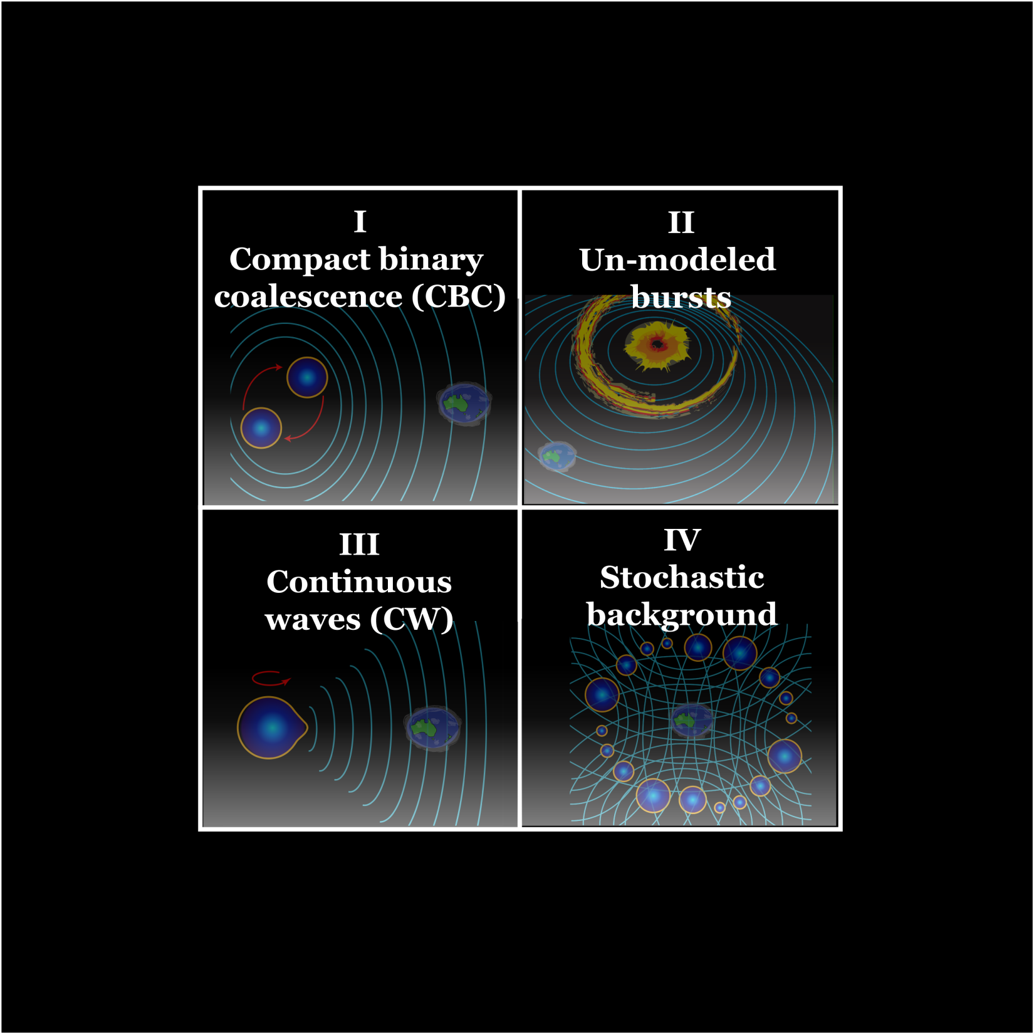
Working groups

Slide 18
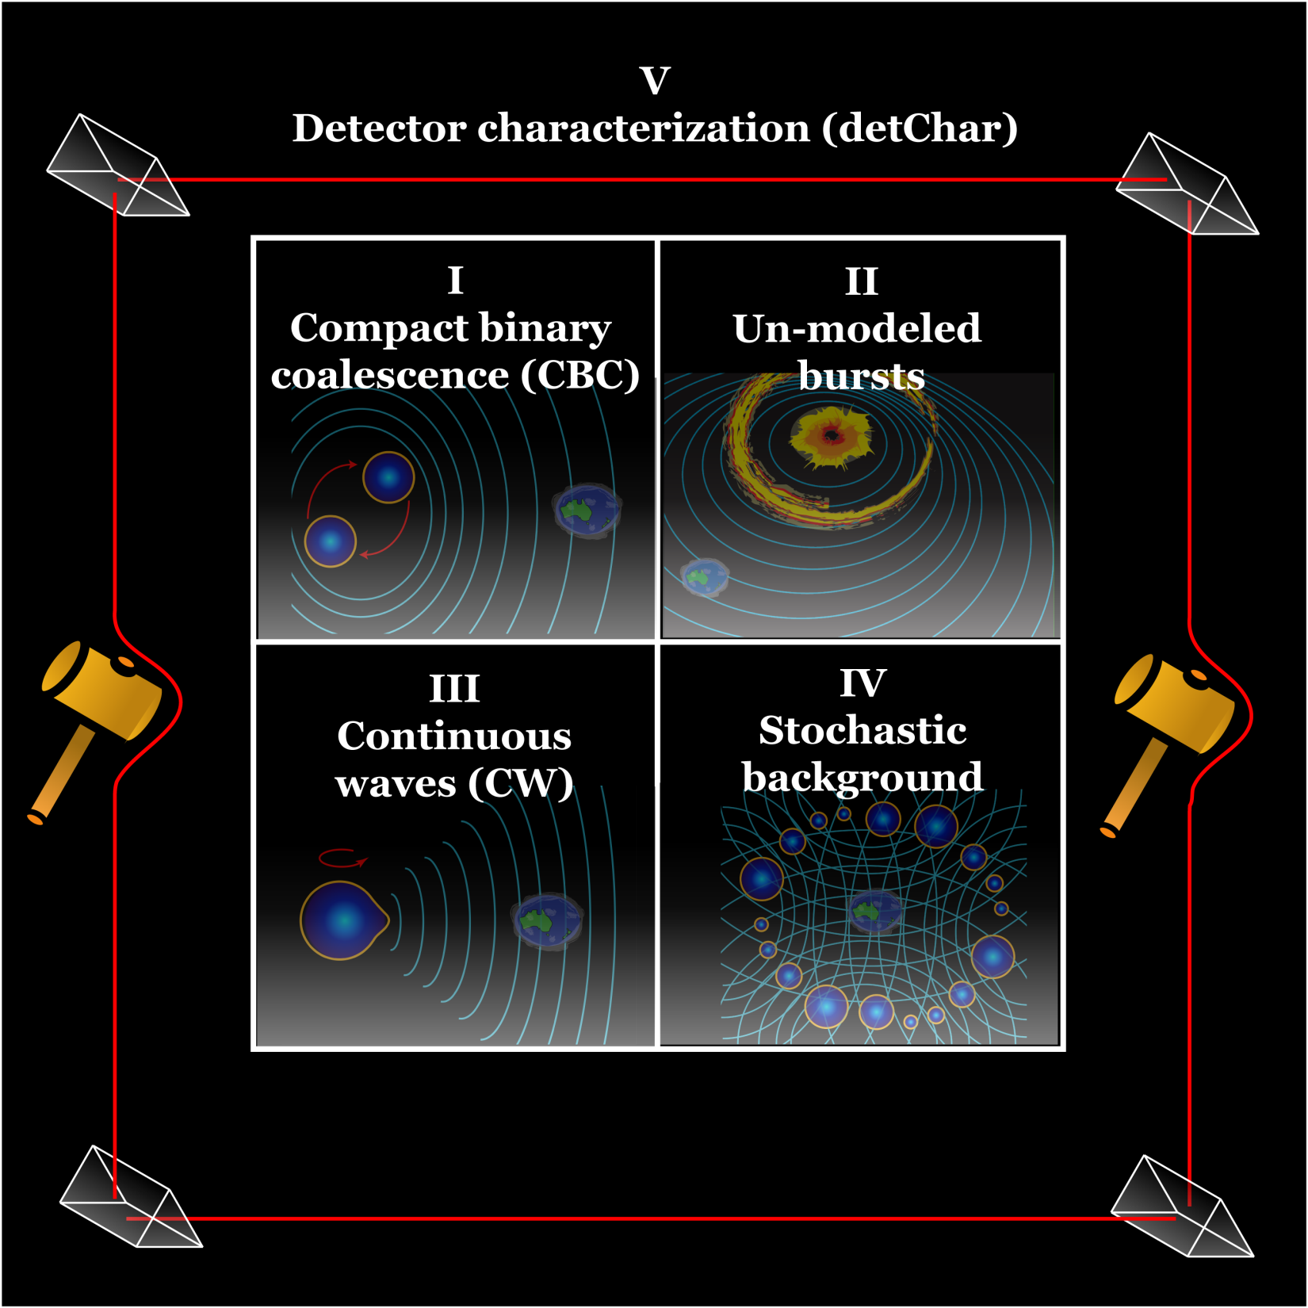

Slide 19
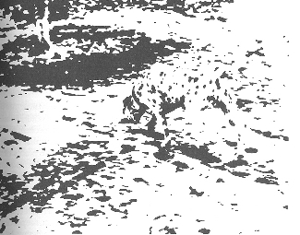
Feature detection

Slide 20
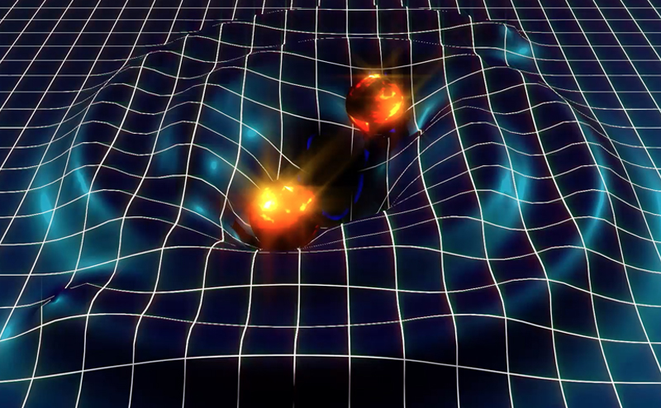
I: Compact Binary Coalescence (CBC)

Slide 21
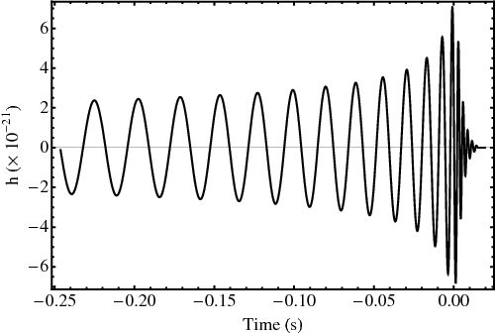
Image: Hannam, Mark et al., Phys.Rev. D 79 (2009) 084025

Slide 22
Chirp mass

Slide 23
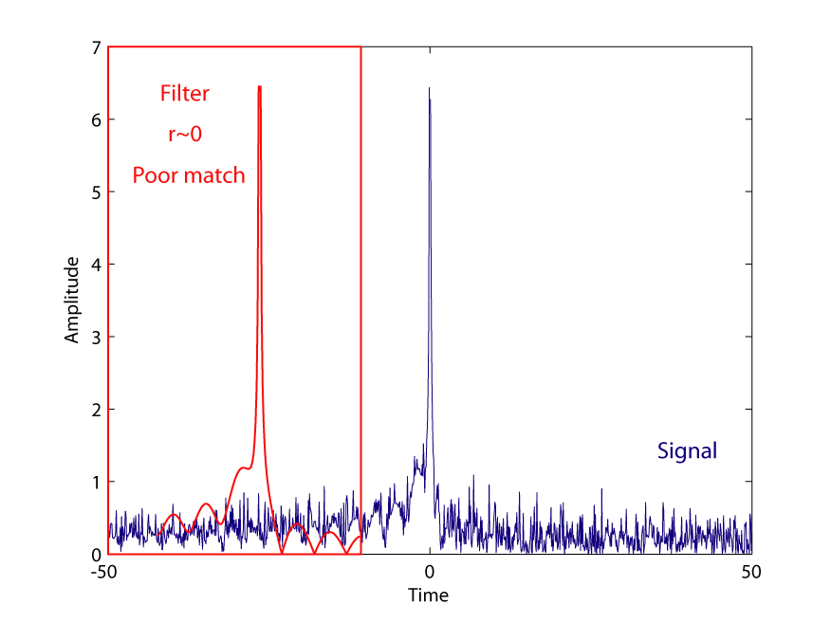
Matched filter
‘Template’ = expected wave-form = filter

Slide 24
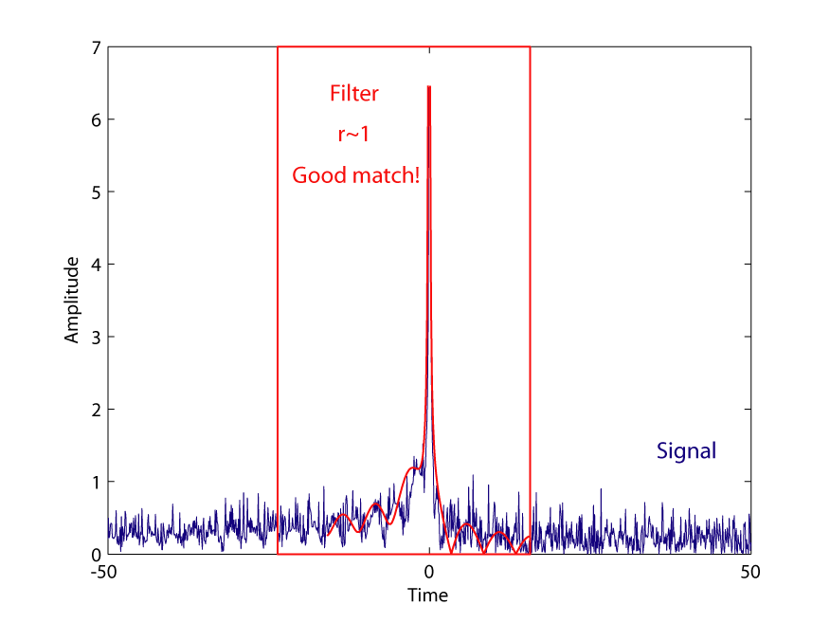
Matched filter
‘Template’ = expected wave-form = filter

Slide 25
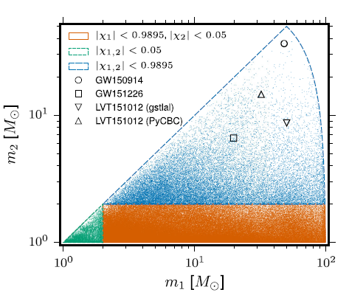
Template banks
LVC: “Binary Black Hole Mergers in the First Advanced LIGO Observing Run,” Phys. Rev. X 6(041015) (2016)

Slide 26
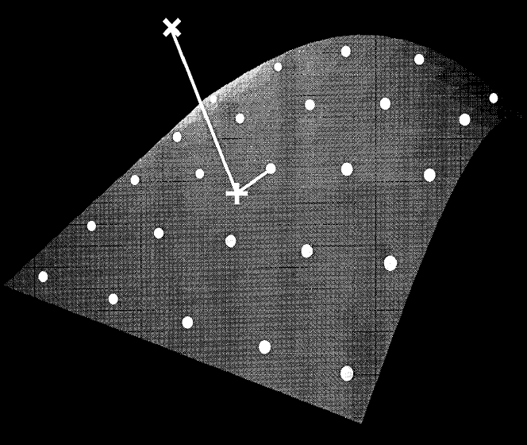
Information geometry
Owen, B.J.: “Search templates for gravitational waves from inspiraling binaries: Choice of template spacing,” Phys. Rev. D 53(12) (1996)
Sathyaprakash,B. S.: Phys. Rev. D 50(R7111) (1994)
Cutler, C. & Flanagan ,E. E. : Phys. Rev. D 49(2658) (1994)

Slide 27
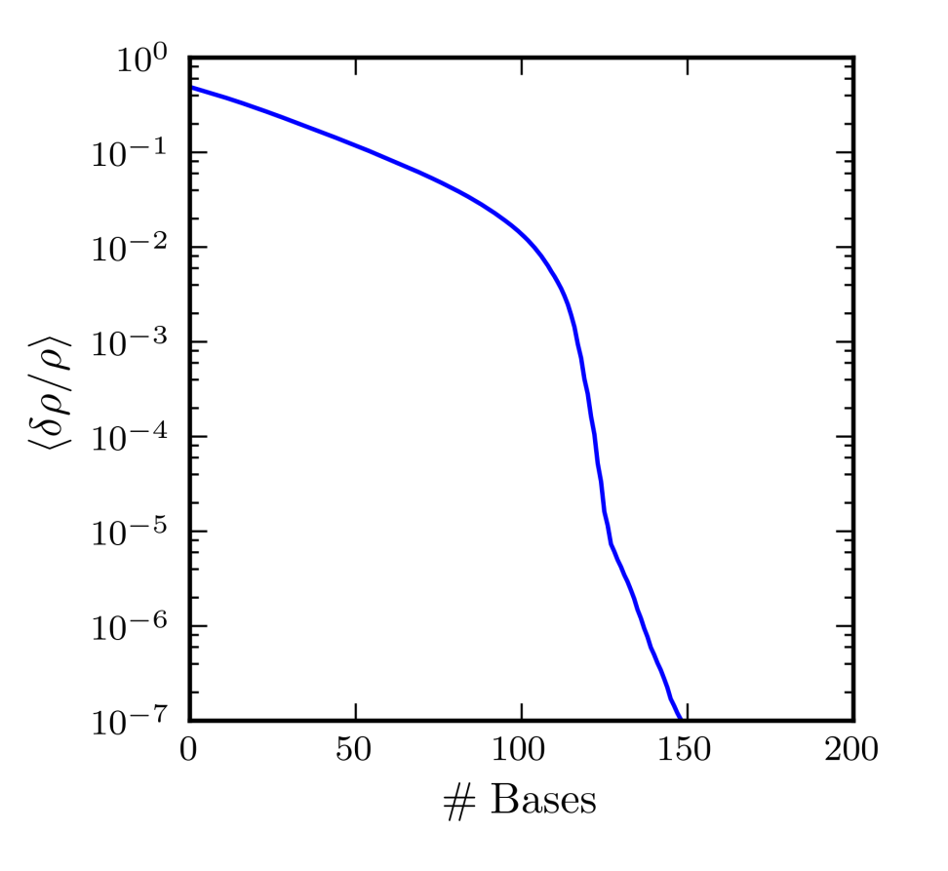
Dimensionality reduction via SVD
Cannon, K. et al.: “Singular value decomposition applied to compact binary coalescence gravitational-wave signals,” Phys. Rev. D 82(044025) (2010)

Slide 28
Further improvements
Abbott, B.P., et al.: “GW150914: First results from the search for binary black hole coalescence with Advanced LIGO” Phys. Rev. D 93:122003 (2016)
Allen, B.: “A chi-squared time-frequency discriminator for gravitational wave detection,” Phys.Rev.D 71:06200 (2005)
Allen, B., et al.: “FINDCHIRP: An algorithm for detection of gravitational waves from inspiraling compact binaries,” Phys. Rev. D 85:122006 (2012)
Capano, C., et al.: “Implementing a search for gravitational waves from non-precessing, spinning binary black holes,” Phys. Rev. D 93:124007 (2016)
Usman, S.A., et al.: “The PyCBC search for gravitational waves from compact binary coalescence,” Classical and Quantum Gravity 33(21) (2016)
Messick, C., et al.: “Analysis Framework for the Prompt Discovery of Compact Binary Mergers in Gravitational-wave Data,” Phys. Rev. D 95:042001 (2017)

Slide 29
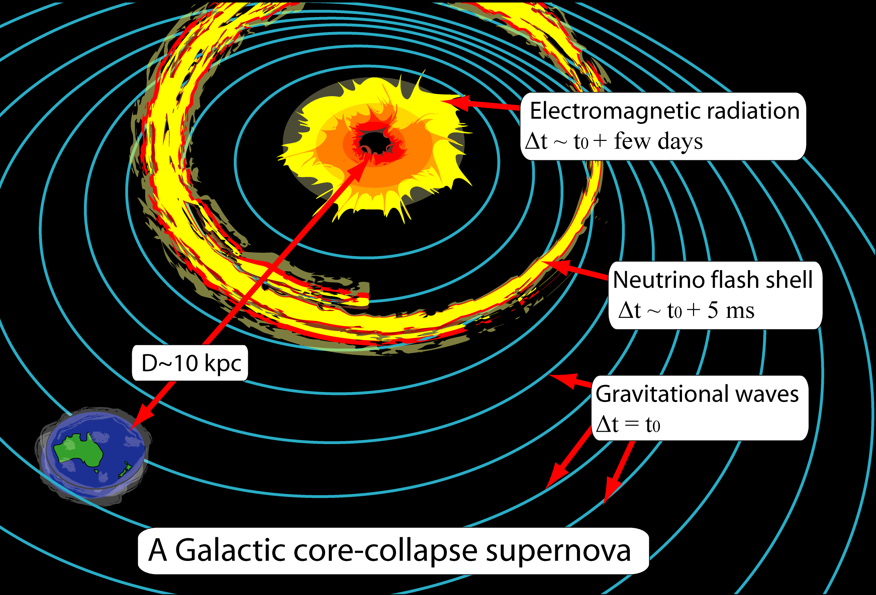
II: Un-modeled Bursts

Slide 30
Wavelets
Image: after Abbott, B.P. et al., PRL 116:061102 (2016)
Klimenko, S. & Mitselmakher, G.: “A wavelet method for detection of gravitational wave bursts,” Class. Quant. Grav. 21(20) (2004)

Slide 31
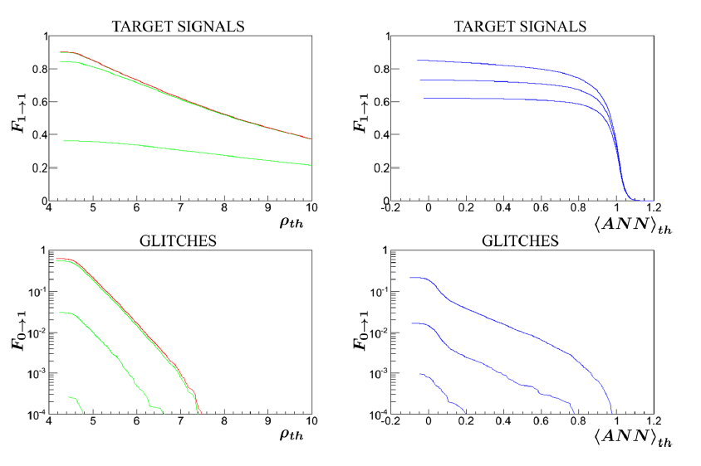
ANN+Wavelets
Vinciguerra, S., et al.: “Enhancing the significance of gravitational wave bursts through signal classification,” Class. Quantum Grav. 34(9) (2017)
Mukund, N. et al.: “Transient Classification in LIGO data using Difference Boosting Neural Network,” arXiv: 1609.07259v2 (2016)

Slide 32
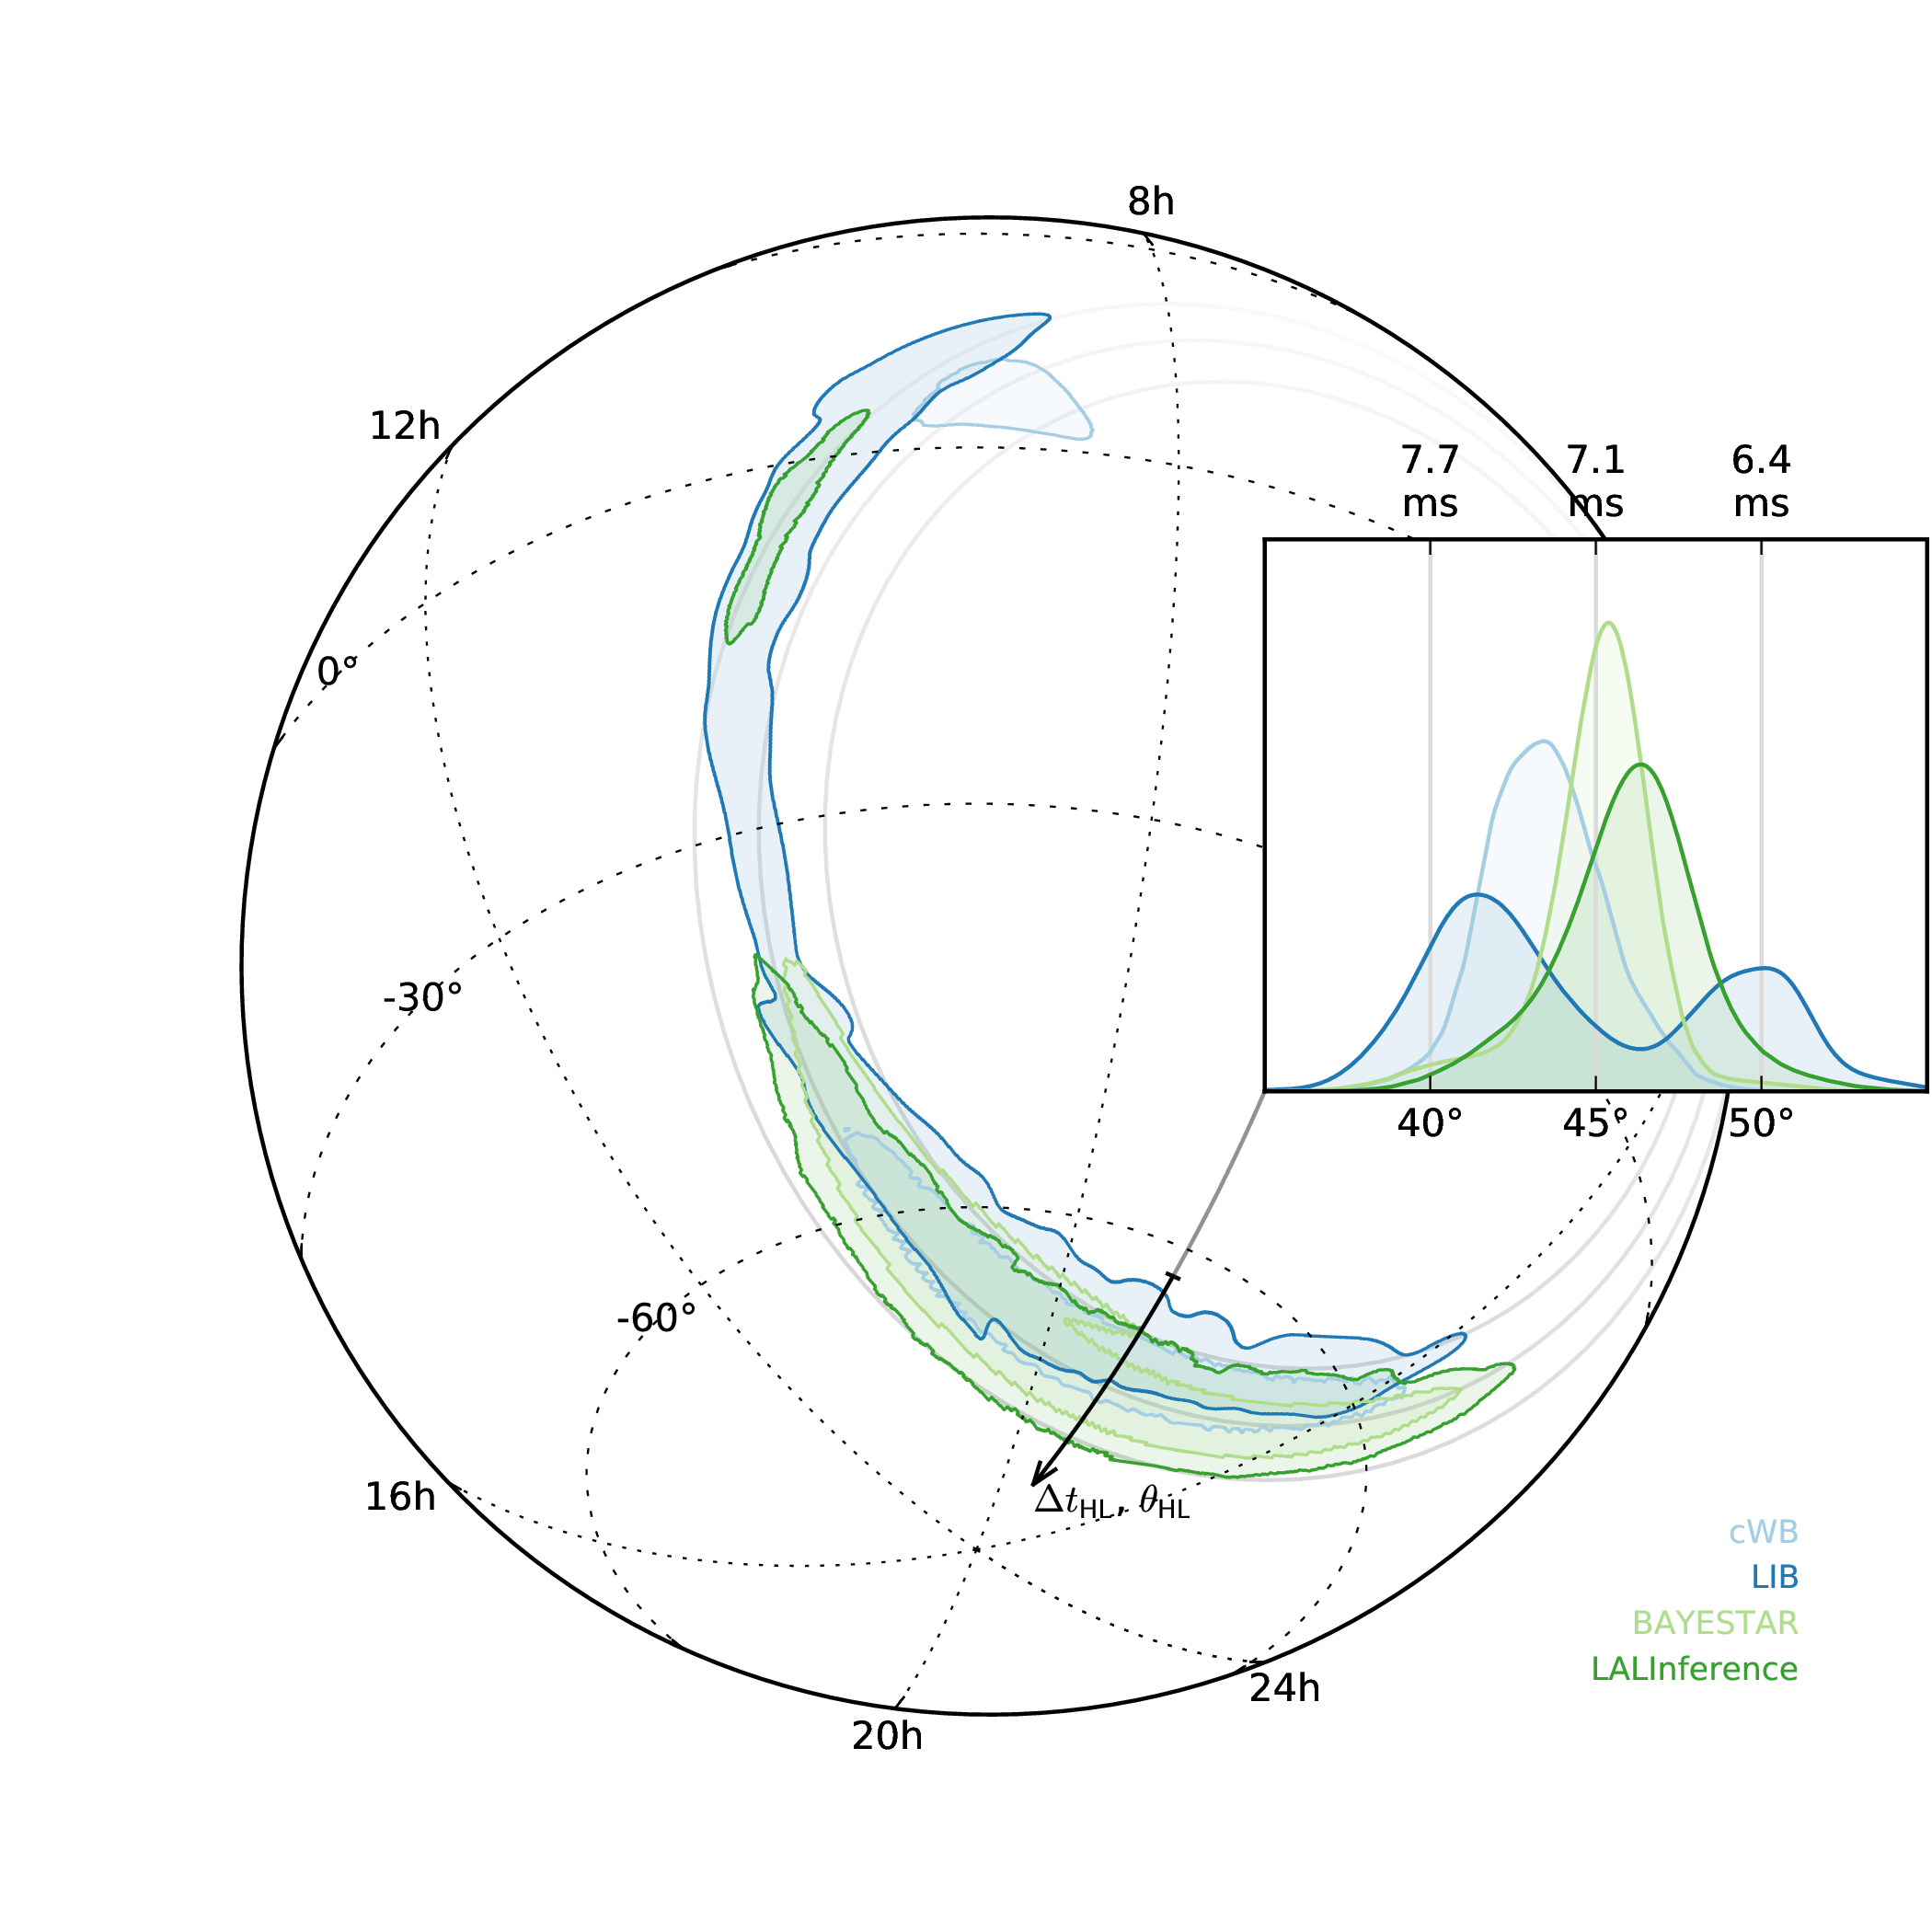
LVC+EM partners: “Localization and broadband follow-up of the gravitational-wave transient GW150914,” Ap. J. Letters 826(L13) (2016)

Slide 33
III: Continuous gravitational waves
Animation: Joeri van Leeuwen

Slide 34
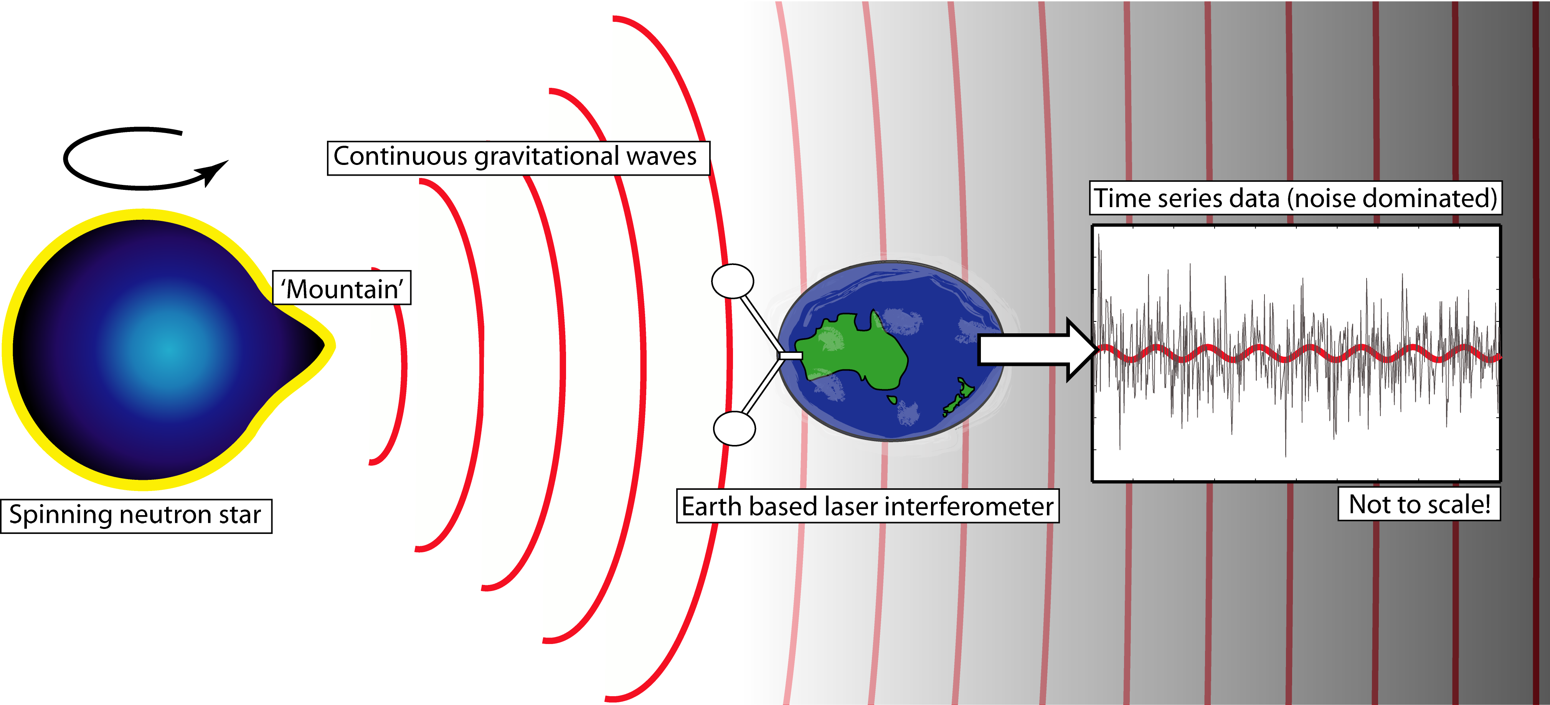
III: Continuous gravitational waves

Slide 35
Expected amplitudes
Tiny!

Slide 36
Computational bound
Averaging means most CW searches are computationally limited
e.g.: typical, modest, search takes ~400,000 CPU hrs on Albert Einstein Institute’s Atlas supercomputer
Bounds often explicitly used to determine a figure of merit for CW searches

Slide 37
Maximum Likelihood Estimation
Jaranowski, P., Królak, A. & Schutz, B.F.: “Data analysis of gravitational-wave signals from spinning neutron stars: The signal and its detection,” Phys. Rev. D 58(063001) (1998)

Slide 38
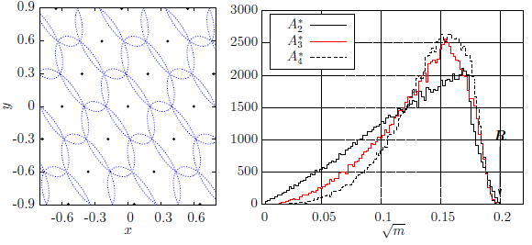
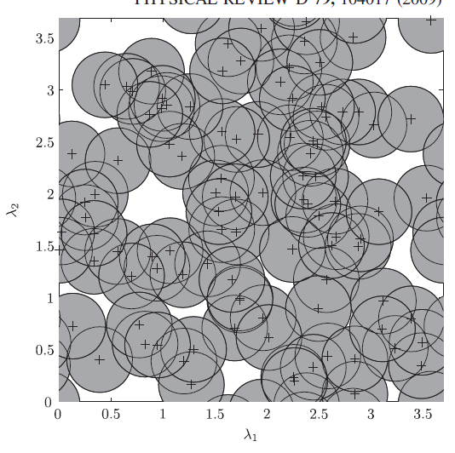
Template banks: sphere covering
Prix, R.: “Template-based searches for gravitational waves: efficient lattice covering of flat parameter spaces,” Class. Quantum Grav. 24(S481–S490) (2007)
Messenger, C., Prix, R. & Papa, M.A.: “Random template banks and relaxed lattice coverings,” Phys. Rev. D 79(104017) (2009)
Wette, K.: “Lattice template placement for coherent all-sky searches for gravitational-wave pulsars,” Phys. Rev. D 90(122010) (2014)

Slide 39
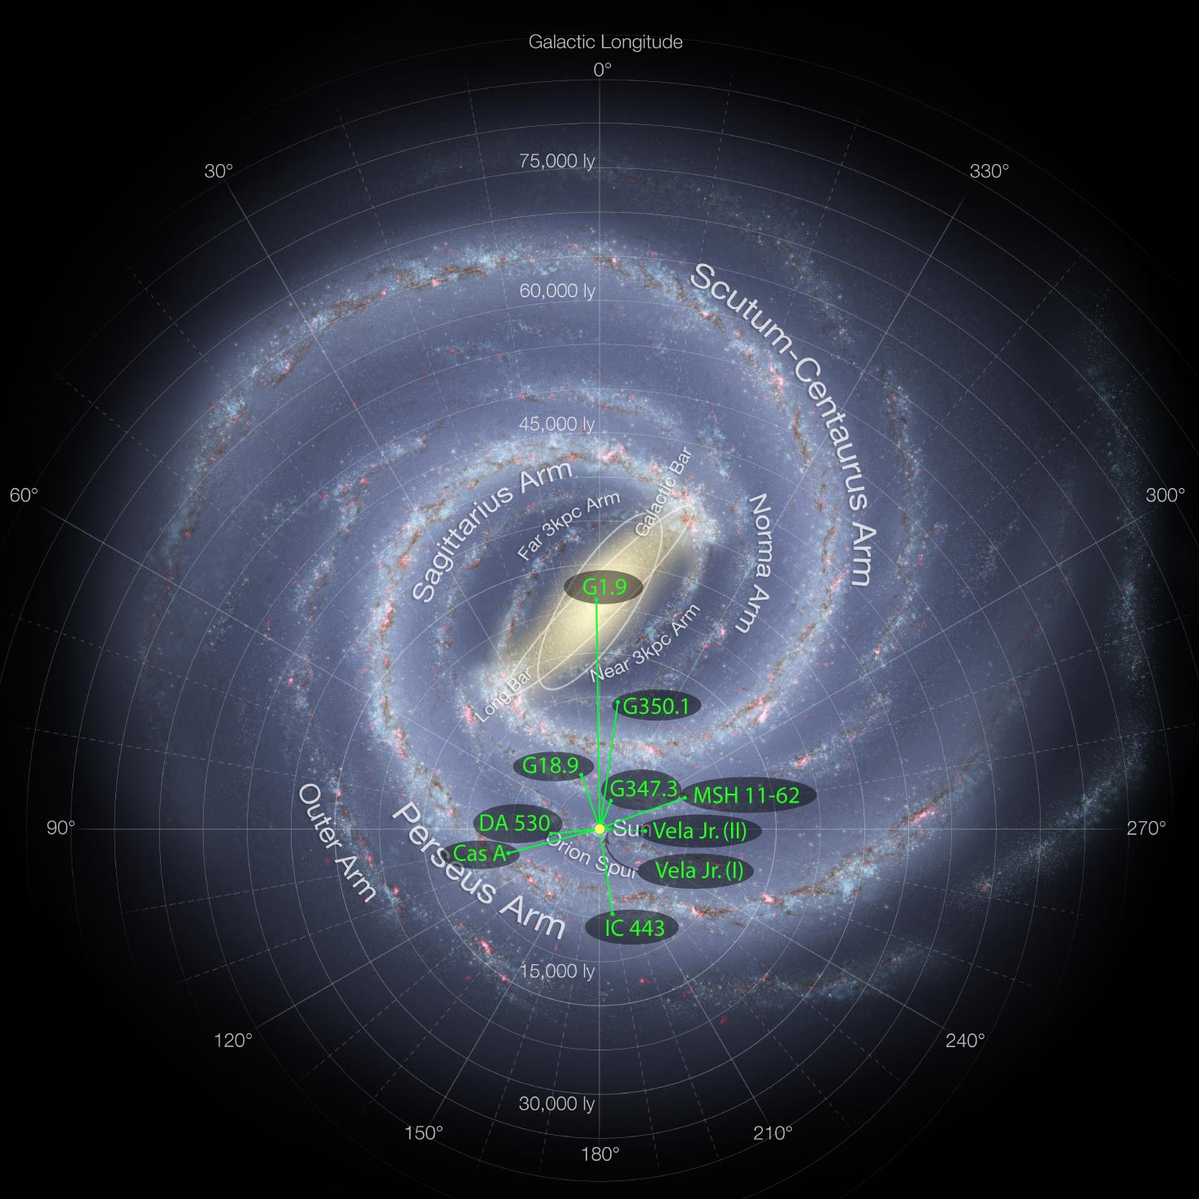
Young supernova remnants
Adapted from NASA/JPL-Caltech/ESO/R. Hurt., with permission
Aasi, J. et al. ApJ. 813(1) 39 (2015)

Slide 40
Other algorithmic improvements
Time series resampling
Viterbi tracking of spin wandering
Cross correlation
Parameter space improvements
2: LVC: “Search for gravitational waves from Scorpius X-1 in the first Advanced LIGO observing run with a hidden Markov model,” arXiv: 1704.03719 (2017)
4: Wette, K., PRD 92:082003 (2015); Jones, D.I., MNRAS 453:53 (2015); Leaci, P. & Prix, R., PRD 91:102003 (2015)
+Many more!

Slide 41
How can you get involved?
https://einstein.phys.uwm.edu/

Slide 42
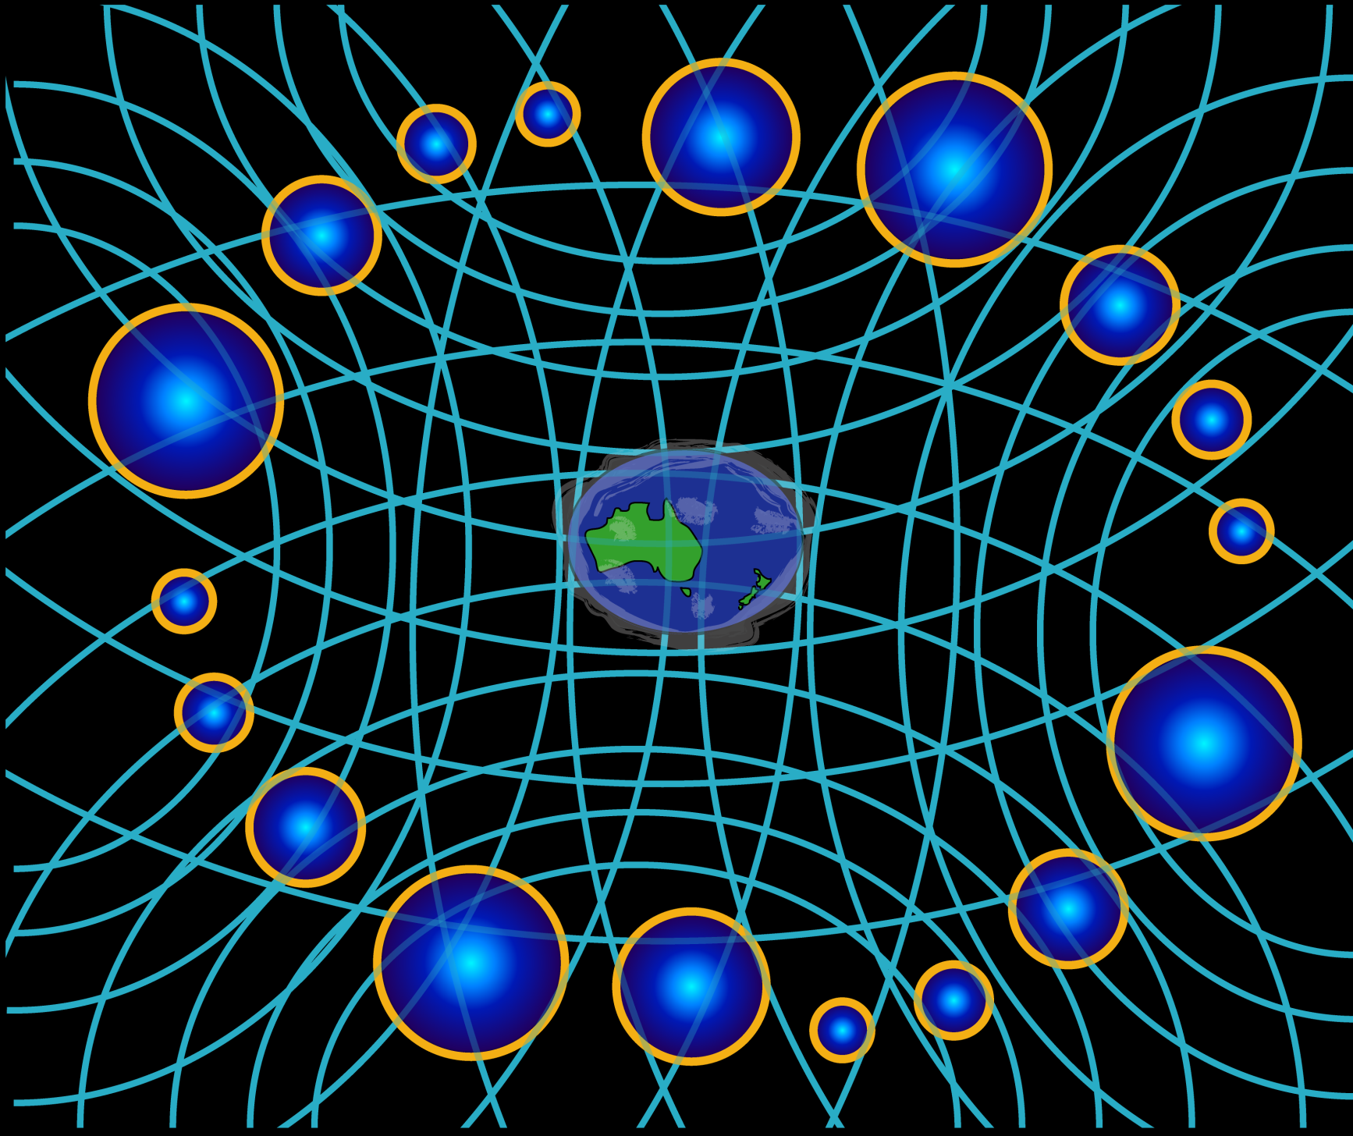
IV: Stochastic Background

Slide 43
Cross-correlation (again)
GW energy density:
Cross-correlation estimator:
Using an optimal filter:

Slide 44
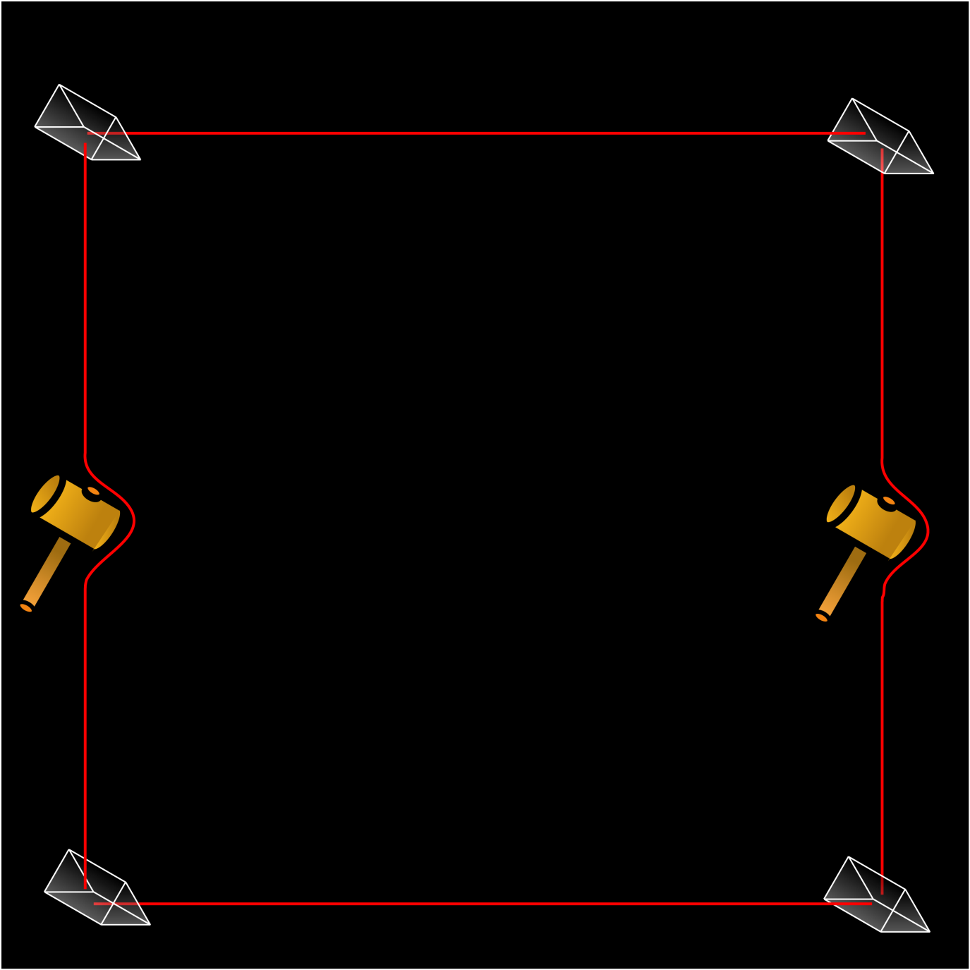
V: Detector Characterization (detChar)

Slide 45
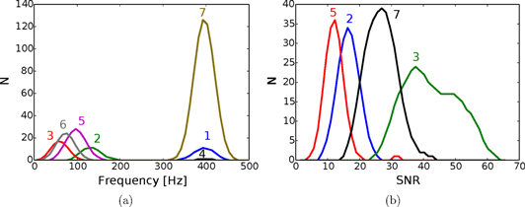
Machine learning
Powell, J.: “Classification methods for noise transients in advanced gravitational-wave detectors,” Class. Quantum Grav. 32(21) (2015)

Slide 46
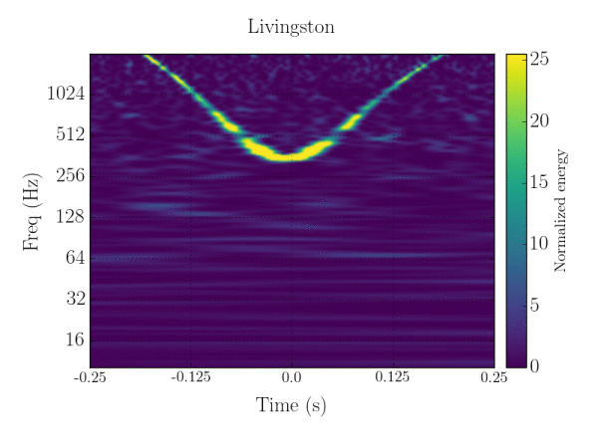
Citizen science: gravitySpy
www.zooniverse.org/projects/zooniverse/gravity-spy
Zevin, M. et al. :“Gravity Spy: Integrating Advanced LIGO Detector Characterization, Machine Learning, and Citizen Science,” arXiv: 1611.04596 (2016)

Slide 47
Conclusion and the future
Very healthy range of algorithms and signal processing techniques
Increasingly more computationally efficient
Rapid adoption of machine learning techniques
Also good use of citizen science (also good for outreach)

Slide 48
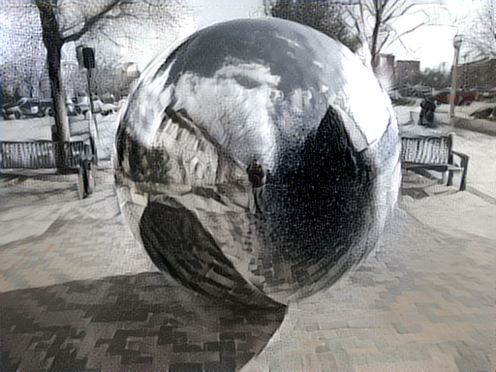

Slide 49
