Slide 1
Galaxy NGC 7331
By : Ramiro Torres

Slide 2
Introduction:
My discussion will cover the following:
Brief description of the project.
Object of Observation.
How was the data gathered?
What was the process taken to complete the project?
Result

Slide 3
Purpose of Project:
The purpose for the project is to image an object in the sky using the equipment on the Texas Tech University observatory.
To process the images obtained using two very useful programs: CCDSoft & Photoshop.
The final goal is to obtain a color image.

Slide 4
Reason To Pick Spiral Galaxy, Ngc 7331:
I decided to image a spiral galaxy for its amazingly structured spiral arms.
The major reason is that NGC 7331 has a structure that resembles that of our own galaxy—Milky Way.

Slide 5
Object of observation:
The object that I decided to image was galaxy NGC 7331—a spiral galaxy, also referred to as Caldwell 30, this galaxy is located in the northern constellation Pegasus.
NGC 7331 is the brightest member in the Deer Lick Group.
It was firstly discovered by William Herschel in 1784.
The distance to NGC 7331 is 12 Mpc, with a diameter of 10⁶ light years.
It is estimated to be receding from us at a velocity of 816 km/s.
This galaxy appears to have companion galaxies: NGC 7335 and NGC 7337 near to it, however these companions are estimated to be 10 times more distant. Their alignment with galaxy 7331 occurs by coincidence.

Slide 6
Data Gathering:
The images were collected over two nights: 2.5 hours in the first night and 1 hour for the second night.
Utilized a 20’’ Planewave-Cassegrain Telescope with CCD STL-1001E.
The images that are to be used: flats, flat darks, and darks, were taken prior to imaging color.
Images were taken using red, green, blue, and clear filters.
Exposures :
Red: 3 minutes x 15 images.
Green: 3 minutes x 15 images.
Blue: 3 minutes x 15 images.
Clear: 3 minutes x 20 images.

Slide 7
Programs & Process Utilized to Process Image:
Two Programs were utilized to process the images for the object: CCDSoft and Photoshop.
CCDSoft is used for--
Calibrate (done for each filter separately): darks--subtract the noise from the images, flats—used to flatten the background of image for each filter, and dark flats—subtract the noise from flat images.
Align – aligning all the images, used to align all filtered images together.
Combine (done for each filter separately)- combining every image.
Photoshop:
Provided the tools—levels, curves to improve the appearance of each image.
As well, the tools to combine the filtered images, into a single color image and finally to combine the color picture with clear filtered image to produce final result.

Slide 8
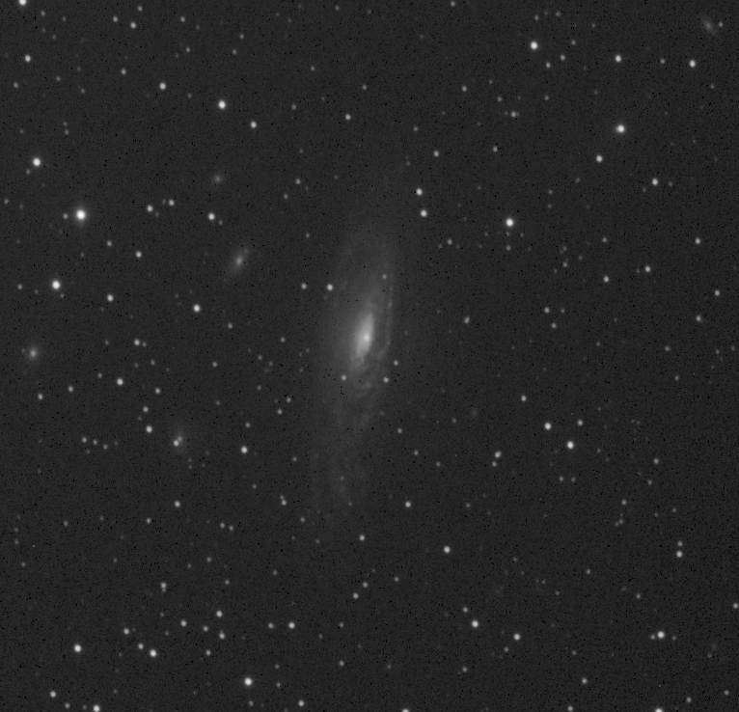
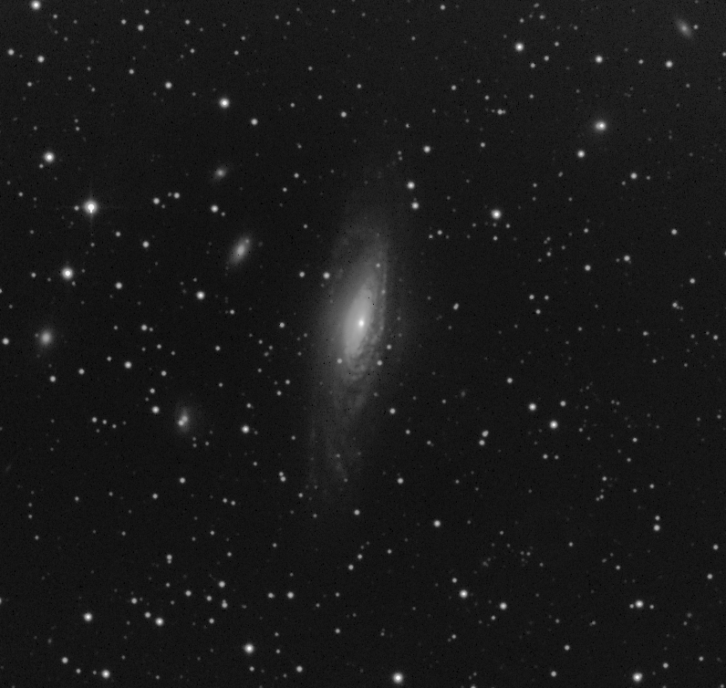
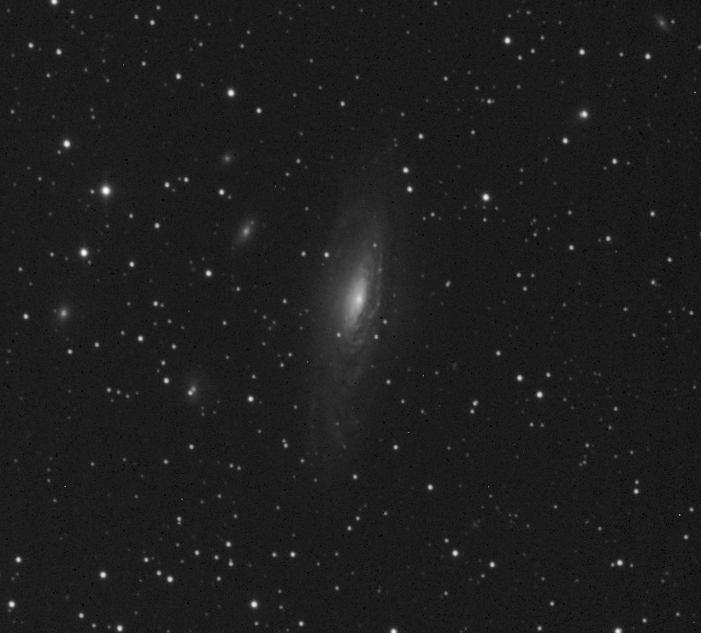
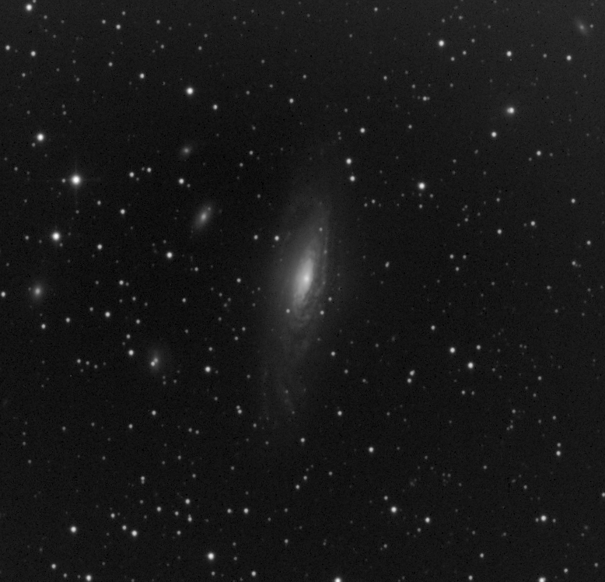
Images Throughout process:
Filtered Images (starting from left): Blue, Clear, Green , and Red.
After using CCDSoft for: calibration, alignment, and combining.
Their appearance was improved using levels, and curves from photoshop.
Blue Clear
Green Red

Slide 9
Images Throughout Process (Continued)
The color filtered images have now been combined into one.
At this point, levels and curves were used to balance the color in the image.
Next, it will be combined with clear filtered to bring out the detail from galaxy.

Slide 10
Resulting Image:

Slide 11
Identifying The Galaxy’s Neighbors:
NGC 7335
NGC 7331
NGC 7337

Slide 12
Sources:
Listed are all the sources I used to gather background information regarding the galaxy I decided to image:
http://annesastronomynews.com/photo-gallery-ii/galaxies-clusters/ngc-7331-by-robert-gendler/
http://www.lvastronomy.com/observing-challenge/97-september-ngc-7331-caldwell-30-galaxy-in-pegasus
http://www.kopernik.org/images/archive/n7331.htm

