Slide 1
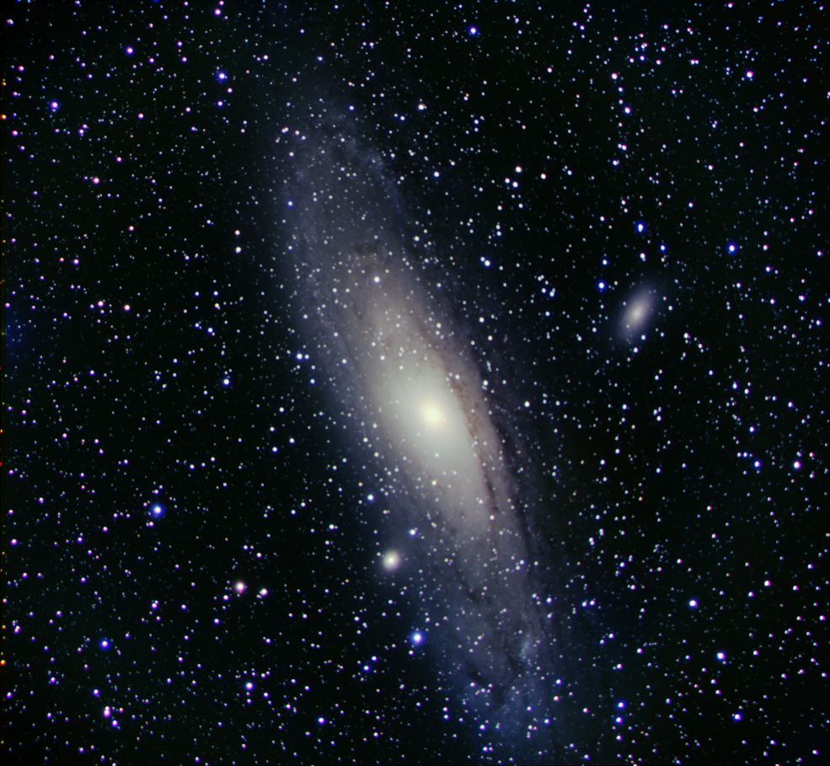
M31, Andromeda Galaxy
Kyle Stewart

Slide 2
Why I chose M31
Never used the 5” telescope before
The galaxy is huge and you HAVE to use the 5” telescope
It can be seen with the naked eye

Slide 3
History
964 Persian astronomer described it as a small cloud
1612 Simon Marius observed in a telescope
1764 Charles Messier cataloged it as M31
Thought to be a nebula until 1925

Slide 4
Fun Facts
Closest spiral to us (2.5 million light-years)
Largest and most massive in our local group with about 1 trillion stars
Collide in 3.75 billion years (approaching at 68 mi/s)
Two major satellite galaxies, M110 and M32

Slide 5
More serious facts
Apparent magnitude – 3.4
Constellation – Andromeda
Formed by the collision of two smaller galaxies

Slide 6
Obtaining the data
TTU Observatory
November 8th, 2014
Clear skies, extremely cold
5” Jaeger telescope
STL 1001E
No flats, five two minute darks
30 green, 30 red, 30 blue images, all two minute exposures

Slide 7
Image Processing
Create master dark and dark subtract all the images
Align (separately)
Combine (pain for this image)
Photoshop!

Slide 8
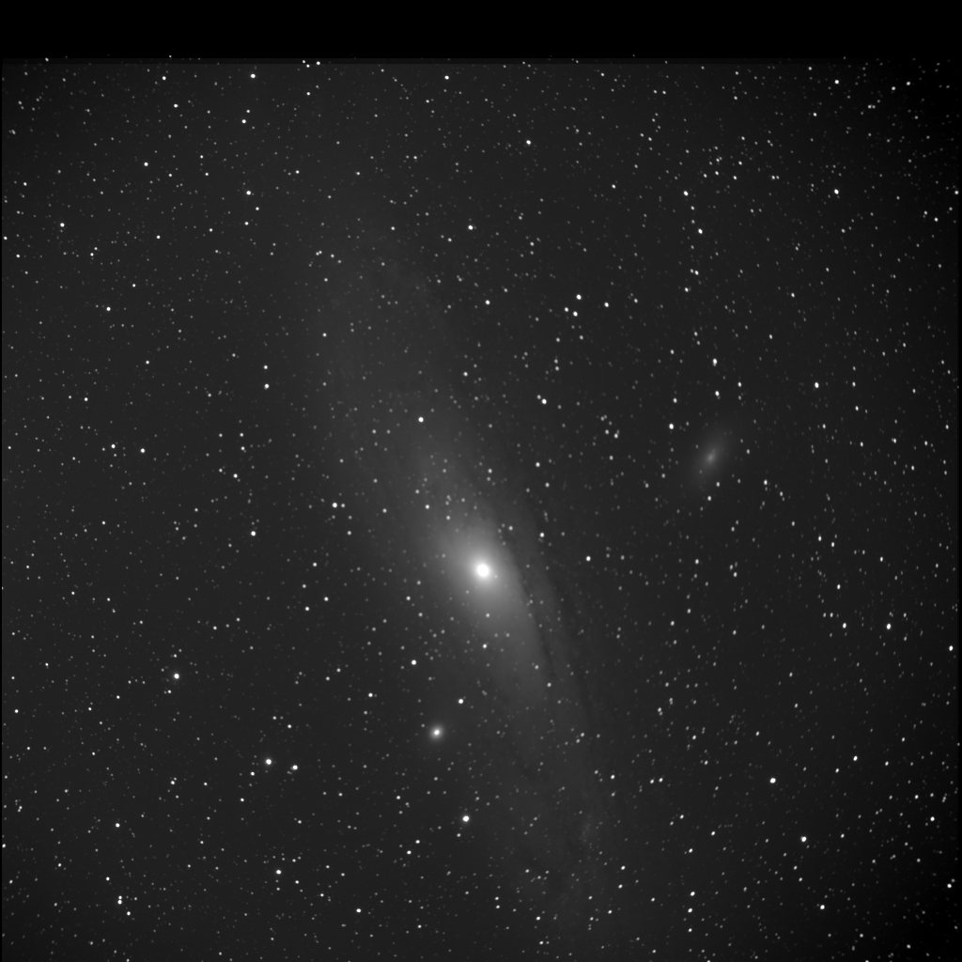
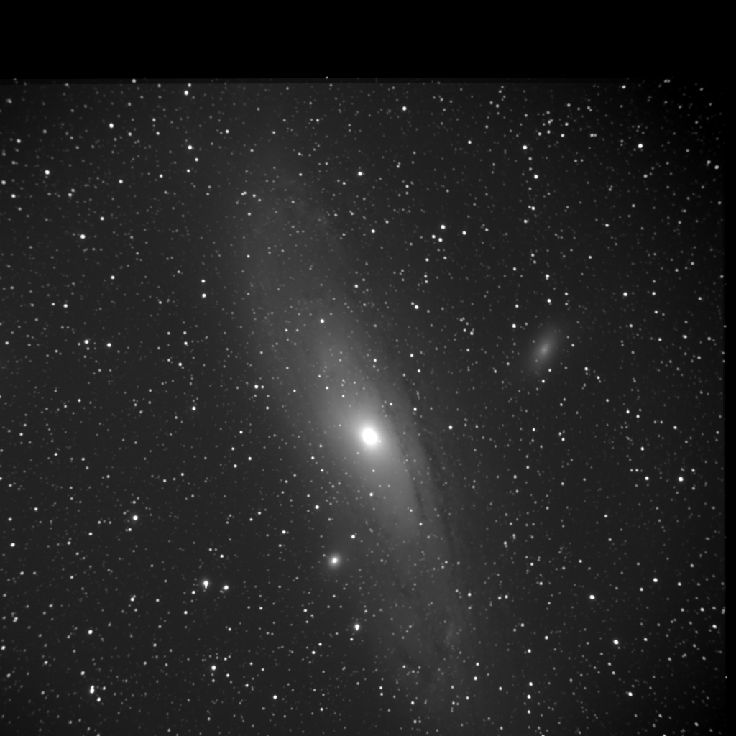
Blue
Green
Red

Slide 9
M110
M32

Slide 10
Sources
http://earthsky.org/clusters-nebulae-galaxies/andromeda-galaxy-closest-spiral-to-milky-way
http://en.wikipedia.org/wiki/Andromeda_Galaxy

