Slide 1
IC 5067 (Pelican Nebula)
Raven LaFave

Slide 2
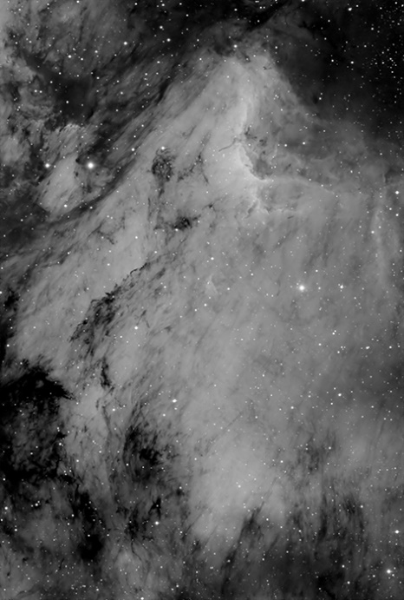
Facts
In the Pelican Nebula; Ridge following curve of head and neck
Constellation: Cygnus
~1,900 light years away; 10 light years in diameter
Northeast of Deneb
Magnitude: 8.0-9.0
RA: 20h50m54s; Dec: +44º25′06″
Emission Nebula
Jets emitted: Herbig-Haro object 555
http://www.perseus.gr/Astro-DSO-IC-5070.htm

Slide 3
Herbig-Haro Objects
Named after George Herbig and Guillermo Haro
What are they?
Pillars indicate a Protostar
http://www.noao.edu/outreach/press/pr03/hh555.html

Slide 4
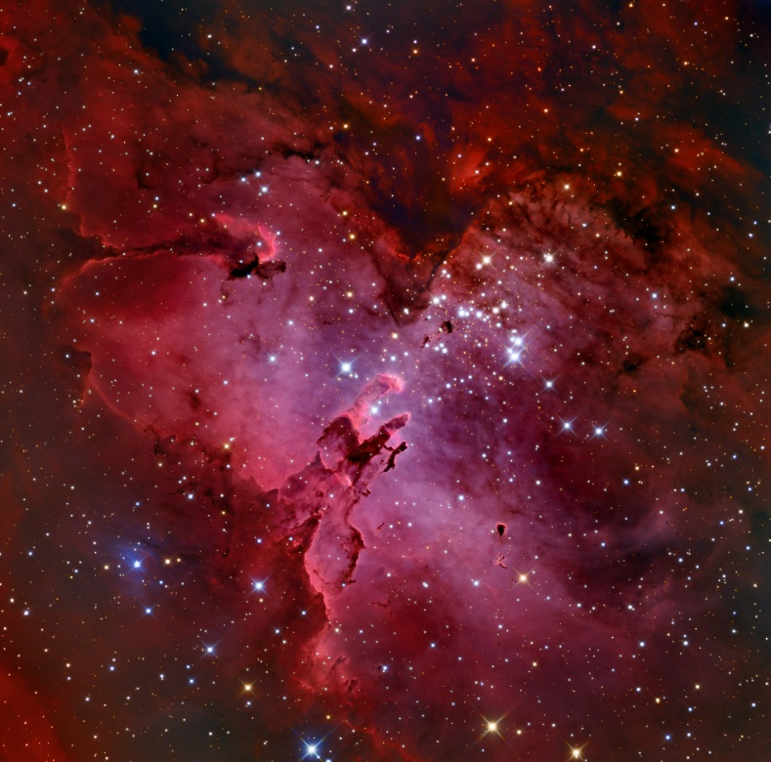
Why would I pick such an object?
1st wanted to image M16 (Eagle Nebula)
IC5067 was above the horizon!
Detail
http://www.phys.ncku.edu.tw/~astrolab/mirrors/apod/image/1406/m16_32block950.jpg

Slide 5
Imaging
Telescope: 12″ Meade LX200
CCD: ST -9XE camera with RGB filters
10 flatfields in each filter and 10 flatdarks; both at .05 exposure
5 Dark Frames at 3min. Exposure
15 unfiltered; 10 of each filter (BGR); all at 3min. exposures

Slide 6
CCD SOft
Masterdark
Masterflat: PROBLEM!
Calibrate
Align
Combine

Slide 7
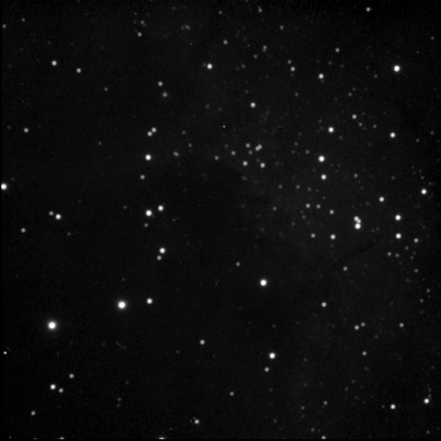
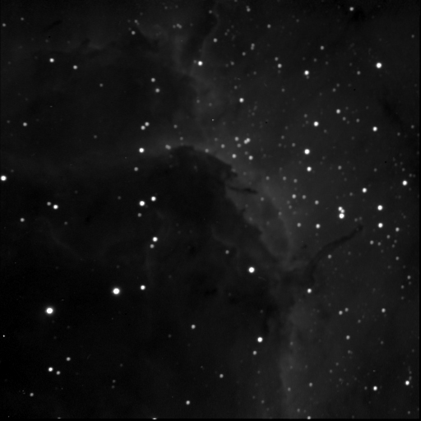
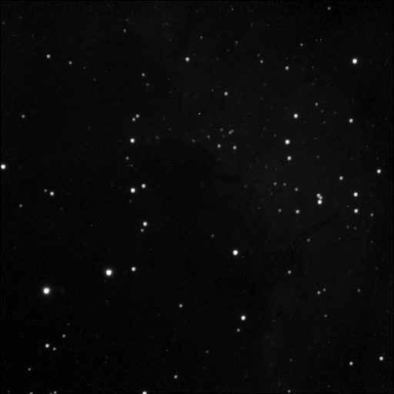
Unfiltered Median
Green Add
Red Add
Blue Add

Slide 8
RGB Combined

Slide 9
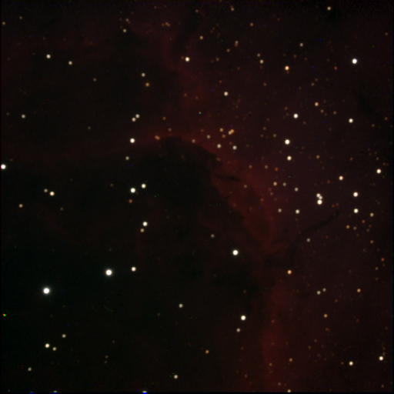
Photoshop
Levels
Curves
Saturation
Flatten
MORE levels/curves/saturation

Slide 10
Final Image!

Slide 11
Sources
http://www.noao.edu/outreach/press/pr03/pr0308.html
http://astronomy.swin.edu.au/cosmos/E/Emission+Nebula
http://annesastronomynews.com/photo-gallery-ii/nebulae-clouds/hh-555/
http://www.perseus.gr/Astro-DSO-IC-5067.htm
http://apod.nasa.gov/apod/ap130822.html

