Slide 1
Light-Curve of Asteroid 1445
Matthew Streseman
Presenting for Dr Clark’s ASTR 2401

Slide 2
Outline
Background
Data Collection
Data Analysis
Results
Conclusions

Slide 3
Asteroids
Rocky bodies in the Inner Solar System
Not planets
Asteroids concentrated in the Asteroid Belt
Not visible to the naked eye

Slide 4
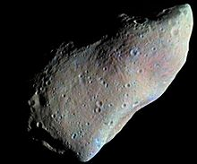

Slide 5
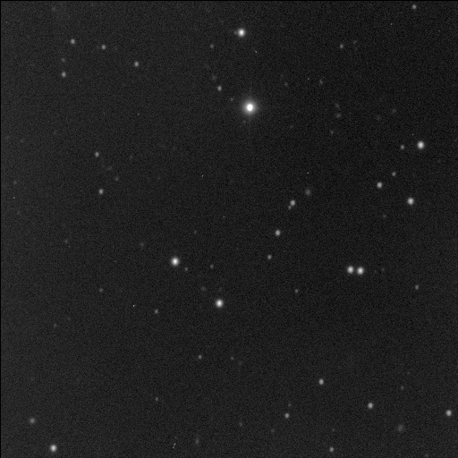

Slide 6
Rotation
Asteroids tend to rotate on an axis of rotation
Small enough that they have irregular shapes
  Some are spherical though
Asteroids can appear brighter or dimmer
  Based on the angle we are viewing them from

Slide 7
How to determine the Rotation
We can use a CCD to measure the brightness
  Can be done for hours, days, or even weeks
We can compare the images
  We look at when we have maximum and minimum brightness
  This can tell us how long it takes to rotate
My project was applying this method

Slide 8
Initial Choice
I initially chose to look at Asteroid 3448
  Called Narbut
  Has an absolute magnitude of 13.1
  Discovered in 1977
Problem: No evidence of rotation
  Slow Rotator
  Almost Spherical
  We are looking at the axis of Rotation

Slide 9
Not to Worry!
There was another, fainter asteroid in my CCD Field
  Unfortunately, it was so faint that the curve fell within the error
Dr Clark then helped me look for a new Asteroid, based on ones he observed
  We chose Asteroid 1445

Slide 10
Asteroid 1445
Discovered
  January 6, 1938
  György Kulin
Called Konkolya
Absolute Magnitude of 11.84
Located in the asteroid belt

Slide 11
Data Collection
I took data Dr Clark gave me
  I also went out on: November 2 and November 6
  Dr Clark further gave me data from November 10
Using all of this data, I conducted data analysis
I used MPO Canopus to analyze my data
  The curve worked, but could have been better

Slide 12
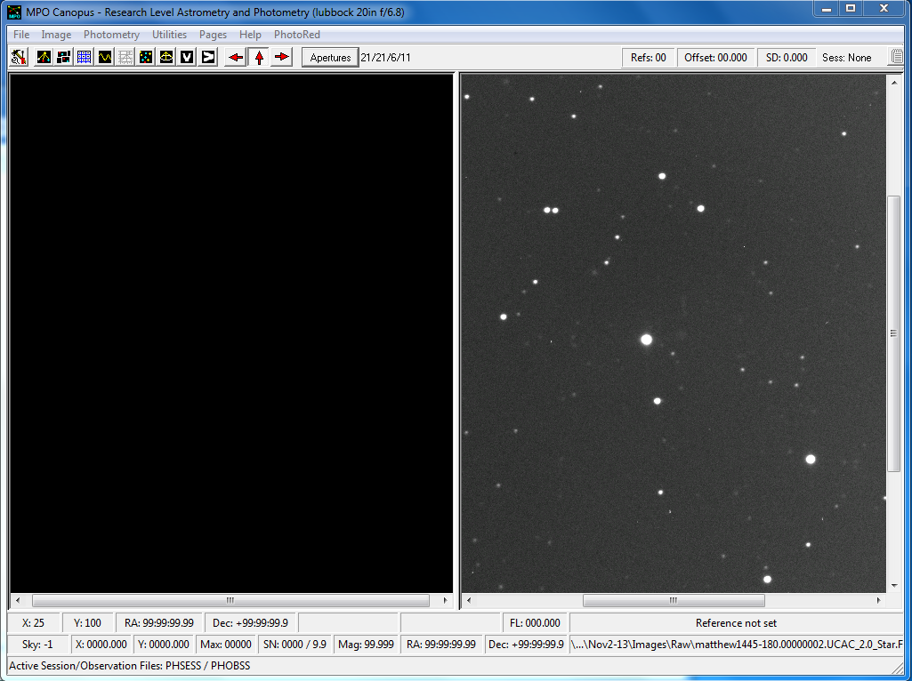

Slide 13
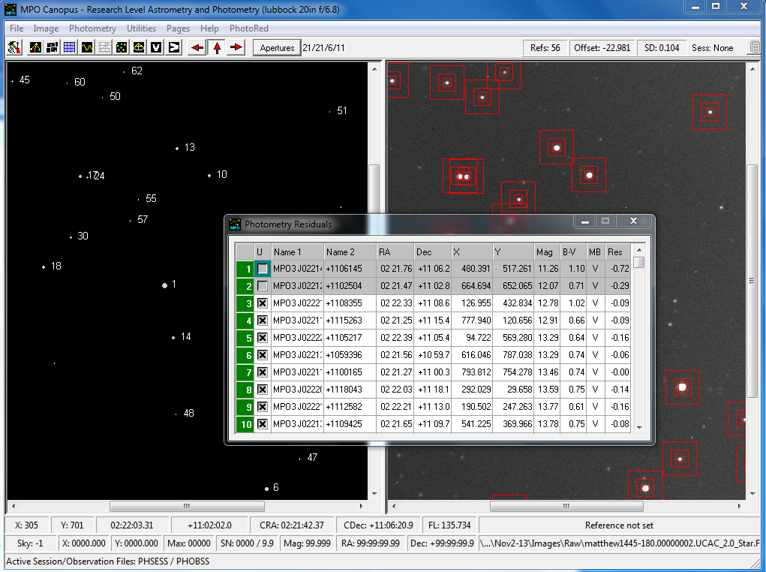

Slide 14
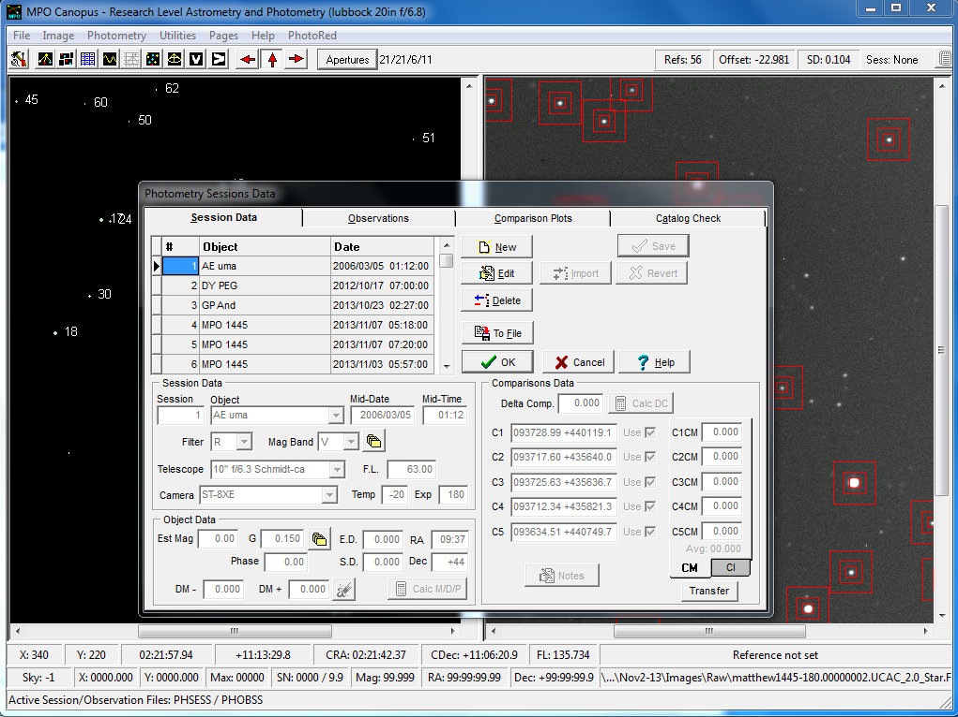

Slide 15
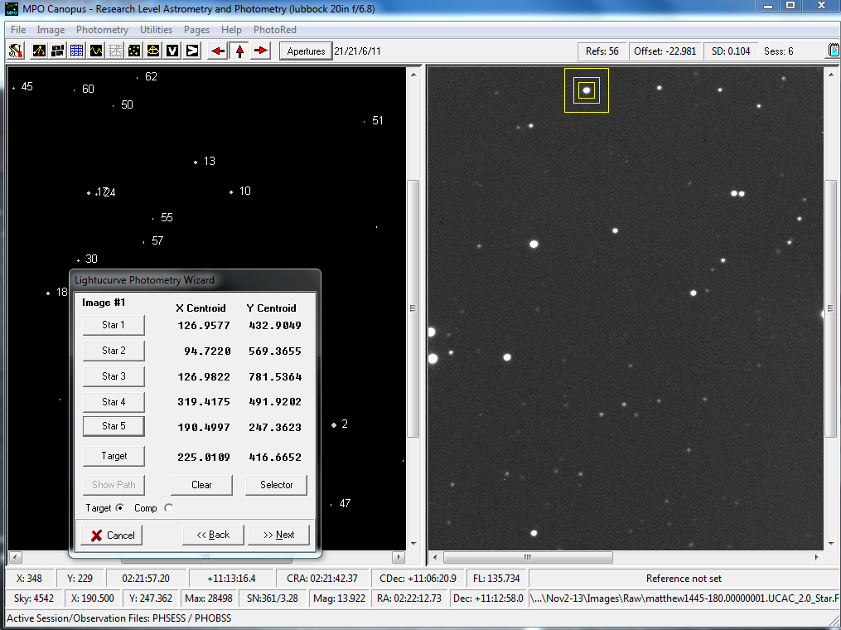

Slide 16
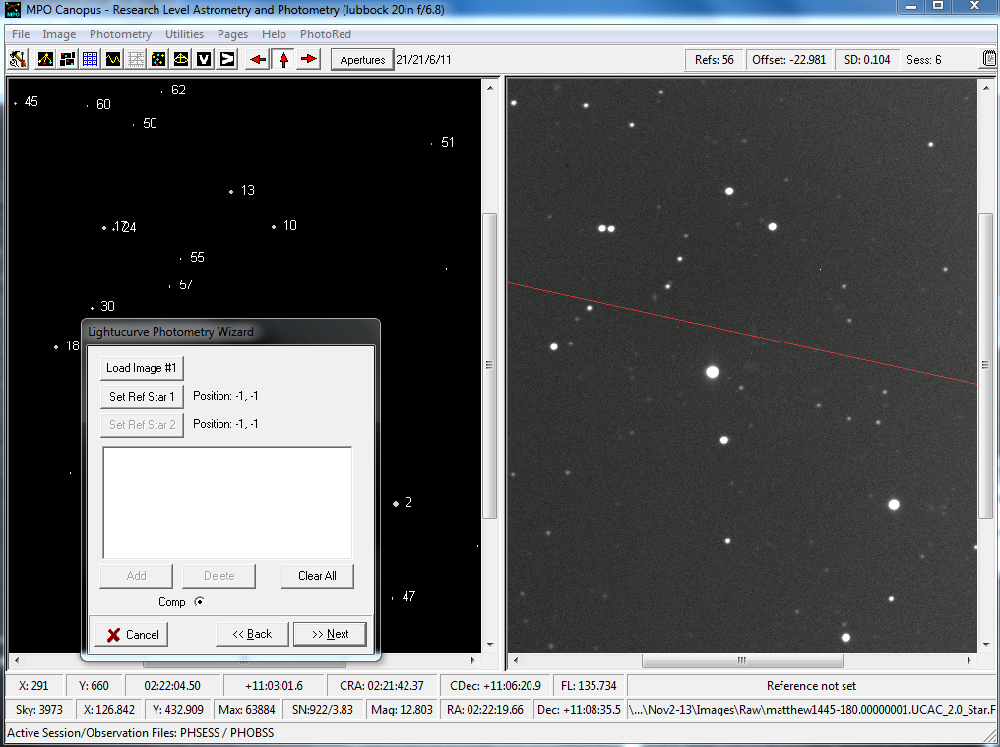

Slide 17
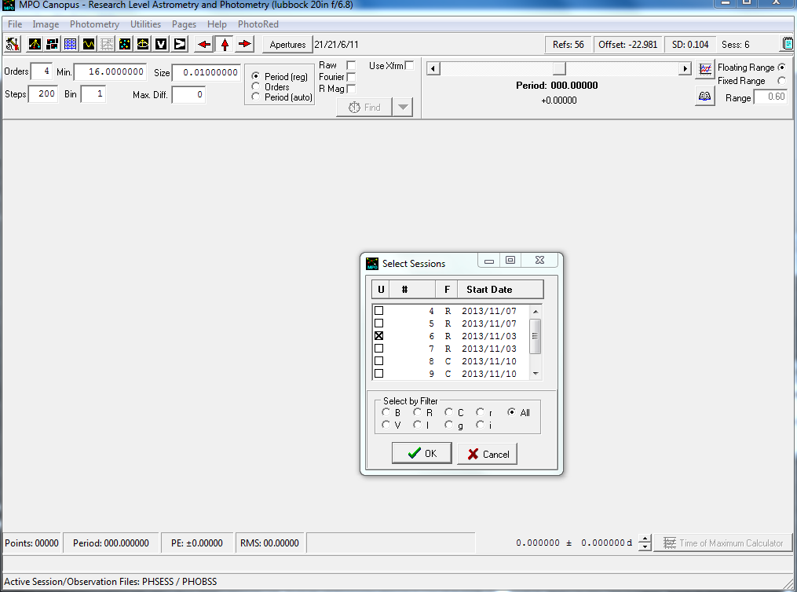

Slide 18
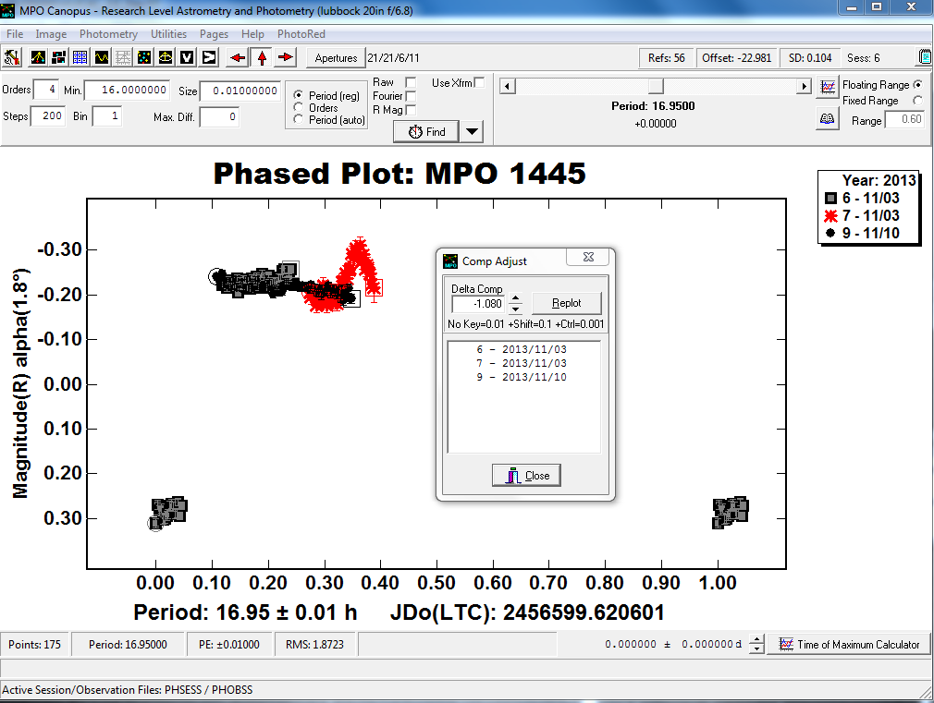

Slide 19
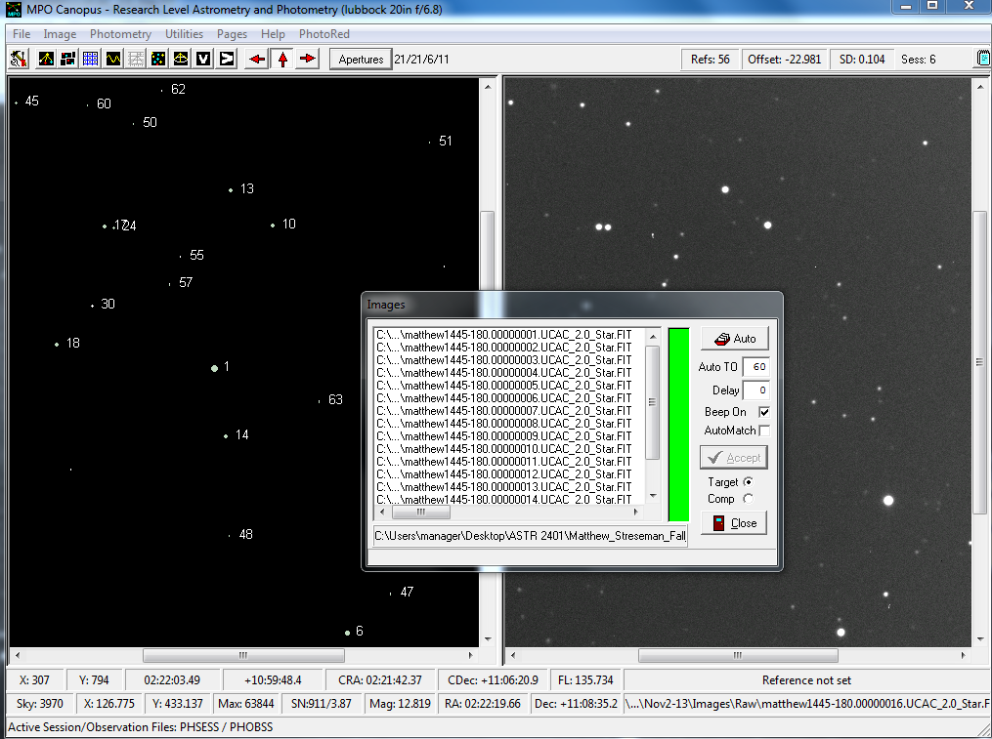

Slide 20
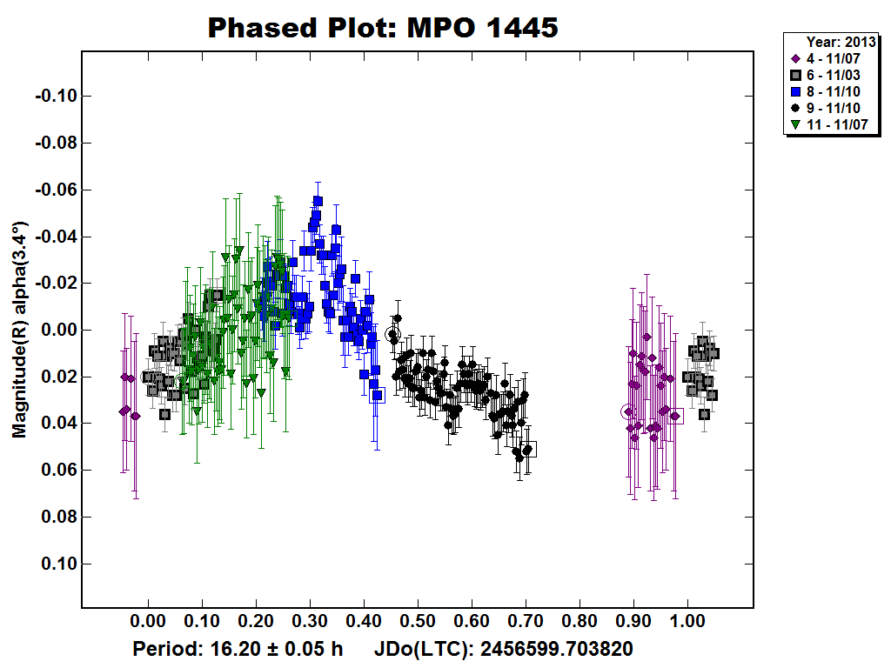

Slide 21
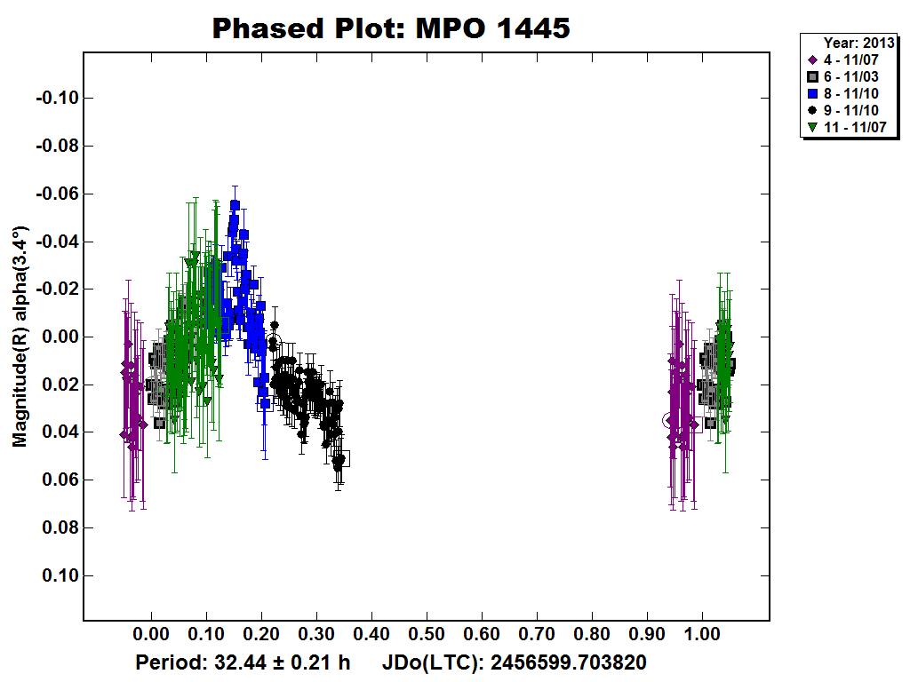

Slide 22
Conclusion
I found a potential rotation period of Asteroid 1445
  The results are not very confident
  More research could be done
    International collaboration
This was a learning experience

