Slide 1
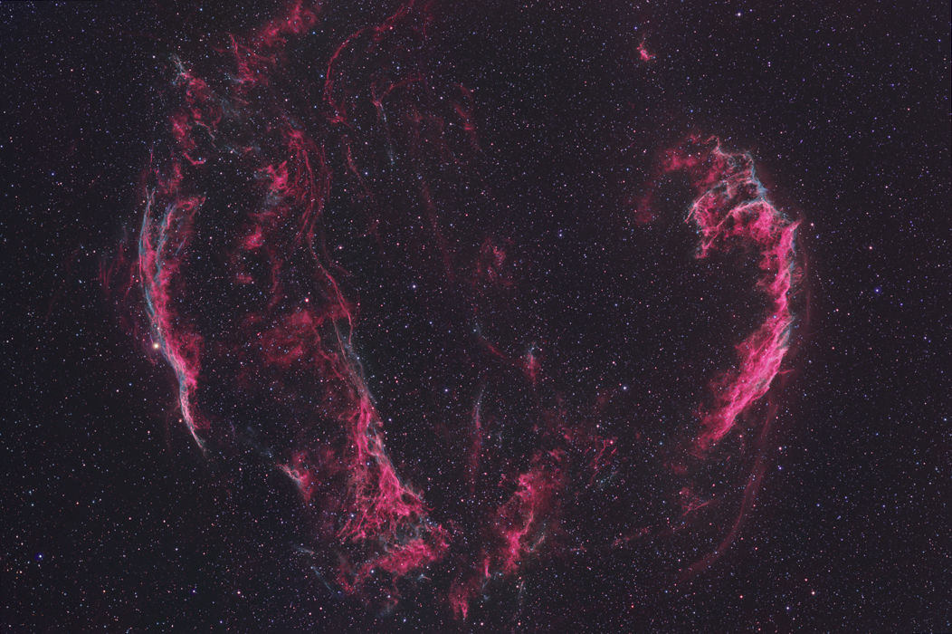
Veil Nebula (Cygnus Loop)
Catherine Fielder

Slide 2
Overview
Goal: Image the Veil Nebula!
Background - What It Is - Specs
- Narrow Bands
Data - Imaging - Processing
Conclusion

Slide 3
What is the Veil Nebula?
A supernova remnant interacting with the interstellar medium (rare).
Discovered on September 5, 1784 by William Herschel
Discovered photographically in 1904 by Williamina Fleming

Slide 4
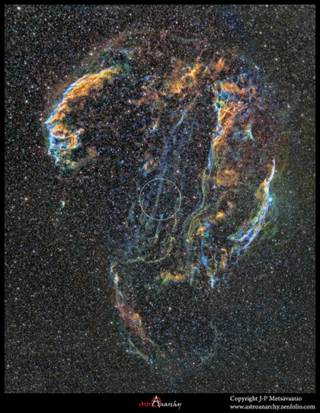
Size and Detail
~3° across
4° - 0.4°
Full Moon is 0.5°
Notorious filaments

Slide 5
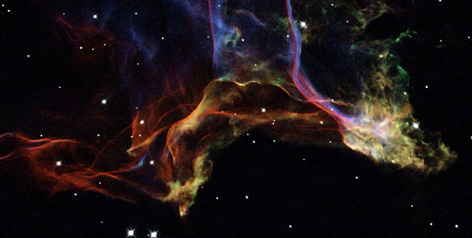

Slide 6
Specifications
Remaining core is either a NS or BH.
10Msun progenitor; Type II SN.
Visible, Radio, IR, X-ray, and UV emissions.
Faster parts still expanding at about 10⁶ km/hr

Slide 7
Age?
Much speculation over age: calculate with the Sedov Size-Age relation
D = 4.3·10⁻¹¹(E₀/n)^{1/5}t^{2/5}
440 pc away; 2400 yrs old; 25 pc diameter

Slide 8
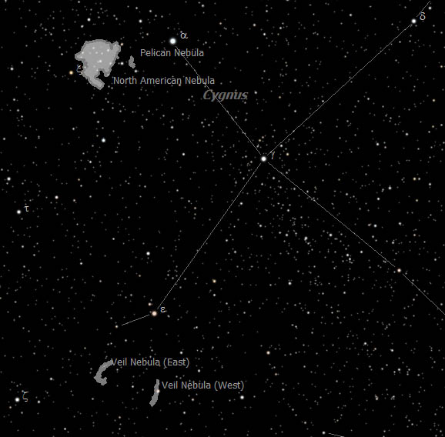

Slide 9
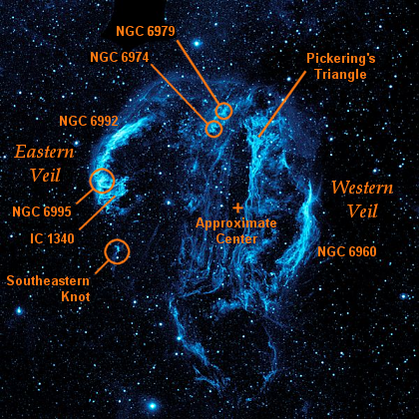
Map

Slide 10
Emission Nebula
Clouds of hot gas.
Atoms are typically excited by hot stars and emit radiation as they de-excite again.
In the Veil: SN shockwave excites the interstellar medium.

Slide 11
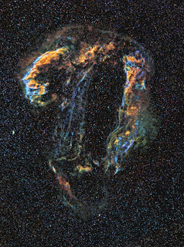

Slide 12
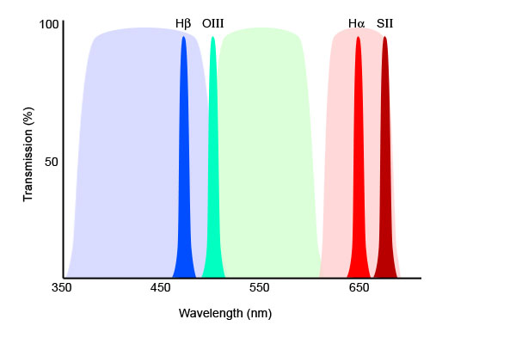
Narrow Band Imaging
Hα: 656.3 nm
SII: 672.4 nm
OIII: 500.7 nm
Great for Emission Nebulae.
Can get better detail visually and scientifically.

Slide 13
Imaging the Veil
2 nights, one night per frame
5” telescope
CCD: SBIG STL Large Format Camera; -35°C
30 min. of Hα; 45 min. of SII and OIII each
No guiding!

Slide 14
Processing
CCDSoft
- image reduction
RegiStar
- alignment
Adobe Photoshop CS5
- color

Slide 15
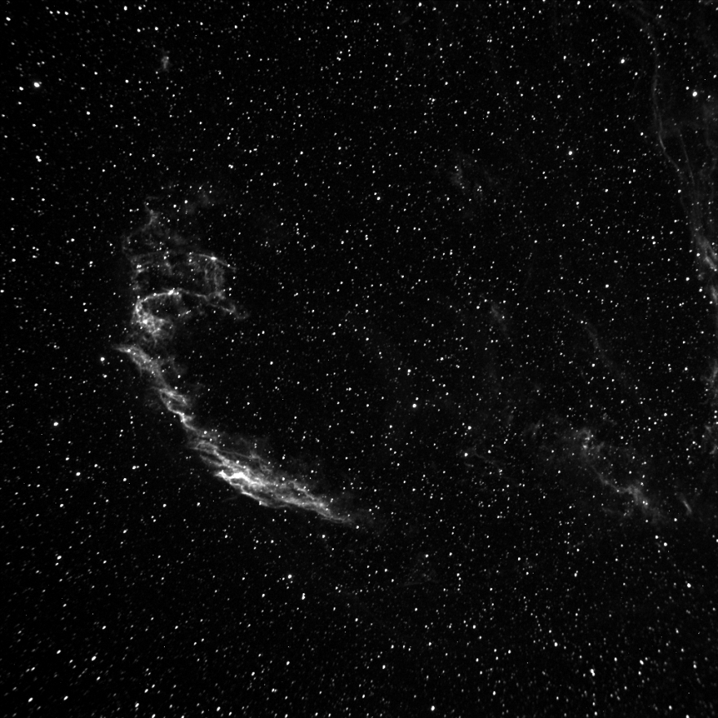
-

Slide 16
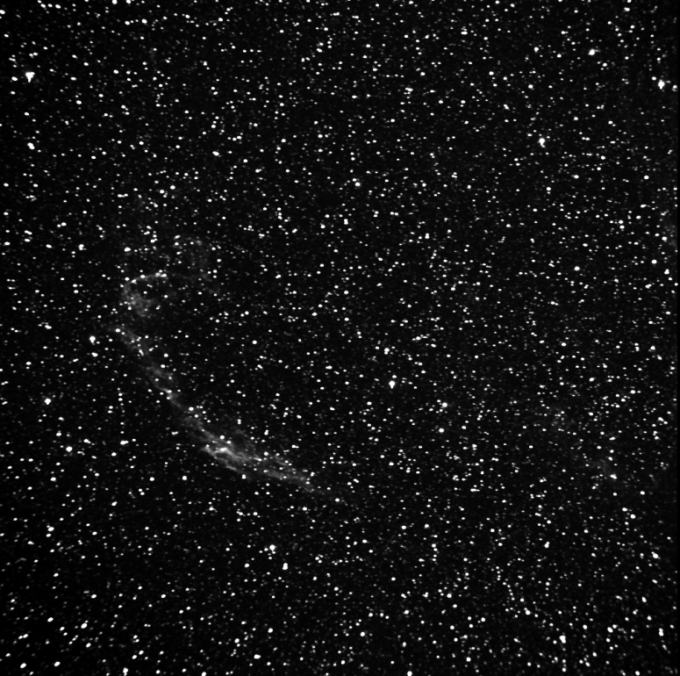
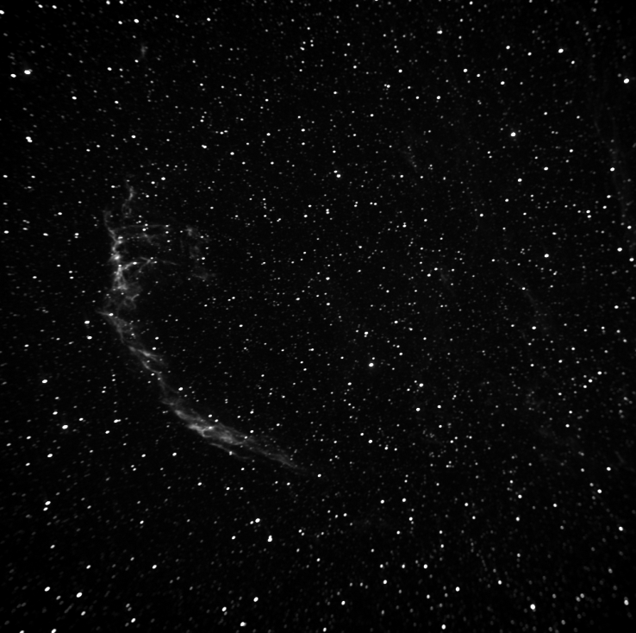
H
H-alpha
SII
OIII

Slide 17
Final Result

Slide 18
Conclusion
The Cygnus Loop is a very interesting and unique object.
A nice challenge for imaging.
Pretty!

Slide 19
Sources
http://astroanarchy.blogspot.com/2012_11_01_archive.html
http://www.astronomy-mall.com/Adventures.In.Deep.Space/Dissecting%20the%20Veil%20Nebula.html
http://observing.skyhound.com/archives/aug1/NGC_6960.html
http://en.wikipedia.org/wiki/Veil_Nebula
http://www.esa.int/Our_Activities/Space_Science/Hubble_uncovers_the_Veil_Nebula
http://www.skyfactory.org/veil/index.php
http://astroprofspage.com/archives/1500

