Slide 1
Stephan’s quintet
-by Matthew Johnson

Slide 2
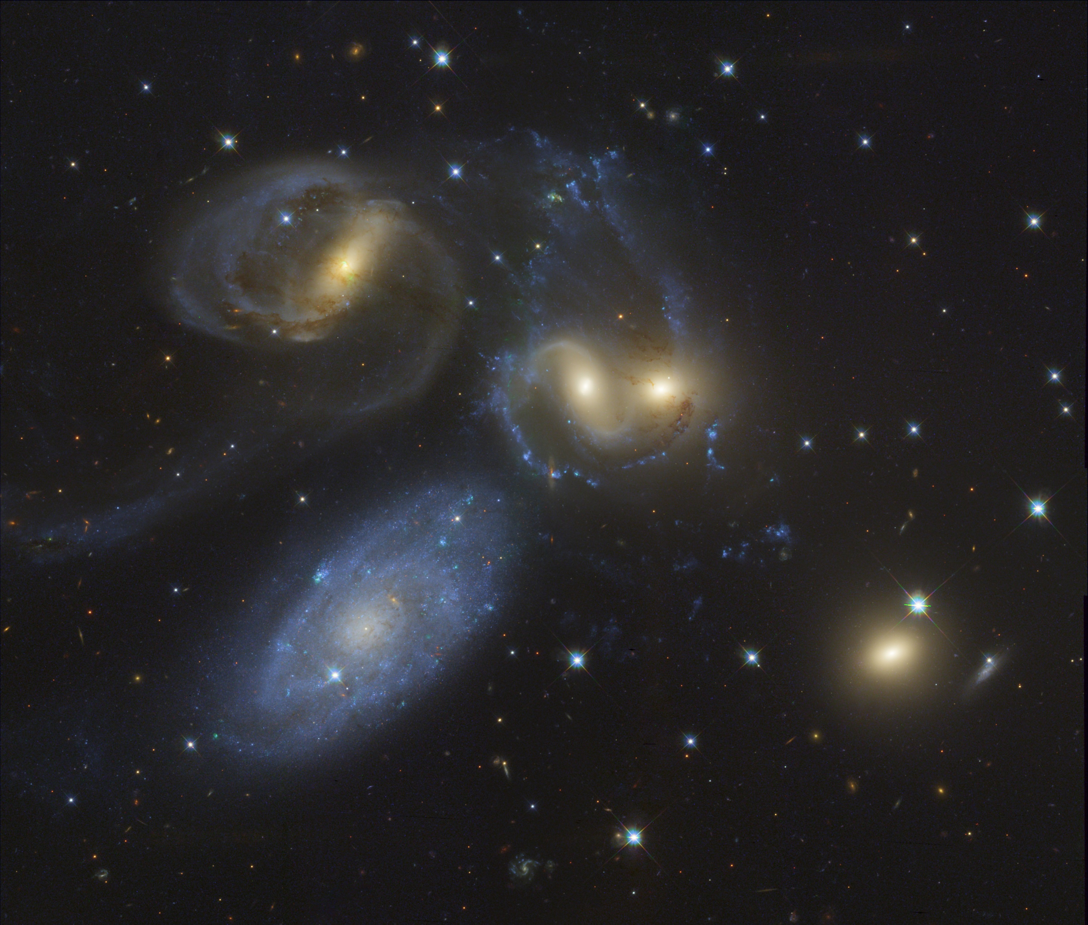
Overview
Why I chose Stephan’s Quintet
Information about the Quintet
How I obtained the images
Final Image

Slide 3

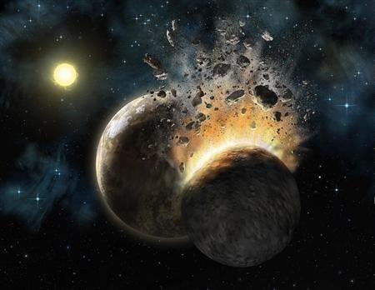
Why I chose this object

Slide 4
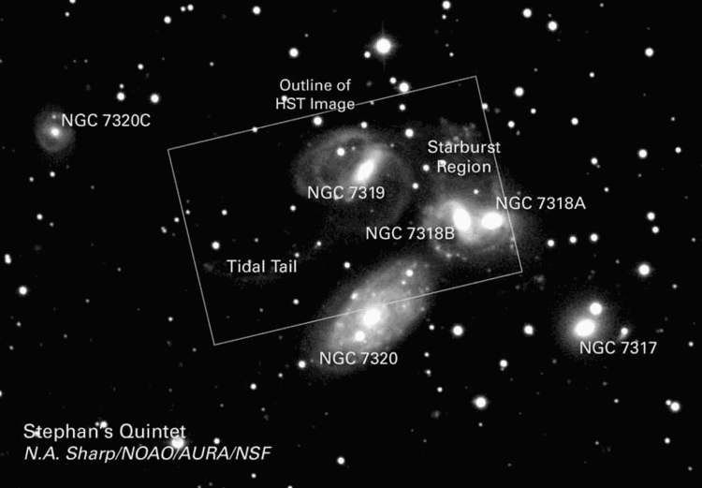
Stephan’s quintet
Édouard Stephan discovered his “quintet” in 1877 at the Marseille Observatory
Located in the constellation Pegasus
About 210-340 million light years from Earth (although NGC 7320 is ~40 million ly)
The molecular hydrogen seen in the starburst region is one of the most turbulent forms of molecular hydrogen ever seen.

Slide 5
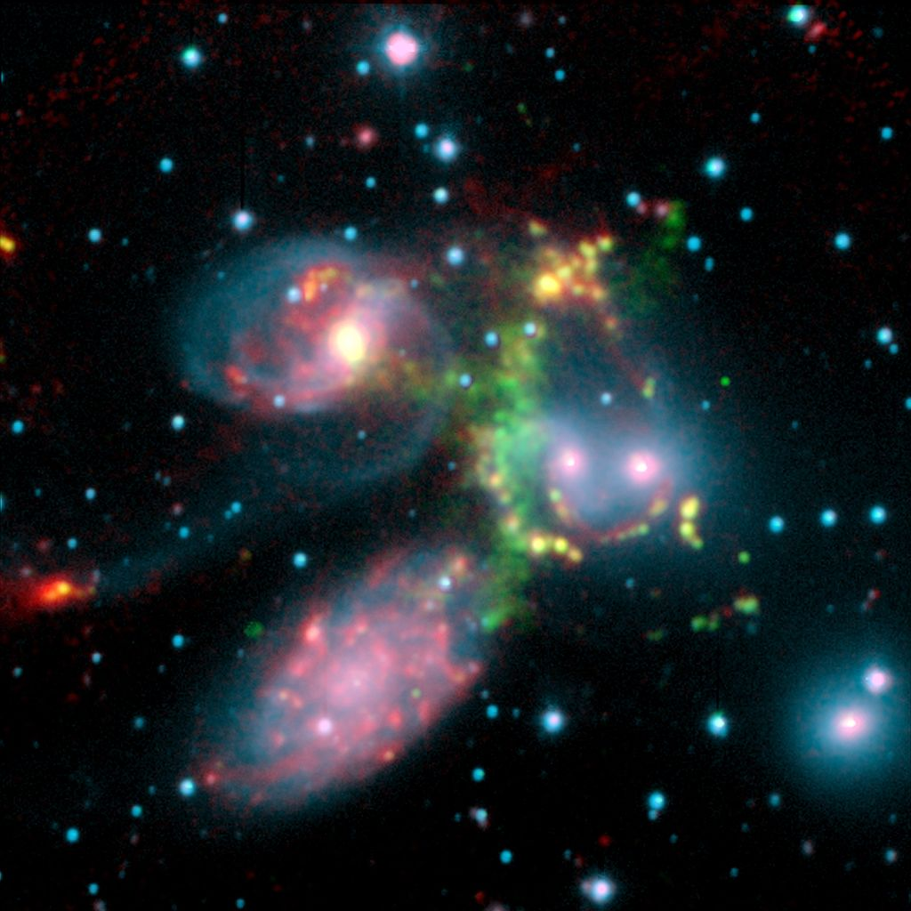
Stephan’s quintet
One of the fastest moving objects in the observable universe is a galactic shock wave (green) moving at several hundred million miles per hour.
This phenomenon is caused by the galaxy NGC 7318B (just to the right of the green gas)
The largest amount of molecular hydrogen ever observed

Slide 6
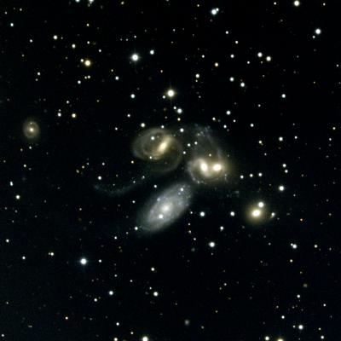
Stephan’s Quintet
This unusual system has often been used as proof that the redshift is not truly a distance indicator
Four of the galaxies have similar, large redshifts, the fifth (NGC7320), shows a much smaller redshift.
Conventional theory states that the low-redshift galaxy is in a nearby group and by coincidence appears on the sky projected against a distant background group.

Slide 7
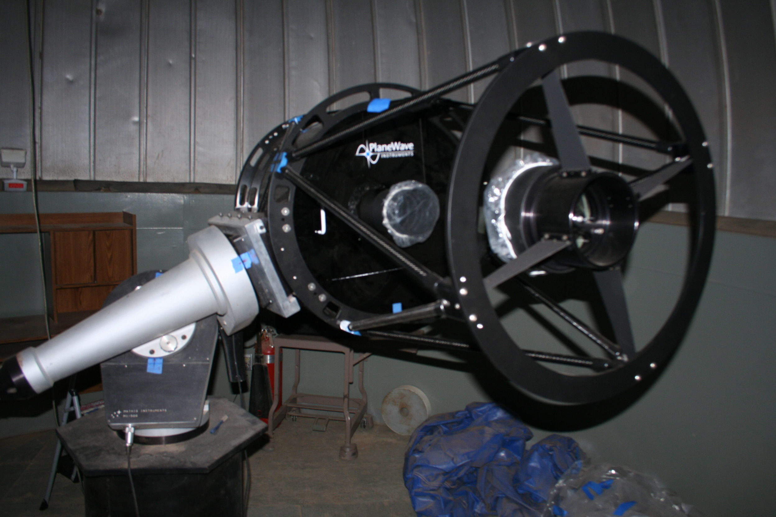
Taking images
20” Cassegrain Telescope
STL CCD-1001E
RGB Filters
20-3 minute clear images
10-3 minute RGB
I chose to use RGB filters instead of narrowband because the galaxies are so far away and so faint. If I were to use narrowband it would not bring forth much more detail than I already have.

Slide 8
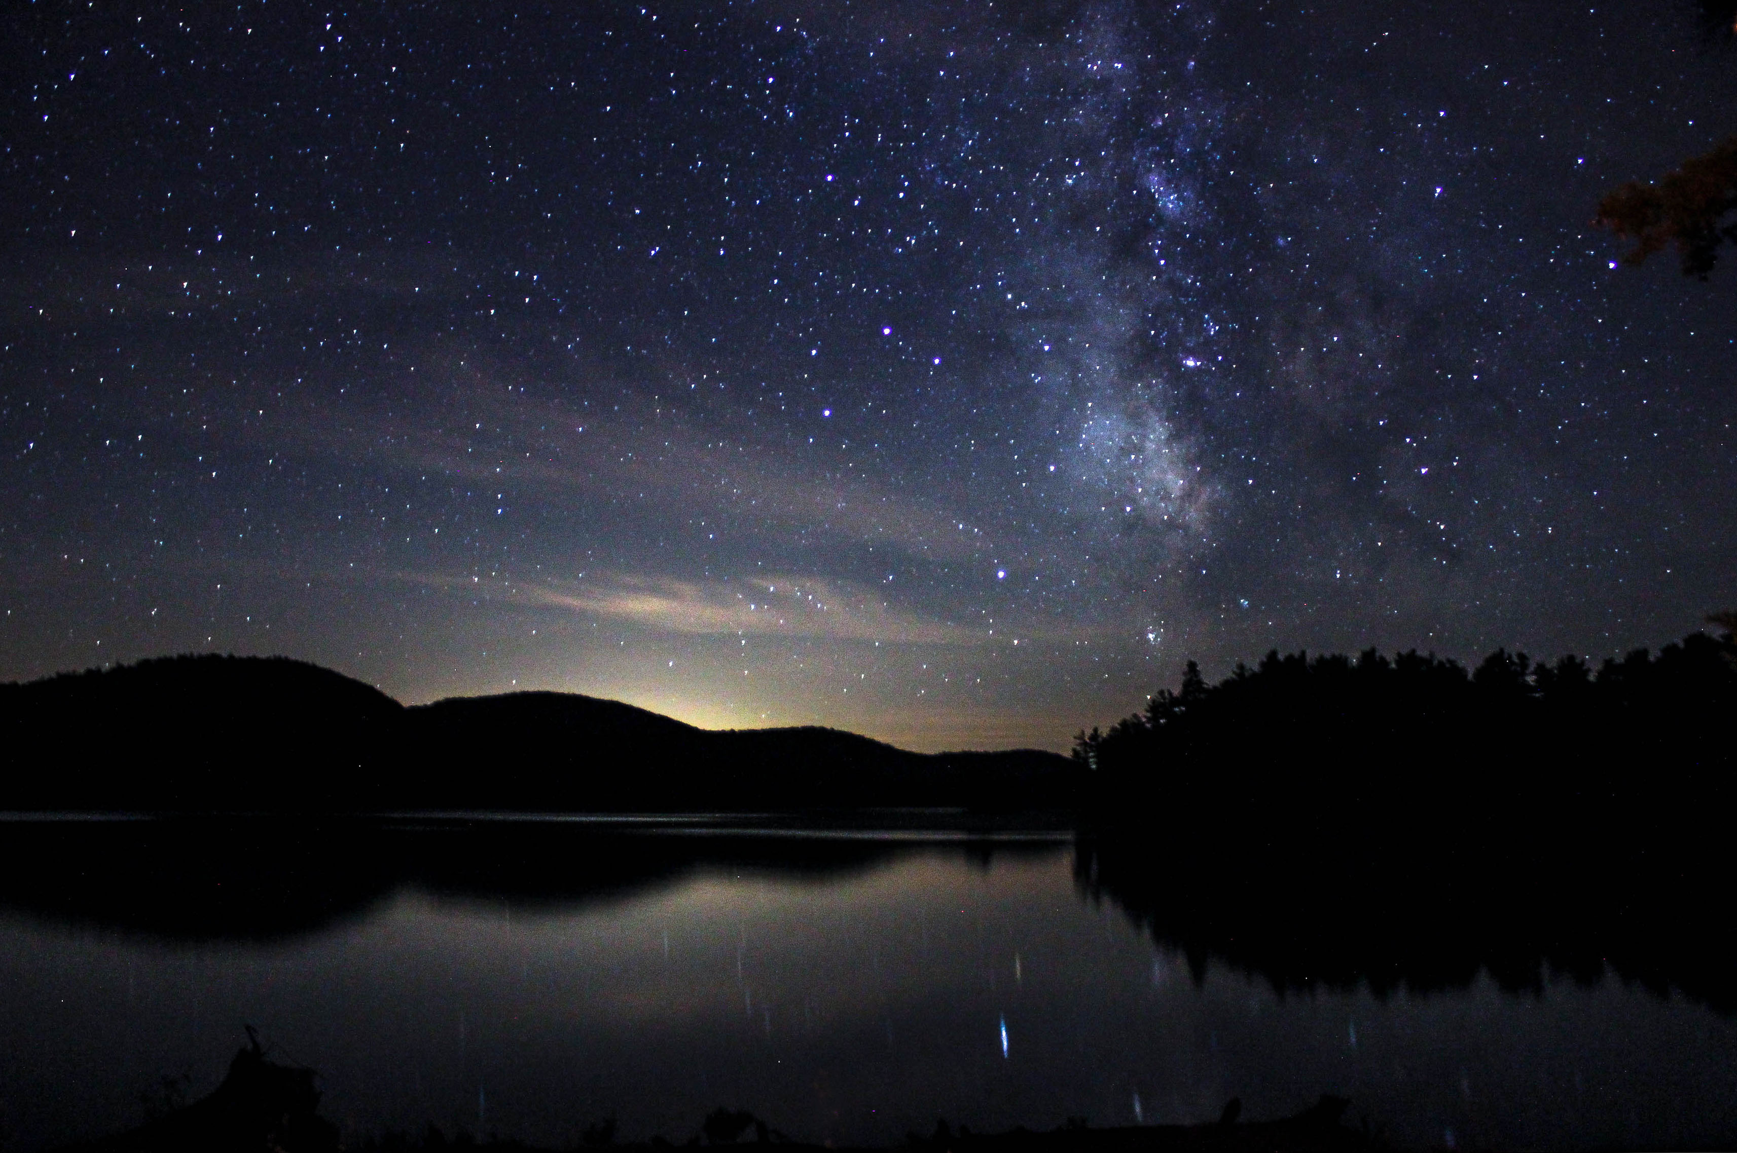
Taking images
Night 1:
Start Time: 1730 (5:30 pm)
End Time: ~0030 (12:30 am)
Never used the 20” by myself, so mainly a learning night
Result: 20 Clear Images

Slide 9
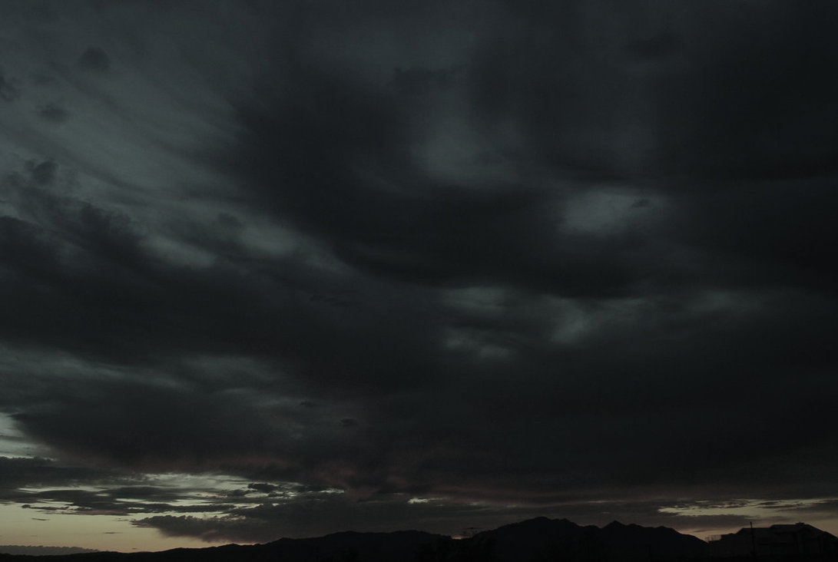
Taking images continued…
Night 2:
Start Time: 1700 (5:00pm)
End Time: 0030 (12:30am)
Mirrors were off. Took about an hour to fix, we got lucky!
After that we fix mirrors, CLOUDS!!
I wait an hour or so……MORE CLOUDS!!
Result: No usable data

Slide 10
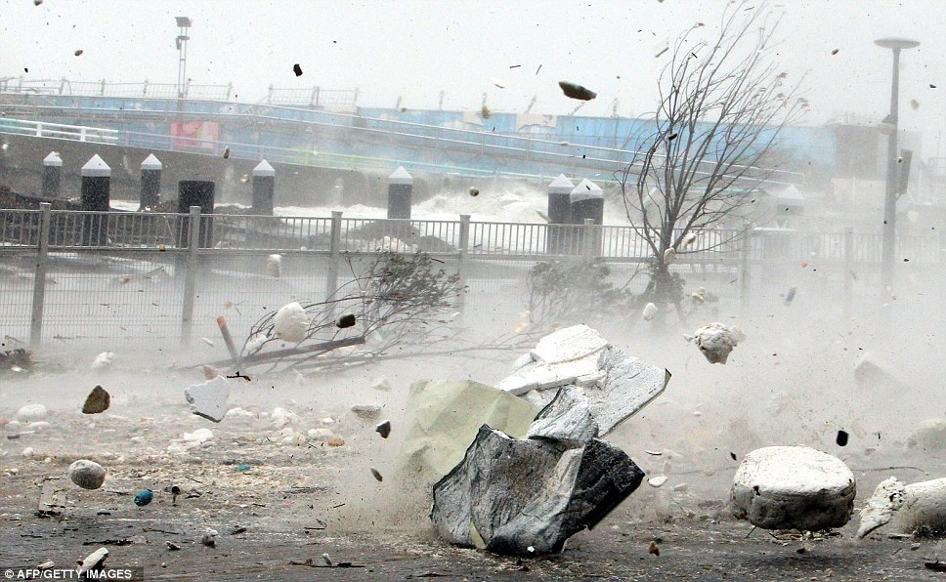
Taking Images continued…
Night 3:
Start Time: 1730 (5:30 pm)
End Time: ~2100 (9:00 pm)
Started out as a perfect night, temperature in the upper 60s, no wind…lets image!!
Then this happened:
Around 8:30 the temperature dropped 30 degrees in less than 5 minutes followed by what felt like 60 mph winds
Result: No usable data!

Slide 11

Taking images continued…
Night 4:
Start Time: 1730 (5:30 pm)
End Time: 0130 (1:30 am)
Clear..ish
Mild wind
20 degrees!
Result: 10 RGB images of each filter!

Slide 12
Final image!
With close to 40 hours of attempted imaging
-Freezing weather
-Tornado like winds
-Equipment malfunctions
Several hours of trial and error with Photoshop!
-Reduce
-Align
-Combine

Slide 13
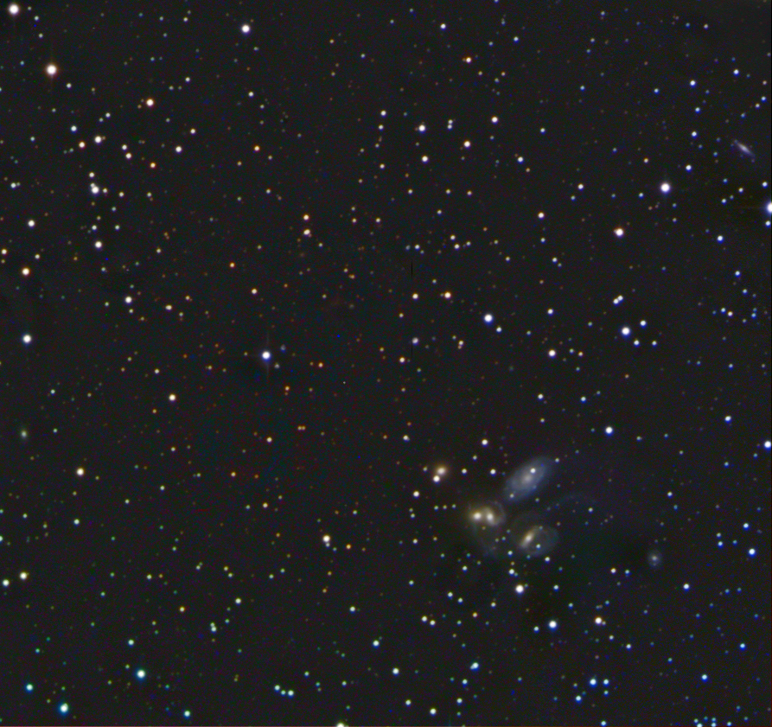
NGC 7317
NGC 7320
NGC 7318A
NGC 7318B
NGC 7319

Slide 14
References
http://www.phys.ttu.edu/~maurice/gott06.jpg
http://th00.deviantart.net/fs33/PRE/i/2008/239/6/5/Cloudy_Night_Sky_by_RamosBurrito.jpg
http://en.wikipedia.org/wiki/Stephan%27s_Quintet
http://under30ceo.com/wp-content/uploads/2014/08/Success.jpg
http://apod.nasa.gov/apod/ap140327.html
http://www.noao.edu/image_gallery/html/im0414.html

Slide 15

Questions?

