Slide 1
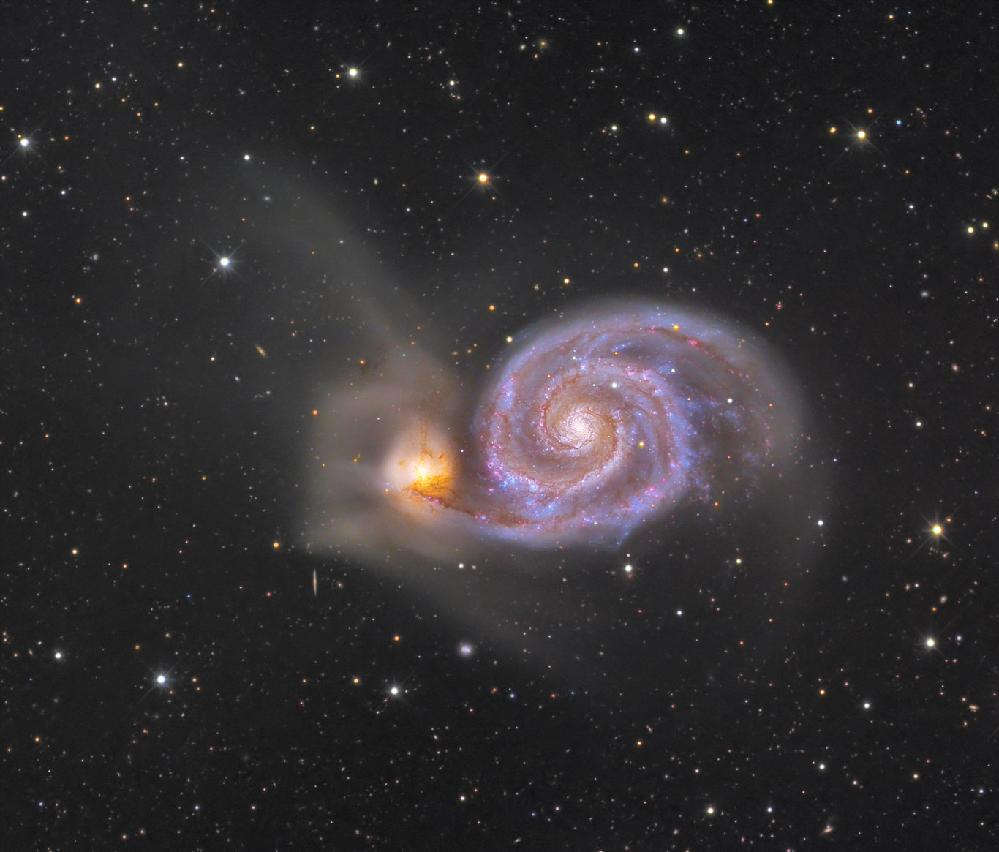
M51/NGC5194
The Whirlpool Galaxy
Marcus Fodor

Slide 2
Why I chose M51:
It’s a spiral galaxy. (Those make for pretty pictures)
It’s spiral arms are very prominent
It’s interacting with a dwarf galaxy (NGC 5195)

Slide 3
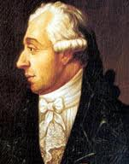
M51 Discovery and History
Discovered on October 13,1773 by Charles Messier
Companion NGC 5195 (M51b) discovered on March 21, 1781 by Pierre Méchain (a friend of Messier)

Slide 4
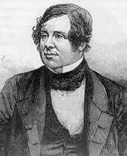
M51 Discovery and History
First object recognized as a Spiral
Lord Rosse (William Parsons) identified it as a spiral in 1845 at Birr Castle, Ireland
He sketched it

Slide 5
M51 Information
RA: 13h 30m 28s
Dec: +47 degrees 7’ 29”
Magnitude: 8.4
Size: 11x13.5 arcmin (about 124,000 ly in diameter)
Estimated mass: 160 billion solar masses
Found in the Canes Venatici Constellation
Distance from us is estimated at 37 Mly
Face on
Spiral shape believed to be caused by NGC 5195 passing through the main disk from behind about 500 million years ago and then passing through again from the front as recently as 50 to 100 million years ago

Slide 6
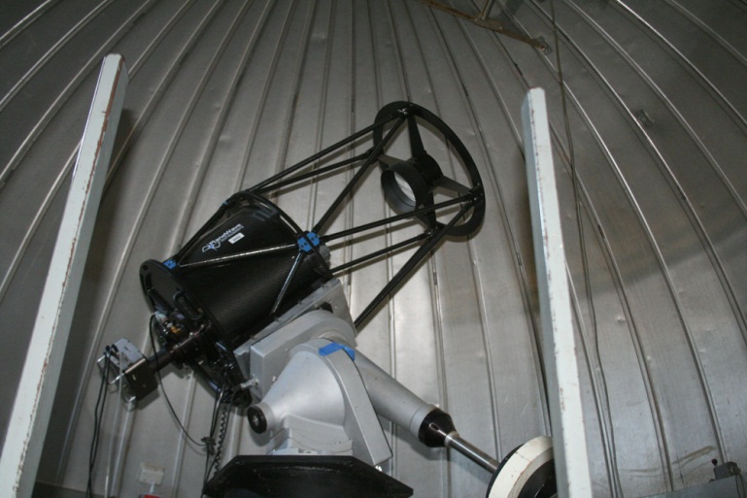
Imaging process
Telescope: 20” f/6.8 Cassegrain
CCD: SBIG STL-1001XE at -25C
Location: TTU Observatory
Date/Time: April 6, 2013, 8:15PM
Conditions: Clear, fairly calm for this area
I thought everything was going to be perfect.
I took my darks
Then, I went to begin my filtered images: red, blue, and green
But wait……

Slide 7
Imaging Process
The filter wheel is the one for narrow-band imaging!
Dr. Clark tried to change the filters without turning off the CCD
The result was having to completely reboot everything using up a solid 45 minutes

Slide 8
Imaging process
Ten 3-minute exposures on each filter in the order red, green, then blue, and finally unfiltered
Total time at the observatory: 3.5 hours

Slide 9
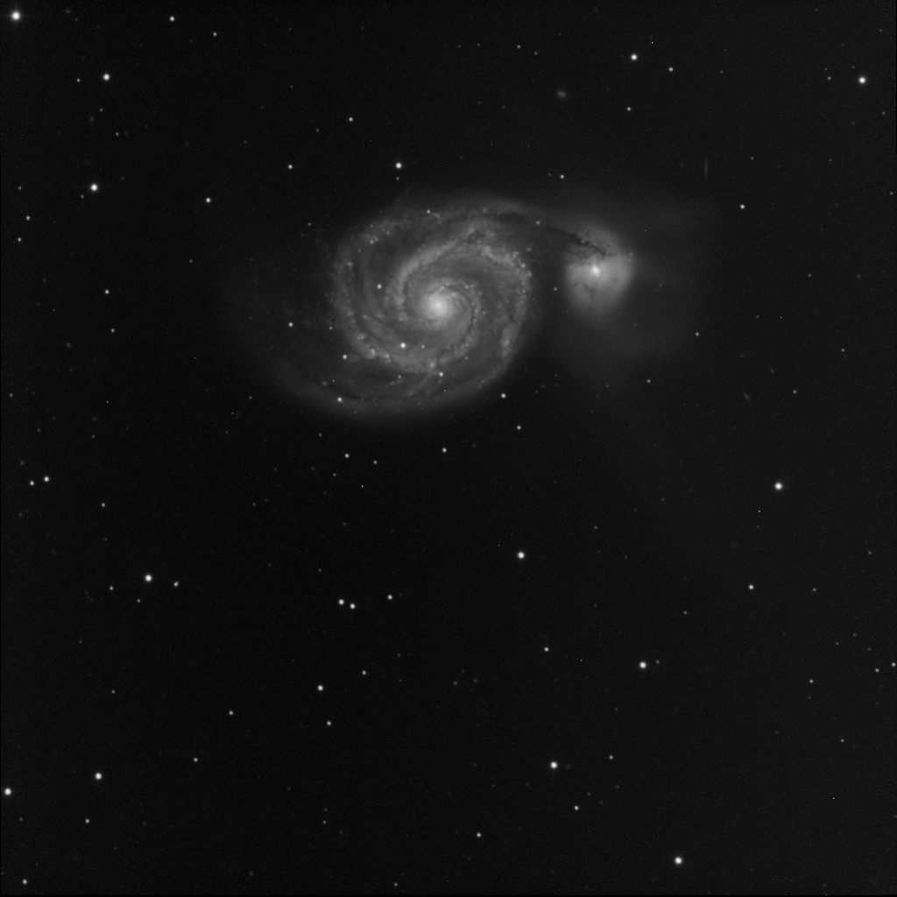
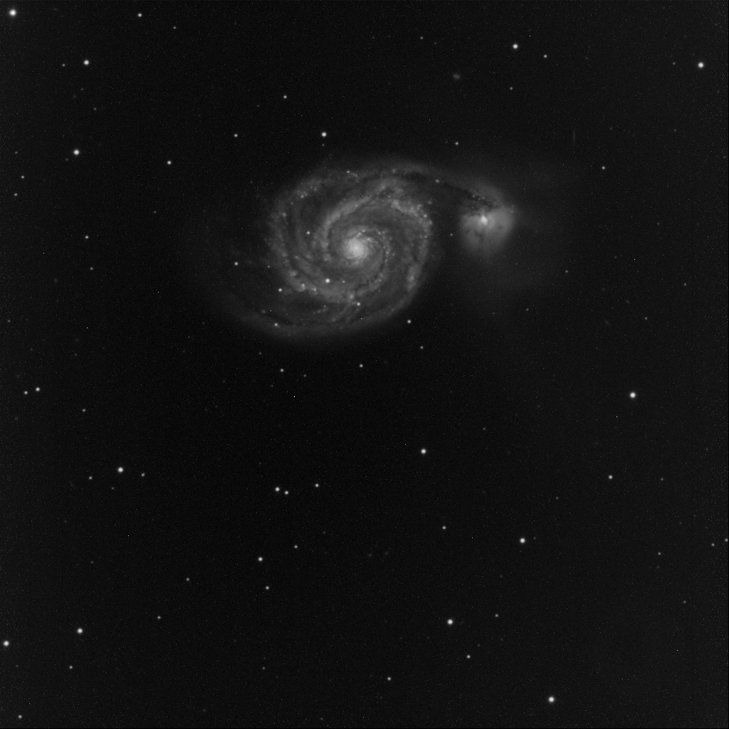
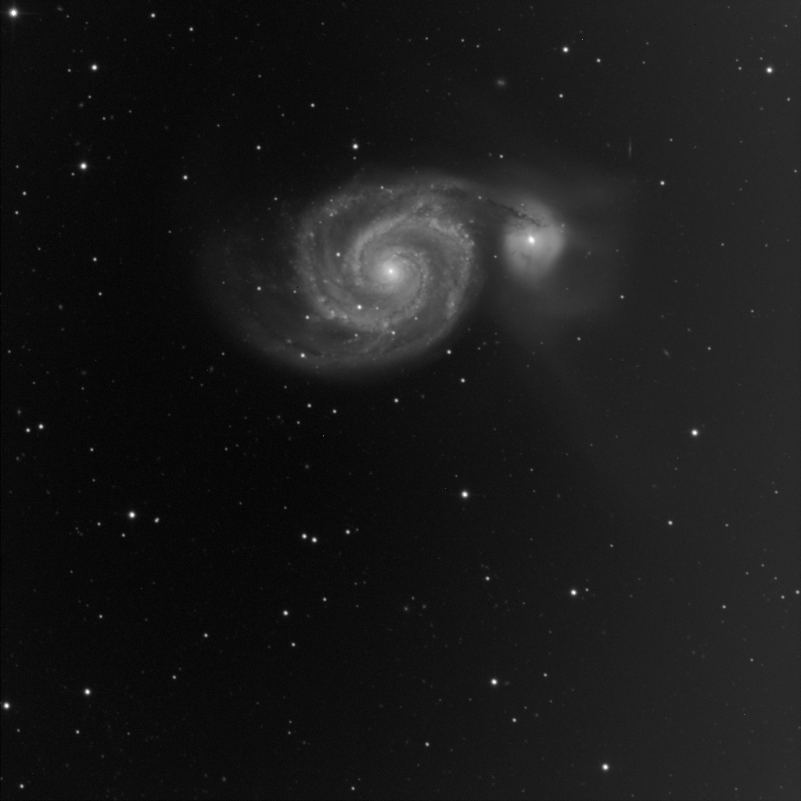
Image processing
CCDSoft
Reduce (dark subtract and flat field)
Combine (median)
Align

Slide 10
Image processing
Photoshop
Match the backgounds of the filtered images using levels
Merge the channels RGB
Adjust saturation, color balance, individual channel levels, and individual color balances until the image looks the way you want it.
Use Gradient Xterminator to get rid of the gradient

Slide 11
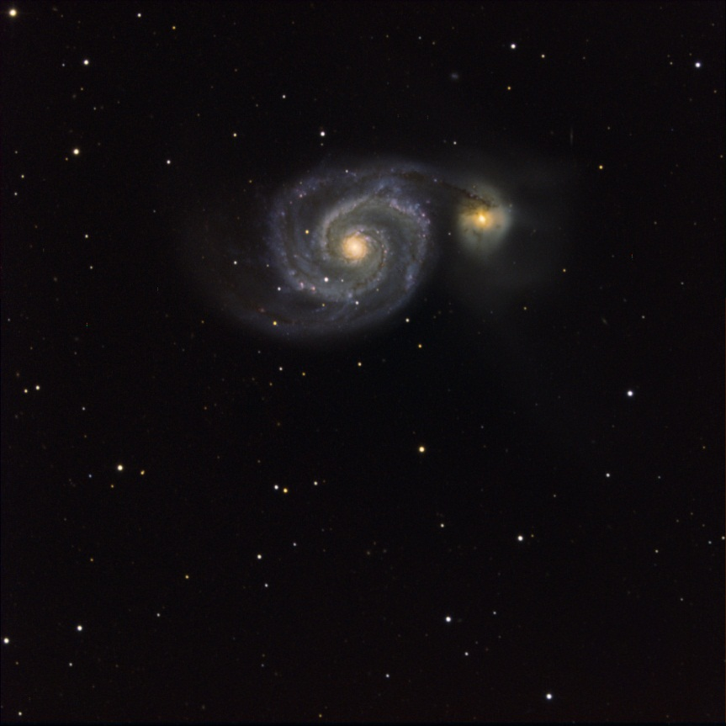
Image processing
Once satisfied with the color image, paste it over the unfiltered image to add luminance and color combine them.

Slide 12
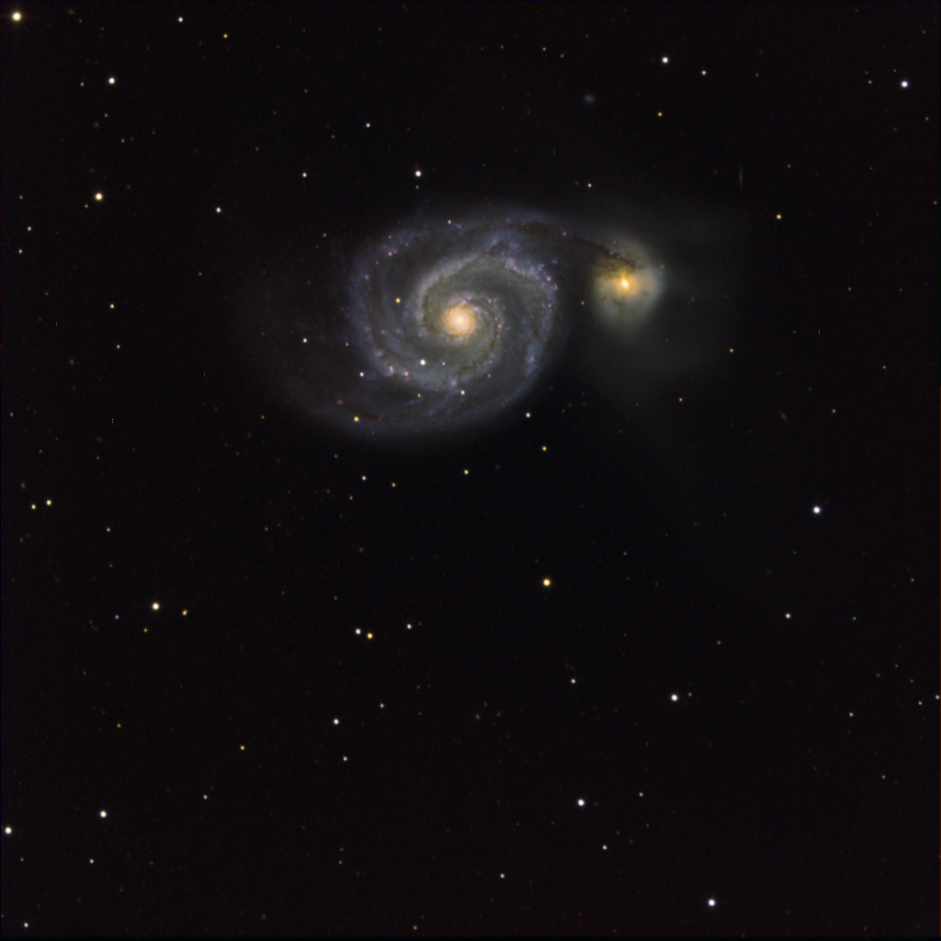

Slide 13
Sources
http://en.wikipedia.org/wiki/Whirlpool_Galaxy#Companion
http://messier.seds.org/m/m051.html
http://coolcosmos.ipac.caltech.edu/cosmic_classroom/multiwavelength_astronomy/multiwavelength_museum/m51.html
http://apod.nasa.gov/apod/image/0905/m51deep_christensen_big.jpg
http://www.phys.ttu.edu/~ozprof/20inskyview01.jpg

