Slide 1
Mahfuz Krueng Asteroid 1825 Klare (1954 QH)

Slide 2
1825 Klare
Objectives
What and Where?
Observation
Data Analysis
Previous Research
Further Works

Slide 3
Objectives
Experience
- professional
- stepping “stone”
More Science
Photometry
- wide
- contribution

Slide 4
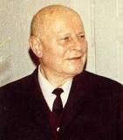
What and Where?
Diameter: 30 KM
Main-Belt Asteroid
Karl Reinmuth
August 31, 1954
Heidelberg, Germany
Magnitude: 15.56 (Absolute:11.8)
Orbit
Period: 1599 days; 4.3 years
Semi-Major Axis: 2.68 AU
Eccentricity: 0.114
Inclination: 4.03 degrees
Rotation Period: 4.744 hours [Asteroid Lightcurve DataBase (Rev. 2012-Nov-10)]
www.klima-luft.de

Slide 5
Current Location
MPCLINUX

Slide 6
Observation
Four Sessions
Aperture: 20” Mirror
Planewave Cassegrain (f/6.8)
CCD Camera: SBIG STL-1001XE
Softwares:
TheSky6
CCDSoft

Slide 7
Observation
3 minutes exposures
(Session 1) 58 –April 3, 2013 (Dr. Clark)
(Session 2) 28 – April 7, 2013 (Dr. Clark)
(Session 3) 38 – April 13, 2013
2 minutes exposures
- (Session 4) 68 – April 22, 2013
Calibration frames
Total: 192 images, 8.5 hrs
Problems
-clouds, moon, dawn, dust

Slide 8
Data Analysis
Softwares:
- CCDsoft
- MPO Canopus
- calibration
- ligthcurve

Slide 9
Data Analysis
Auto-match
Target

Slide 11
Data Analysis
Rotation Period = 1/5 of Earth day
More data: 5 hours continuous

Slide 13
Previous Research

Slide 14
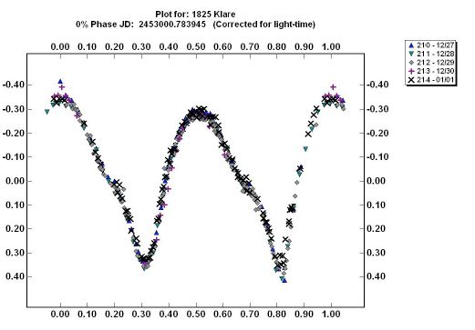
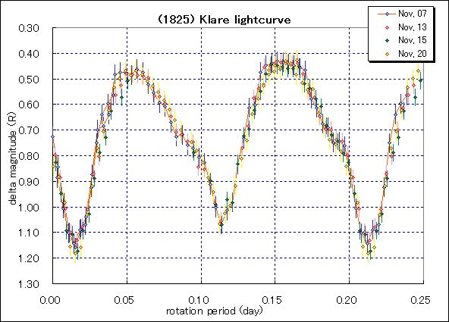
03/04
03/04
4.744+-0.009h
0.75+-0.02m
Pray, D
*1
*2
4.7429± 0.0003h, 0.9±0.1mag
Clark, M
07
Hamanowa, H
0.721 +/- 0.005 mag
*3
Galad, A
*4

Slide 16
*3

Slide 17
Further Works
Complete Data
New software
3-D model

Slide 18
References
1- [Pray, D. (2004) Minor Planet Bul. 31, 34-36.]
2- [Clark, M. (2006) Minor Planet Bul. 33, 53-56.]
3- [Behrend, R. (2007) Observatoire de Geneve web site, http://obswww.unige.ch/~behrend/page_c ou.html]
[Hamanowa, H.; Hamanowa, H. (2011) http://www2.ocn.ne.jp/~hamaten/astlcdata.ht m] 4- [Galad, A. (2008) Minor Planet Bul. 35, 128-131.]
JPL Small-Body Database Browser on 1825 Klare

