Slide 1
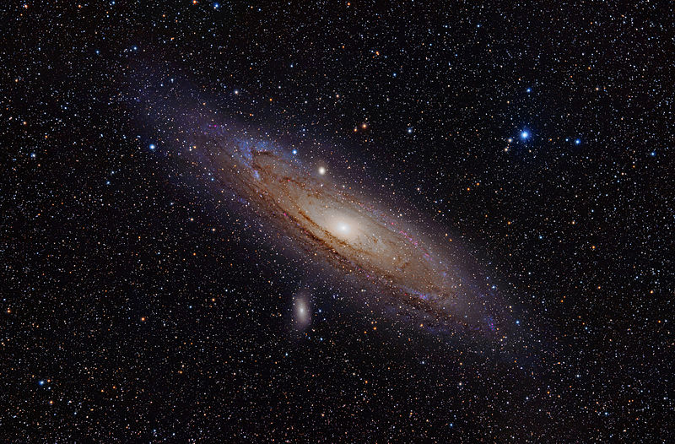
M-31 The Andromeda Galaxy
Jeff Rebarchik – ASTR 2401

Slide 2
M-31 The Andromeda Galaxy
Why M-31?
A Brief History
Facts About the Galaxy
Observation Record
Processing and Images

Slide 3
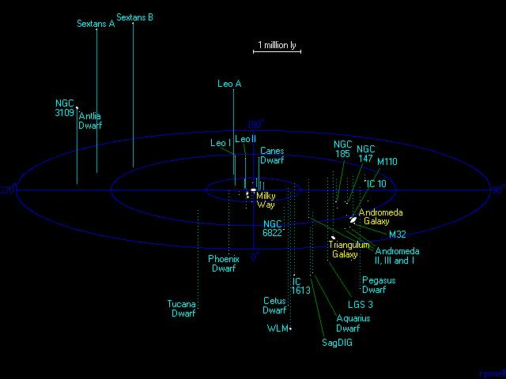
Why M-31?
Personal Observation History
Good Point to Start
General Facts Particular to this Galaxy Make It Interesting

Slide 4
Historical Data
First viewed in 964
In 1612, first viewed with a telescope by Simon Marius
Designated M-31 in 1764
First Photographed by Issac Roberts in 1887

Slide 5
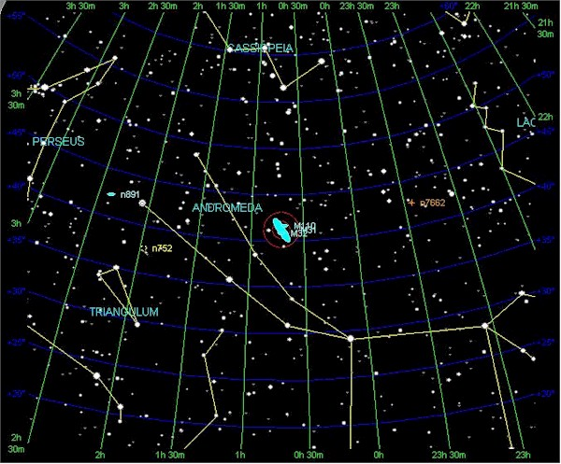
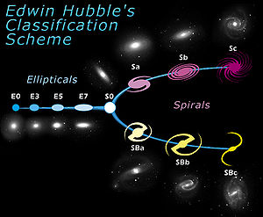
Factual Data (Pretty Cool Stuff)
Look UP (that way)
R.A. 00H 43M 26S, Dec. 41°20’22”
A whole lotta stars
A Sb what?

Slide 6
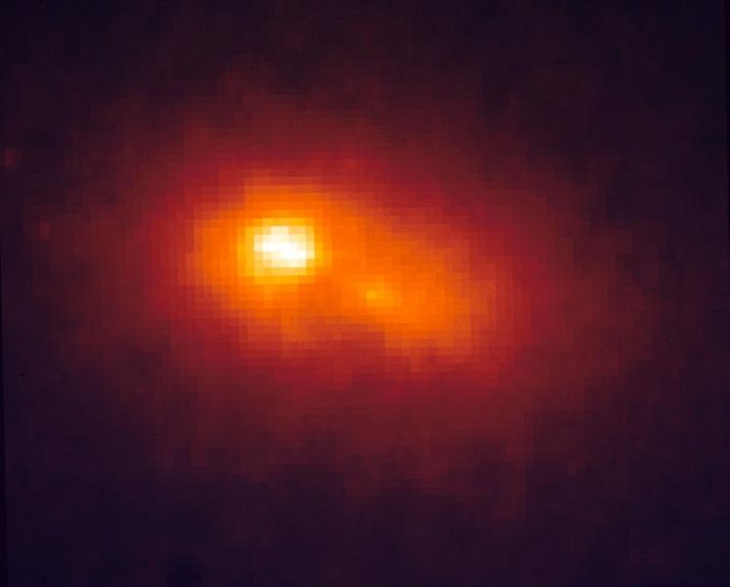
Interesting…..(Really Cool Stuff)
The gravity of the situation
Dual Core Power!!

Slide 7
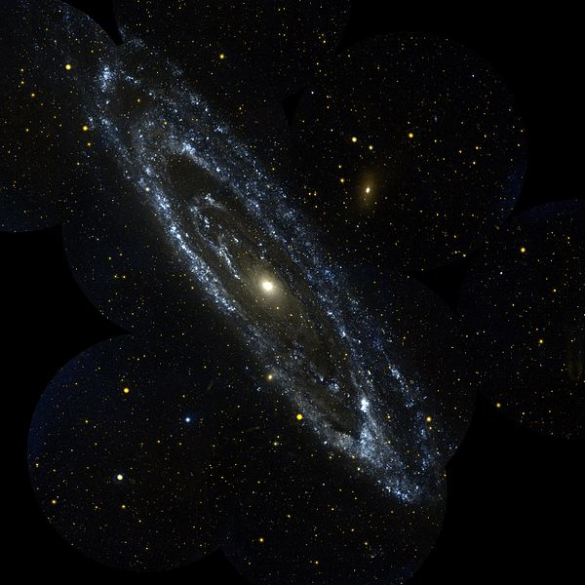
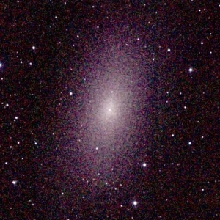
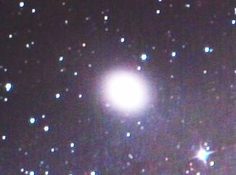
Interesting…..(Really Cool Stuff)
Spiral Stuff Solved!
Hubble’s a genius!
That’s no one Galaxy, it’s 15.
M-32
M-110

Slide 8
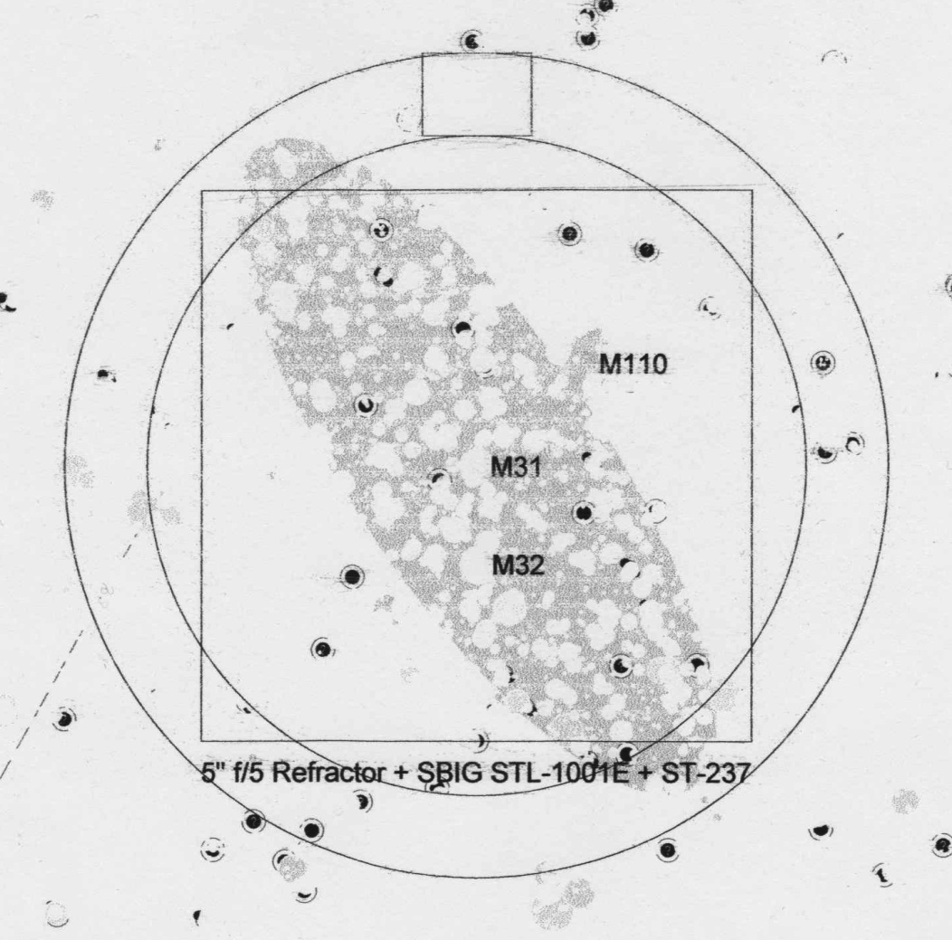
Observations
Cold nights at the TTU Observatory
Nov.15 and Nov. 22, 2011
5” f/5 Refracting Telescope
STL-1001E CCD Camera
1 Minute exposures
Red, Green, Blue filters

Slide 9
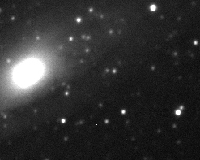
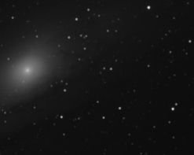
Image Processing
Getting what you want, not what you see….
+
=

Slide 10
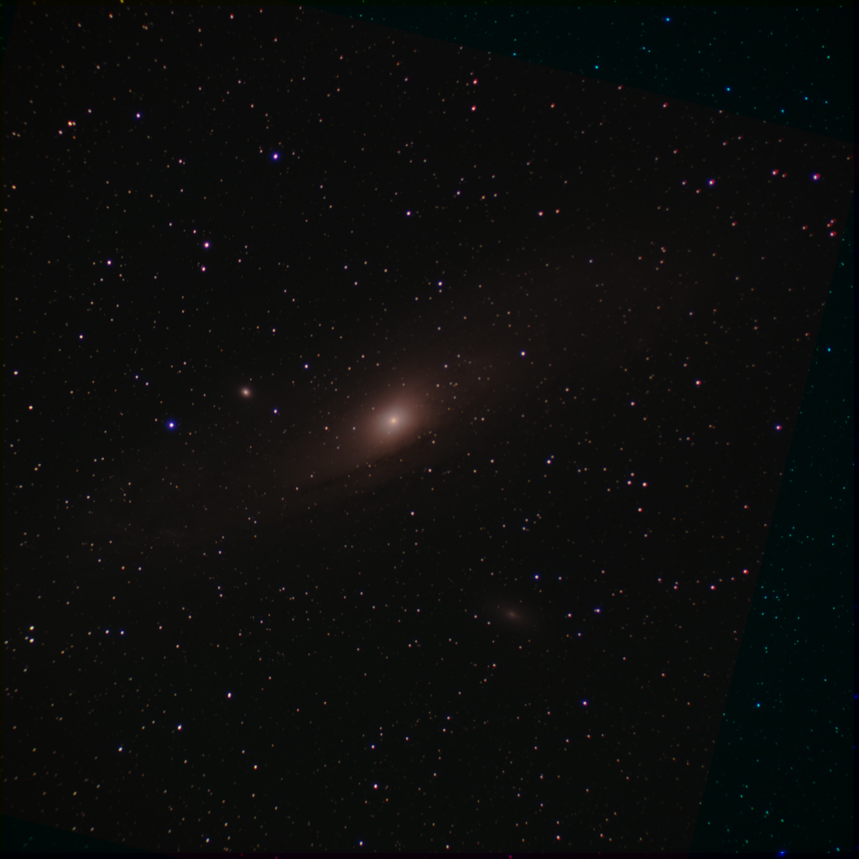
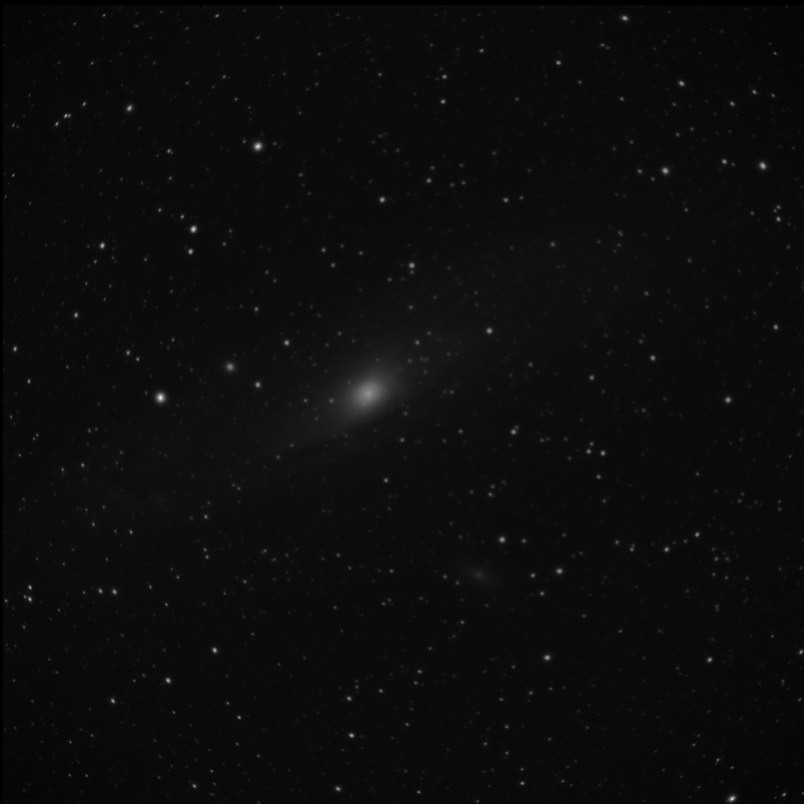
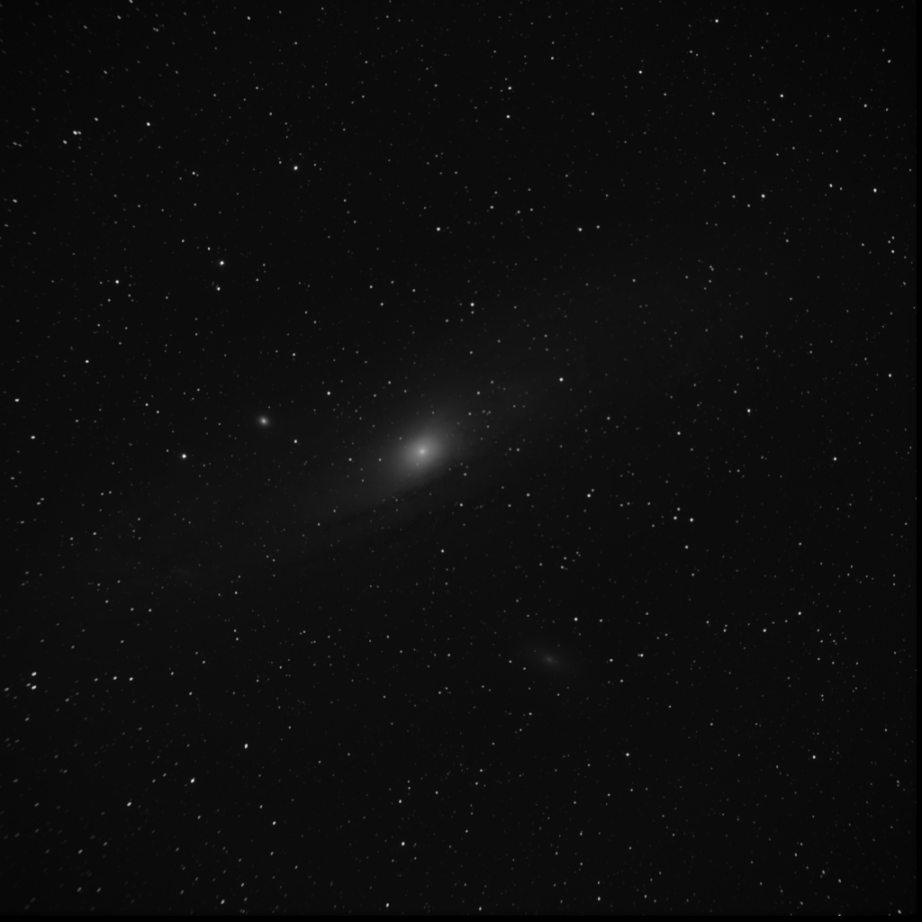
Making Color

Slide 11
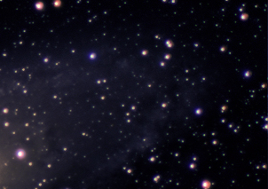
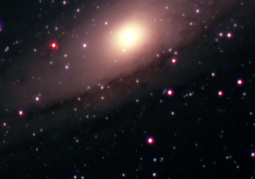
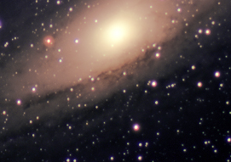
Final Processing
Color Levels
Color Curves
Selective Color
Hue/Saturation
Color Balance

Slide 12
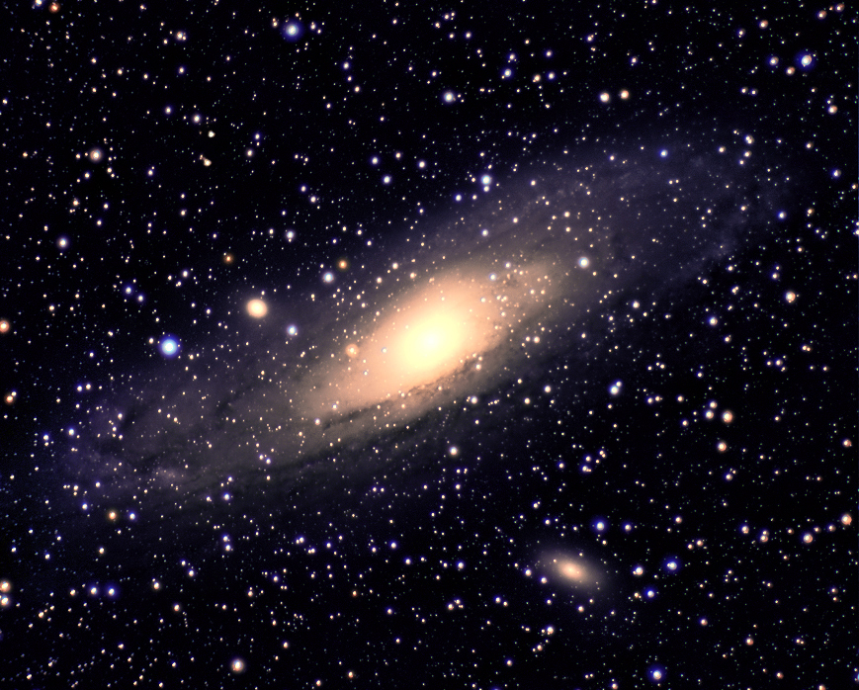

Slide 13
Older, Reddish stars in galactic core
M-32
Ring Structure and Young, Blue Stars in Outlying Arms
M-110
Dust Lanes in Spiral Arms

Slide 14
Inevitable Fate

Slide 15
References
http://en.wikipedia.org/wiki/Andromeda_Galaxy
http://apod.nasa.gov/apod/ap100109.html
http://hea-www.harvard.edu/~fine/Tech/desktop-images.html

