Slide 1
The Heart Nebula
John Hefele
Nov. 23, 2014

Slide 2
Heart Nebula Basic Information
Other Names: IC 1805, Sh2-190
Object Classification: Emission Nebula
Distance: 7,500 Light Years
Size: 180 Light Years, 20 Arc Minutes across
Age: 7 Million Years
Notes:
Index Catalogue (IC), Perseus Arm of the Galaxy in the constellation Cassiopeia, a beautiful and vain/arrogant queen who’s daughter is Andromeda. It is a star forming region

Slide 3
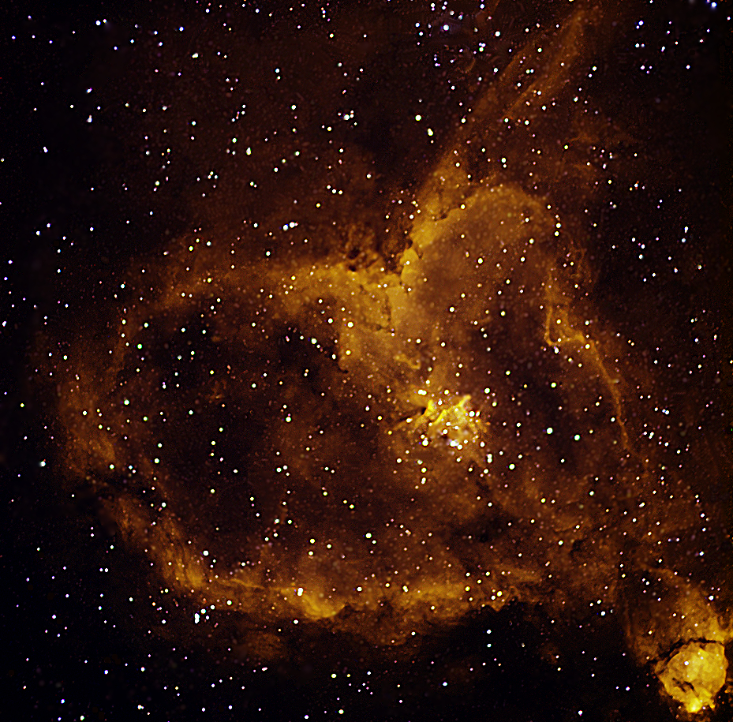
Melotte 15
NGC 896
Notes:
The majority of the nebula emission comes from a small group of stars in the nebula’s center. This contains a few bright stars which are 50 times more massive than our sun meaning they are about 800 thousand times brighter than our sun using the standard mass luminosity relationship of L=m^3.5. Melotte 15 is approximately 30 lights years across, and is only 1.5 million years old.

Slide 4
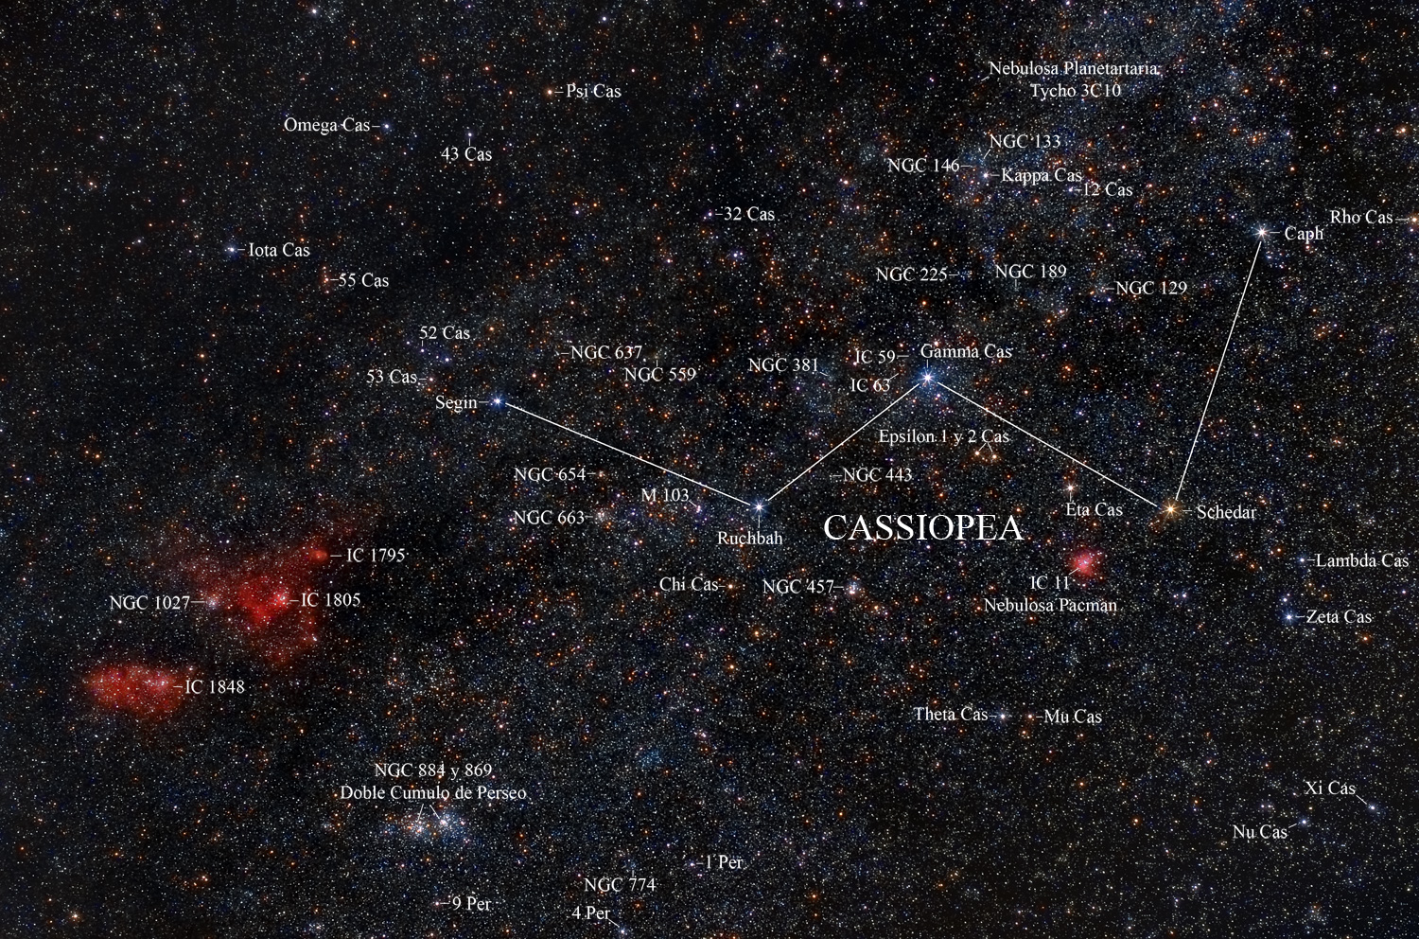
Heart Nebula
Notes:
The nebula below the Heart Nebula is known as the “Soul Nebula”

Slide 5
Data Acquisition
Date Gathered: October 28, 2014
Telescope: Jager 5” f/5” Refractor
CCD: SBIG STL-1001 E
Images Taken:
-15 H-Alpha
-20 OIII
-20 SII
-5 Darks
Notes:
The scope was manual, so Dr. Clark had to get the nebula within the CCD focus tool because I don’t know how to use star maps. Each image was a 3 minute exposure, flats were not needed because it was narrow band. There were clouds, but they stayed just low enough, and there were planes

Slide 6
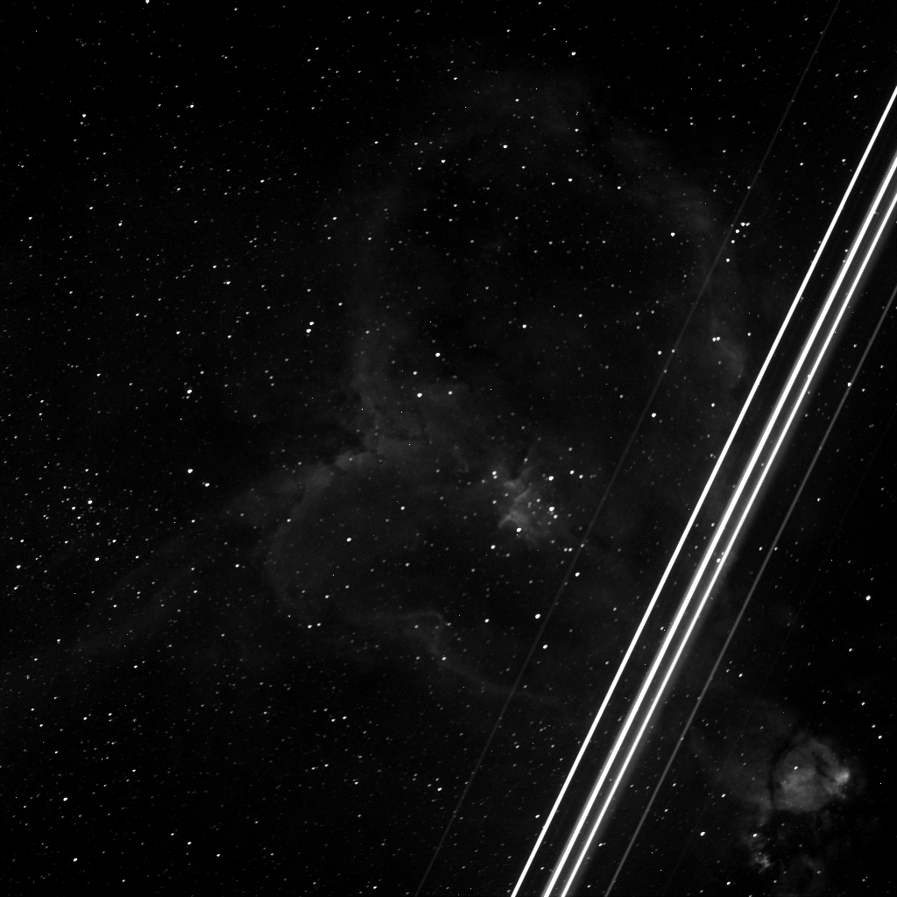

Slide 7
Data Processing, CCDSoft
-I first created 3 separate images from my H-Alpha, SII, and OIII data sets.
-From here, I removed the images’ hot and cold pixels
-The images were then aligned on each other in preparation of the next steps
Notes:
For this I created 3 separate folders for reducing the images with respect to the darks, aligning and combining in the median and add style. Because of this, it was necessary to align the each image on each other.

Slide 8
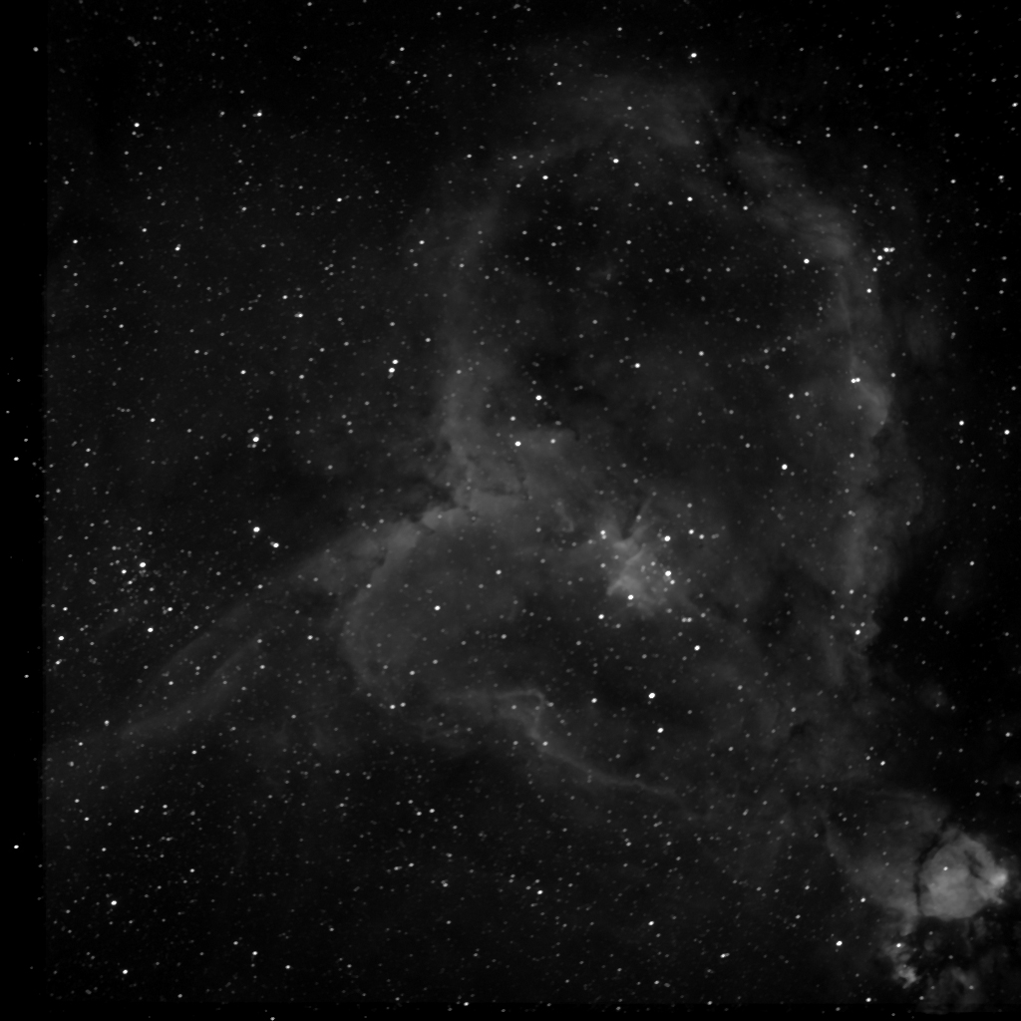
H-Alpha Image
Notes:
I decided to use the add-combined images because more detail was visible

Slide 9
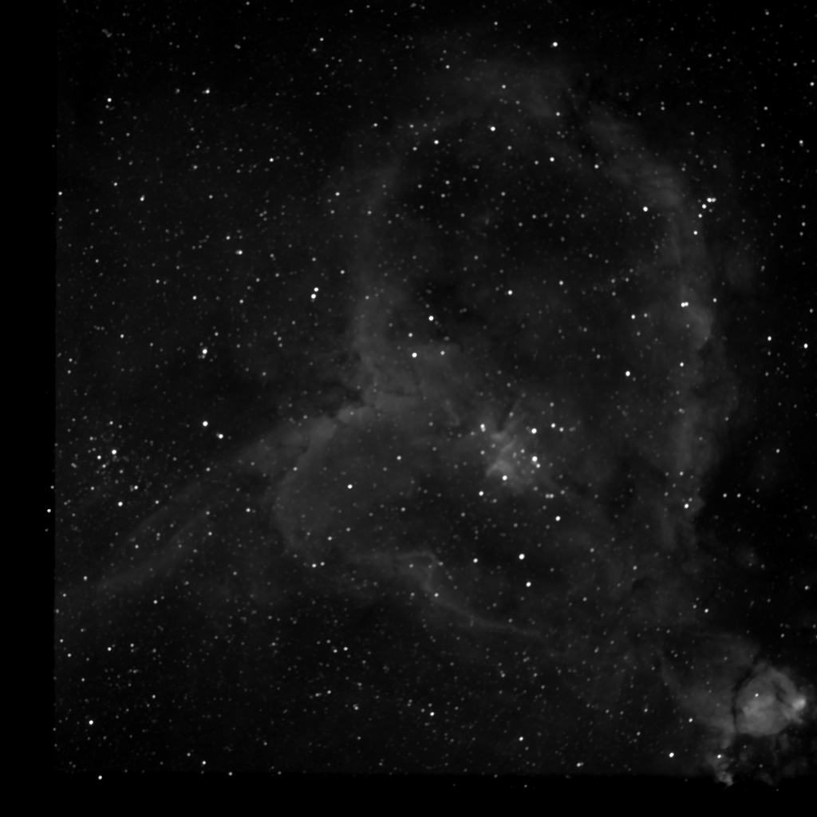
SII Image

Slide 10
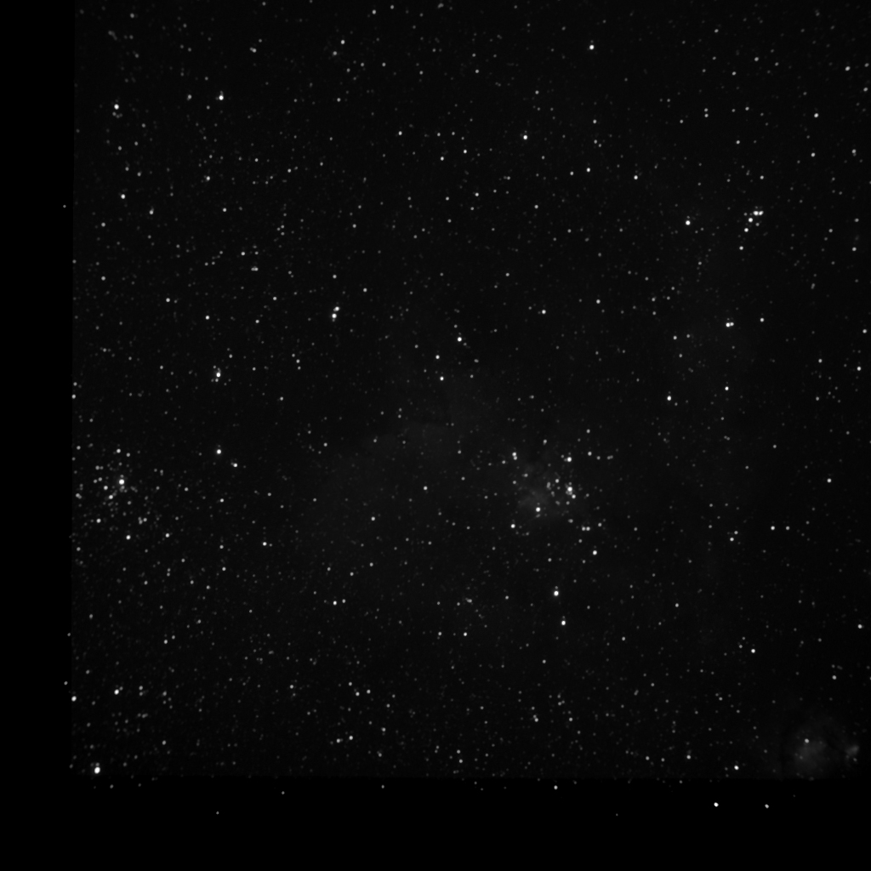
OIII Image

Slide 11
Data Processing, Photoshop
-As seen, the 3 images were adjusted so they would have equal background brightness
-They were then merged according to the Hubble and CFH T palette
CFHT (Canada France Hawaii Telescope
Red: H-Alpha
Green: SII
Blue: OIII
Hubble
Red: SII
Green: H-Alpha
Blue: OIII

Slide 12
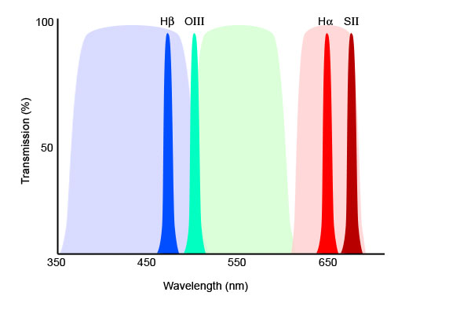
Narrowband Diagram

Slide 13
Hubble Pallet

Slide 14
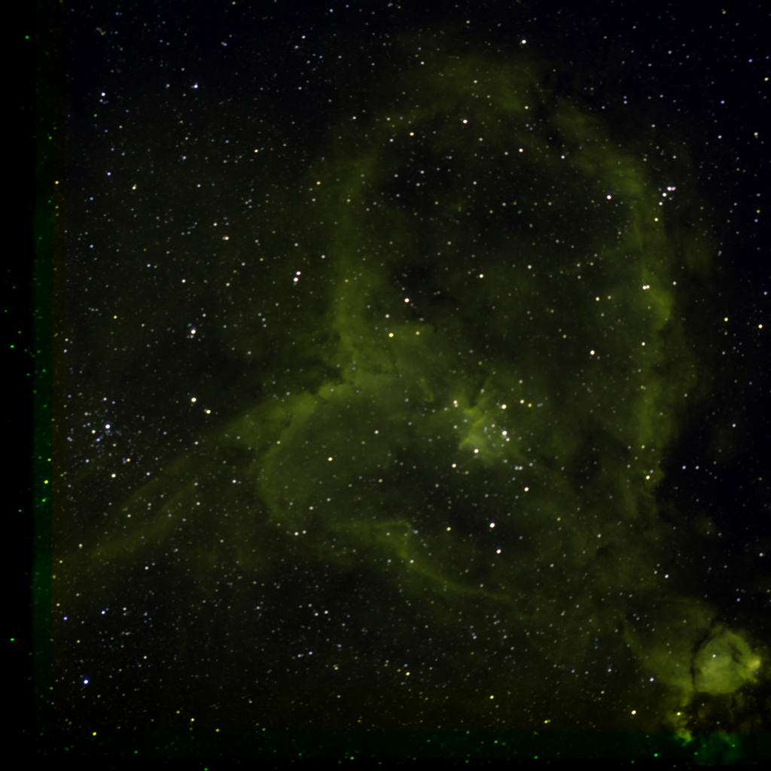
Notes:
The image started off green because of the dominance of H-Alpha

Slide 15
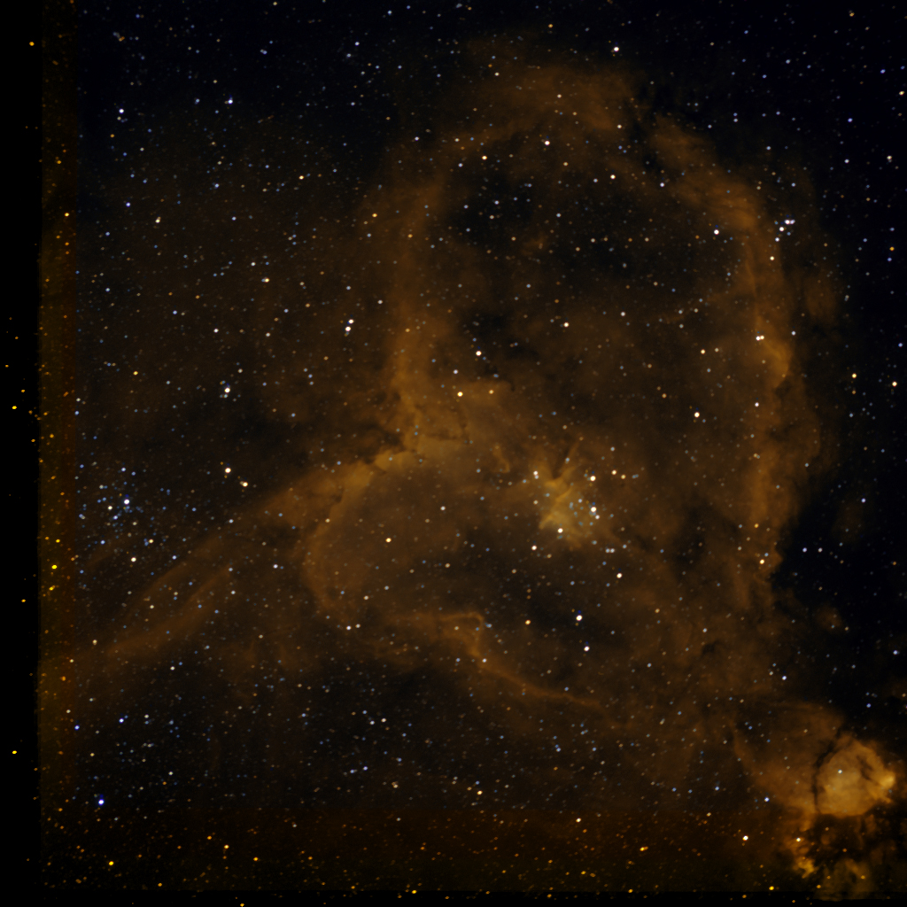
Notes:
I followed online instruction provided by Dr. Clark to reduce the green color. Using the selective color tool, I made multiple adjustments to the image’s color.

Slide 16
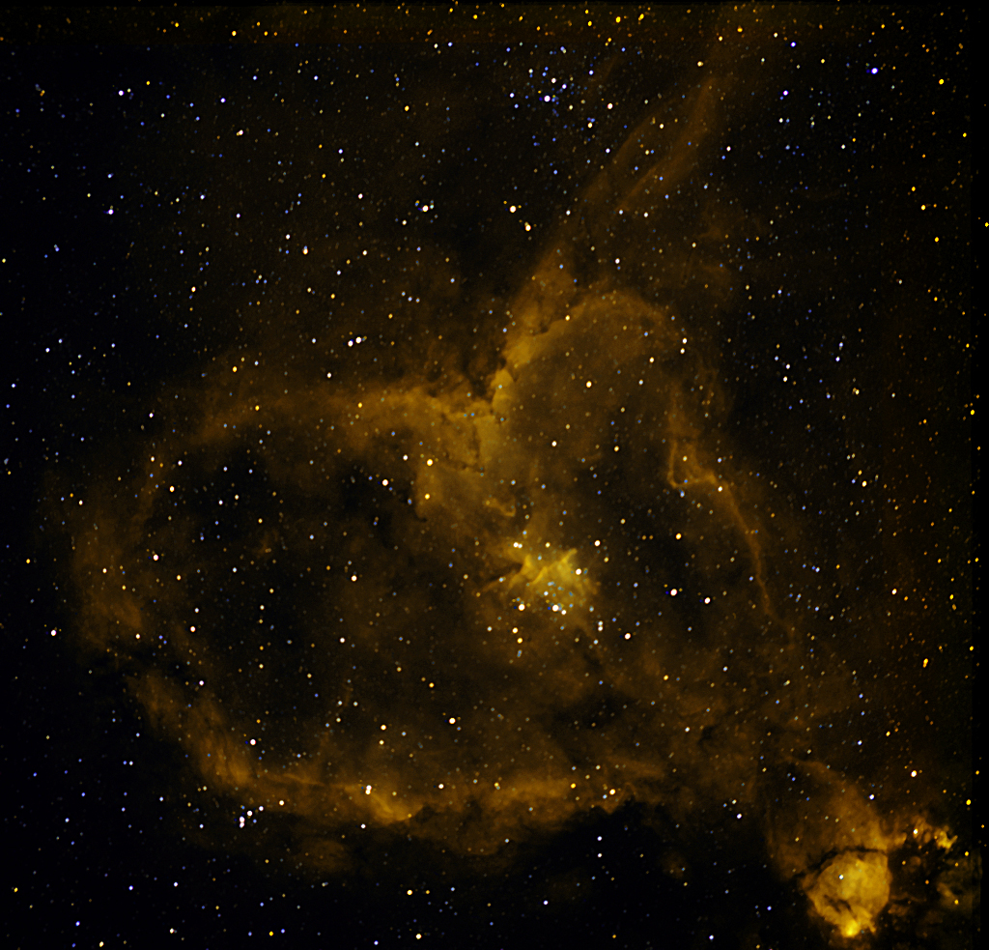
Notes:
I flipped and rotated the image. I used unsharp mask to increase sharpness by 80%, and I did some curves.

Slide 17
CFHT Pallet

Slide 18
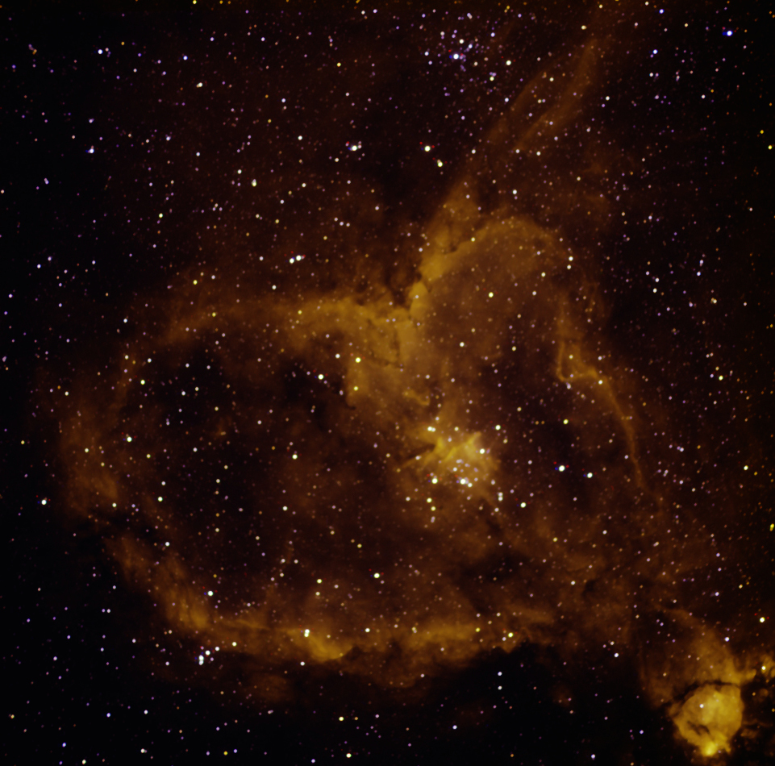
Notes:
After combining, and 1 round of curves/levels, this was my image

Slide 19
Notes:
I used unsharp mask to bring out the detail. This also brought out allot of star, and hot pixels which cluttered the image

Slide 20
Notes:
I then went to town using the clone stamp to remove most of the hot pixels and a few stars

Slide 21
Notes:
Using the GIMP software, I blurred the edges of the nebula removing additional hot pixels. I also used sharp mask on 2 areas of the nebula to bring out some more detail

Slide 22
Data Processing, GIMP
-For some of my imaging processing I used the free software “GIMP”
-GIMP stands for: GNU Image Manipulation Program
-It performs 99% of Photoshop's tasks and more.
Notes:
It is a freely distributed program that is compatible with Windows, Mac, and Linux operating systems. Easy to download and install, very logical layout. Free also means that users can freely distribute and/or modify the program.

Slide 23
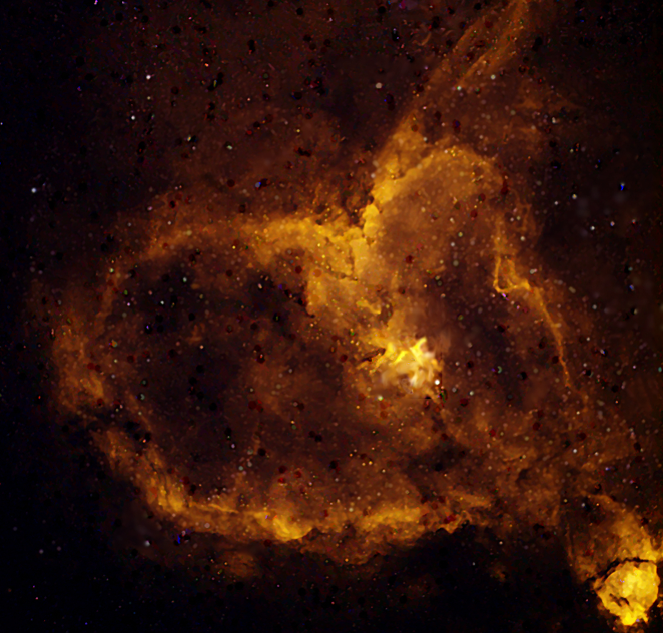
Notes:
Using GIMP, I smoothed the image further with the blur and smudge tool. From here I ‘de-speckled’ the image and add a light source in the top left corner.

Slide 24
Sources
https://www.gnu.org/gnu/about-gnu.html
http://www.gimp.org/about/introduction.html
http://bf-astro.com/hubblep.htm
http://www.atlasoftheuniverse.com/nebulae/ic1805.html
http://apod.nasa.gov/apod/ap090214.html

Slide 25
Questions,
Comments?

