Slide 1
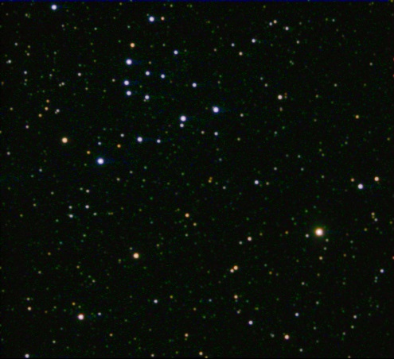
NGC 743
David Randall

Slide 2
Topics
What is a H-R Diagram?
What is an open cluster?
Why open clusters?
Procedure

Slide 3
H-R Diagrams
Ejnar Hertzsprung plotted luminosities of stars against their color.
Henry Norris Russell plotted luminosities of stars against their spectral types.
Luminosity is a measurement of the energy given off by a star.
Color and spectral class both measure surface temperature
http://skyserver.sdss.org/dr1/en/proj/advanced/hr/

Slide 4
H-R Diagrams
http://www.le.ac.uk/ph/faulkes/web/stars/o_st_overview.html

Slide 5
Open Clusters
Group of up to a few thousand stars.
Formed from the same molecular cloud.
Found in spiral and irregular galaxies where active star formation is occurring.
Usually less than a few billion years old.
http://www.bibliotecapleyades.net/universo/open_cluster.html

Slide 6
Why Open Clusters?
Can assume all stars in a cluster formed almost at the same time from the same cloud
The stars are about the same distance away
The chemical composition is about the same
https://www.e-education.psu.edu/astro801/content/l7_p6.html

Slide 7
Why Open Clusters?
https://www.e-education.psu.edu/astro801/content/l7_p6.html

Slide 8
NGC 743

Slide 9
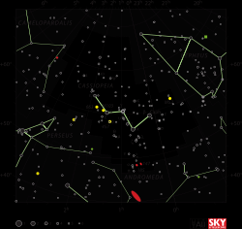
NGC 743
Discovered September 29, 1829 by John Herschel
Located in Cassiopeia
http://cseligman.com/text/atlas/ngc7.htm#743

Slide 10
Procedure
Plot the stars of NGC 743.

Slide 11
Procedure
Compare to a plot of main sequence stars for the turnoff point.

Slide 12
Procedure
Calculate the age from the turnoff point.
Turnoff: 0.15 V-R value.
Corresponds to a FII class star.
FII Class has a solar mass of 1.5
$\frac{{10}^{10}}{{Mass}^{2.5}}=age in years$
NGC 743 is approximately 3.63 billion years old.
http://www.essex1.com/people/speer/main.html

Slide 13
Procedure
Compare the graph of the main sequence stars to NGC 743

Slide 14
Procedure
Find the difference between absolute magnitude of the main sequence and apparent magnitude of the cluster.
$10∗{10}^{\frac{M−m}{5}}=distance pc$
1841.4 ly
Interstellar reddening was not accounted for. So the cluster would be a bit closer and younger.
http://www.stsci.edu/~inr/intrins.html

Slide 15
Conclusion
NGC 743
3.63 billion years old
1841.4 ly away
But is it a cluster?

Slide 16
Is it a Cluster?

Slide 17
References
http://www.stsci.edu/~inr/intrins.html
http://www.essex1.com/people/speer/main.html
https://www.e-education.psu.edu/astro801/content/l7_p6.html
http://cseligman.com/text/atlas/ngc7.htm#743
http://www.bibliotecapleyades.net/universo/open_cluster.html
http://skyserver.sdss.org/dr1/en/proj/advanced/hr/
http://simbad.u-strasbg.fr/simbad/

