Slide 1
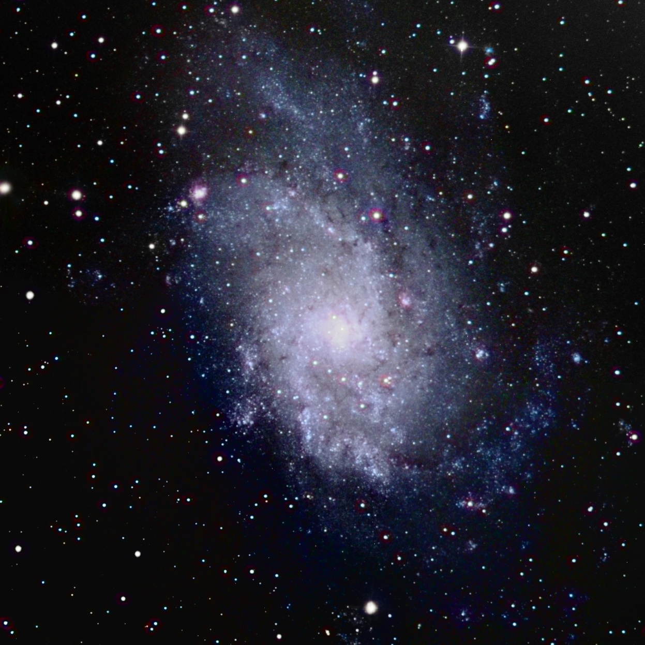
M33 – The Triangulum Galaxy
Astrophotography Project; Astronomy 2401 - Fall 2012

Slide 2
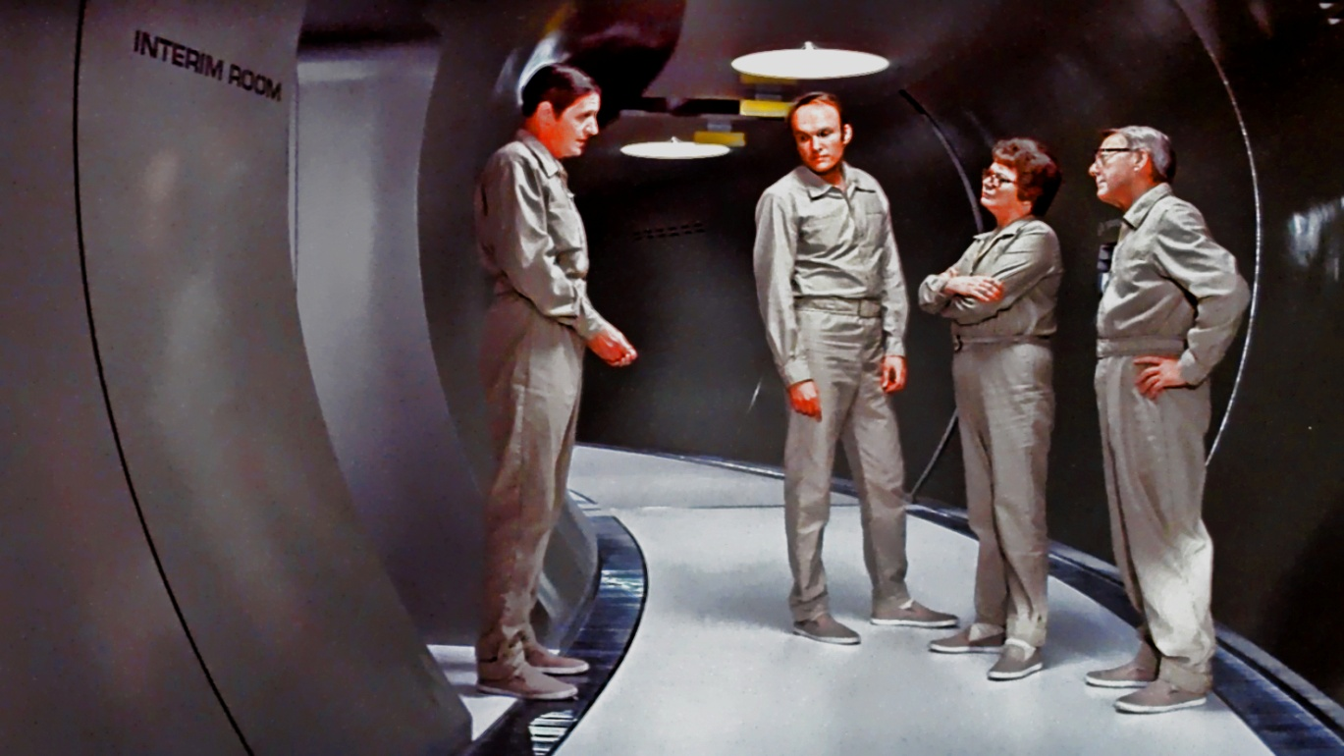
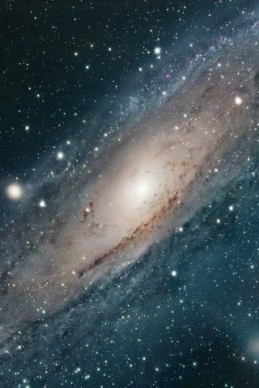
Why I chose this Object
Personal interests
The Andromeda Strain
1969 novel by Michael Criton;
1971 film by Robert Wise
Andromeda is relatively too large for my later project goals
Like Andromeda, Triangulum is in our Local Cluster
Triangulum is just the right size and just as interesting as Andromeda

Slide 3
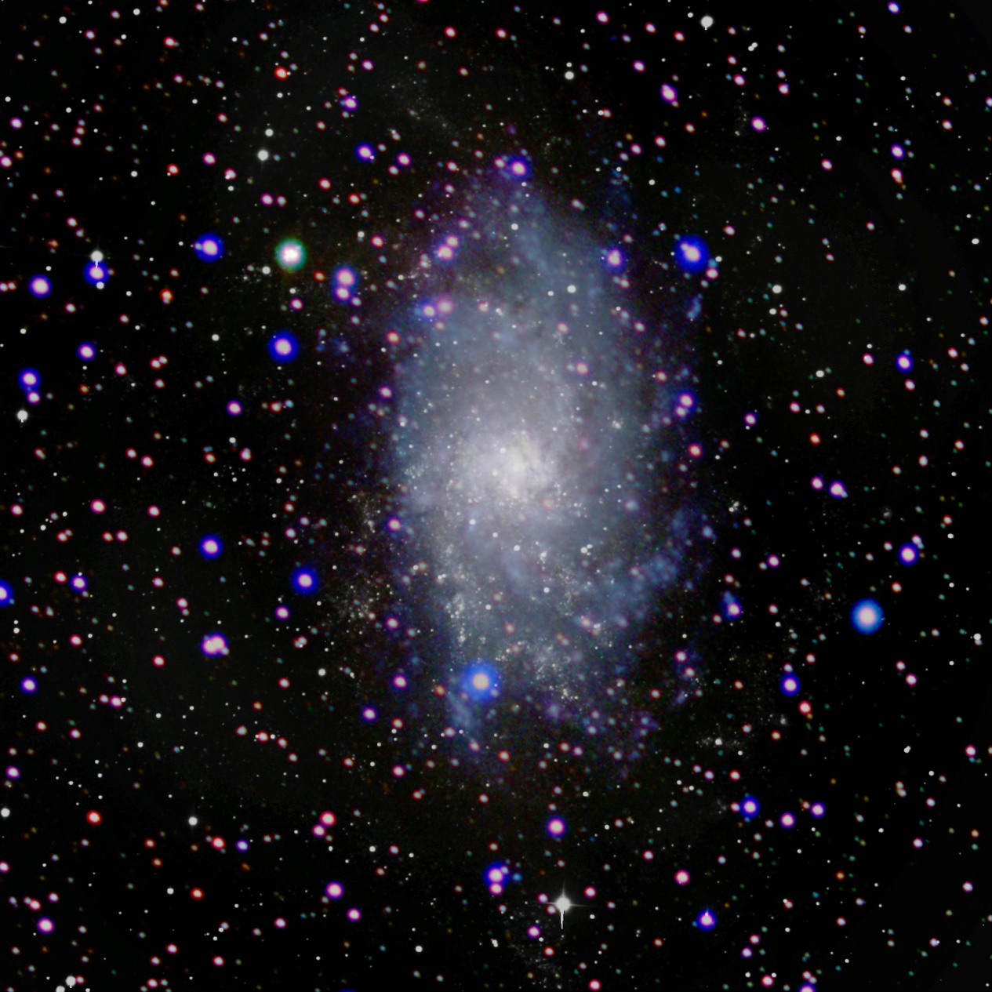
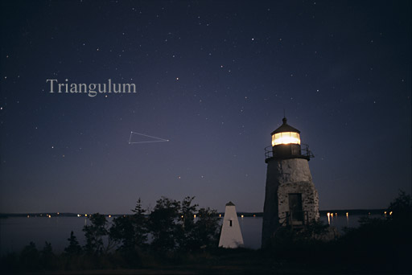
Triangulum Galaxy
M33 or NGC 598
Sometimes referred to as the Pinwheel Galaxy
Location
RA: 01h 33m 50.02s; Dec: +30° 39’ 36.7″
Aprox. 3 million light years from Earth
Third largest member of the Local Group of galaxies
In the Constelation Triagulam
Named for the near right angle formed by three brightest stars

Slide 4
Triangulum Galaxy
Notable Characteristics
Spiral Galaxy ; SA(s)cd
Diameter of roughly 50,000 light years
40 Billion Stars
Combined mass of all the matter within the galaxy is estimated at
10^10 solar masses.
Likely a gravitationally bound companion of the Andromeda Galaxy

Slide 5
Triangulum Galaxy
Image Capture; Basic Process
Basic Process
(Raw images - Dark frames) / Flats = Clean Image
R+G+B=Color
Color + Monochrome = Detail with Color
Two Methods
(Due to time restraints, I chose to experiment)
Color data captured with a 5” refractor telescope
Higher resolution monochrome image would be achieved through creating a mosaic with the 20” Cassegrain telescope
Combine the color composite with the monochrome Mosaic

Slide 6
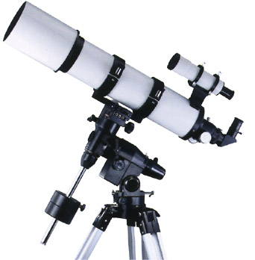
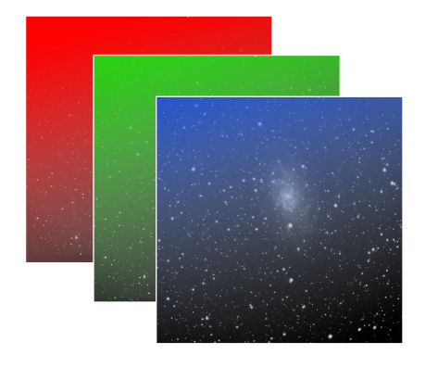
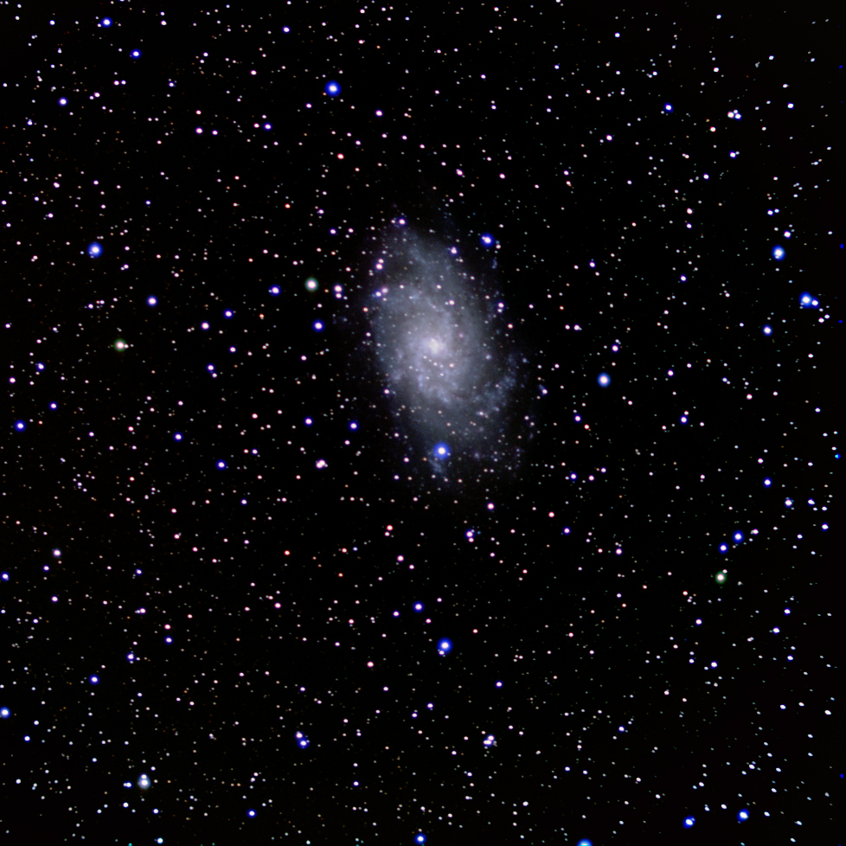
Triangulum Galaxy
Image Capture; RGB Filters
RGB; 5” Refractor Telescope
Red, Green, and Blue Filters
CCD only captures a monochrome image
Separate filters transmit specific wavelengths of light
Filtered images then combined to create full color image
Exposures
Fifteen images taken with each RGB filter
Exposure of 3 minutes each
Total: 45 images and 135 minutes exposure time
Dark Frames
5 images at an exposure time of 3 minutes each
No Flat field images used

Slide 7
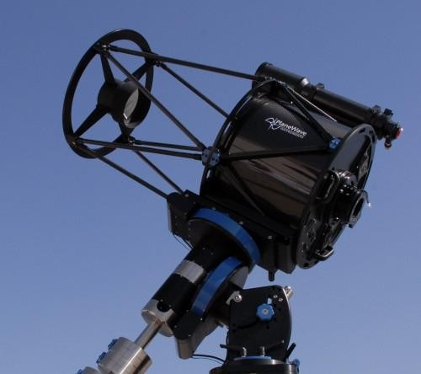
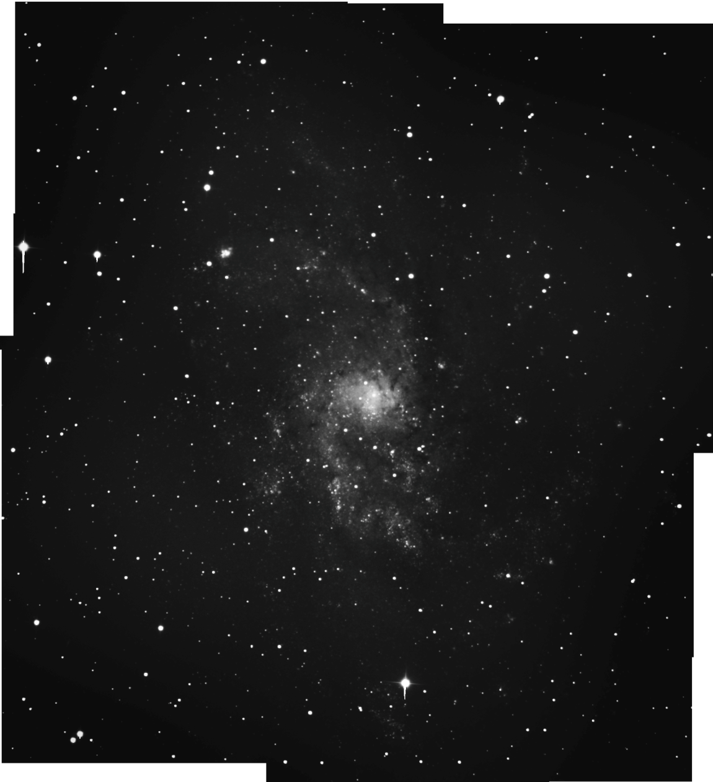
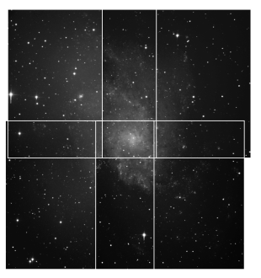
Triangulum Galaxy
Image Capture; Monochrome Mosaic
Monochrome; 20” Cassegrain Planewave Telescope
Mosaic
Different regions of the object are imaged and
Then assembled into a single larger image
Exposures
4 separate regions imaged
10 images each @ 3 minutes
Dark frames
5 images @ 3 minutes
Flat-field images
Sourced from Dr. Clark; obtained the previous night

Slide 8
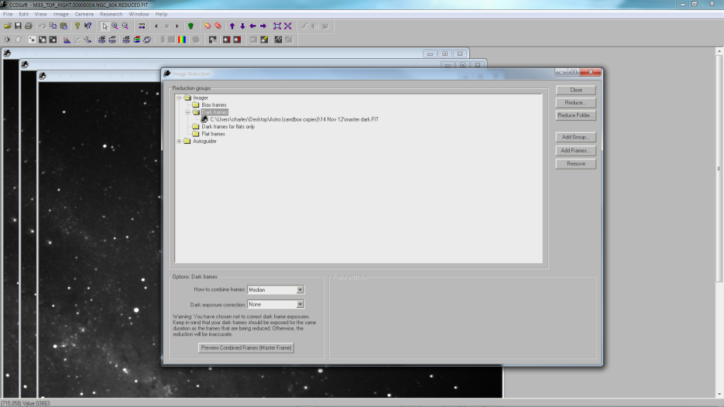
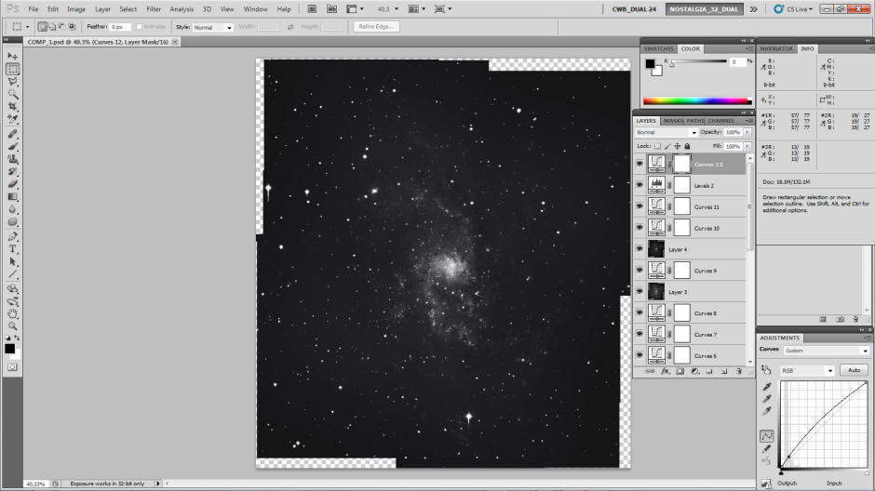
Triangulum Galaxy
Image Processing
+

Slide 9
Triangulum Galaxy
Image Processing; CCDsoft
Image Reduction
Images are removed of noise by
subtracting information from Master Dark
Alignment
RGB filtered images aligned together
Separate alignment of the 4 regions to be used in mosaic
Combine
RGB filters are combined separately
4 regions for mosaic are combined separately
Final output files
Final .FIT images are copied, ready for processing in Photoshop

Slide 10
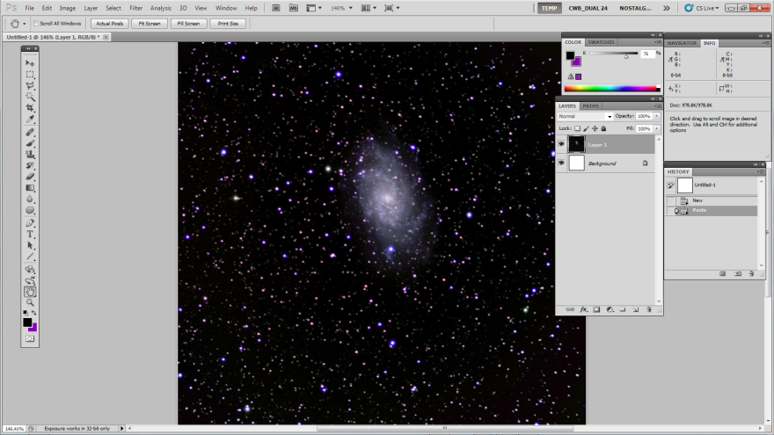
Triangulum Galaxy
Image Processing; Photoshop,
RGB Color Composite
Baseline retouching
Establish uniform background
& object brightness
RGB Channel Merge
Separate filtered images are injected into the appropriate RGB channels
Retouching
Color correction and boost of lower-midtones
Levels
Curves
Separate curves adjustments for each channel
RCAstro / Gradient Exterminator
Removal of Blooming

Slide 11
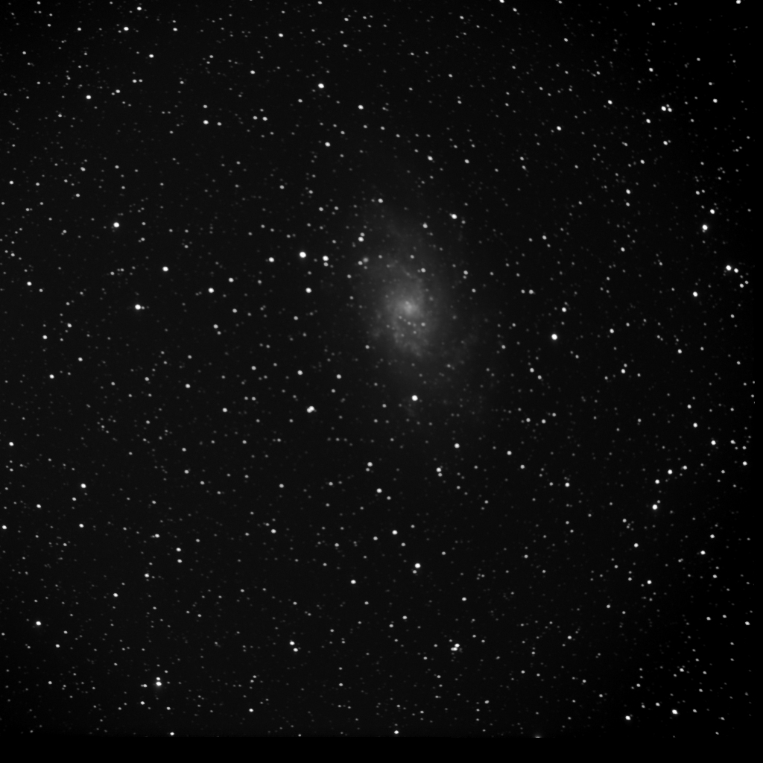
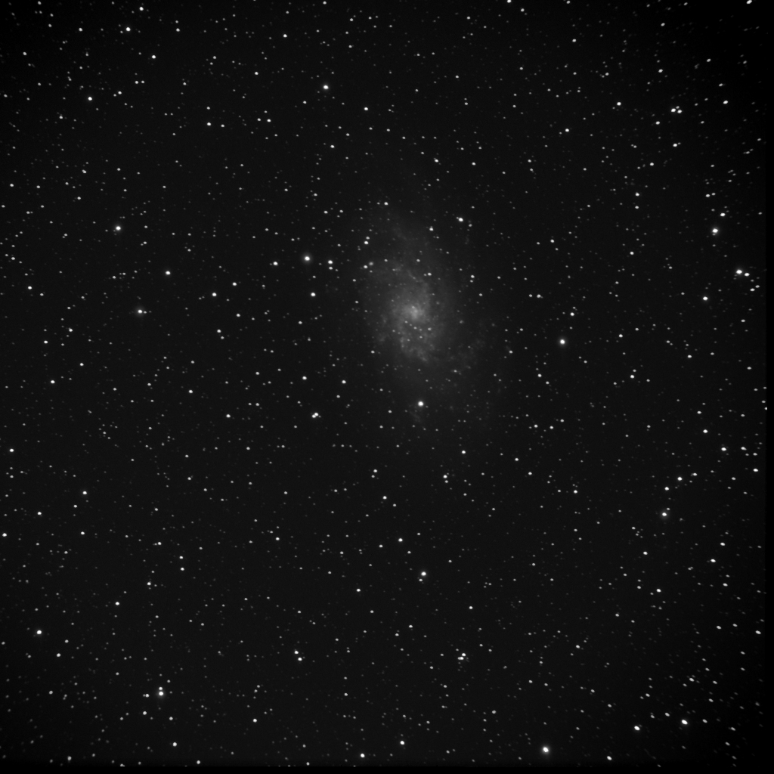
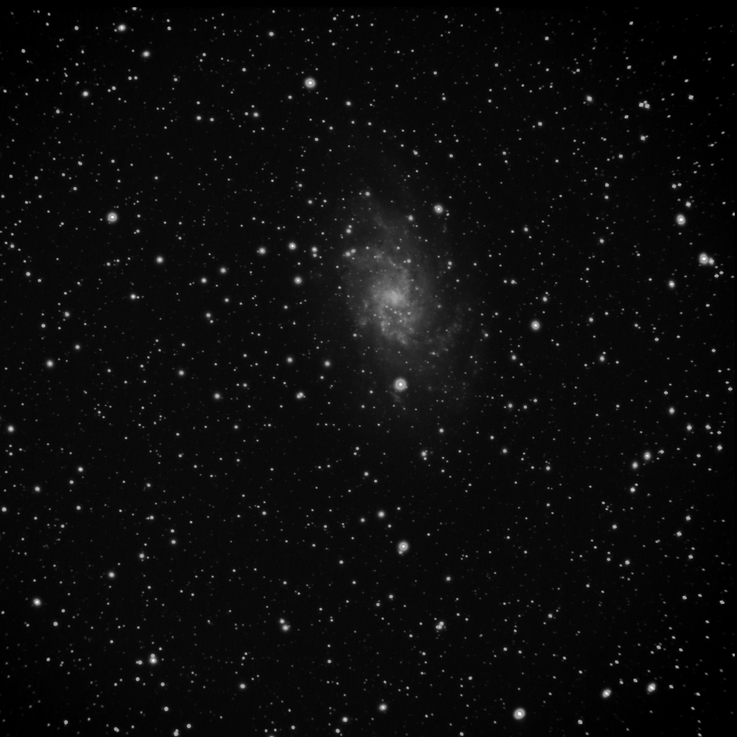
Triangulum Galaxy
RGB; 5” Refractor Telescope
Red
Green
Blue

Slide 12
Triangulum Galaxy
Image Processing; Photoshop
Mosaic
Baseline retouching
Stitching
Crop the 4 source images; reduces ghosting
Automate -> Photomerge
Re-touching
Gradient correction and boost of lower-midtones
Levels
Curves
Separate curves adjustments for each channel
RCAstro / Gradient Exterminator
Removal of Blooming
Removal of ghosted objects

Slide 13
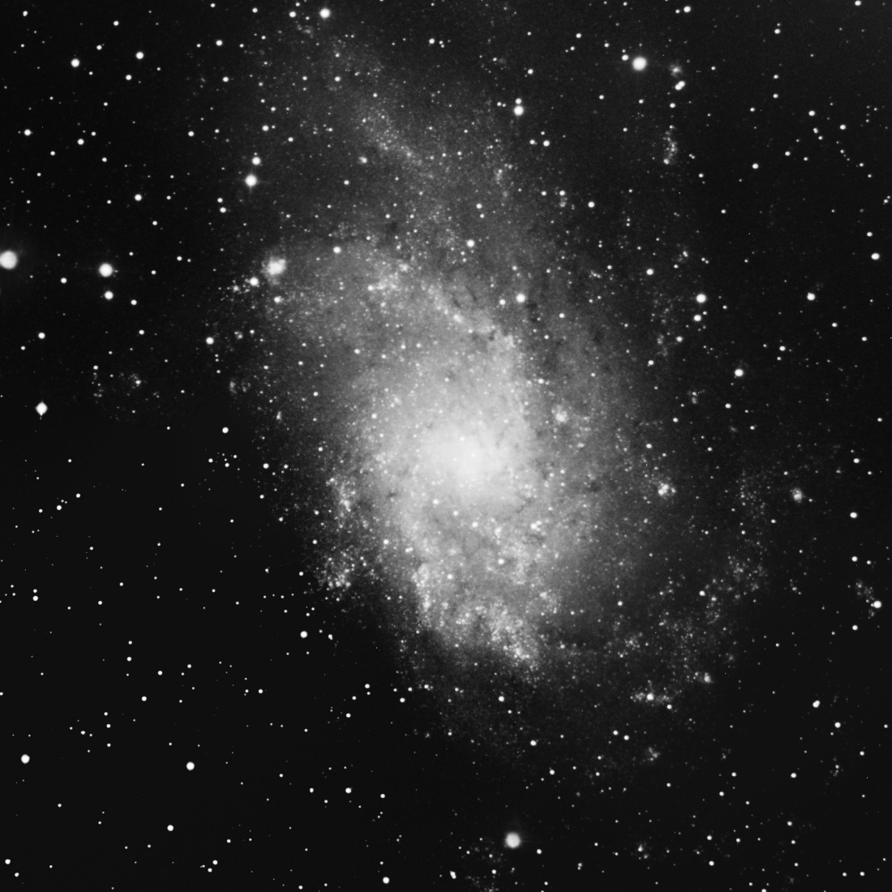
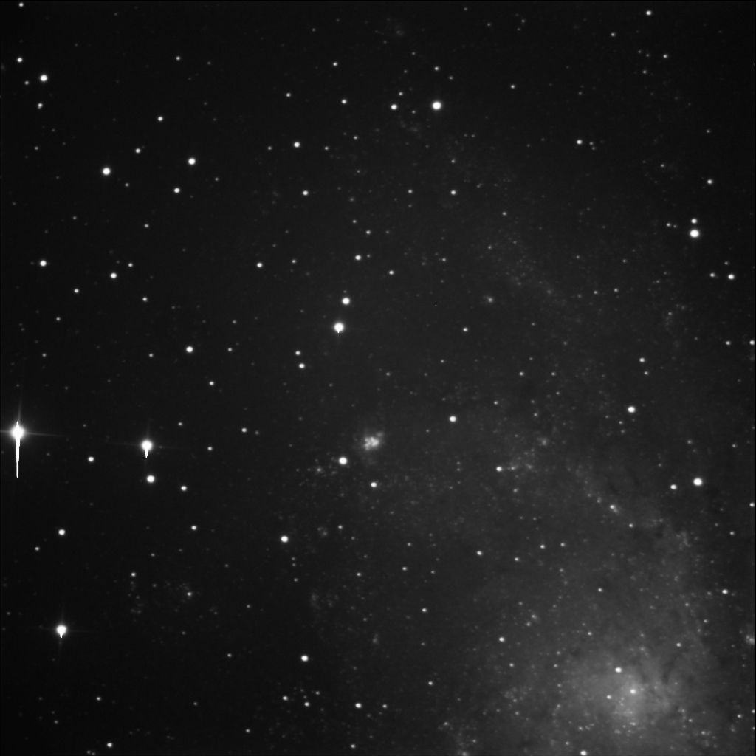
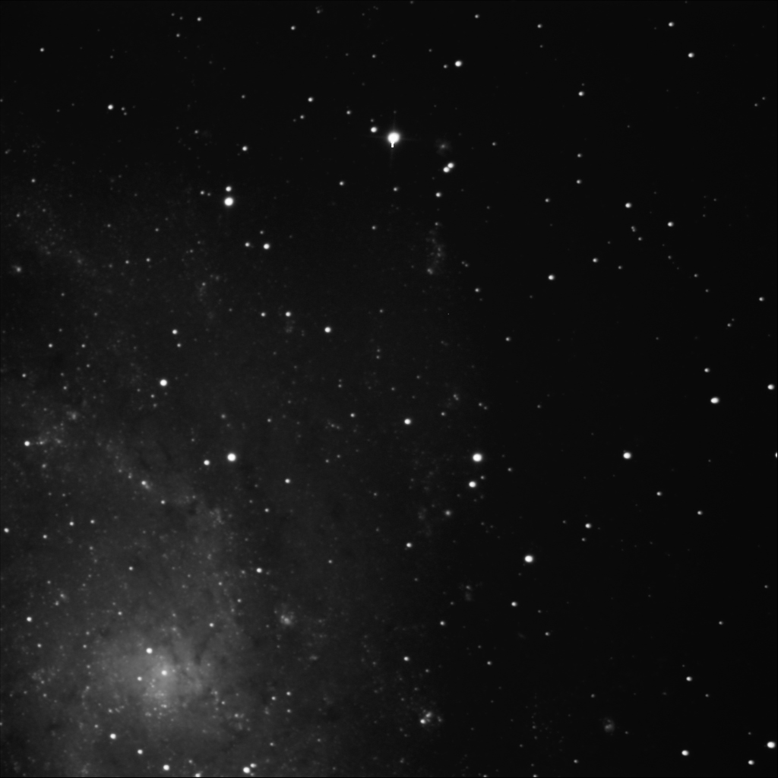
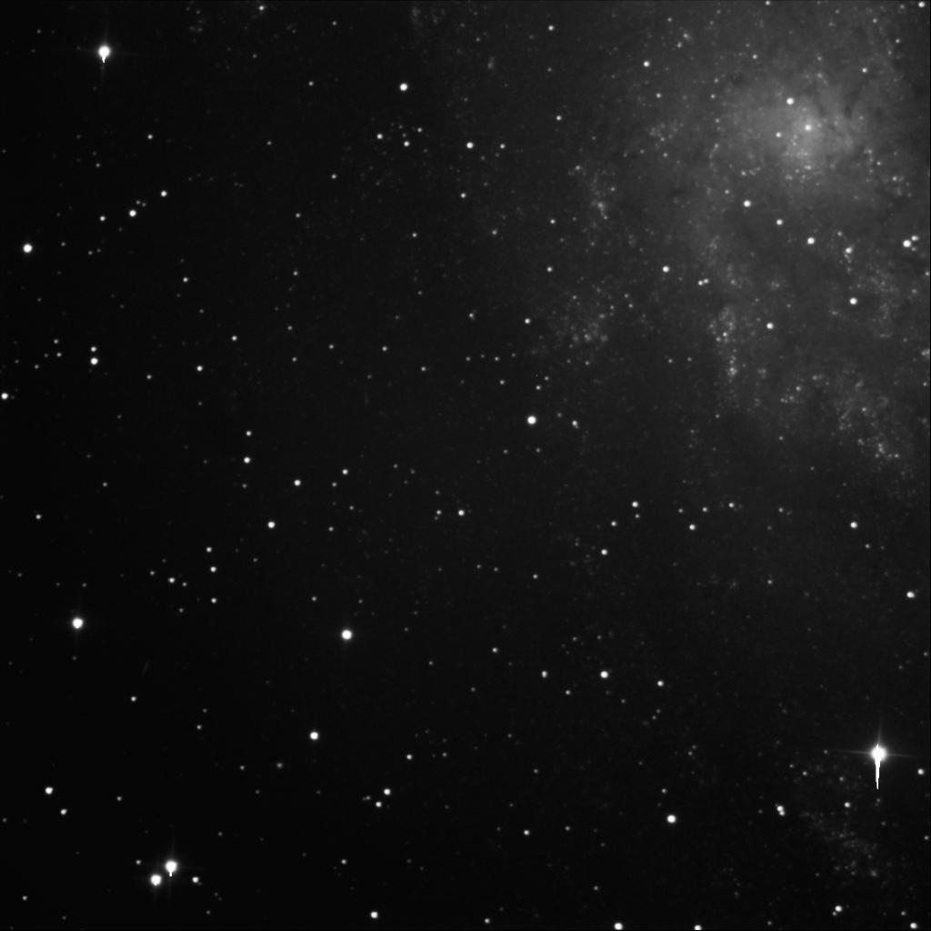
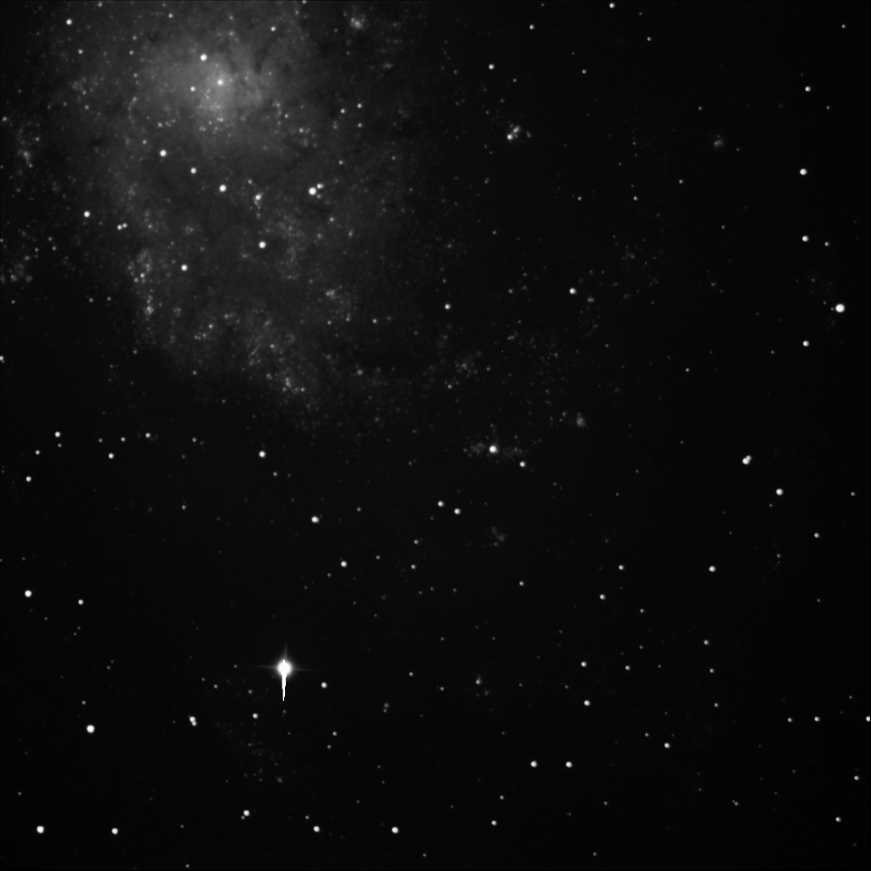
Triangulum Galaxy
Mosaic; 20” Cassegrain Planewave Telescope

Slide 14
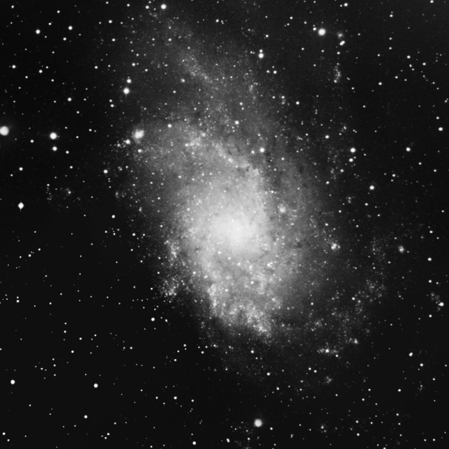
Triangulum Galaxy
Final Composite

Slide 15
Triangulum Galaxy
Sources
http://en.wikipedia.org/wiki/Triangulum_Galaxy
http://www.nasa.gov/multimedia/imagegallery/image_feature_1841.html
http://messier.seds.org/m/m033.html
http://galaxiessolarsystem.blogspot.com/p/galaxie-facts.html
http://en.wikipedia.org/wiki/File:TriangulumCC.jpg
http://www.solstation.com/x-objects/and2disk.jpg
Wise, Robert , dir. Andromeda Strain. 1971. Film.

Slide 16
Triangulum Galaxy
Thank You!

