Slide 1
PALETTE COMPARISONS
UNDERSTANDING THE NUANCES OF NARROW BAND COLOR
-PRESENTED BY BETHANY HARDCASTLE

Slide 2
WHY THIS TOPIC?
CONSTRICTIONS
UNIQUENESS
TIME
SIMPLICITY
COLOR
THE TELESCOPE

Slide 3
THE DUMBBELL NEBULA
Nebula without star, discovered in Vulpecula, between the two forepaws, & very near the star 14 of that constellation, of 5th magnitude according to Flamsteed; one can see it well with an ordinary telescope […] it appears of oval shape, & it contains no star.
Charles Messier
M-27, (Commonly, the Dumbbell Nebula), was discovered by Charles Messier himself in 1764. It was the first planetary nebula to be discovered. Distance of 1,360 light years.
-It’s star one of the largest white dwarfs (in size) known currently.
-It’s one of the brightest nebulae in the sky, at a visual magnitude of 7.5

Slide 4
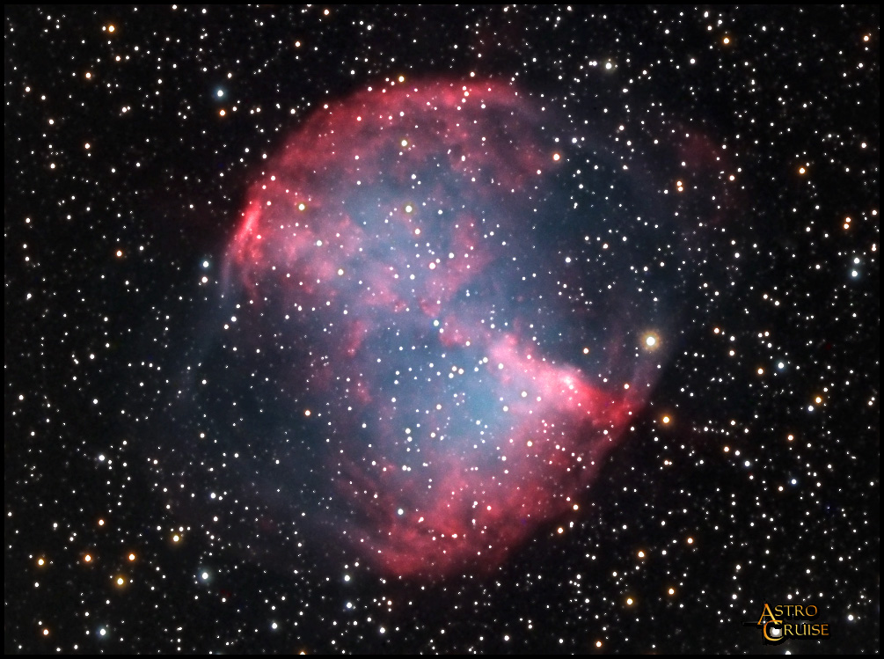
-At its faintest extensions, the Dumbbell is the second largest planetary
nebula we currently know of, behind the famous Helix Nebula.
-The Dumbbell is estimated to only be roughly 15,000 years old, which may
attribute to its brightness.
http://www.astrocruise.com/milky_way/m27.htm

Slide 5
GOALS, EQUIPMENT, ETC.
Main goal? To compare the “Hubble” palette and the “European” palette, and see if there were any definite nuances and main differences other than just color.
Equipment-
20 inch Planewave Cassegrain with an STL 1001-E CCD. Using the software, “The Sky 6” as well as “CCDSoft”.
60 frames of actual data, at 3 minute exposures for each one. (20 H-alpha, 20 S-ii, 20 O-iii)
About 3 hours of actual data, and 4-5 hours of work. (fortunately accomplished in one night)
Processed using CCDSoft and Photoshop. The results? Confusion.

Slide 6
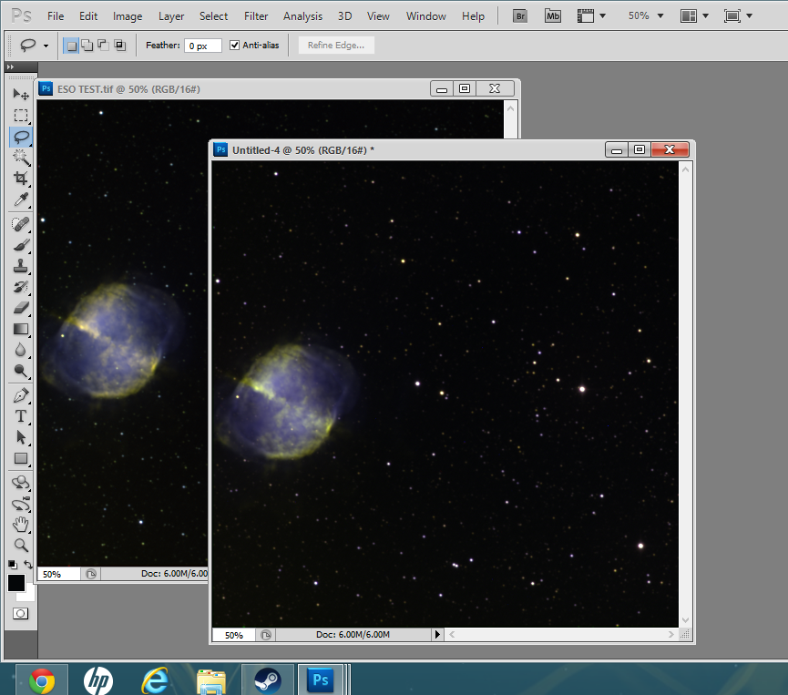

Slide 7
THE INTERNET QUEST
After rigorous Googling, I discovered that both H-Alpha and S-ii were emitting at almost the exact same intensity, H-alpha being just a hair brighter. I also learned the There are NOT two main palettes for narrow band imaging. It’s more similar to five or six. Naming palettes- Red- (The red channel)
Green- (The green channel) Blue- (The blue channel) The first letter of each filter creates your designation. Hubble colors use a palette known as SHO, while the European palette is known as HSO.
HOWEVER there are two other very commonly used schemes, known as HOO (or HSS) and HOS. This sparked an obsession.

Slide 8
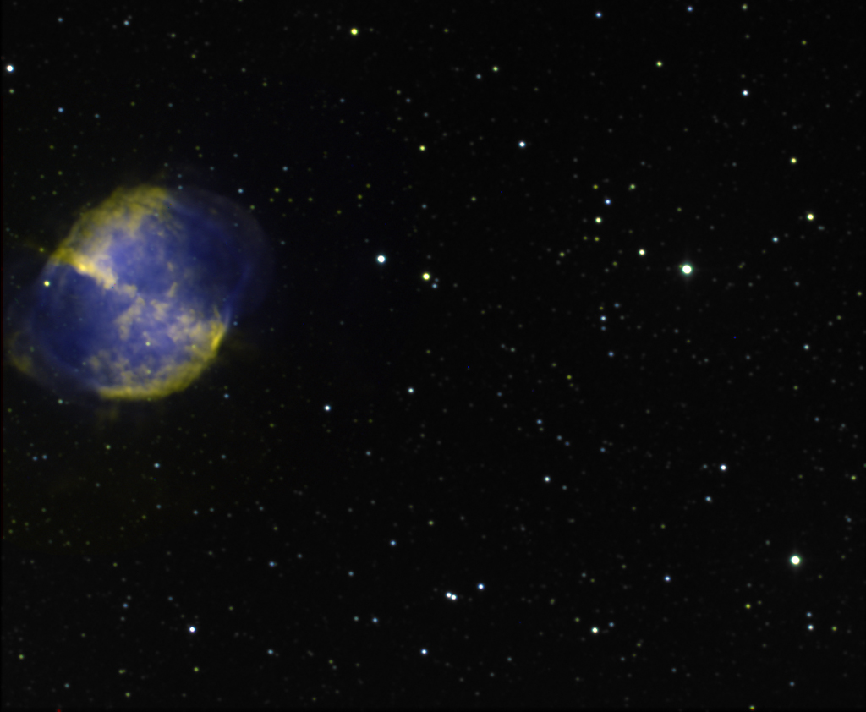
EUROPEAN PALETTE (HSO)

Slide 9
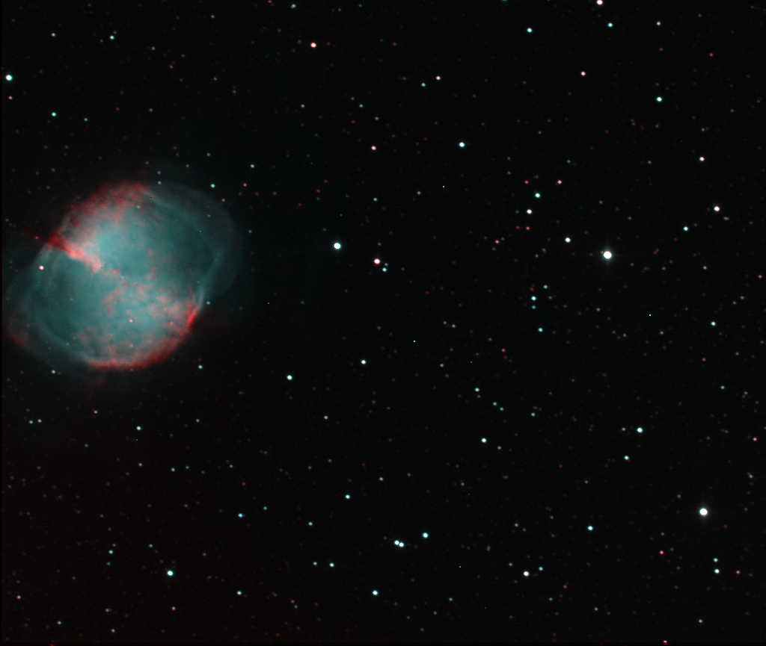
HOO

Slide 10
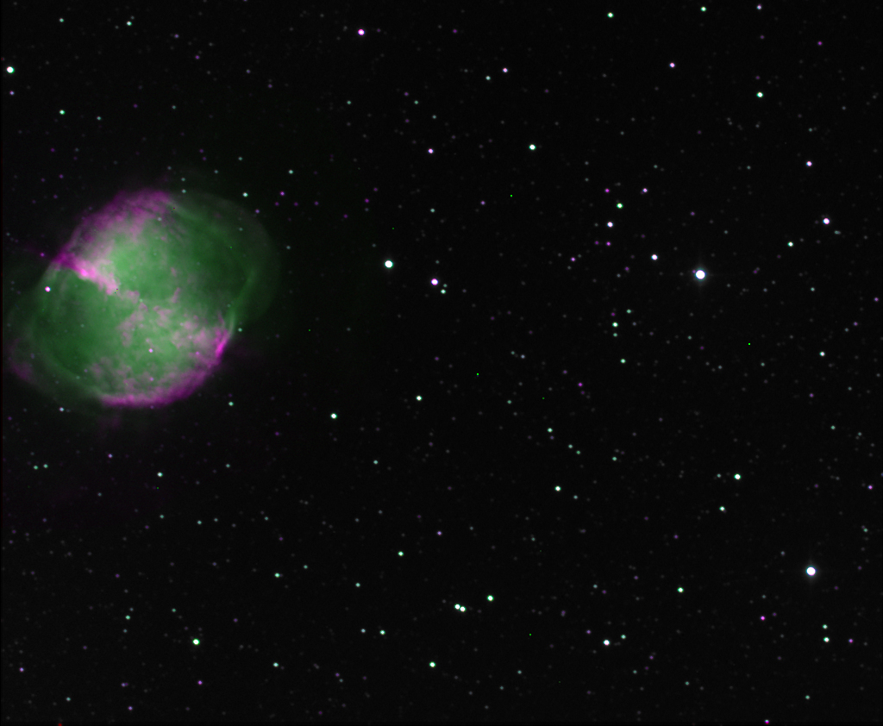
HOS

Slide 11
HUBBLE PALETTE (SHO)

Slide 12
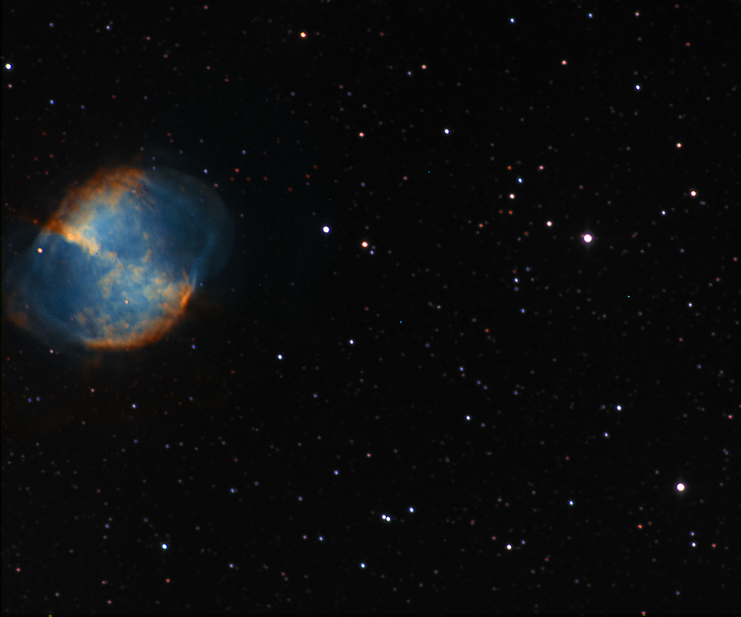
HUBBLE GOLD/TURQUOISE

Slide 13
FINDINGS?
-After discovering and creating these four different color schemes for the dumbbell nebula, I had some odd findings. -The Hubble and European palettes CAN show up very similar. I suspected that the S-ii and H-alpha were almost the exact same brightness, but couldn’t tell for certain. The colors in the HOS scheme confirmed that.
-I also found that there was almost no similarity to true RGB color in reference to the Hubble and the European palettes, although it is generally believed that HSO is a better approximation. In this case, it was HOO, one of the stranger and less used schemes, that came closest to actual color.

Slide 14
CONCLUSIONS?
-The Dumbbell- one of the worst objects I could have chosen for this topic! -On a few occasions, there may be very few differences between the Hubble and European palettes.
-There is a much MUCH wider range of options for color imaging than I first thought. I only covered four of them. There are more, and EVEN MORE if you include the other available narrow band filters.

Slide 15
Sources
http://www.constellation-guide.com/dumbbell-nebula-messier-27/
https://medium.com/starts-with-a-bang/messier-monday-the-dumbbell-nebula-m27-cc000b85491a
RGB color photo- http://www.astrocruise.com/milky_way/m27.htm
Color palette information-
http://www.almadenobservatory.net/Color_Imagery.htm
lhttp://starizona.com/acb/ccd/advimnarrow2.aspx
https://www.google.com/webhp?sourceid=chrome-instant&ion=1&espv=2&es_th=1&ie=UTF-8#q=narrow%20band%20color%20palettes

