Slide 1
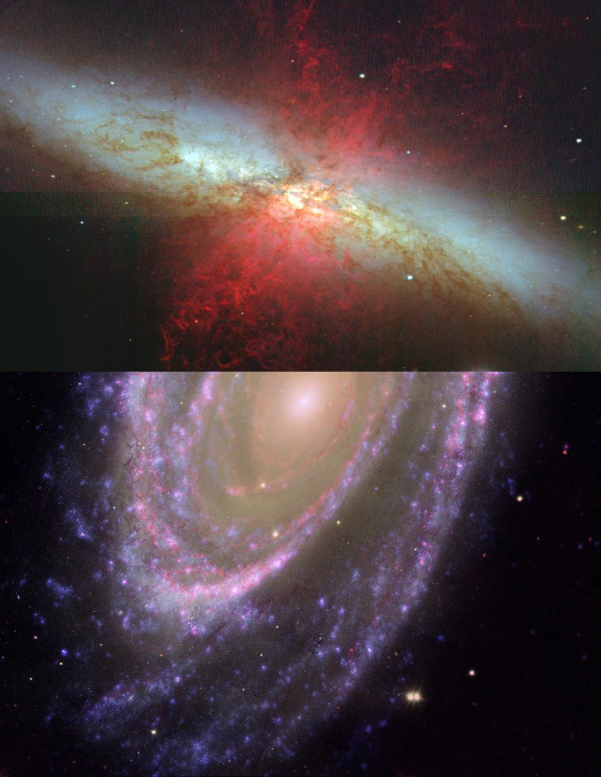
M81 – Bode’s galaxy
M82 – Cigar Galaxy

Slide 2
ASTR 2401
Goal
Target selection
Object information
Data collection
Image calibration
Processing
Mosaicing
Perils of Astrophotography
Final image
References

Slide 3
Goal
To capture color images of an object or objects that required mosaic work to form the final image.

Slide 4
Why M81/82?
M81 and M82 lie far enough apart that the 20” cannot capture both in a single frame, and the frames for each galaxy would not overlap at any point, presenting not only the challenge of forming the mosaic, but in taking the images in such a way as to form an overlap.

Slide 5
M81
Known as Bode’s galaxy after its discoverer Johann Elert Bode^{[1]}
Discovered in 1774^{[1]}
Located in Ursa Major
12 million light-years away^{[2]}
Contains 70 million solar mass black hole^{[3]}
Burst of star formation in the spiral arms due to gravitational interaction with M82

Slide 6
M82
Known as the Cigar galaxy due to its shape.
Edge-on spiral galaxy (approx. 80°).^{[4]}
Gravitationally interacting with M81, causing a large amount of star formation.^{[4]}
Distorted due to this interaction.^{[4]}

Slide 7
Data Collection
20” Planewave Cassegrain f/6.8 Telescope
SBIG STL-1001XE CCD
23x Red 3 minute exposures
23x Blue 3 minute exposures
23x Green 3 minute exposures
23x Clear 3 minute exposures
10x 3 minute Dark frames
5/night over two nights
5.1 hours total data collection

Slide 8
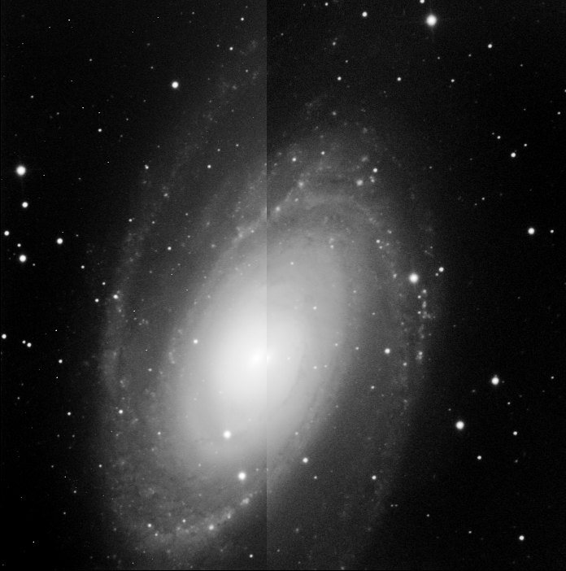
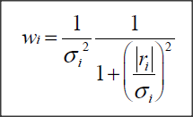
Calibration
Dark subtract
Flatfielding
Align
Combine
Auto Adaptive Weighted Average
Before
After
Notes:
dark-frame subtraction is a way to minimize image noise for pictures taken with long exposure times.
Used to reduce fixed-pattern noise from the CCD, dead or hot pixels.
picture with the shutter closed.
A dark frame is an image captured with the CCD in the dark, essentially just an image of noise in an image sensor.
It can then be subtracted from subsequent images to correct for fixed-pattern noise such as that caused by dark current.
Flatfielding is a technique used to remove artifacts from 2-D images that are caused by distortions in the optical path.
I used an Auto Adaptive Weighted Average as a combination routine used to further reduce noise

Slide 9
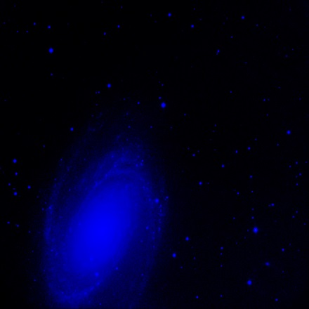
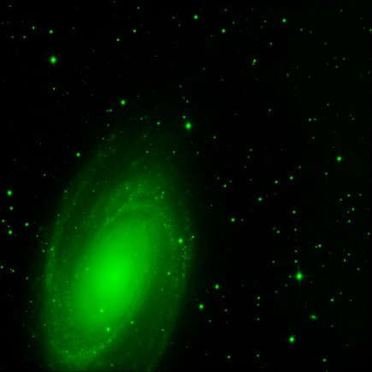
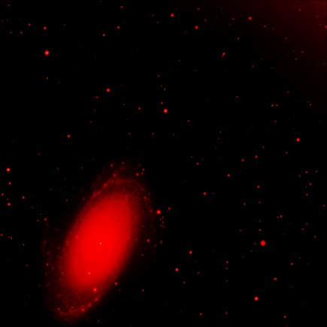
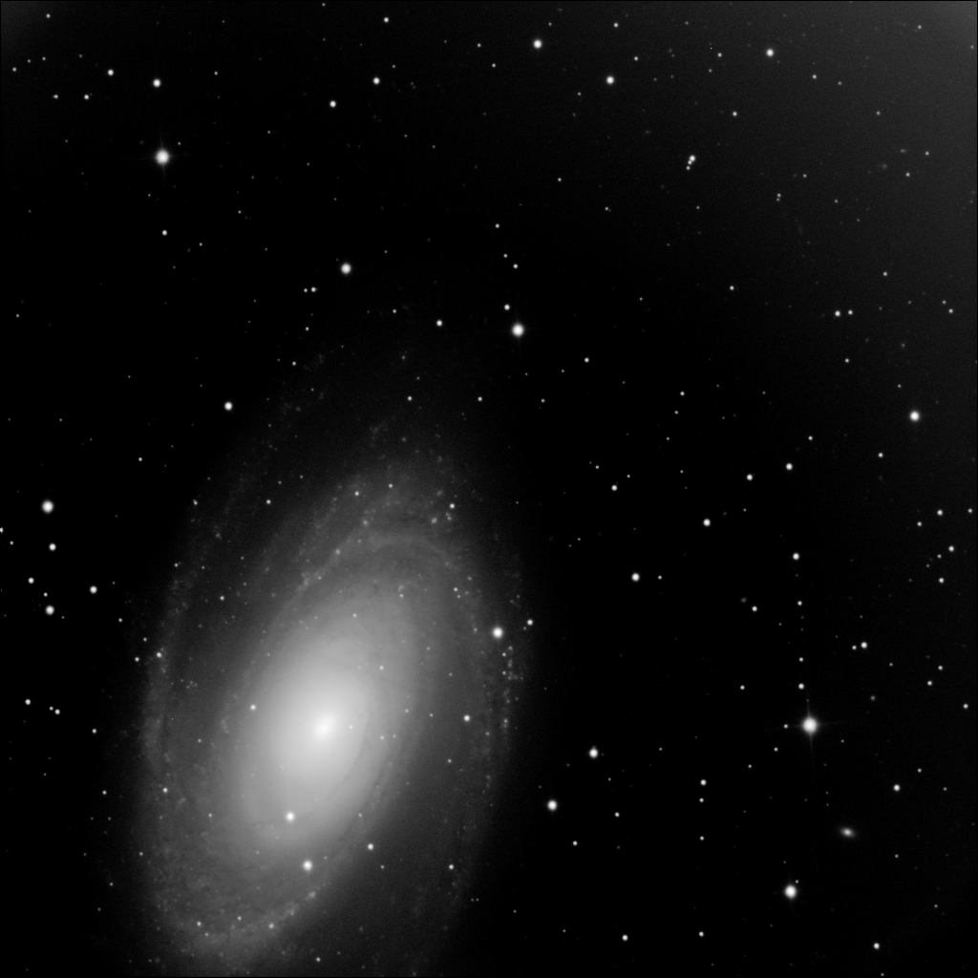
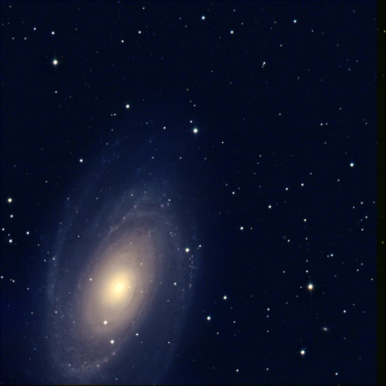
Processing
Color combination
Each series combined separately
M81, M82, and the middle stars

Slide 10
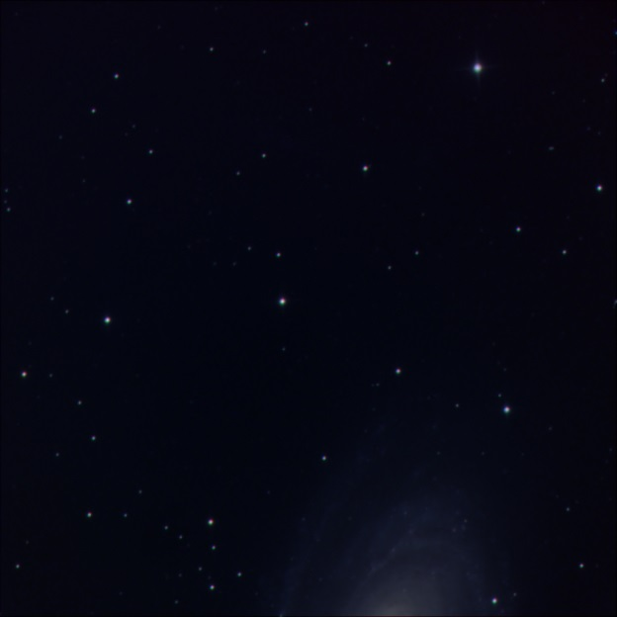
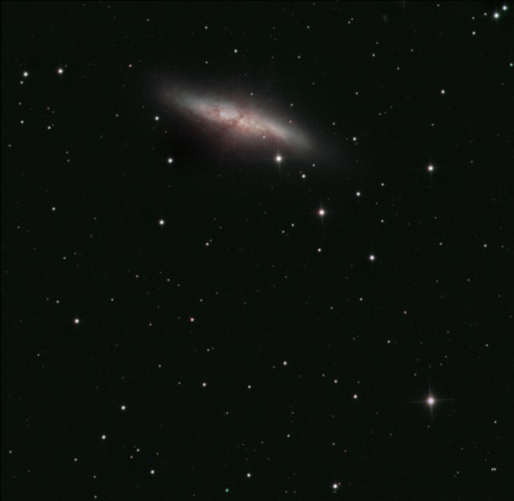
Mosaic
Rotate and combine images to form 1 image
Make minor adjustments to color for a matching background.

Slide 11
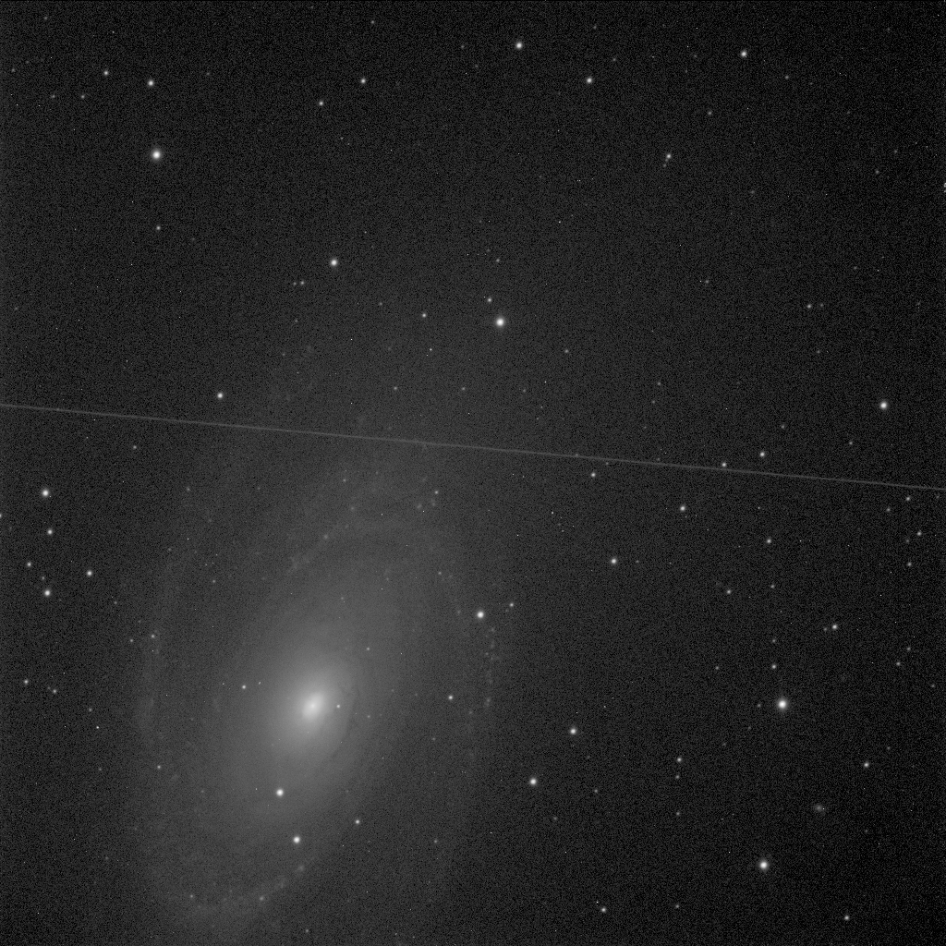
Satellites

Slide 12
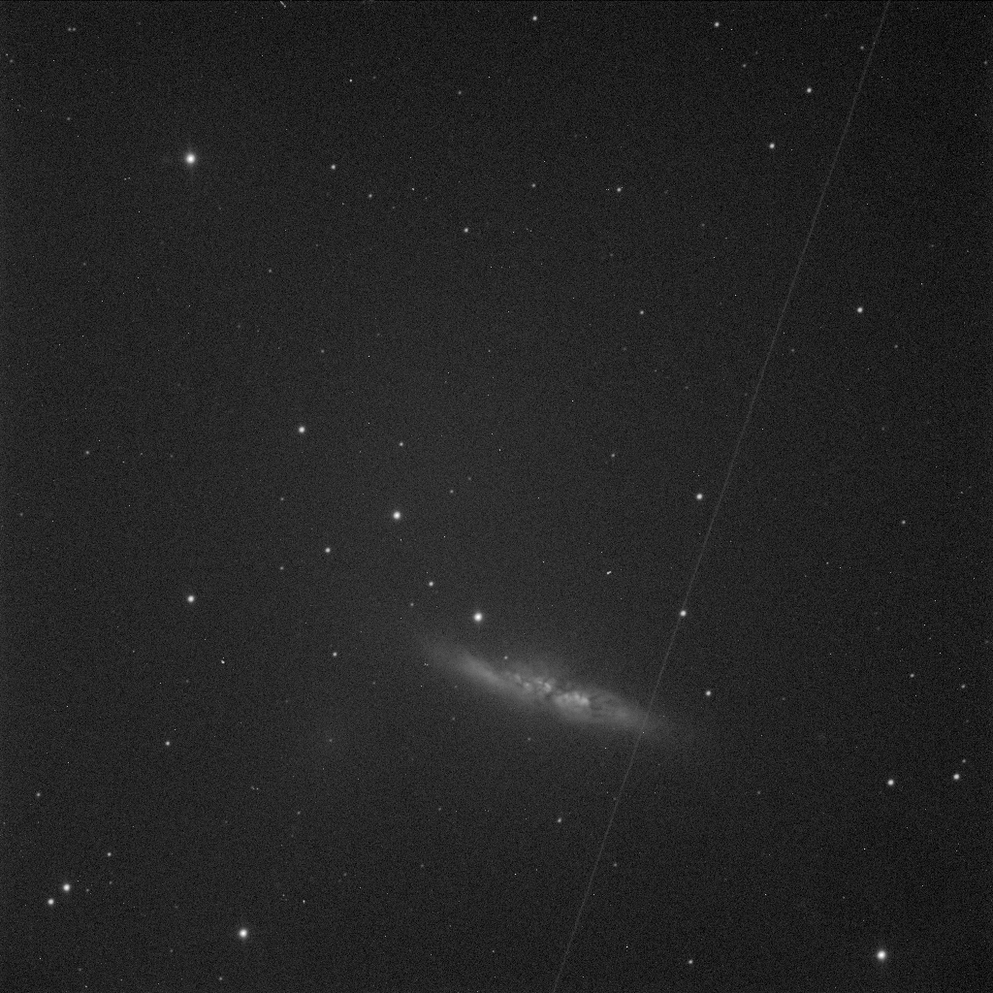
Satellites

Slide 13
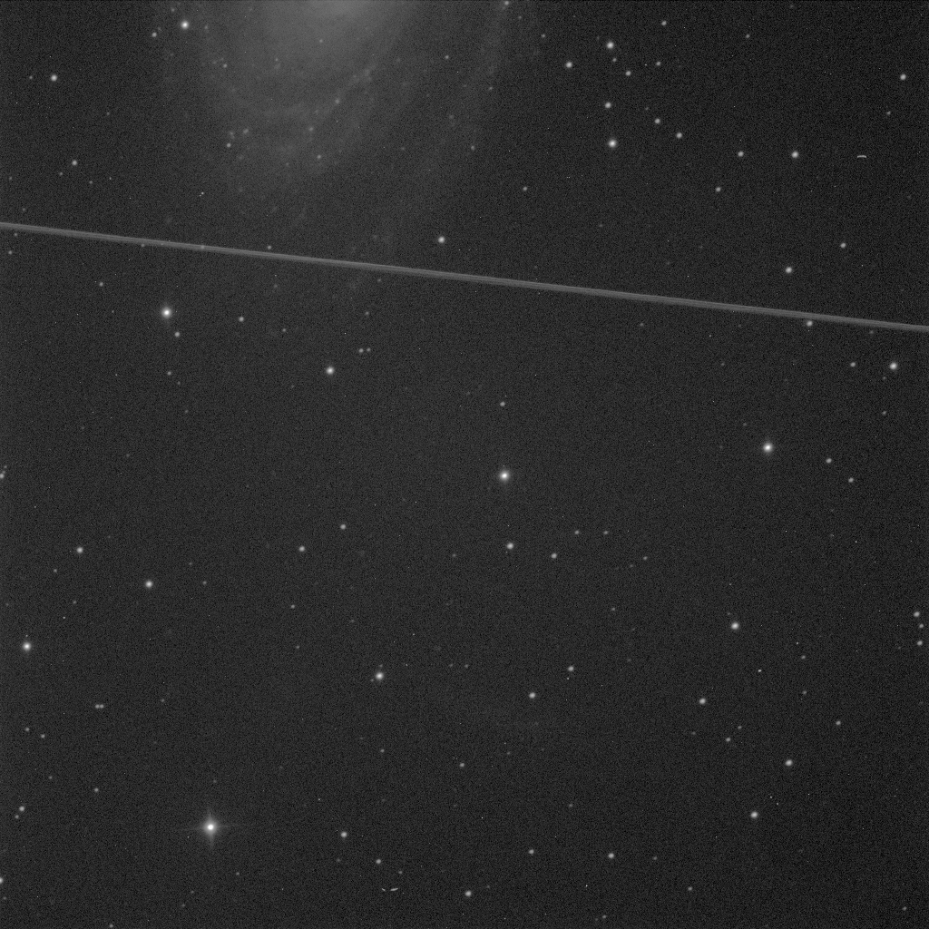
Plane

Slide 14
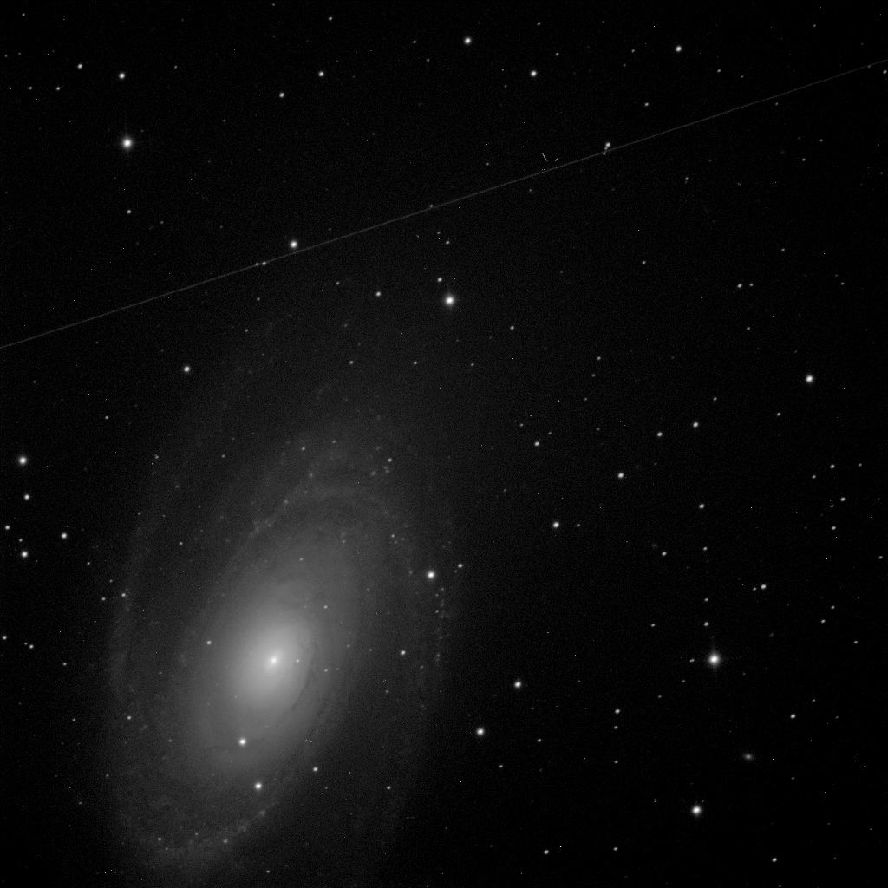
Satellites

Slide 15
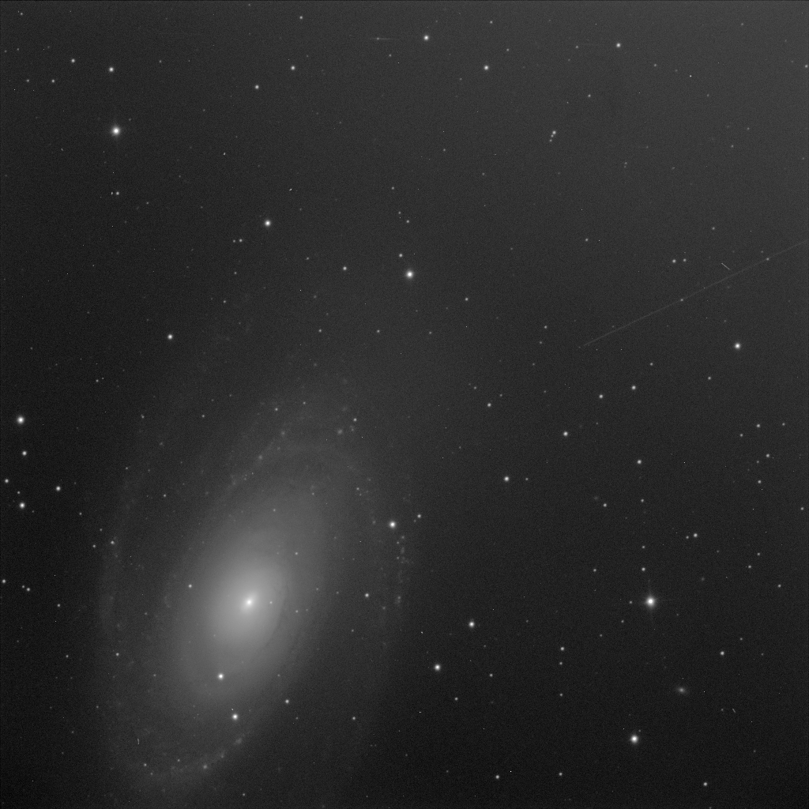
Satellites

Slide 16
Satellites

Slide 17
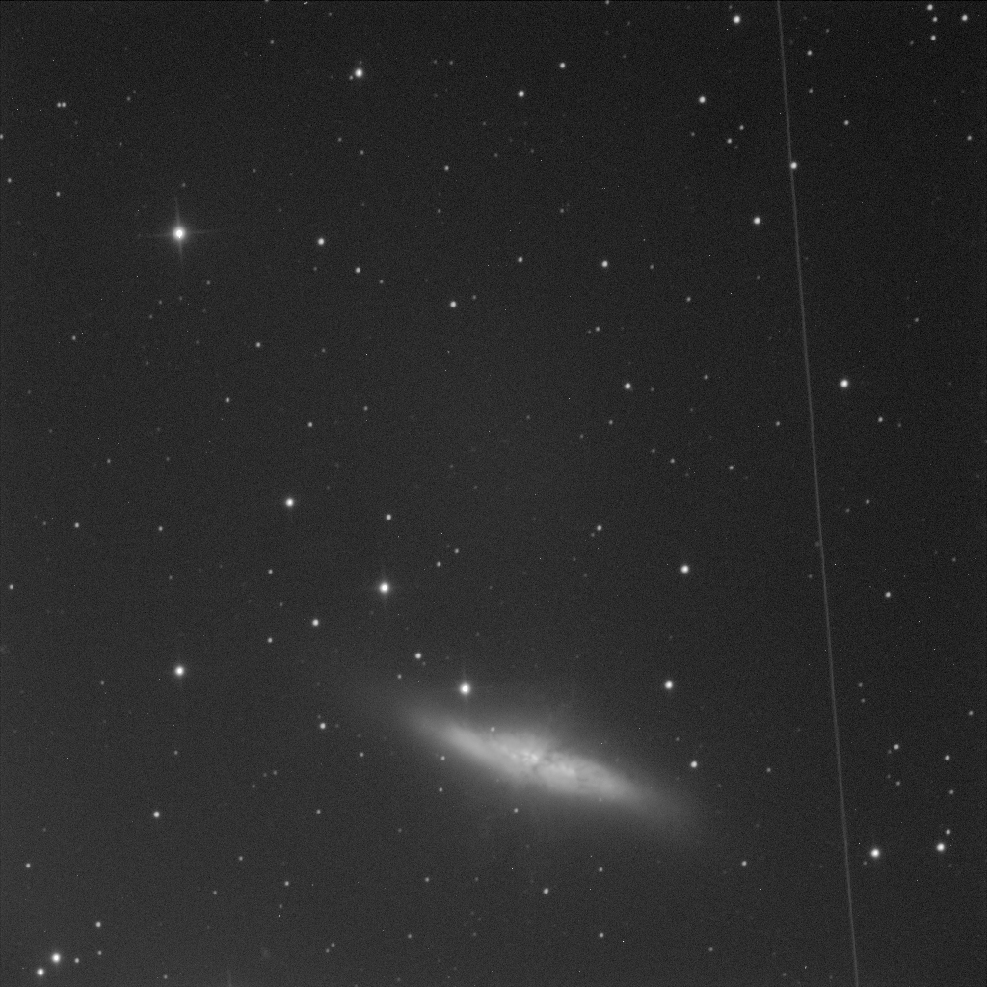
Satellites

Slide 18
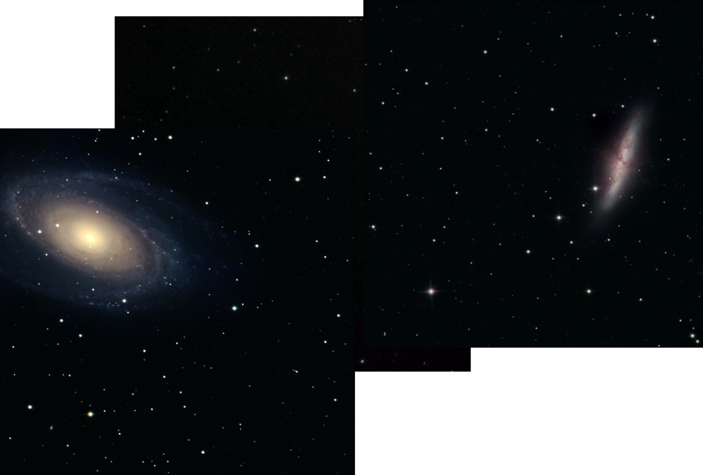
Final image

Slide 19
References
[1] - K. G. Jones (1991). Messier's Nebulae and Star Clusters (2nd ed.). Cambridge University Press. ISBN 0-521-37079-5.
[2] - S. J. O'Meara (1998). The Messier Objects. Cambridge University Press. ISBN 0-521-55332-6.
[3] - N. Devereux, H. Ford, Z. Tsvetanov, and J. Jocoby (2003). "STIS Spectroscopy of the Central 10 Parsecs of M81: Evidence for a Massive Black Hole". Astronomical Journal 125 (3): 1226–1235. Bibcode:2003AJ....125.1226D. doi:10.1086/367595
[4] - Barker, S.; de Grijs, R.; Cerviño, M. (2008). "Star cluster versus field star formation in the nucleus of the prototype starburst galaxy M 82". Astronomy and Astrophysics 484 (3): 711–720. arXiv:0804.1913. Bibcode:2008A&A...484..711B. doi:10.1051/0004-6361:200809653.

Slide 20
References (images)
M81 - This image combines data from the Hubble Space Telescope, the Spitzer Space Telescope, and the Galaxy Evolution Explorer (GALEX) missions. The GALEX ultraviolet data were from the far-UV portion of the spectrum (135 to 175 nanometers). The Spitzer infrared data were taken with the IRAC 4 detector (8 microns). The Hubble data were taken at the blue portion of the spectrum.
M82 - the Cigar galaxy . Exposure: 30 sec (B) , 25 sec (V), 120 sec (H alpha) dithering two frames for each color. The long streamers moving away from the nucleus are now believed to be caused by the Superwind effect. Photo from Astronomy Picture of the Day, April 4, 2000, from FOCAS Subaru 8.3 meter Telescope, NAOJ.

