Slide 1
Narrowband Imaging
By: Kevin Ryan

Slide 2
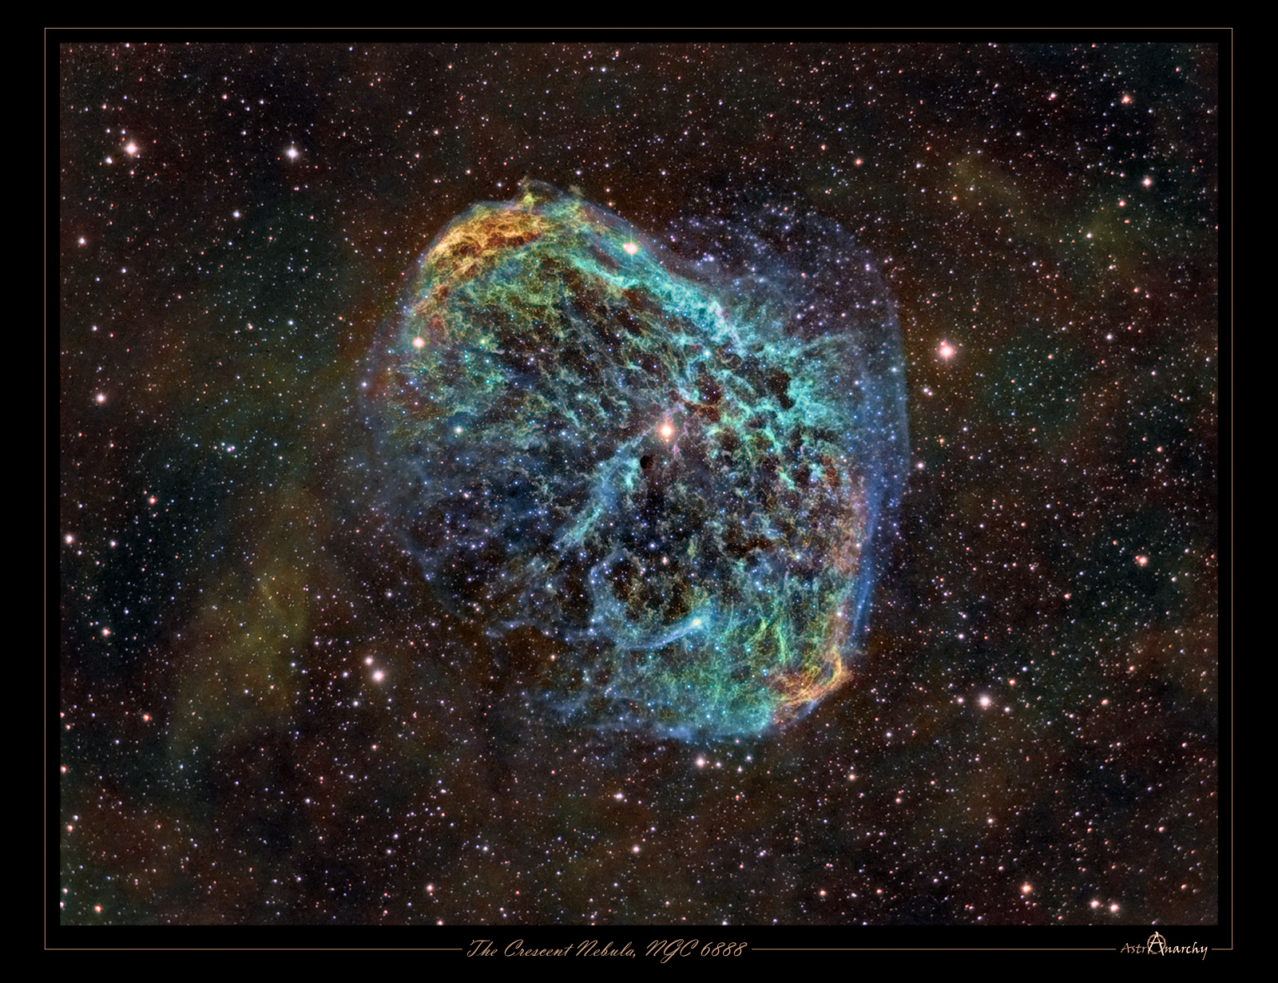
Why NGC 6888?
Narrowband imaging only works with an emission nebula, because the filters only show specific emission lines
It had a bright enough guide star
It makes for a great picture

Slide 3
About the Crescent Nebula
It is a part of the constellation Cygnus
It is about 5,000 light years away
The central star, WR 136, is shedding it’s outer envelope in a strong stellar wind
The nebula’s complex structures are a result of this stellar wind interacting with materials ejecting from the star at an earlier stage in the star’s life
The central star is near the end of it’s stellar life
When this star goes supernova it is probable that it will eventually destroy this nebula

Slide 4
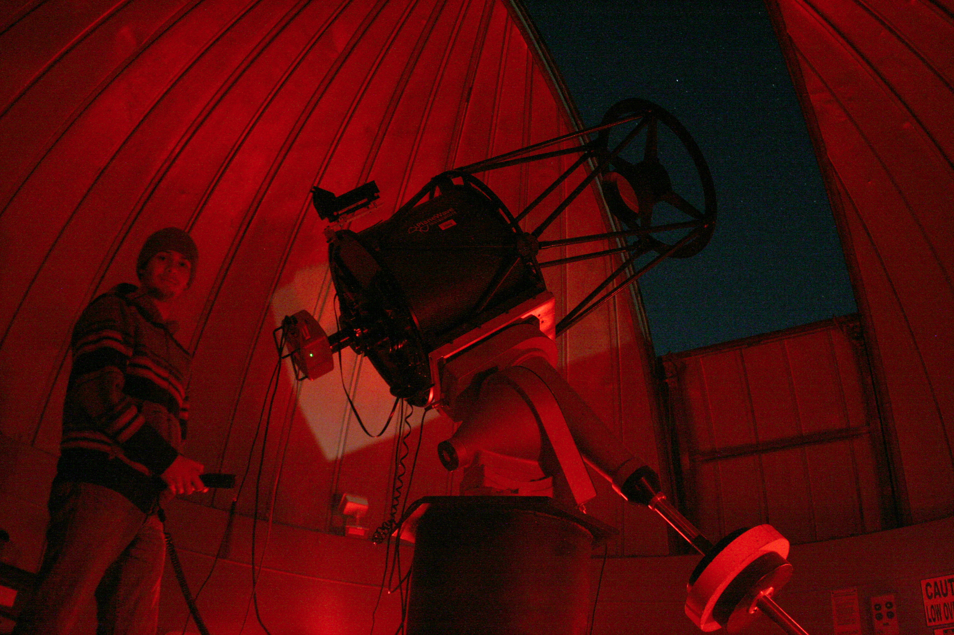
Taking the Images
20” Cassegrain Telescope
SBIG STL 1001E CCD
H-Alpha, Sulfur [II], and Oxygen [III] filters
Exposure length for all filters was 5 minutes

Slide 5
Taking the Images Cont.
13 H-Alpha, Most Detail
12 Sulfur [II]
12 Oxygen [III]
Took the H-Alpha on a separate night because of time constraints

Slide 6
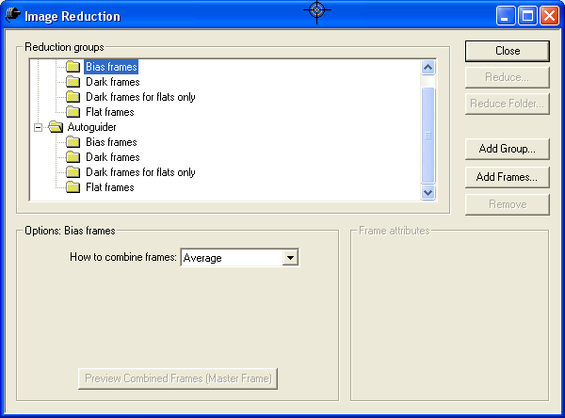
Processing
CCD Soft
Master Dark
Dark Subtraction
Alignment
Add and Median Combining

Slide 7
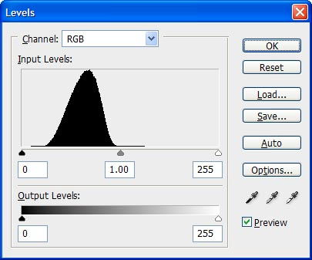
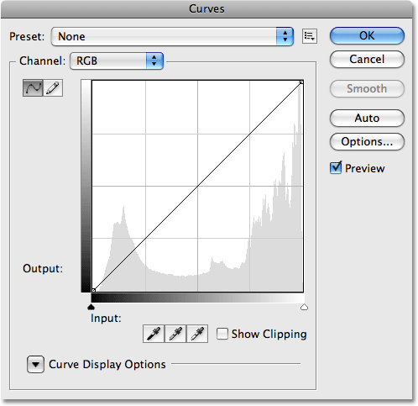
Photoshop
Utilizing levels and curves
After this process I realized that the add combine had greater detail so I only used those for the rest of the processing.
Combining the different filters using color channels

Slide 8
Hubble Palette
Sulfur [II] has a slightly longer wavelength than H-Alpha so it should be placed in the Red channel
Sulfur [II]= Red
H-Alpha= Green
Oxygen [III]= Blue

Slide 9
ESO Palette
Hydrogen appears as a red color when imaging and the H-Alpha filter shows how much Hydrogen is in a nebula
It is truer to the image if you place H-Alpha in the Red channel
H-Alpha= Red
Sulfur [II]= Green
Oxygen [III]= Blue

Slide 10
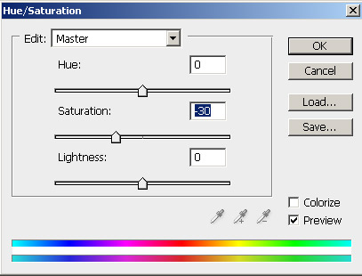
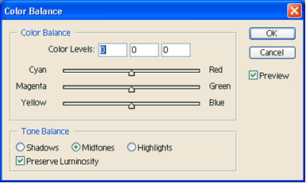
Photoshop Cont.
RC-Astro
Color Balance Tool
Saturation and Hues

Slide 11
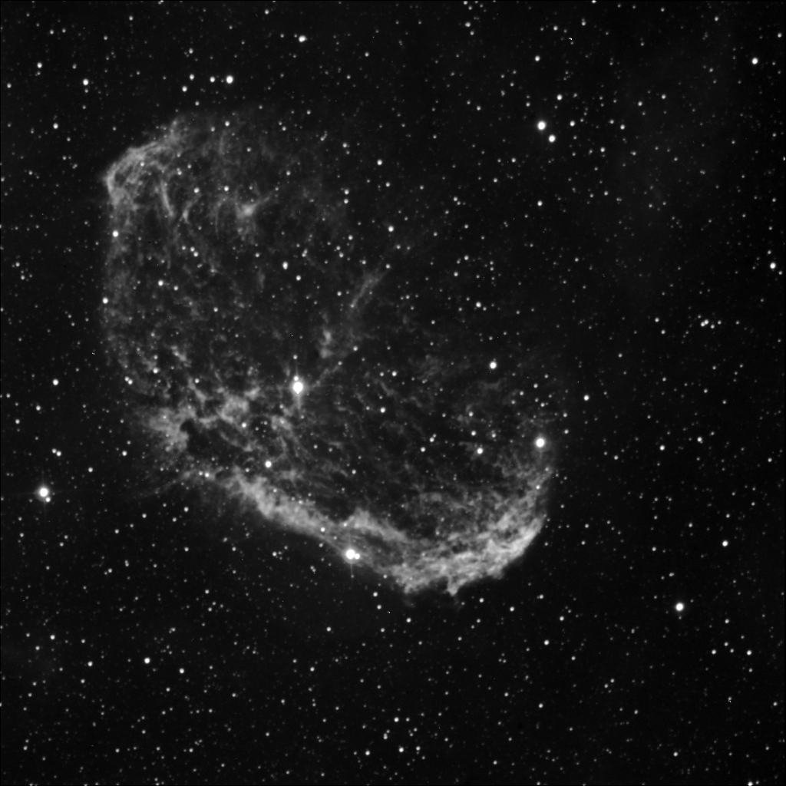
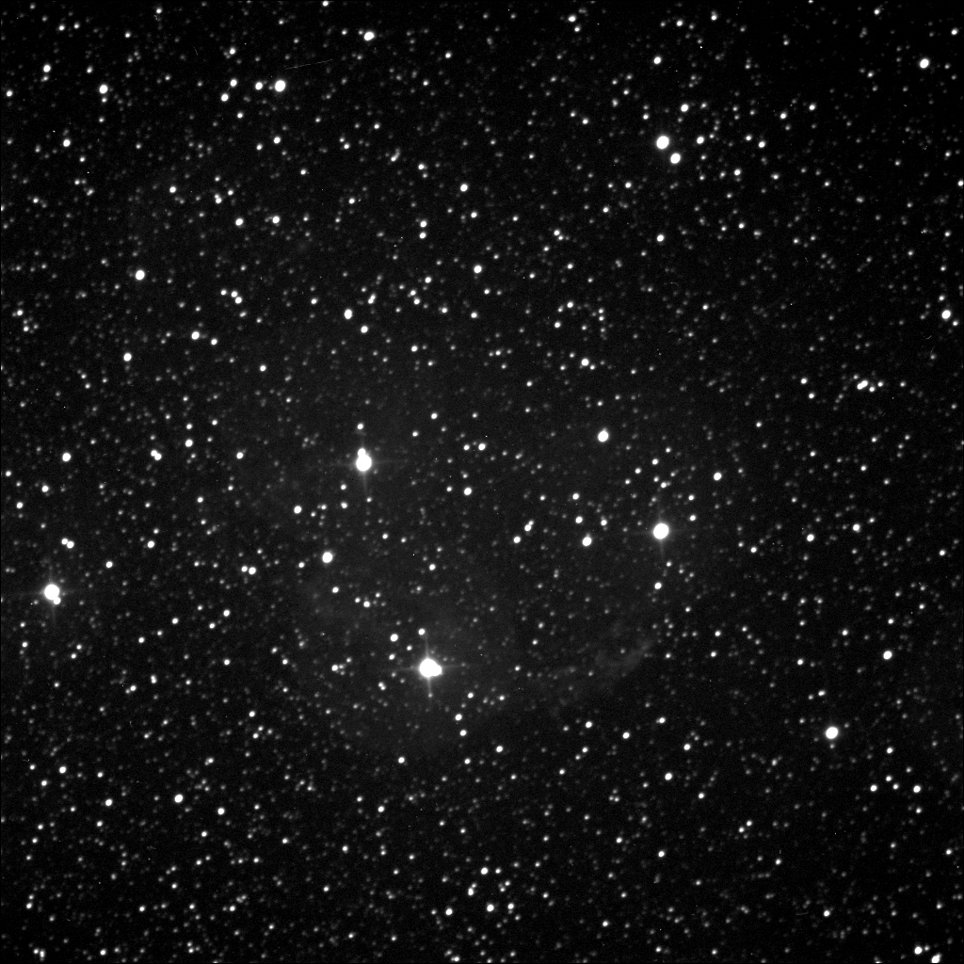
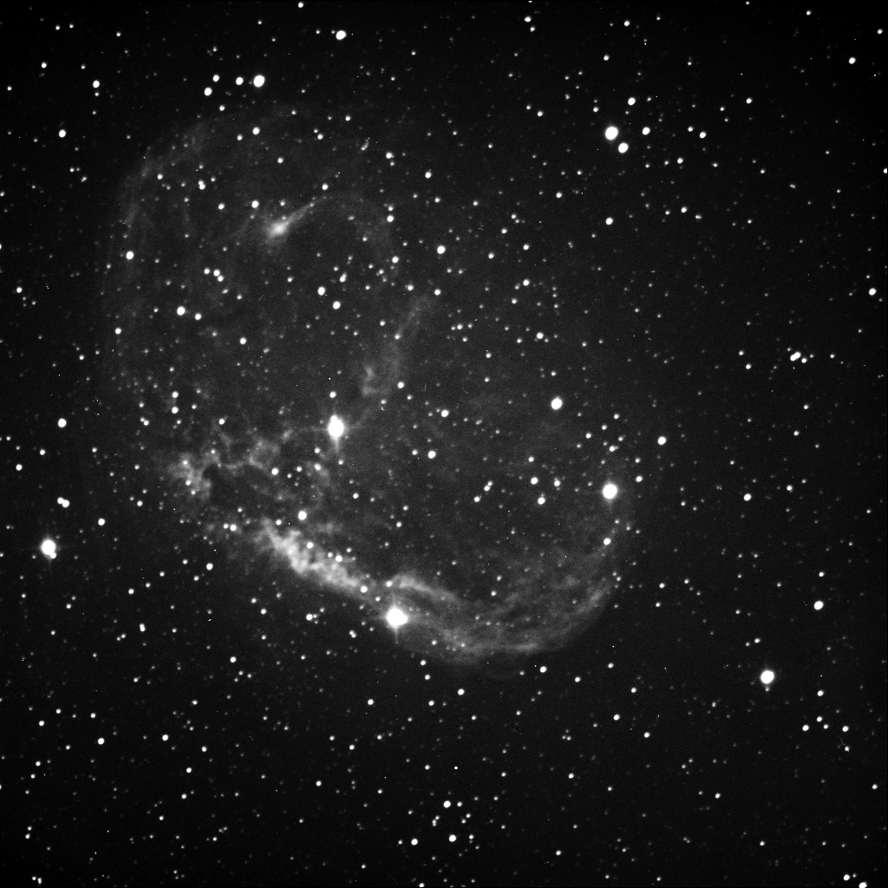
H-Alpha
Sulfur [II]
ESO Palette
Oxygen [III]

Slide 12
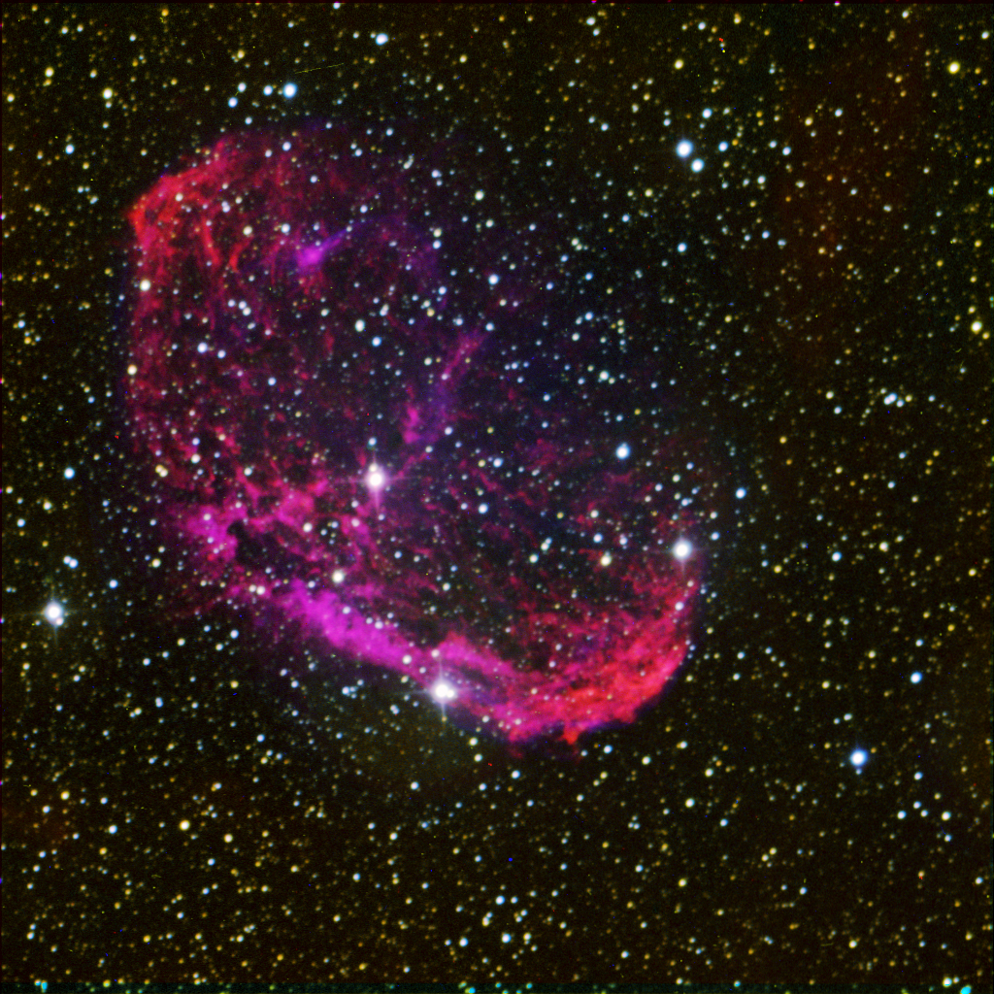

Slide 13
Sulfur [II]
H-Alpha
Hubble Palette
Oxygen [III]

Slide 14
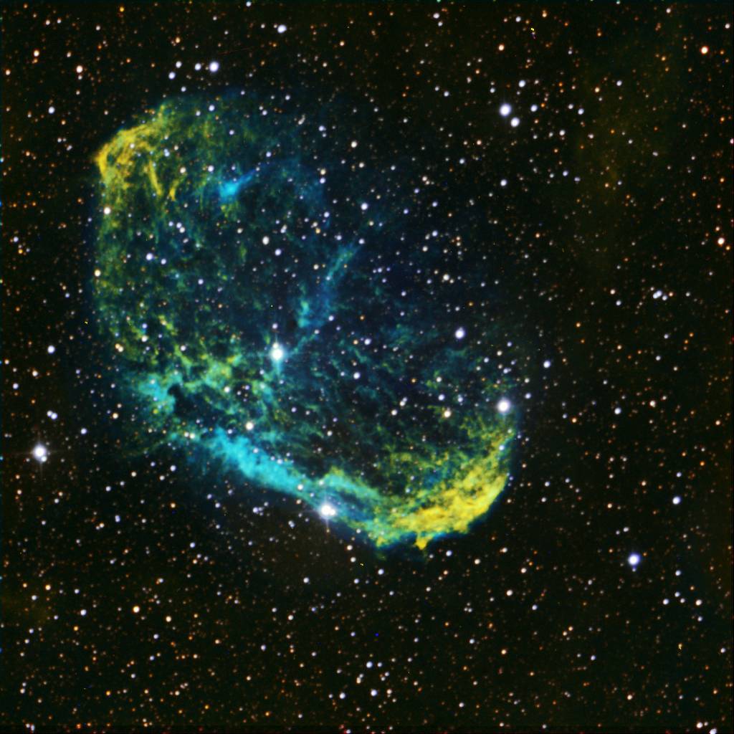

Slide 15
Works Cited
http://bf-astro.com/hubblep.htm
http://apod.nasa.gov/apod/ap120816.html
http://www.noao.edu/image_gallery/html/im0834.html
http://www.ancientstarlight.com/NGC6888Hub.html
http://www.starrywonders.com/hacrescent.html
http://www.bisque.com/help/CCDSoft/afxcore/image_reduction_command.htm

