Slide 1
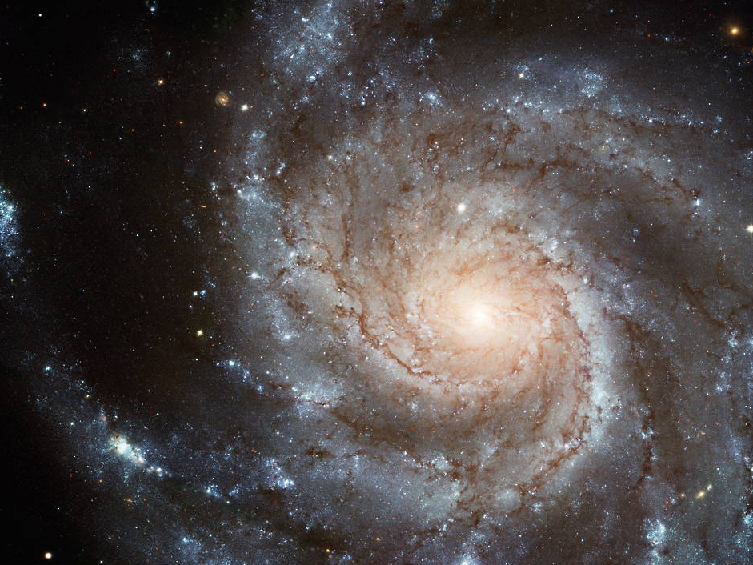
M101
the pinwheel
hubble

Slide 2
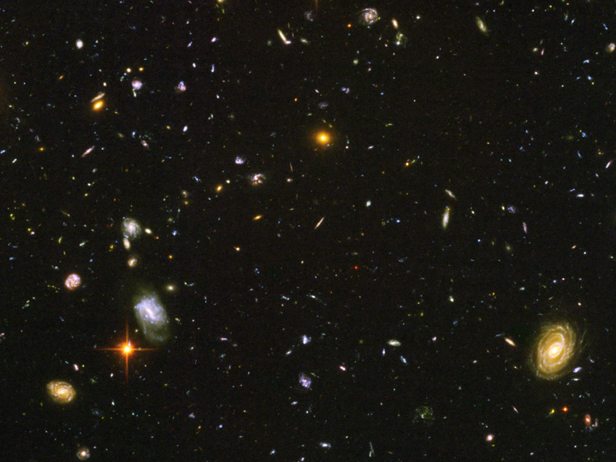
Goal
Capture a detailed image of a galaxy
with hydrogen alpha highlights
Why M101?
It seemed like the galaxy most likely to yield detailed images
&
Bright h-alpha regions
hubble

Slide 4
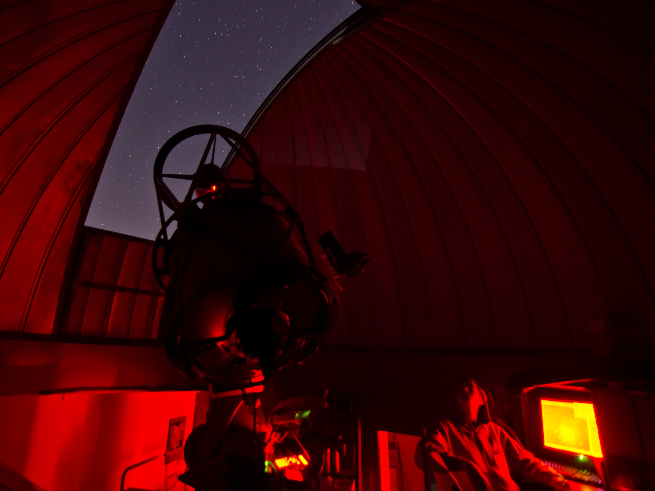
Gathering Data
the telescope:
20” Planewave Cassegrain CDK f/6.8
the exposures:
Red:
Green:
Blue:
Hydrogen Alpha:
Luminance:
Total:
10x 3 minutes
10x 3 minutes
10x 3 minutes
10x 3 minutes
10x 3 minutes
2.5 hours

Slide 5
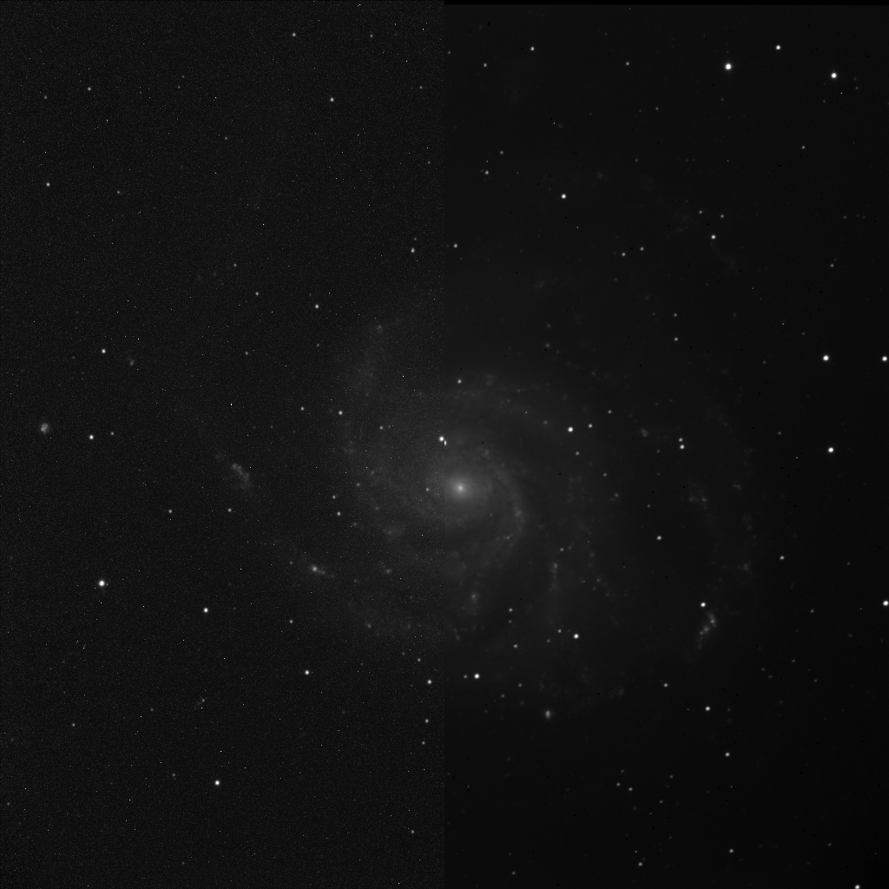
Before
&
After Dark Subtract

Slide 6
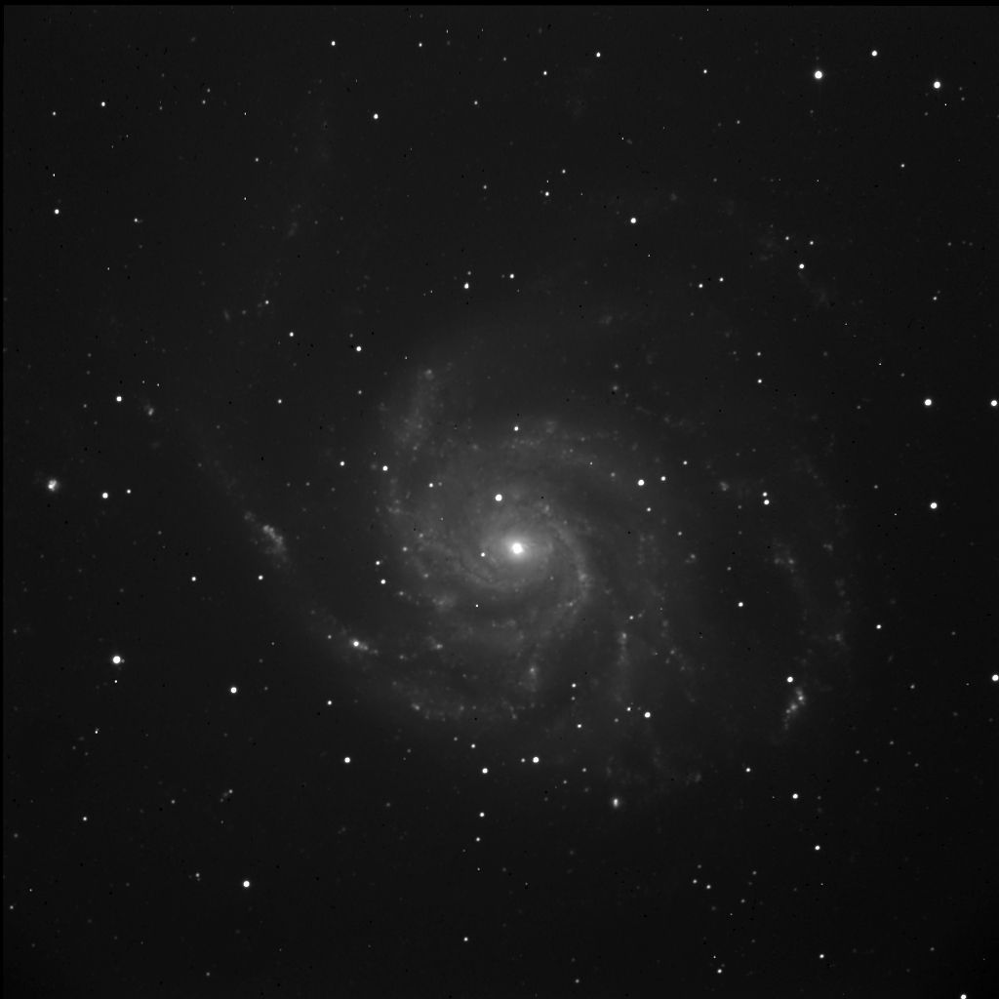
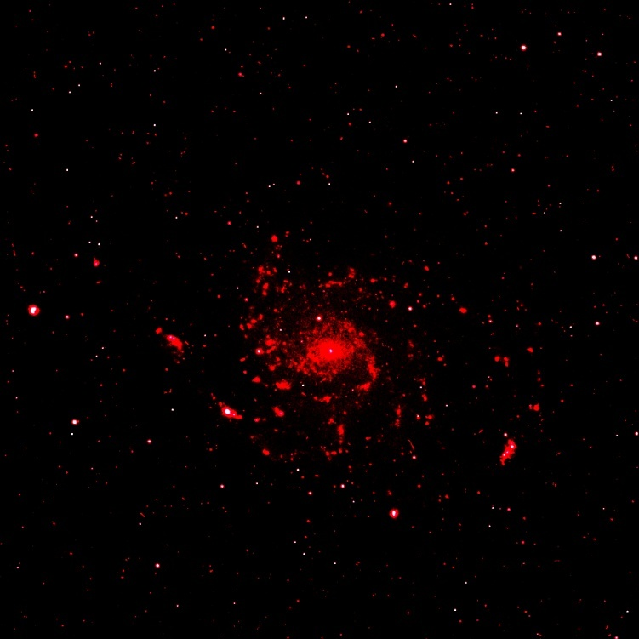
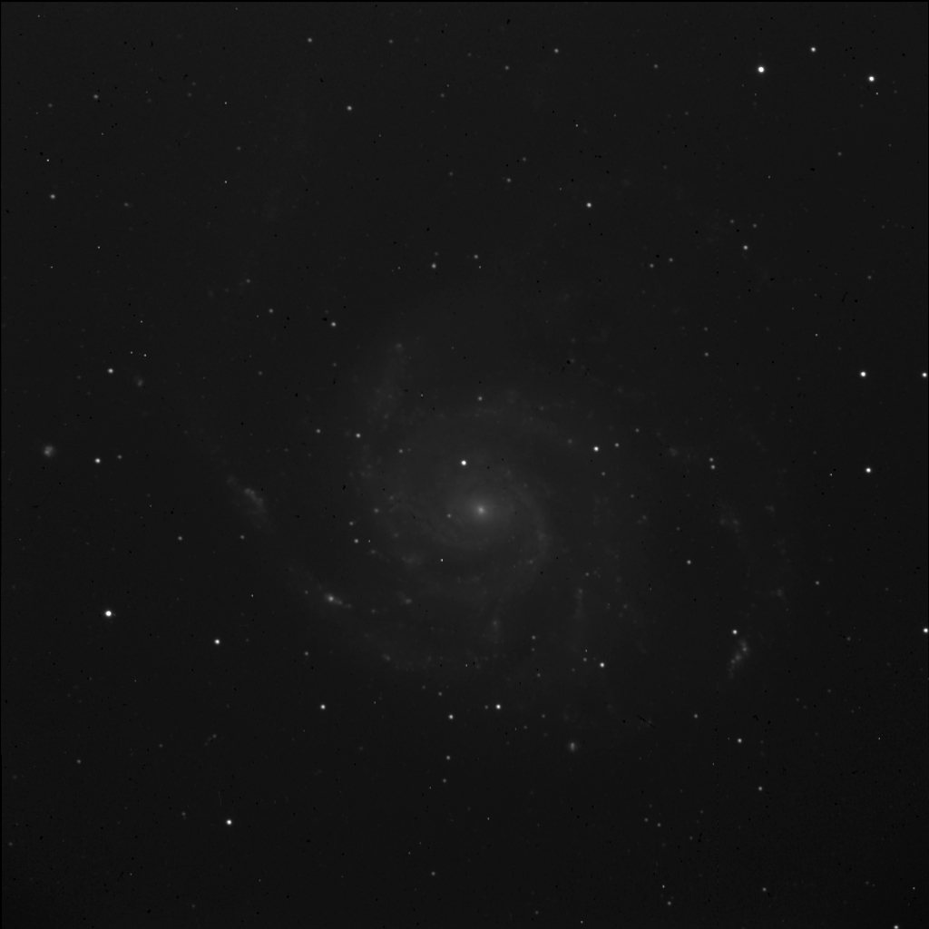
Luminance
H-Alpha
Red
Green
Blue

Slide 7
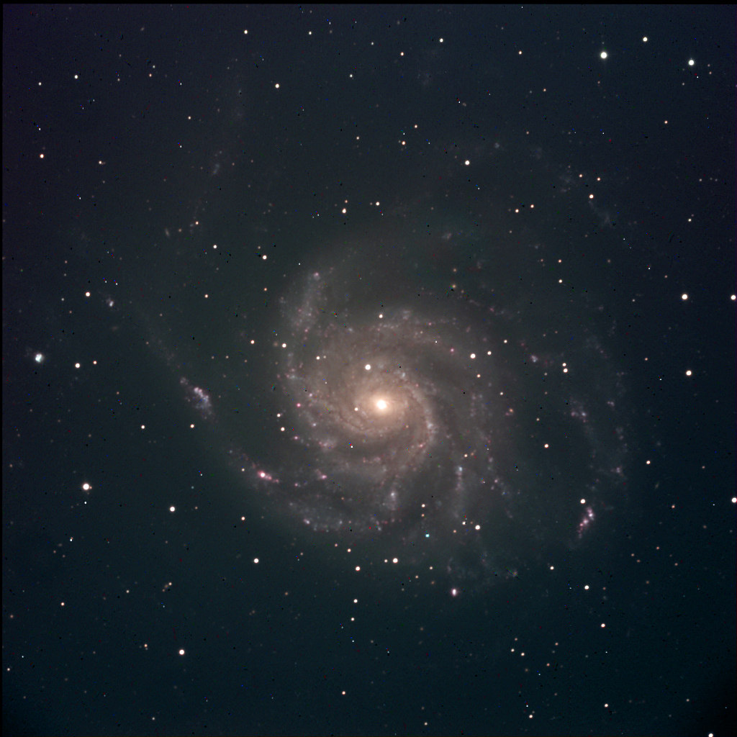
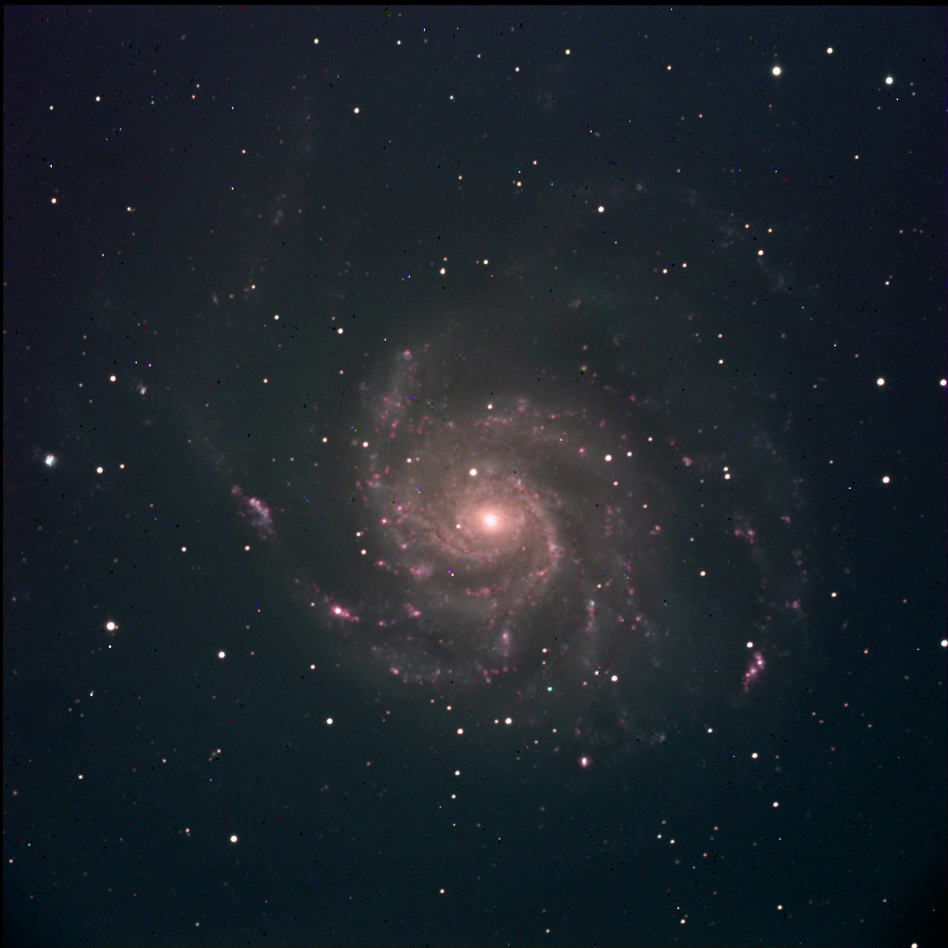
Color
&
Hydrogen Alpha

Slide 8
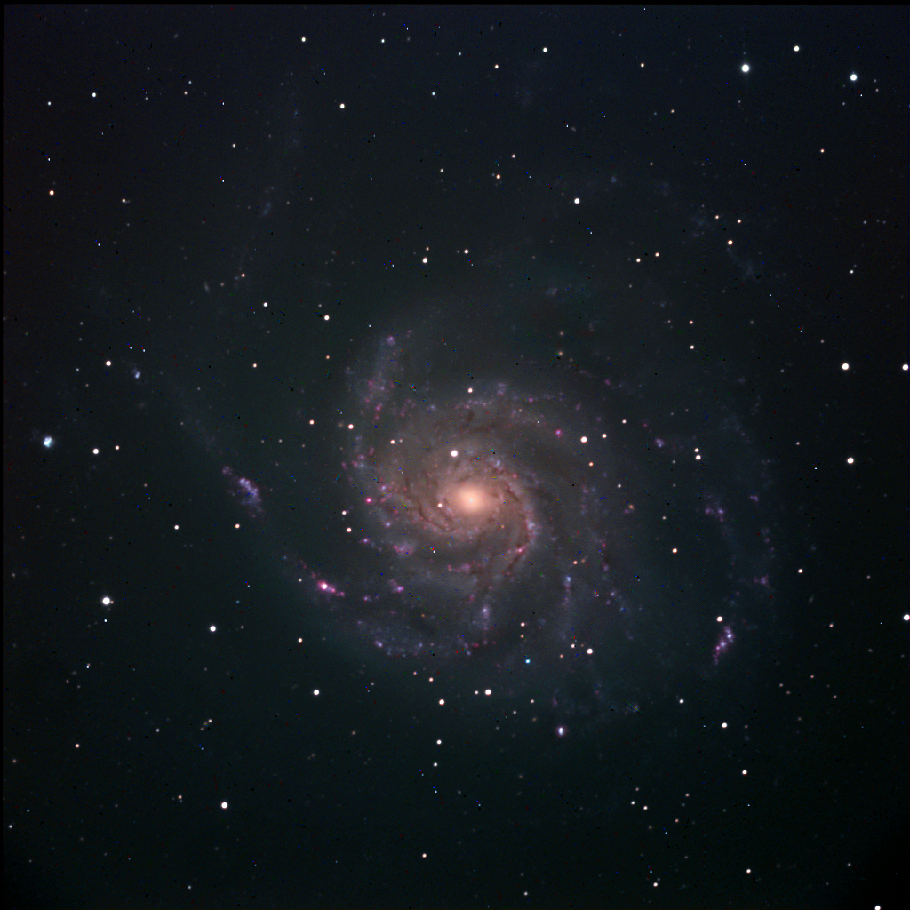
More Color Adjustments
&
Burning

Slide 9
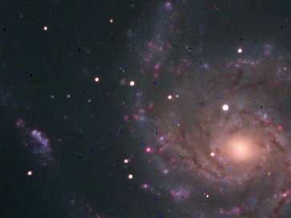
Speck Removal

Slide 10
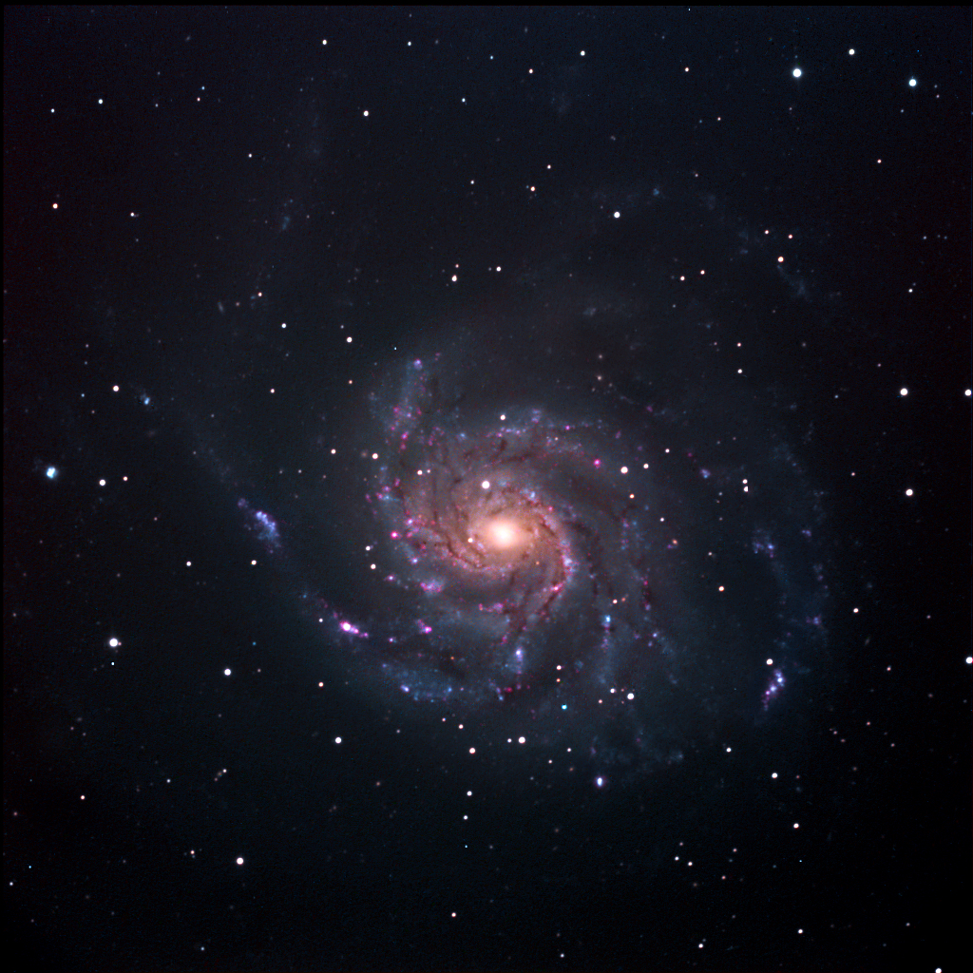
Final Image

Slide 11
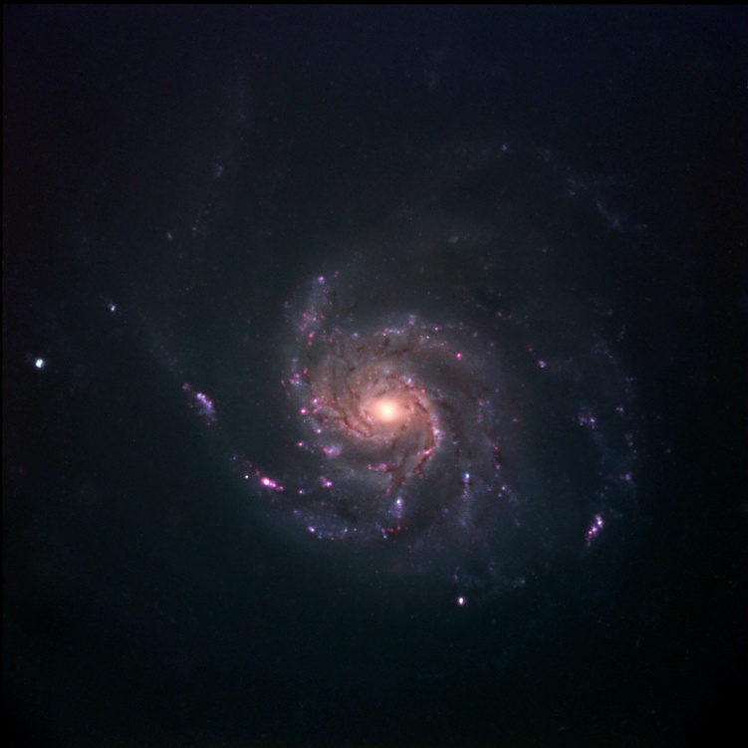
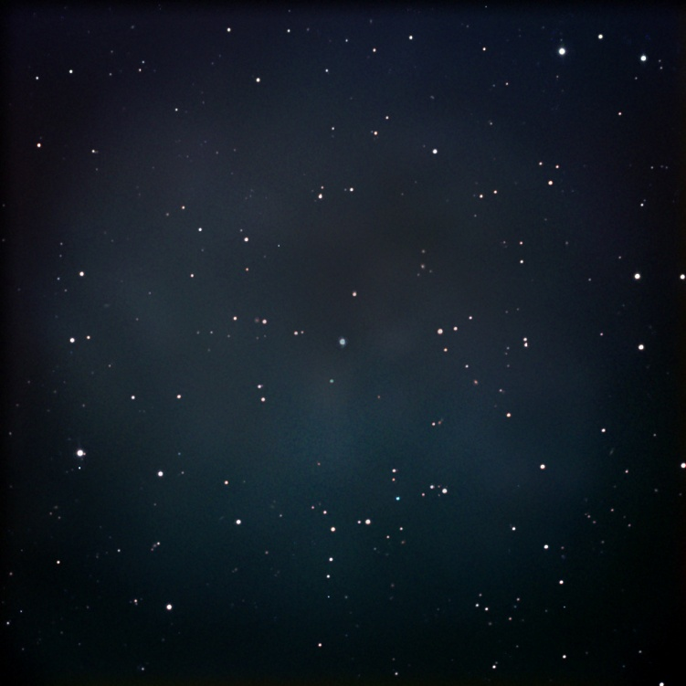
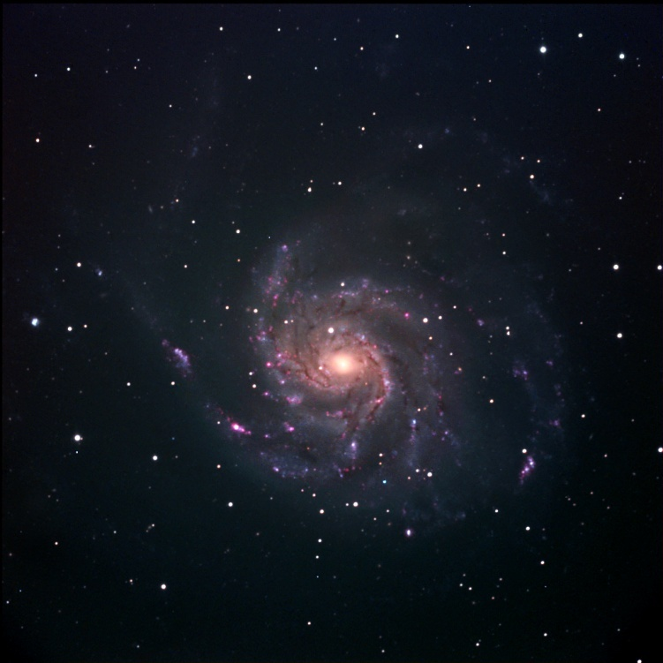
Separating Elements
stars
original
galaxy

Slide 12
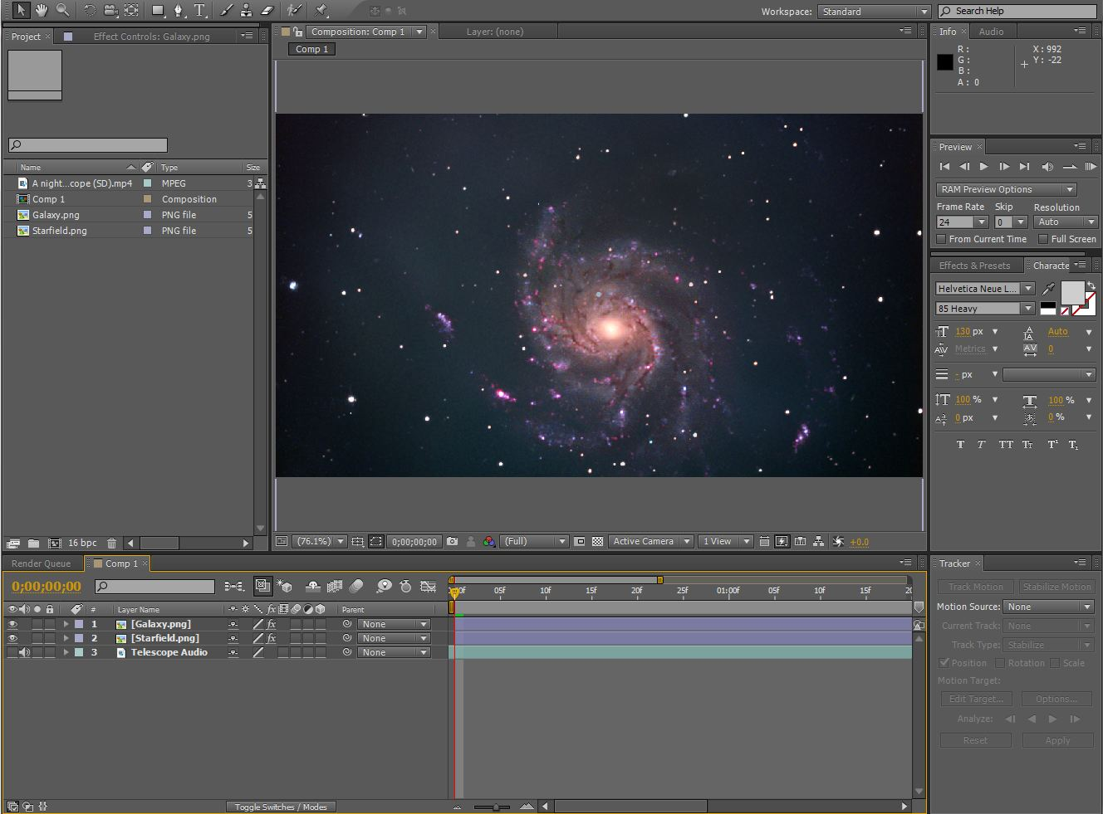

Slide 14
Sources
http://messier.seds.org/m/m101.html
http://blogs.discovermagazine.com/badastronomy/2011/08/25/astroalert-type-ia-supernova-in-m101/
http://www.astr.ua.edu/gifimages/m101b.html
http://ltscorpio.lamost.org/article/article_hargbprocessing/article_hargbprocessing.htm
http://en.wikipedia.org/wiki/Messier_101
http://starizona.com/acb/ccd/software/ps_hargb.aspx
http://www.docstoc.com/docs/3644163/Tips-for-Processing-LRGB-and-HaRGB-Images-Getting-the-Color-Right

