Slide 1
Photometric Data of USNO-B1 1289-0181948
Blake Head

Slide 2
What is a Variable Star?
A variable star is simply a star that changes in brightness over a set period of time (generally). This can happen in eclipsing binaries, where a star passes in front of another companion star, and pulsating variables, in which a star physically pulsates inwards and out due to instabilities within its core.

Slide 3
Why Photometry?
I chose to do photometry because it seemed like a great way to learn what kind of things people working in Astrophysics fields do for a living. Since we take pretty pictures every week in class, it was something different to do. Also, more data was needed for these stars, and little brown-nosing never hurts your grade!

Slide 4
Differentiable Photometry
This type of photometry works by comparing your target star’s brightness to another’s brightness and measuring the difference between the two.

Slide 5
Object
My object name is USNO-B1 1289-0181948
It is located in the constellation Lynx.
It is a magnitude 14.97 star
It was discovered by Dr. Clark in December 2011
It has already been studied in some detail by Dr. Clark in December of 2011.
It has a recorded period of around 3.0166 hours.
It is an eclipsing binary system

Slide 6
Picture of sky w/ star labeled

Slide 7
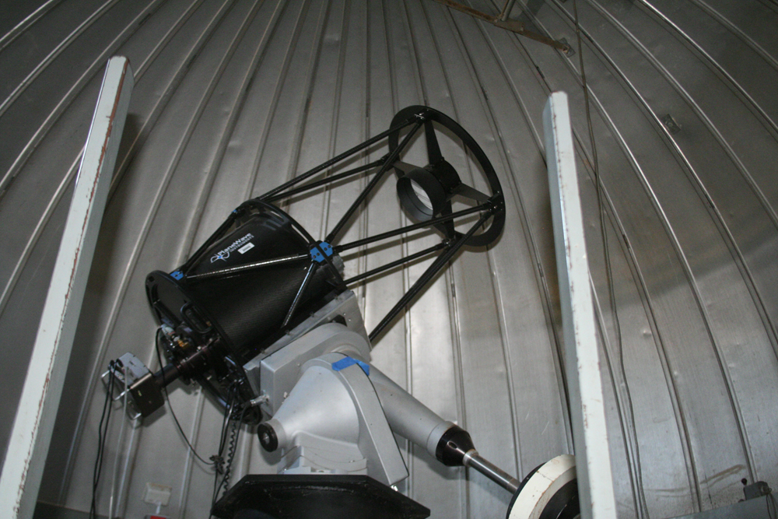
Data Collection
20” f/6.8 Planewave Cassegrain
STL-1001XE CCD
CCD Cooled from -25 to -32 C°
Dark-Frame calibration
Flat-Frame Calibration
Dirt
Picture courtesy of Dr. Clark from TTU Observatory Website

Slide 8
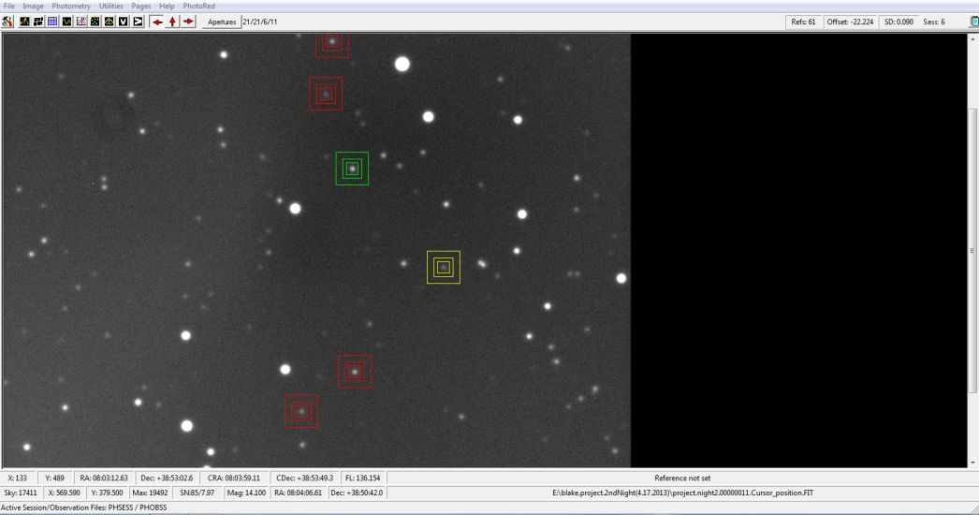
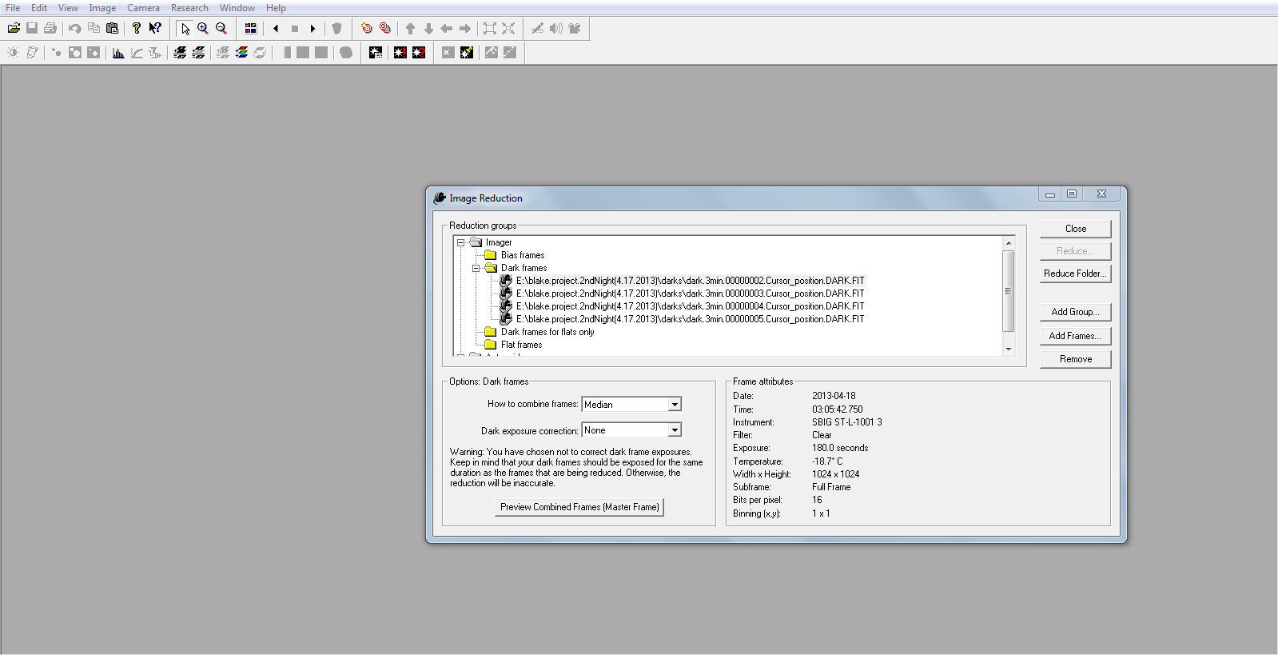
Data Processing
I processed my data using CCD-Soft and MPO Canopus .
CCD-Soft is used for creating my Master Dark frames, and MPO Canopus is used for analyzing and creating the light curve of my data.

Slide 9
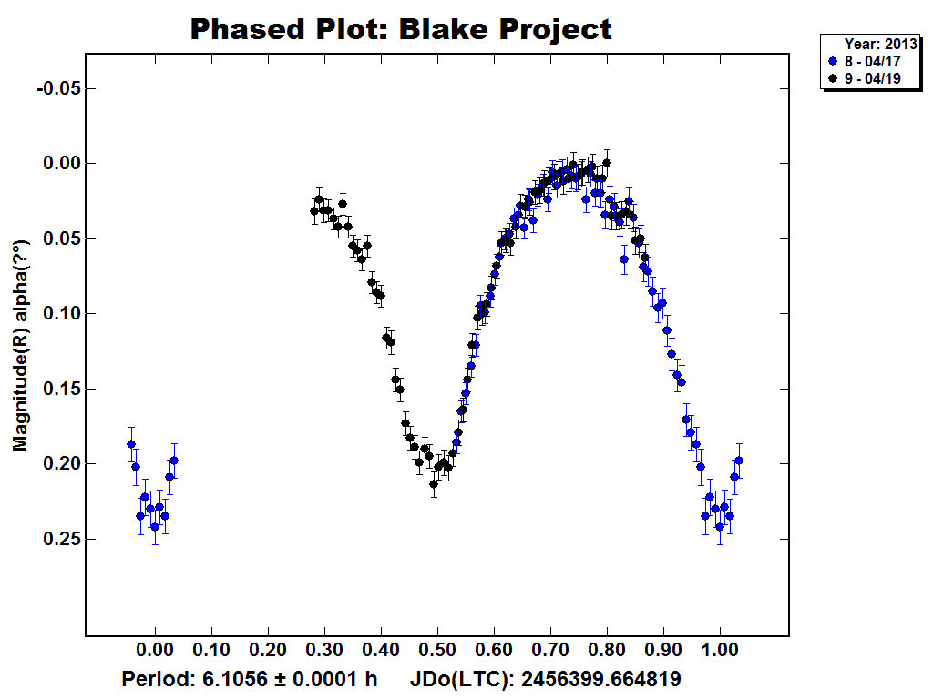
The Light Curve Plot

Slide 10
Dr. Clarks Data from Dec. 2011

Slide 11
When you combine the graphs…

Slide 12
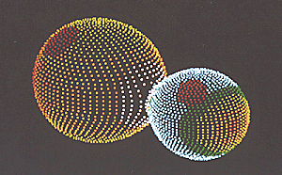
So what is it?
WUMA-Star
Stars so close together that they exchange matter!
Explains fast orbit
Could explain change in period from 2011-2013 observations
We would need to get a spectrum of the stars

Slide 13
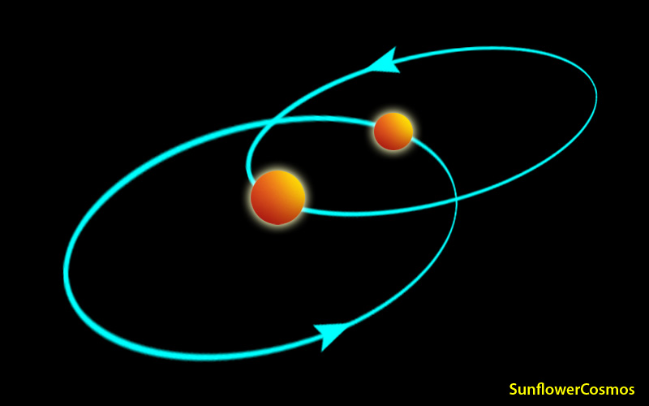
So what is so special about a light curve?
Physics!
Matter Transfer rate
Detailed description of orbits
3D Modeling

Slide 14
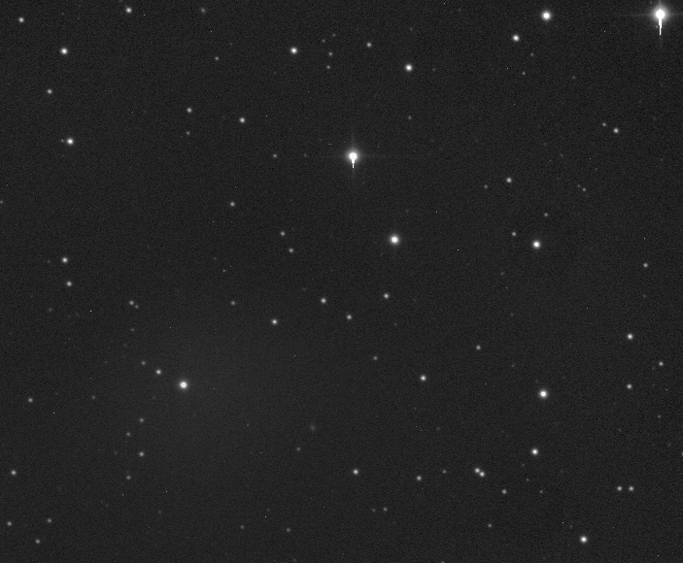
Photometry? What could possibly go wrong?
Telescope not wanting to connect!
CCD not wanting to conncet!
Original Project was too low! (Got to find this out while AT the observatory)
Gale force winds!
Almost missing the target!
Not being able to find the target!
Clouds!
Telescope re-syncing!
Dark frames with light in!
Seeing conditions deteriorate within 1 minute!
Dirt storms!

Slide 15
Sources
http://www.astro.wisc.edu/~bailey/BSs_Formation.html
http://www.sunflowercosmos.org/gallery/gallery_12.html

