Slide 1
NGC 3718
Amy Meadows

Slide 2
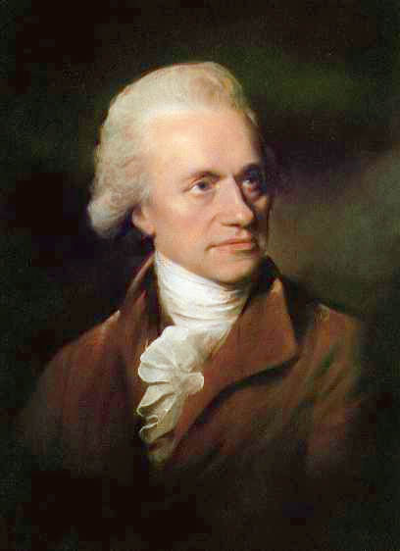
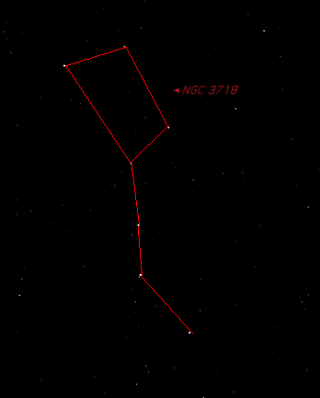
History
Discovered by William Herschel in April 1789
Located in the Big Dipper
“What a strange galaxy. There is not much information about this galaxy in the astronomical literature.”
-http://www.noao.edu/outreach/aop/observers/n3718.html

Slide 3
NGC 3718 Facts
Magnitude: 11.5
RA: 11h 32m 35.57s
Dec: +53˚ 03’ 59”
Barrel Spiral Galaxy (S-shaped)
Known as “peculiar” or “warped”
52,000,000 light-years away from Earth
It is believed the galaxy interacting gravitationally with it is NGC 3729
~150,000 light-years apart

Slide 4
Hickson Group 56
400 million light-years away from us
Group of 5 galaxies
4 of them interacting

Slide 5
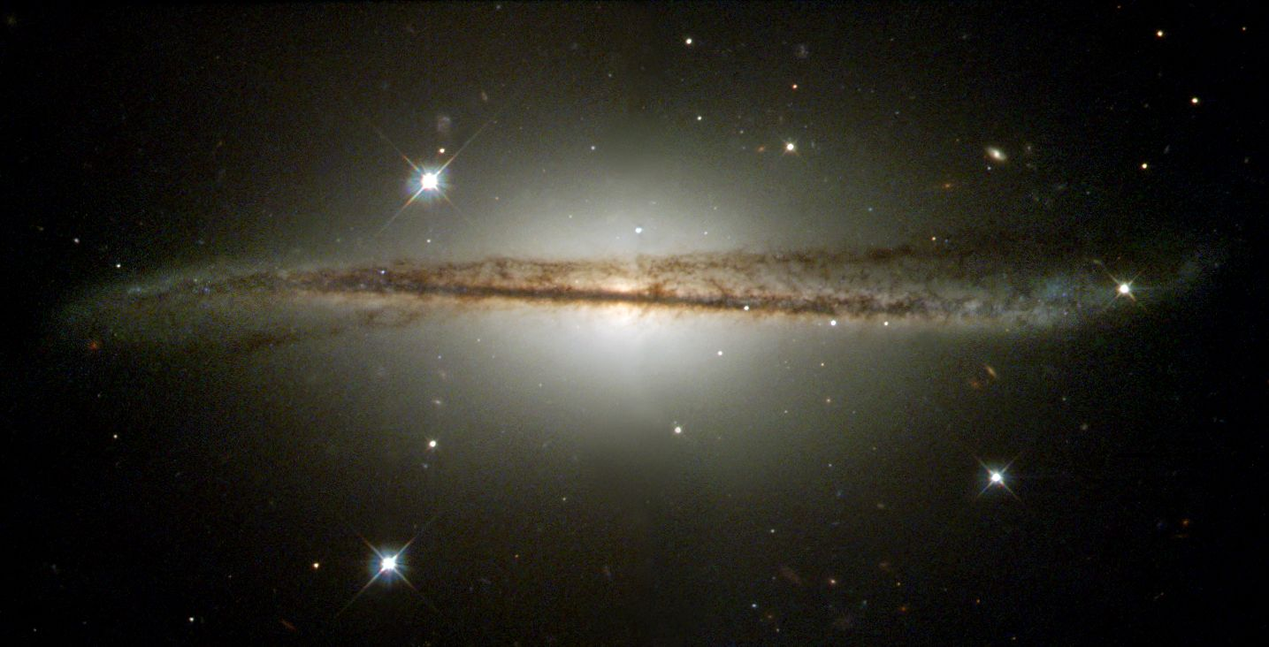
Reason for Choosing
Originally wanted to do ESO 510-13
http://lempel.pagesperso-orange.fr/bizarre_une_galaxie_gauche_uk.htm

Slide 6
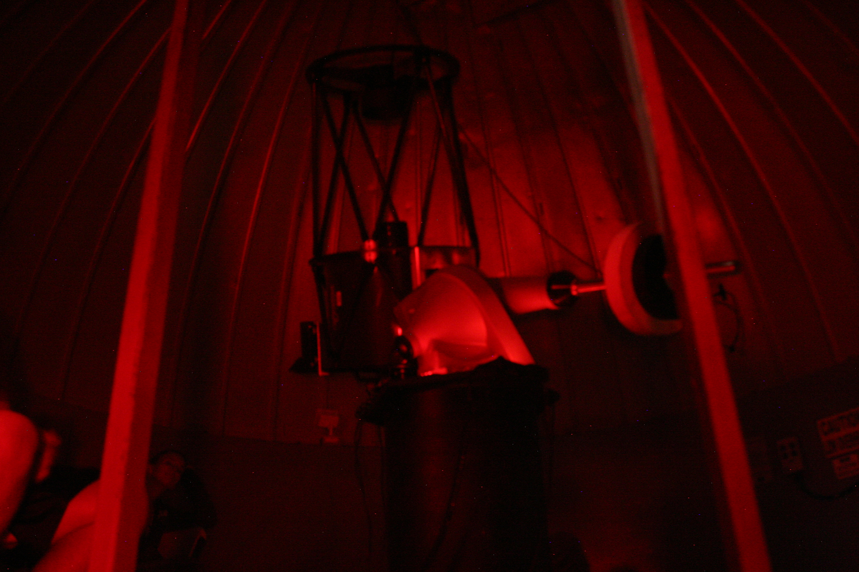
Telescope
20” Cassegrain
STL SBIG Large Format Camera
5- 3 min darks
10- 3 min red, green, blue filter
15- 3 min unfiltered

Slide 7
CCD Soft
Reduce
Align
Combine

Slide 8
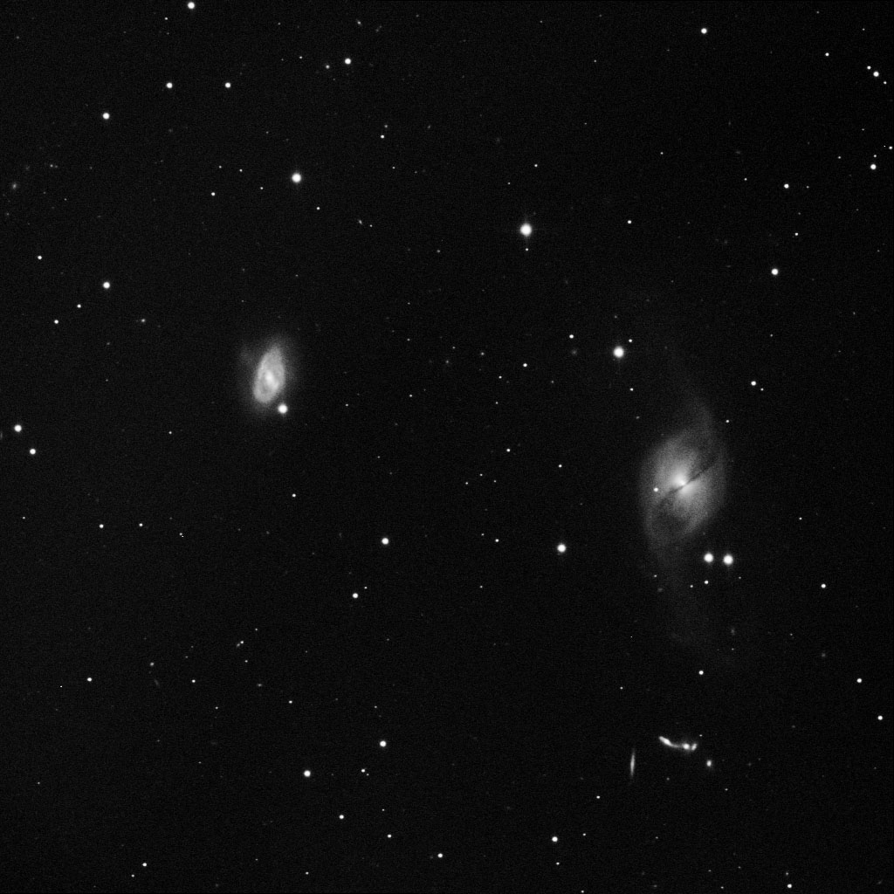
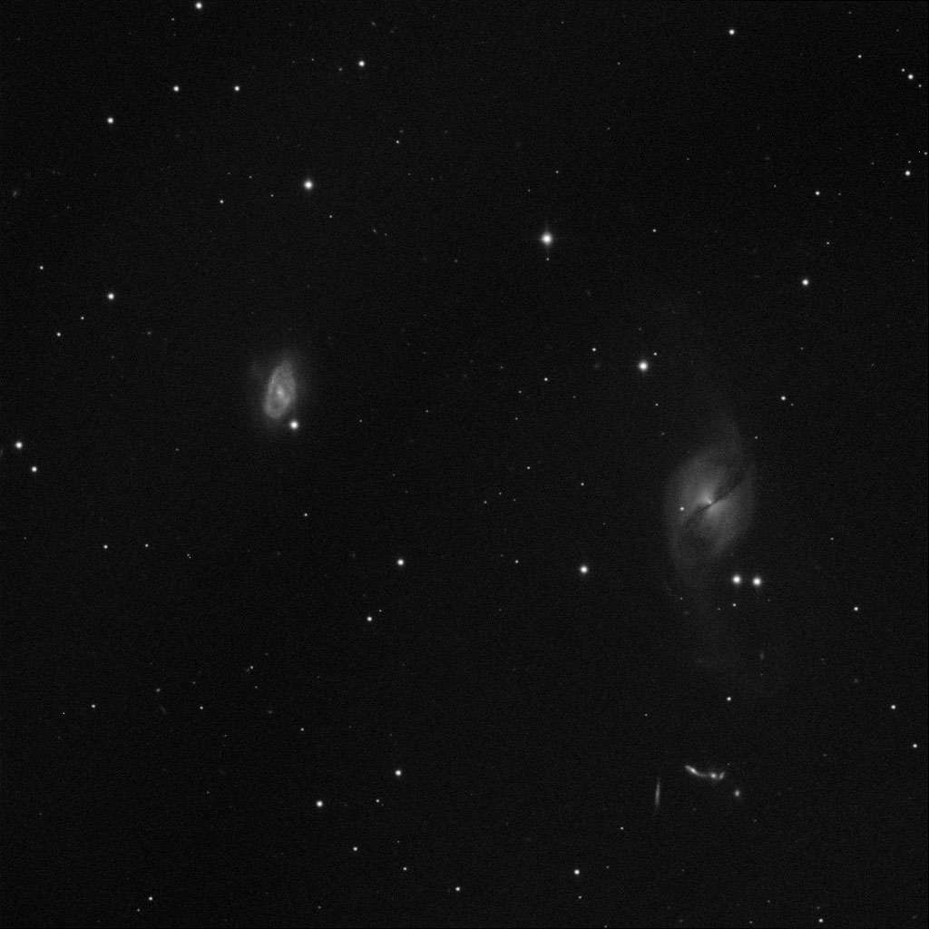
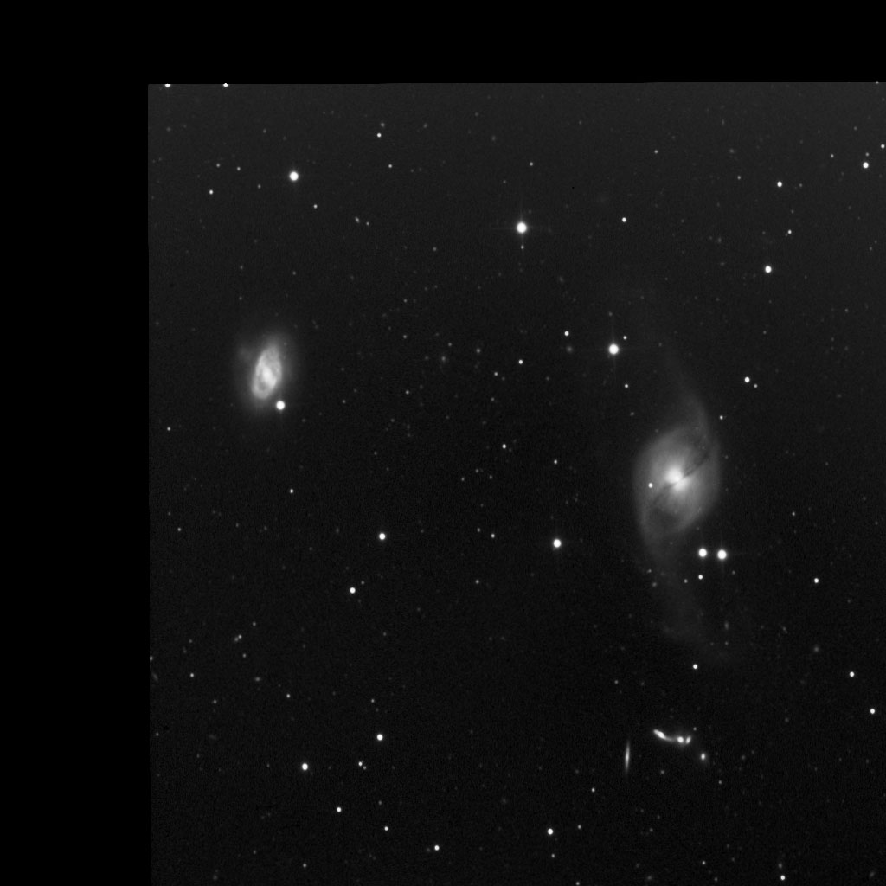
+
RED
GREEN
BLUE
+
+
=
UNFILTERED

Slide 9
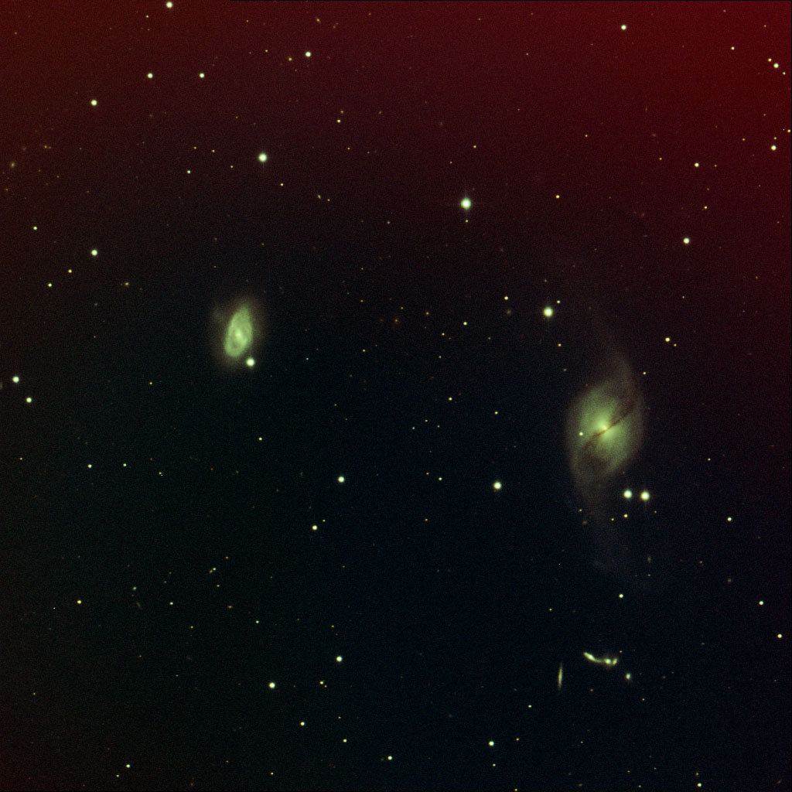

Slide 10
Photoshop
GradiantXTerminator
Levels
Curves
Color balance
Hue/Saturation

Slide 14
Bibliography
http://www.stargazer-observatory.com/ngc3718.html
http://lempel.pagesperso-orange.fr/bizarre_une_galaxie_gauche_uk.htm
http://www.kopernik.org/images/archive/n3718.htm
http://www.astronomersdoitinthedark.com/index.php?c=123&p=373

