Slide 1
DREAM Collaboration:
Recent Results on Dual Readout Calorimetry .
F.Lacava
for the DREAM Collaboration
Cagliari – Cosenza – Iowa State – Pavia – Pisa – Roma I – Texas Tech.
EPS Conference 2011

Slide 2
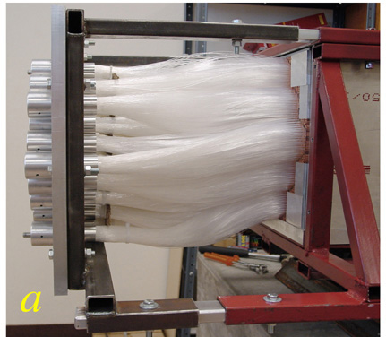
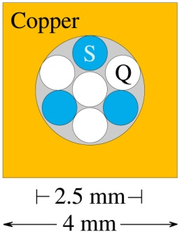
The Dual Readout Method The DREAM calorimeter
In hadronic calorimeters the fluctuations of the e.m. shower fraction (fem) dominate
the energy resolution for hadrons and jets.
In non compensating calorimeters (i.e. where e/h ≠ 1) it is possible to eliminate this
effect by measuring fem event by event.
This was achieved in 2003 in the DREAM Calorimeter with two active media:
- the signal S from Scintillating fibers to measure dE/dx from all charged particles,
- the signal Q from clear fibers (quartz or plastic) for Cherenkov light mostly from
the e.m. component of the showers.
Copper – Scintillating and Quartz (clear) fibers
19 hexagonal towers,
each tower: 270 hollow copper rods,
2 m (10 λInt) in depth , radius ≈ 16 cm ( < 1 λInt).

Slide 3
If R = 1 for e.m. shower , the response of the active media for an hadronic shower is:
where e/h is 1.3 for Scintill. and 4.7 for clear fibers
From the ratio of the signals in the quartz (clear) fibers Q and in scintillating fibers S :
fem is measured and the energy is corrected.
Resolution is limited by the small Cherenkov photon yield (9-18 per deposited GeV ).
“Jets” 200 GeV (pions interacting in a target)

Slide 4
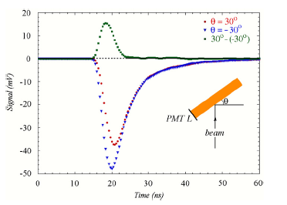
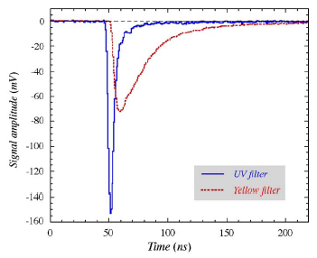
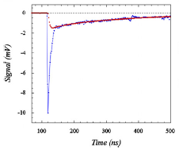
Dual Readout in crystals
In last years extensive studies were performed to extend the Dual Readout in crystals
used in homogeneous calorimeters . In these crystals a fraction of the light yield is due
to Cherenkov emission (1% in BGO, up to 15% in PWO).
The peculiar features of the Cherenkov light can
be exploited to separate the two types of light:
directionality : cos θ = 1/βn
timing : Cherenkov light is prompt (few ns) while
scintillation light has decay costant.
Spectral properties: 1/λ² distribution
One more tool: polarization of the Cherenkov light.
PbWO4
Yellow filter
long decay tail
UV filter
PbWO4
prompt light
BGO
(Signals after an UV filter)

Slide 5
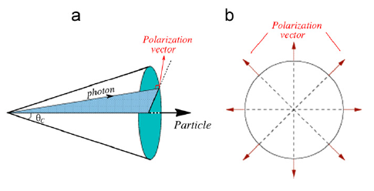
Polarization in dual read out
Cherenkov light is emitted by molecules that are excited and polarized by a
superluminal particle crossing the medium.
The molecules emit coherent radiation at an angle θC =arcos (1/βn) with
respect to the particle directon and with the polarization vector perpendicular to
the cone whose central axis is the particle track.
Then the Cherenkov component can be separated from the scintillation
light by a polarizer in front of the PMT.
This was done by the DREAM Collaboration in the 2010 test beam.
(see NIM A 638 (2011) 47-54.

Slide 6
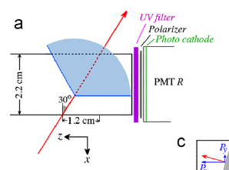
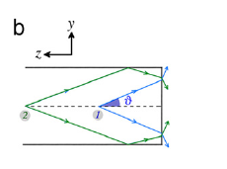
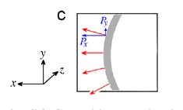
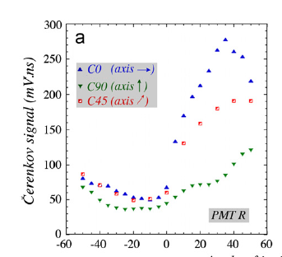
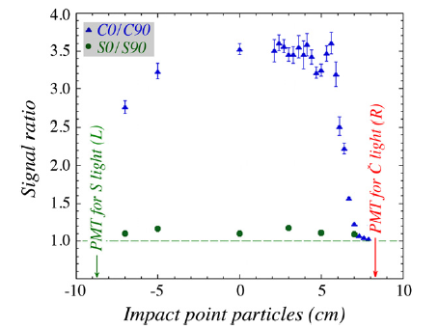
Top view
Side
Edge
Mostly horizontal
polarization
180 GeV/c pion beam crossing a BSO crystal at 30°,
UV filter followed by a polarizer to separate the Cherenkov light.
Cherenkov
Scintillation
θ

Slide 7
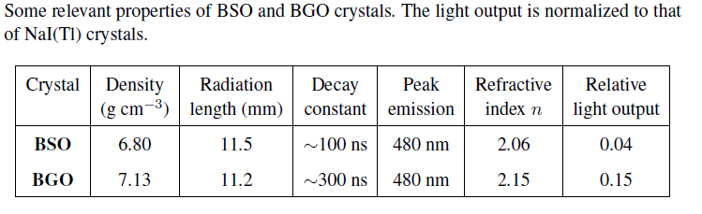
BSO vs BGO crystals
High density scintillating crystals are used as excellent e.m. calorimeters
but they have poor performance for detection of hadrons and jets
(very large e/h ratio).
The possibility to separate the Scintillation/Cherenkov components in
crystals demonstrated by the DREAM Collab. allows to extend
the dual-readout also in e.m. crystals calorimeters.
Extensive studies have been performed in the past by the DREAM
Collaboration on PWO and BGO crystals (see NIMA) .
A recent test beam compared two crystals of BSO (Bismuth Silicate) and
BGO (Bismuth Germanate) of equal dimensions ( 2.2 x 2.2 x 18 cm³).
Now on NIM A 640 (2011) 91-98

Slide 8
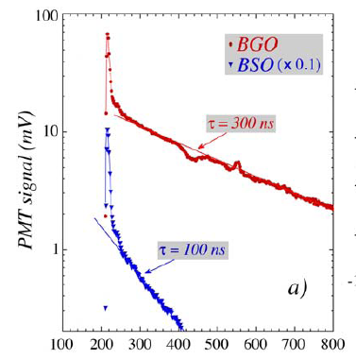
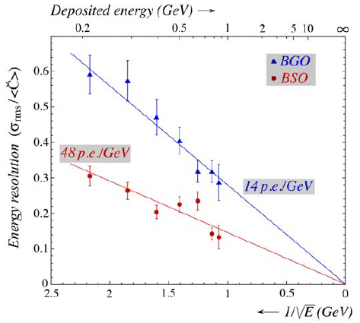
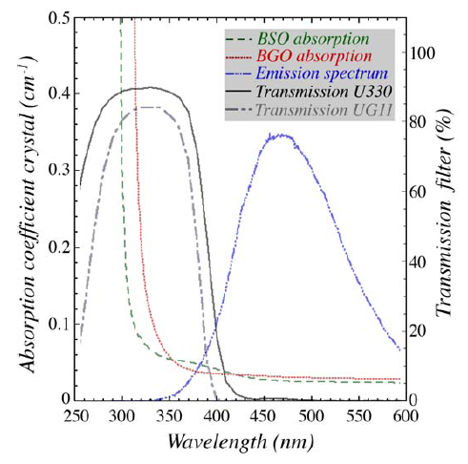
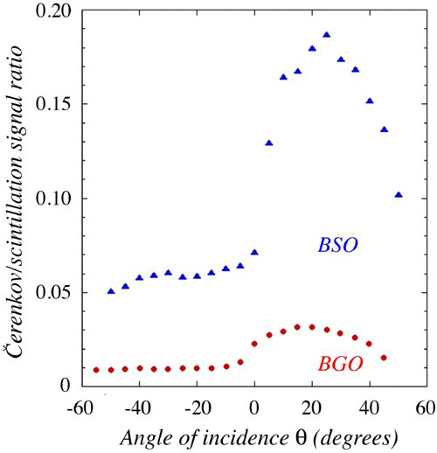
UV filter
Average signals
Cherenkov
PMT
Crystals on a rotating
platform,
UV filter (UG11/U330)
for Cherenkov PMT
Yellow filter
for Scintillation PMT
Yellow filter
θ
Scintillation
PMT
180 GeV pions
Faster scintillation in BSO ( Scint. yield BGO / BSO ≈ 4),
Same attenuantion length (Cher. and Scint.) ≈ 34 cm ,
Absorption for Cherenkov (1/λ²) smaller in BSO ,
Cherenkov yield BSO / BGO ≈ 5 with UV330 , less with UG11.
Time (ns)
Deposited Energy (GeV)
C/S
UG11 filter

Slide 9
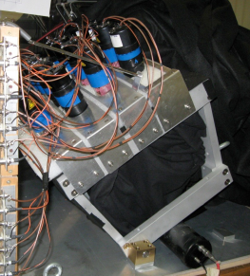
BGO Matrix (1)
Often in present experiments the e.m.
calorimeter is realized with crystals and an
hadronic calorimeter is behind.
Since the dual read out was proven to be
possible in crystals, the DREAM Collaboration
has tested a full size BGO Calorimeter
backed by the original DREAM calorimeter.
The e.m. section was a matrix of 100 BGO
crystals, 24 cm long and tapered (2.4 x 2.4
cm² – 3,2 x 3.2 cm²) from L3 experiment.
A first test performed in 2009 ,
see NIMA 610 (2009), 488-501 .
In the 2010 test beam 16 PMTs with UG11
filters (scintillation strongly attenuated).

Slide 10
BGO Matrix (2)
Both Scintillation and Cherenkov signals in the
same PMT read out: signal from scintillation
extracted by a fit on the tail of the signal,
Cherenkov = total – scintillation.
Preliminary results for 100 GeV e.m. shower.
Scintillation - Cherenkov yields = 67 - 8 ph.e. /GeV
Work on the extension of the dual readout to
both e.m. and hadronic sections is in progress.
Total
Only scintillator
Only Cherenkov

Slide 11
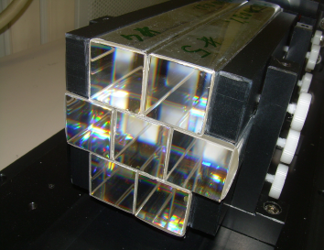
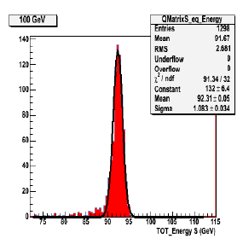
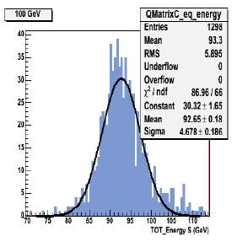
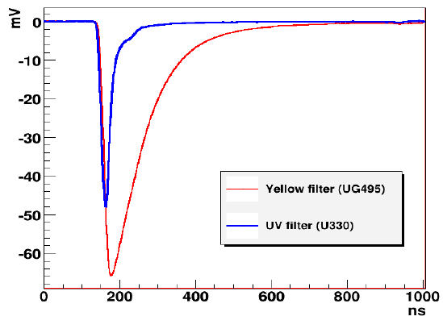
Seven PWO4 crystals
doped: 0.3% Molybdenum already
characterized NIM A621, 212-221.
Each crystal: (3 x 3 x 20 cm³)
Both: wavelenght and timing
analysis.
PWO Matrix
Cherenkov side
UV 330 filters
4
5
1
2
3
8
9
Scintillation
Cherenkov
Scintillation side
Yellow filters
beam
σ = 1,2 %
σ = 5,0 %
100 GeV electrons (work in progress)

Slide 12
Dual Readout with Tiles
Dual Readout can be also implemented in a tile sampling calorimeter.
A test of a small prototype 9 x 9 cm² was performed in the 2010 test beam.
Two samplings: 4 x (4mm Lead + 4 mm Quartz + 7mm Scint), for a total of 6 R.L.
Separate read out of Cherenkov and scintillation light in each sampling.
S1
S2
Photonis XP 2970 pm
4 mm Lead
4 mm Quartz
7 mm Scint.
C2
1 phel
beam
C1
Hamamatsu R8900 pm
2 phel
Charge distribution in C1 PMT for 180 GeV/c muon
Fit of a poissonian for the Nphe convoluted
with a gaussian with σ² = a + b ·Nphe .
In both modules: Nphe = 1.3 for normal beam ,
1.6 for 12° tilted detector.
Average signal for 1 phe = PMT gain.
3 phel
Integrated Charge (unit: 10⁵e )

Slide 13
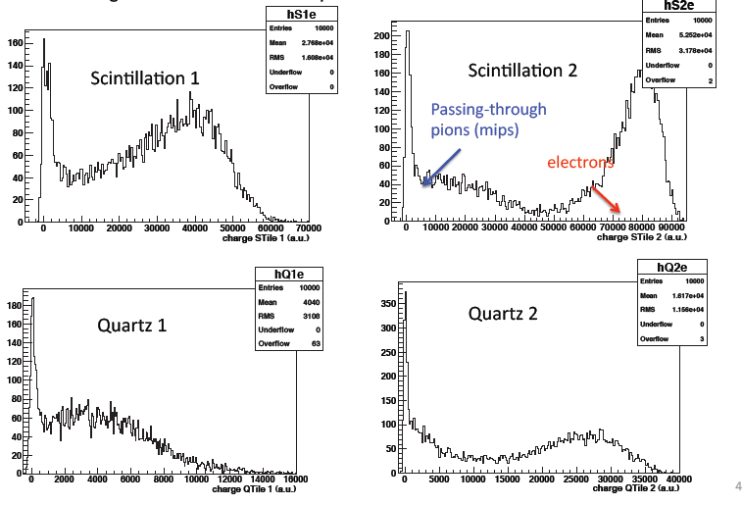
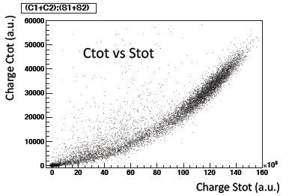
80 GeV electrons in Quartz – Scint. Tiles
Ctot vs Scint tot
Integrated Charge (a.u.)
From a Geant4 simulation: 1.7 GeV / 11.3 GeV deposited in module 1 / 2.
From average signals in C1 and C2 and PMT gains :
58 Nphe/ GeV in module 1 , 47 Nphe / GeV in module 2
Comparable with Cherenkov crystal yield.

Slide 14
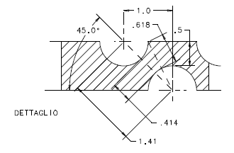
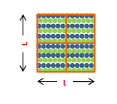
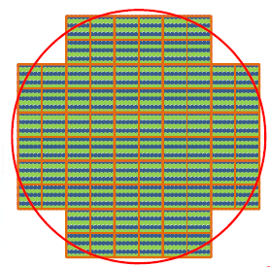
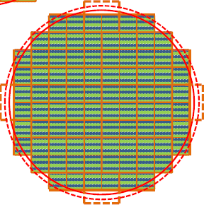
The New Dream Calorimeter
The DREAM Collaboration is now preparing a new prototype of DREAM like
calorimeter with better performances.
Two options: copper or lead ( as the module tested in 2010),
Extensive studies performed for clear fibers to have the largest Cherenkov light yield,
Sampling fraction : 5% (was 2.6% in the DREAM calorimeter),
Quantum efficiency ~ 50% larger,
Expected 90 Cherenkov phe /GeV , was 18 in DREAM
1 module: 92 fibers per layer, 46 fiber layers of each type (scintillating/clear)
Dimensions of the module: 92 x 92 mm², 2,5 m in length
Divided in 4 towers readout for Cherenkov and Scintillation signals.
For copper : X0 = 2.31 cm , RM = 2,33 cm , λInt = 22.5 cm
For lead : X0 = 0.92 cm , RM = 2,33 cm , λInt = 25 cm
L =92 mm
21 modules :
Req = 23.8 cm
16 modules
+ 12 half modules:
Req = 24,35 cm

Slide 15
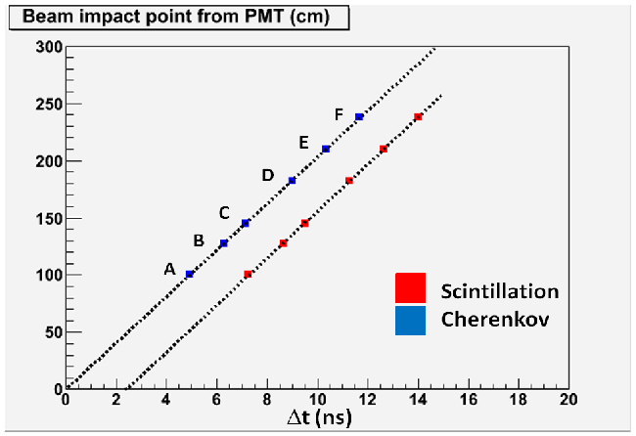
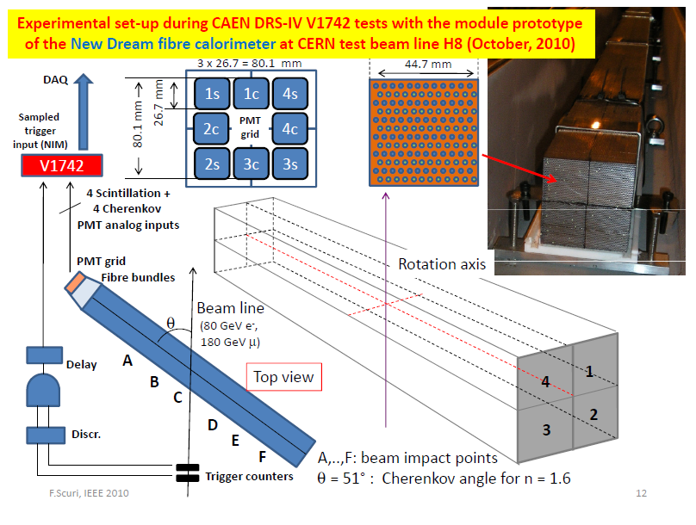
Test of the first NewDream module in the 2010 test beam
(Pb absorber)
Constant delay = 2,4 ns from
Scintillation de-excitation
2.03·10¹⁰ cm/s
Beam impact point from PMT (cm)
2.05·10¹⁰ cm/s
θ = 51°
Delay

Slide 16
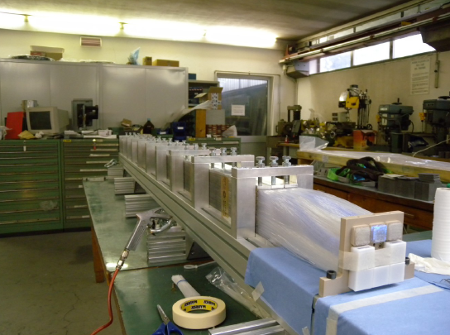
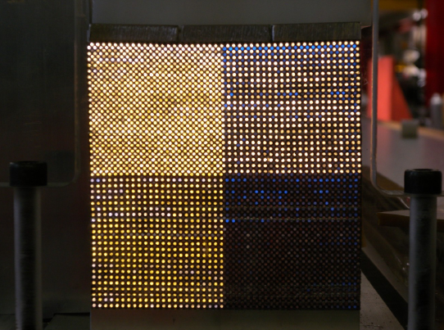
A new lead module built in Pavia and next week in
the test beam
A copper module in
preaparation in Pisa
will be ready for October
test beam.

Slide 17
Conclusions
After the pioneering tests of the first DREAM calorimeter,
the DREAM Collaboration has extensively studied the
Dual Readout in crystals.
The separation of Cherenkov and Scintillation light can be achieved with
several techniques based on the peculiar features of the Cherenkov
radiation.
Dual read-out e.m. calorimeters composed with crystals have been
tested also followed by an hadronic calorimeter (DREAM).
Dual read-out can be used also in tile calorimeters.
The DREAM Collaboration is now preparing and testing a new fiber
Dual Readout calorimeter larger than the DREAM calorimeter.

